Slide 1


Quality Month – November 2019

Slide 2
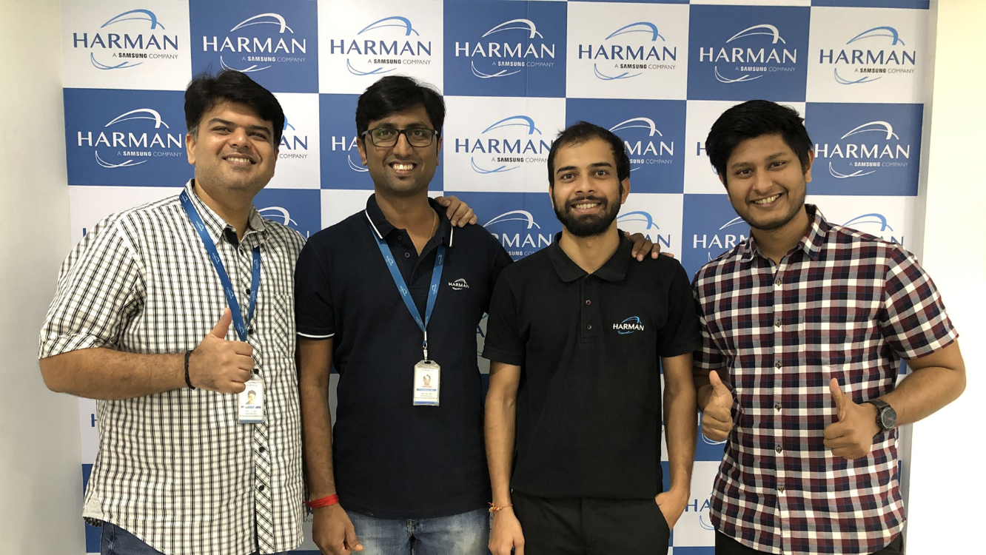
the Team
UT Workshop
Team (From left to right)
Mohit Rajani
Prashantkumar Raut
Rajat Gupta
Gaurav Garg

Slide 3
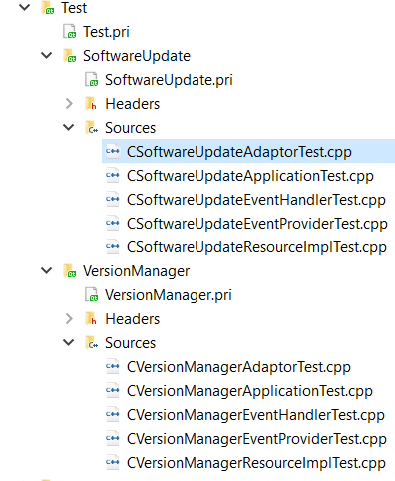
Scope
UT Workshop
“Version Manager and Software Download modules from Tata HMI code”
Description:-
The Tata HMI follows layered architecture. Any module has the below layers:-
1) A resource layer responsible for communication with domain services (C++)
2) Qt Adaptation layer responsible for communication between resource layer and UI layer
3) UI layer responsible for UI (HMI) and UI logic
From the above, we cover layers 1 and 2.

Slide 4
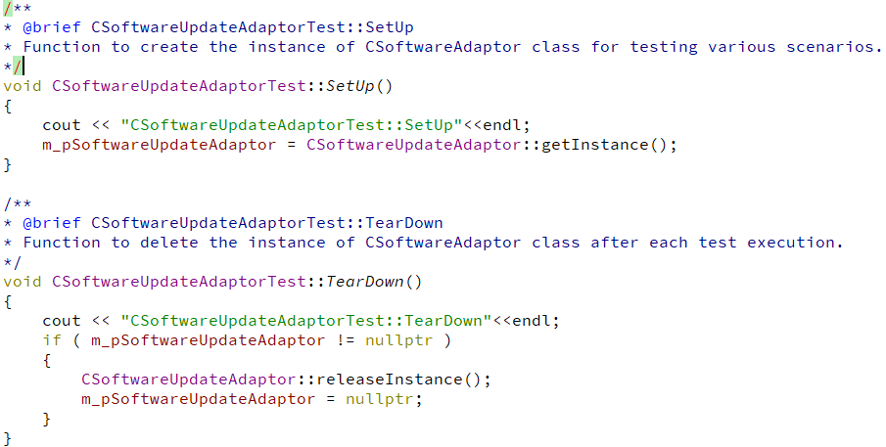
Techniques Used
UT Workshop
Arrange, Act, Assert
Arrange
Arrange

Slide 5
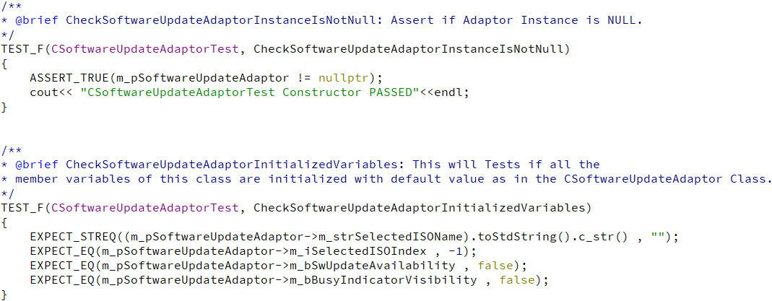
Techniques Used
UT Workshop
Arrange, Act, Assert
Assert

Slide 6
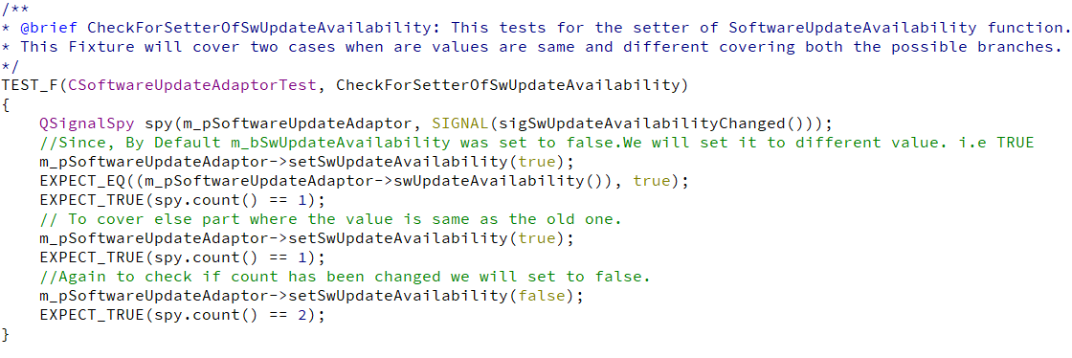
Techniques Used
UT Workshop
Arrange, Act, Assert
Act

Slide 7
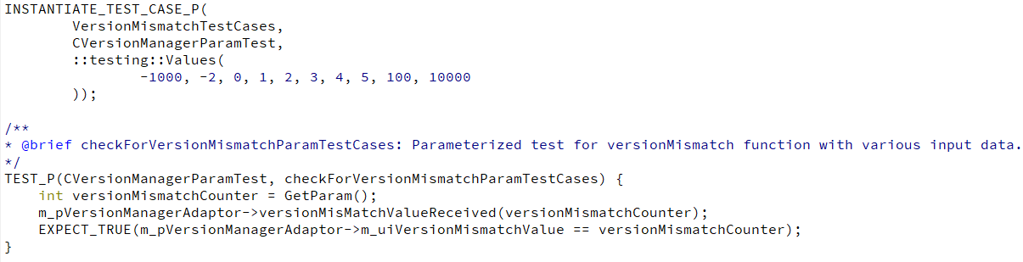
Techniques Used
UT Workshop
Behavior, BESOD - Parameterization
Parameterization

Slide 8
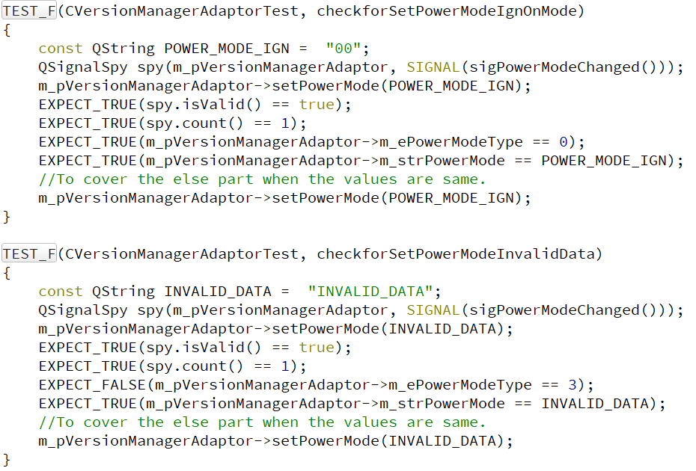
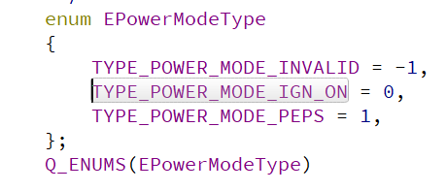
Techniques Used
UT Workshop
Behavior, BESOD – Boundary Value check
Boundary check

Slide 9
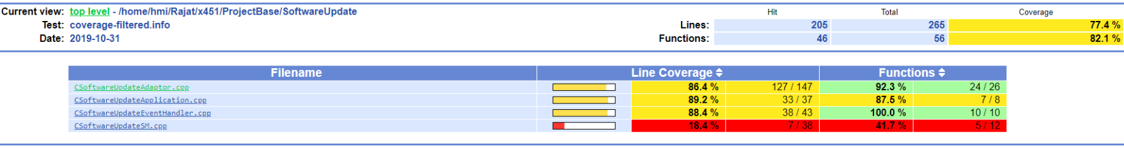
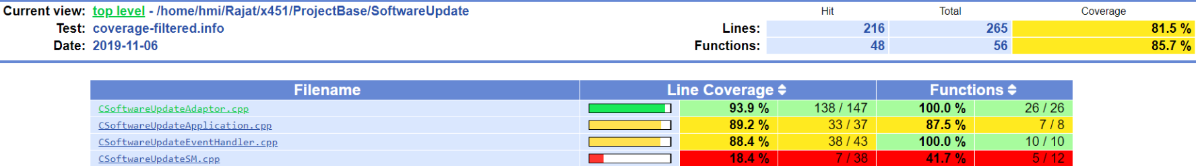
Techniques Used
UT Workshop
Coverage Report

Slide 10
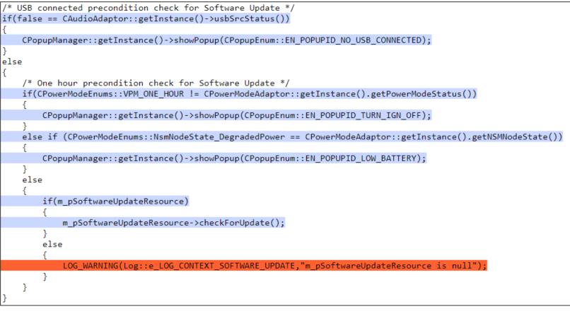
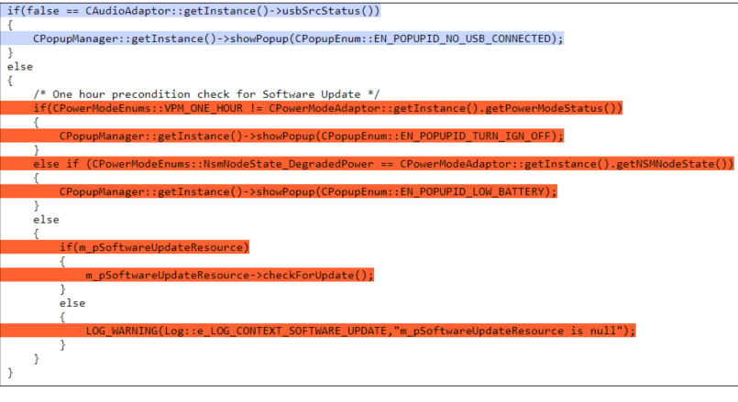
Techniques Used
UT Workshop
Coverage Report

Slide 11
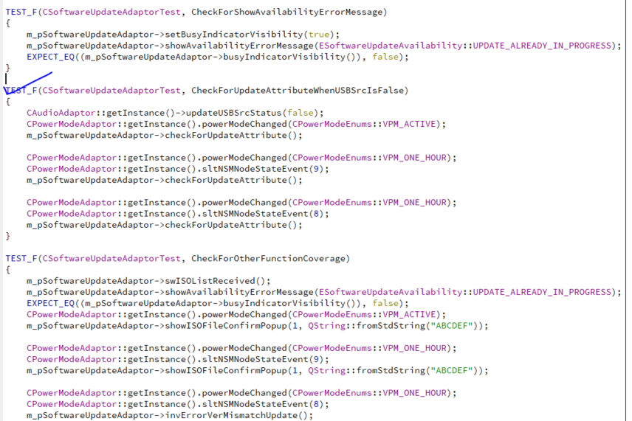
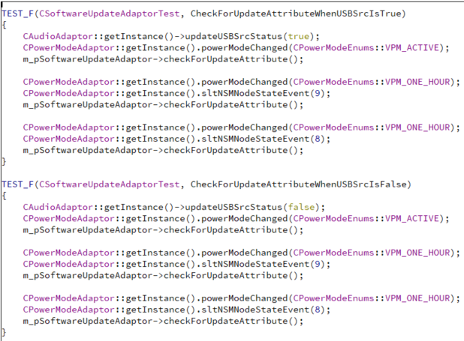
Techniques Used
UT Workshop
Coverage Report
To be updated

Slide 12
Unique Value
UT Workshop
Code coverage is improved ( >90%) for 2 HMI modules
Defect capture is easy during development cycle
With auto builds in future, defect inflow can be reduced further
…
To be updated

Slide 13
Thank you

