Slide 1

EduAI Nexus
AI-Powered Smart Education Ecosystem
Personalised · Accessible · Intelligent · Scalable
TEAM NAME :- MAHADEV
Education Theme · April 2026 · Team Proposal

Slide 2
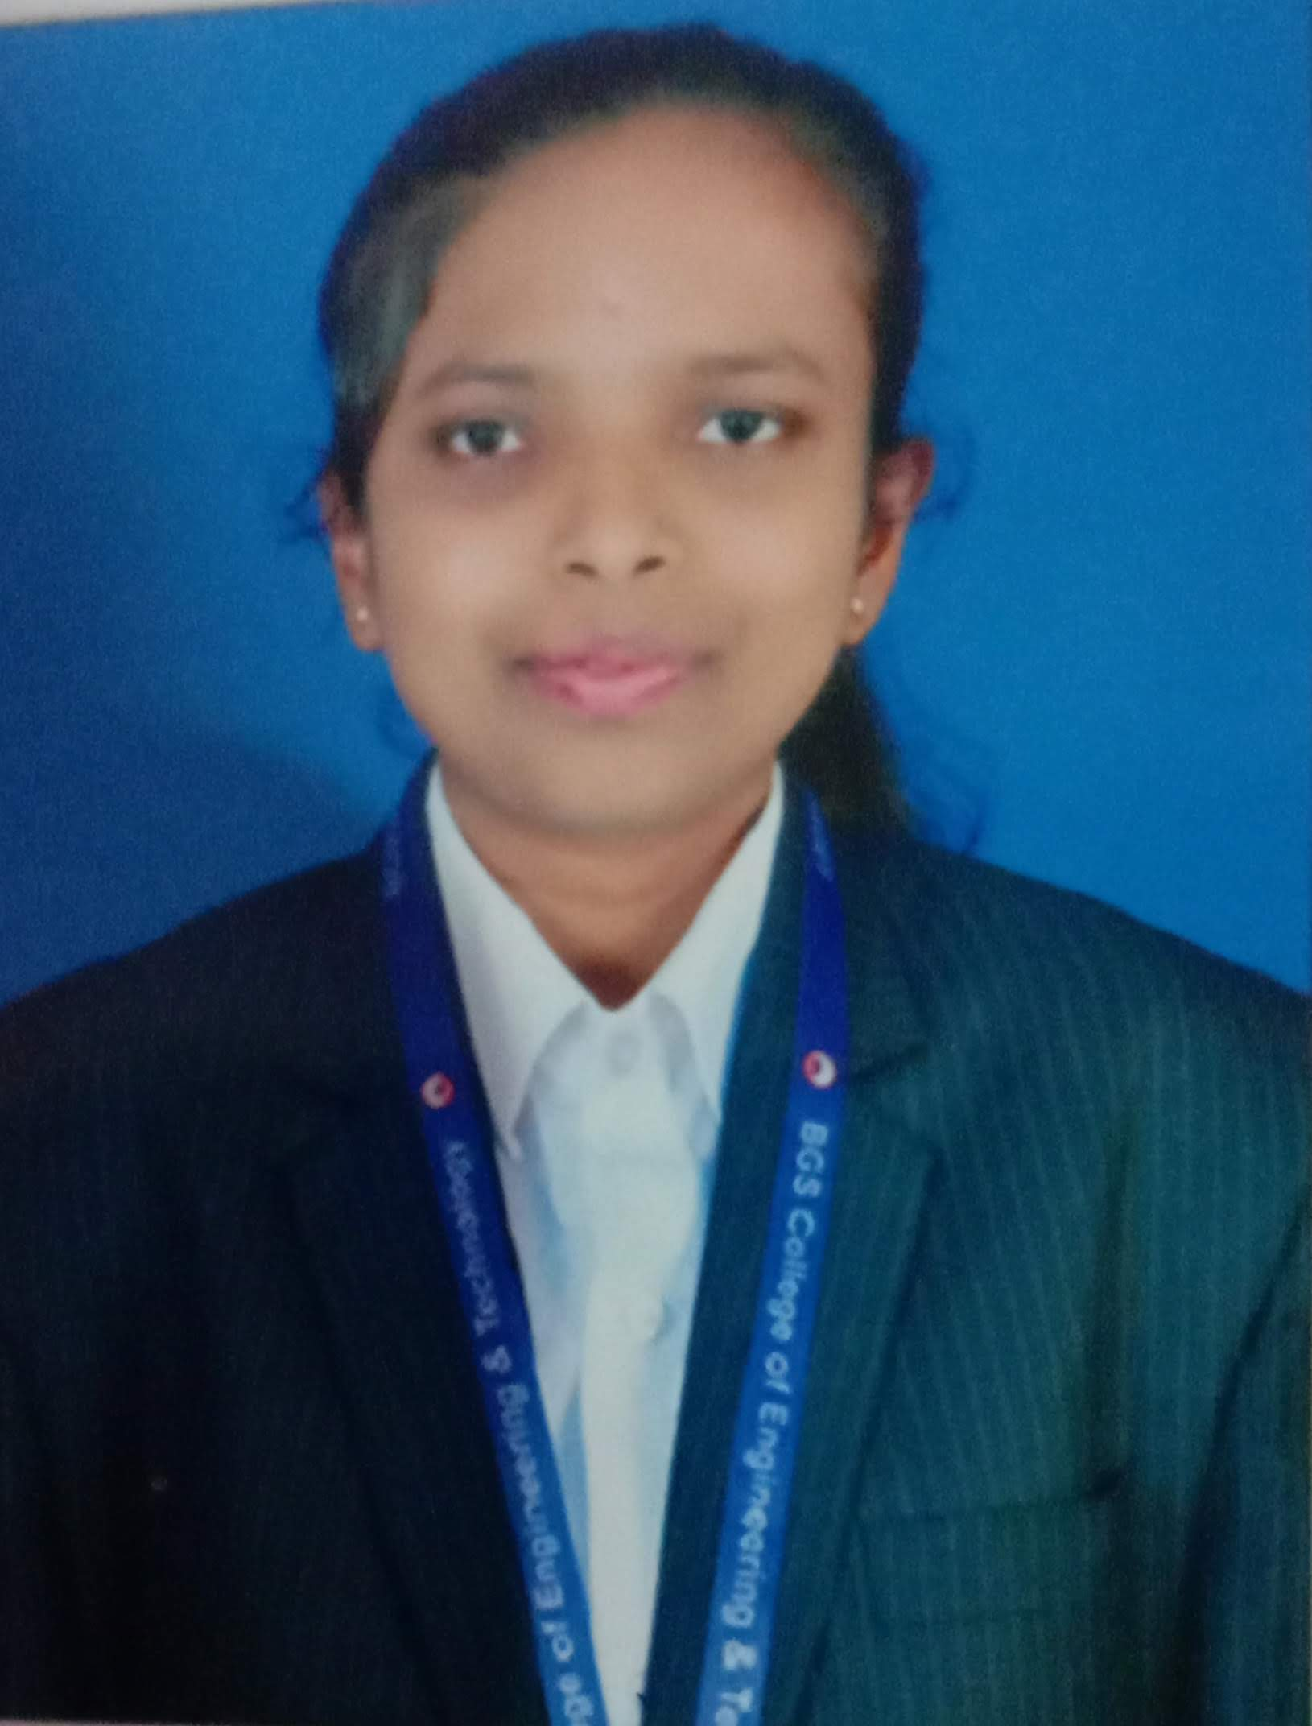

MEET THE TEAM
I am the Team Lead responsible for driving the overall product vision, strategy, and execution. I design the system architecture and handle backend development using modern frameworks, ensuring scalability and performance. I also lead the integration of AI components to build intelligent features within the product. I coordinate tasks, manage timelines, and ensure smooth collaboration within the team. With a strong focus on solving real-world problems, I aim to create impactful and efficient solutions. My approach is inspired by high-level engineering practices, similar to NASA-level problem solving, ensuring reliability, innovation, and scalability in our project.
JAYASHREE H N
Roshini D is a third-year Computer Science and Design student at BGS College of Engineering, Bangalore, graduating in 2026. She has strong skills in Python, Flutter, machine learning, web development, and network security, along with teamwork and communication. She has worked on impactful projects such as the EcoRide Carpool App, Anomalous Network Traffic Detection, CareLog First Aid App, and Packet Sniffing Research. She is passionate about machine learning, data science, Flutter development, and cybersecurity, and actively seeks opportunities to apply her skills and contribute to real-world, high-impact projects while continuously learning and growing.
ROSHINI D

Slide 3
PROBLEM STATEMENT
Why Indian education needs AI now
01
02
03
One-Size-Fits-All Teaching
No Labs in Rural Schools
Language Barriers
Students learn differently — visual, auditory, kinesthetic — yet schools deliver uniform instruction.
Millions of students lack access to science labs, stunting practical education & vocational skills.
Content delivered only in English leaves regional language students behind.
04
05
06
Resource Misallocation
Job Market Gap
Socio-Economic Divide
Teacher & infrastructure distribution across districts lacks data-driven coordination.
Traditional systems focus on exams, not real-world skills, ATS resumes, or career readiness.
Underprivileged students have no access to personalised digital education tools.

Slide 4
PROJECT DETAILS
EduAI Nexus
250M+
6 AI
AI-Powered Smart Education Ecosystem
EduAI Nexus is a cloud-native, microservices AI platform that transforms how students learn and how governments manage education. It integrates six AI-driven modules — personalised learning, virtual labs, multilingual support, career readiness, smart resource allocation, and micro-project learning — into one unified ecosystem accessible via smartphone.
Students in India
Core Modules
22+
100%
Regional Languages
Smartphone Accessible

Slide 5
USER PERSONA MINDSET
Who we are building for
Build for real humans, not hypothetical users
Start with people who face real friction every day
Think beyond convenience — focus on need and necessity
Assume constraints, not perfect conditions
Design for simplicity, empathy, and dignity
Aim for solutions that actually change someone's daily reality

Slide 6
USER PERSONA 1
P
Priya
Class 10 Student (Rural Maharashtra) · 15 years old
Motivated
Digital Learner
Goal-Driven
PROBLEMS
GOALS & NEEDS
CHALLENGES
No science lab at school
Understand concepts practically
Poor internet connectivity
Textbooks only in English
Learn in Marathi
No smartphone of her own
No career guidance available
Prepare for competitive exams
Falling behind urban peers

Slide 7
USER PERSONA 2
R
Ramesh
Government School Teacher · 38 years old
Motivated
Digital Learner
Goal-Driven
PROBLEMS
GOALS & NEEDS
CHALLENGES
No real-time data on student performance
Identify weak students early
Overwhelming class sizes
Teaching 60+ students single-handedly
Personalise teaching methods
No digital support tools
No personalised teaching tools
Reduce administrative workload
Resisting technology adoption

Slide 8
USER PERSONA 3
A
Aruna IAS
District Education Officer · 48 years old
Motivated
Digital Learner
Goal-Driven
PROBLEMS
GOALS & NEEDS
CHALLENGES
No data-driven resource allocation tools
Equitable teacher distribution
Dependency on manual surveys
Teacher surplus in cities, shortage in villages
Forecast infrastructure needs early
Delayed reporting cycles
Budget wasted on wrong priorities
Prove policy impact with data
Resistance from school principals

Slide 9
OUR SOLUTION
EduAI Nexus — Six AI Modules, One Integrated Ecosystem
🌐 Multilingual
Learning System
🎯 Personalised
Learning Engine
💼 Career Readiness
System
EduAI
NEXUS
🔬 Virtual Labs
for Rural Schools
🚀 Micro-Project
Learning
📊 Smart Resource
Allocation

Slide 10
OUR SOLUTION — CONTINUED
🎯 Personalised Learning Engine
🔬 Virtual Labs for Rural Schools
🌐 Multilingual Learning System
Adaptive content delivery by learning style. Current affairs flash cards. PDF-to-MCQ exam interface. Student dashboard with performance heat maps. Educational games & quiz battles.
Physics, Chemistry, Biology & Agriculture simulations on smartphones. 3D anatomy models. AI step-by-step lab guidance. Auto-generated experiment reports.
Real-time textbook translation in 22+ Indian languages. AI tutors in regional languages. TED Talk pronunciation training with phoneme-level AI feedback.
🚀 Micro-Project Learning
📊 Smart Resource Allocation
💼 AI Career Readiness System
Project-based learning post-lesson. ML/LLM behavioral analysis for goal-based project suggestions. Live extraction of hackathons, internships, and competitions.
Real-time dashboard for policymakers. Predictive teacher & infrastructure shortage alerts. District-level simulation before policy decisions.
ATS-optimised resume builder with JD matching. Skill gap analysis with top 5 learning paths. AI conversational career coach. Exportable career development plan.

Slide 11
USE OF ARTIFICIAL INTELLIGENCE
AI is not a feature — it is the foundation of EduAI Nexus
LLM Engine
NLP Pipeline
Recommendation Engine
Fine-tuned Llama/Mistral or Claude API for question generation, ATS analysis, conversational coaching, and personalised project suggestions.
spaCy + HuggingFace Transformers for PDF extraction, board detection, difficulty classification, and flash card generation at grade-appropriate complexity.
Collaborative filtering + vector similarity (Pinecone) for content recommendations, opportunity surfacing, and resume-JD semantic matching.
Speech AI
Adaptive Learning Model
Predictive Resource Model
OpenAI Whisper for STT, custom phoneme comparison model for TED Talk pronunciation scoring and fluency tracking with real-time feedback.
Reinforcement learning model that personalises content format per student profile, updated in real time every session.
Time-series forecasting for teacher and infrastructure shortage prediction at district level; simulation dashboard for policy impact evaluation.

Slide 12
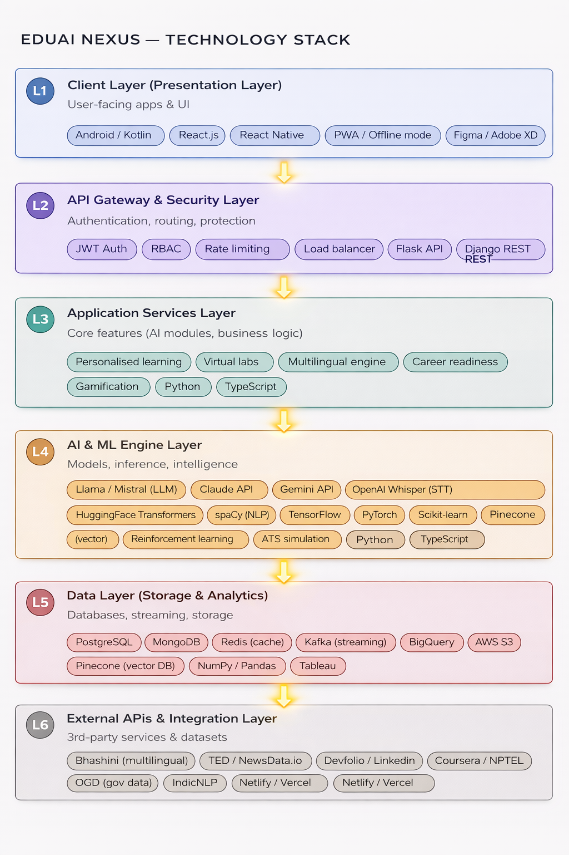

Slide 13
CHALLENGES & RISKS
01
Data Privacy & DPDP Compliance
02
Low Connectivity in Rural Areas
Student learning data and resumes are sensitive. Ensuring DPDP-compliant anonymisation, consent management, and zero third-party data sharing is critical and adds complexity.
Virtual labs and AI features require bandwidth, yet rural schools often have poor or no internet connectivity.
MITIGATION
End-to-end encryption, anonymised data pipelines, and consent UI built into onboarding.
MITIGATION
Offline-first caching of core content, compressed model inference, and progressive loading strategy.
03
AI Model Bias & Fairness
04
Adoption by Teachers & Policymakers
Recommendation and adaptive learning models may inadvertently favour certain demographics, learning styles, or languages.
The platform's value depends on teachers using dashboards and policymakers trusting AI forecasts for resource decisions.
MITIGATION
Regular bias audits, diverse training data, and explainable AI recommendations with visible reasoning.
MITIGATION
Simple UX design, training programs, and district-level pilot deployments before scale.

Slide 14
TECHNICAL REQUEST FOR FACILITATED DATASETS
✅ WHAT WE HAVE
🎯 FACILITATED DATA ASK (AI4India)
Bhashini (open multilingual NLP datasets)
Indic-language speech samples (8+ languages)
→ Improve phoneme model accuracy for pronunciation training
OGD Open Government Data — enrollment, attendance
District-level teacher & school infrastructure data
IndicNLP library for regional language processing
→ Train predictive resource allocation model on real patterns
Synthetic student interaction logs (generated for prototype)
Anonymised student performance records (CBSE/State)
NPTEL & Coursera public course metadata
→ Validate adaptive learning model against real progressions
News APIs (NewsData.io, PIB RSS) for flash cards
Regional dialect audio data
→ Ensure multilingual bot works for underserved populations

Slide 15
ANTICIPATED RESULTS & IMPACT
🎓 Educational Impact
🌍 Social Impact
30–40% improvement in concept retention via adaptive content
Rural students gain lab access via smartphone with offline mode
Students from Class 1–12 served across all boards: CBSE, ICSE, State
22+ Indian languages eliminate language-barrier dropout
Flash cards improve competitive exam readiness (UPSC, JEE, NEET)
Underprivileged students access the same quality as urban peers
🏛️ Government Impact
💼 Career Impact
District-level dashboards reduce teacher mismatch by 25%+
ATS-optimised resumes increase interview callback rates
Predictive model prevents infrastructure crises before they occur
Skill-gap coaching aligned to real JD requirements
Policy simulation reduces cost of failed interventions
Career plan export gives students a concrete 4-week action schedule

Slide 16
SCALABILITY & INNOVATION
Operational Scalability
Innovation Summary
Microservices on Kubernetes — scale each module independently
PDF-to-MCQ engine with board-specific exam customisation
Multi-state deployment via AWS/GCP regional zones
Age-graded current affairs flash cards using NLP complexity scoring
Government SaaS licensing for state & district education boards
ML/LLM behavioural intent model updated per session
Offline-first design for 0-connectivity rural schools
TED Talk pronunciation AI with phoneme-level comparison
White-label version for NGOs and private EdTech partners
ATS resume optimiser with side-by-side comparison & JD matching
Policymaker simulation dashboard before resource decisions

Slide 17
THANK YOU
for your time and attention
EduAI Nexus · WitchHunt Hackathon 2026 · Education Theme
🎯 Personalised
🔬 Virtual Labs
🌐 Multilingual
💼 Career Ready
📊 Policy AI
🚀 Micro-Projects

