Slide 1
Maze Generator& Solver
By: Wenhao Li
Contact: wl85v@mail.Missouri.edu

Slide 2
What is a maze?
S
E

Slide 3
How to generate? (Divide conquer)
OH no!

Slide 4
How to solve
Breadth First Search
Depth first search
Uniform cost search
A* search

Slide 5

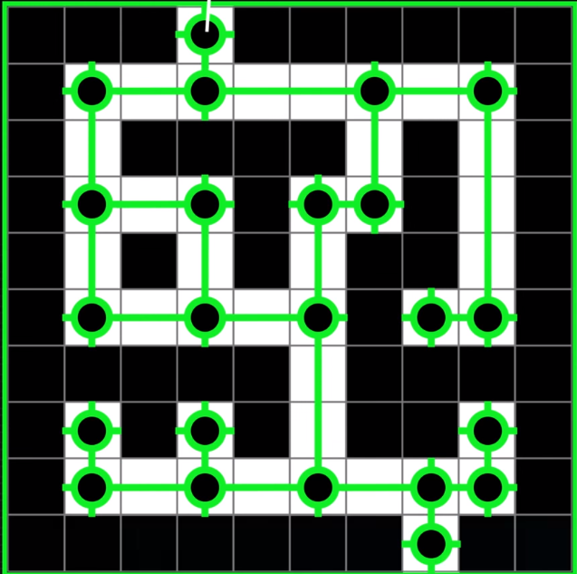
Optimization
Credit: (computerphile) https://www.youtube.com/watch?v=rop0W4QDOUI&t=755s

Slide 6


Implementation
*(C++17)
GUI

Slide 7
Demo

Slide 8
Achievements
High performance (solving mazes 10x~100x faster than Dr. Mike’s code using A*, depending on the “quality” of the maze)
Cross platform (thanks to QT)

Slide 9

Code is on

