Slide 1
Direct Link Networks
  Point-to-Point Links
  Shared Access Networks
FTP
HTTP
NV
TFTP
Our goals:
understand principles behind data link layer services:
TCP
UDP
IP
NET
NET
■ ■ ■
NET
1
2
n
MU CS4850/7850

Slide 2
Shared Access Networks
Slides adapted from Larry Peterson
Outline
  Bus (Ethernet 802.3)
  Wireless (802.11)
Reading:
Chapter 2: 2.6 and 2.7
MU CS4850/7850

Slide 3
Media Access Control (MAC) Protocols: a taxonomy
Three broad classes:
Channel Partitioning
  divide channel into smaller “pieces” (time slots, frequency, code)
  allocate piece to node for exclusive use
Random Access (e.g., Ethernet CSMA/CD)
  channel not divided, allow collisions
  detect and “recover” from collisions
“Taking turns” (e.g., Token ring)
  tightly coordinate shared access to avoid collisions
MU CS4850/7850

Slide 4
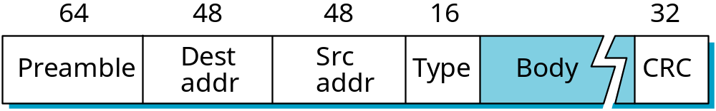
Ethernet Overview
History
  developed by Xerox PARC in mid-1970s
  roots in Aloha packet-radio network
  standardized by Xerox, DEC, and Intel in 1978
  similar to IEEE 802.3 standard
Media access control (MAC)
  CSMA/CD
    carrier sense
    multiple access
    collision detection
Frame Format
De-multiplexing key
MU CS4850/7850
Notes:
Preamble? an introductory fact or circumstance; especially : one indicating what is to follow
Carrier sense: distinguish between idle and busy link, by transceiver
Type: demultiplexing key

Slide 5
Ethernet (cont)
MAC Address
  unique, 48-bit unicast address assigned to each adapter by manufacturer
  example: 00:40:96:e4:b1:02 (hex numbers)
  First three bytes determine adapter manufacturer (e.g., 00:40:96 = Cisco)
  broadcast: all 1s
  multicast: first bit is 1
Bandwidth: 10Mbps, 100Mbps, 1Gbps
Length: <2500m (500m segments with 4 repeaters/hub)
  Support less than 1024 hosts
  Why?
Use Manchester (10 Mbps), 4B/5B (100 Mbps), or 8B/10B (1Gbps) encoding
Problem: Distributed algorithm that provides fair access
MU CS4850/7850
Notes:
Hexadecimal digit, separated by colons

Slide 6
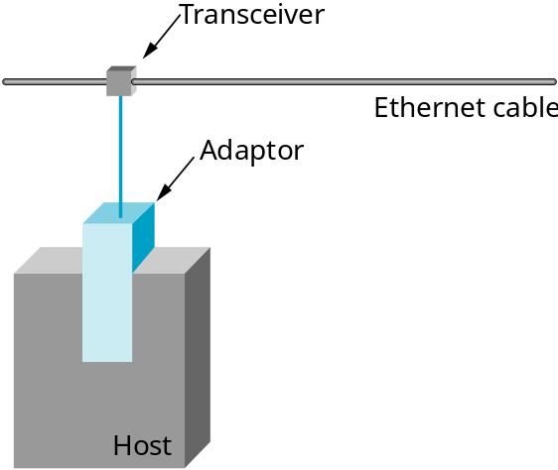
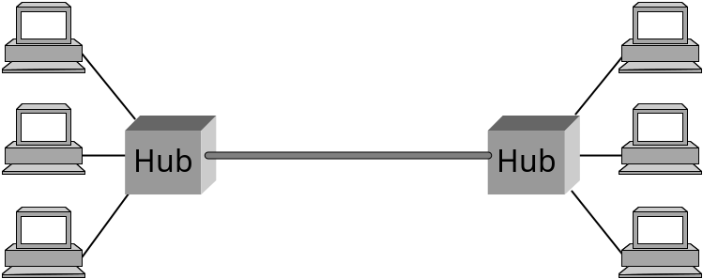
Ethernet (cont)
Layer 1 device
Same collision domain
MU CS4850/7850
Notes:
Hubs and repeaters are Layer 1 (Physical) devices

Slide 7
Transmit Algorithm (in MAC)
If line is idle…
  send immediately
  lower bound frame size of 64 bytes
  upper bound frame size of 1500 bytes
If line is busy…
  wait until idle and transmit immediately
  called 1-persistent (special case of p-persistent)
MU CS4850/7850
Notes:
1-persistent or p-persistent? Ethernet always does 1-persistent except when a collision is detected.

Slide 8
Algorithm (cont)
If detect collision…
  Send a 32-bit jamming signal, then stop transmitting frame
  minimum frame is 64 bytes (header + 46 bytes of data)
    For collision detection
  delay and try again (Concept of randomization)
    1st time: delay 0 or 51.2us
    2nd time: 0, 51.2, 102.4, 153.6us
    3rd time: 0, 51.2, 102.4, …, or 7*51.2us
    nth time: k x 51.2us, for randomly selected k=0..2^{n} - 1
    give up after several tries (usually 16)
    exponential backoff
MU CS4850/7850
Notes:
Jam? Send 32 bit jamming sequence
Ethernet work best under lightly loaded conditions (<30% utilization)

Slide 9
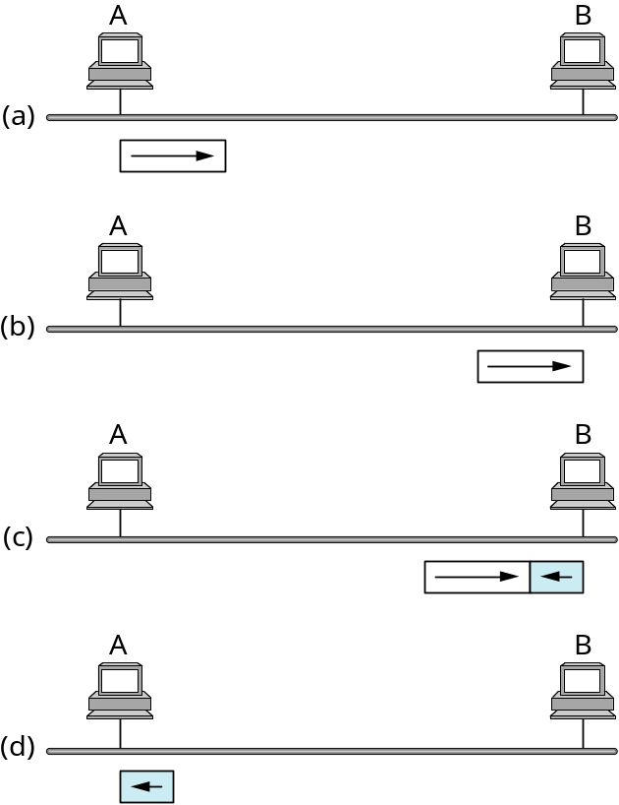
Collisions
Worst case scenario:
RTTmax = 51.2 us
Frame size >= BW * RTT_{max}
=512 bits (64 bytes)
B sends right before
A’s frame arrives
Collision detected by B,
B sends jamming signal
A receives jamming signal,
while still transmitting
Knows collision occurred
MU CS4850/7850
Notes:
For 10 Mbps Ethernet. 100 Mbps and Gbps Ethernets are designed to be used in full-duplex, point-to-point configurations in switched networks.

Slide 10
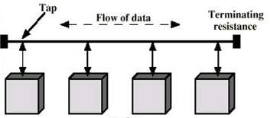
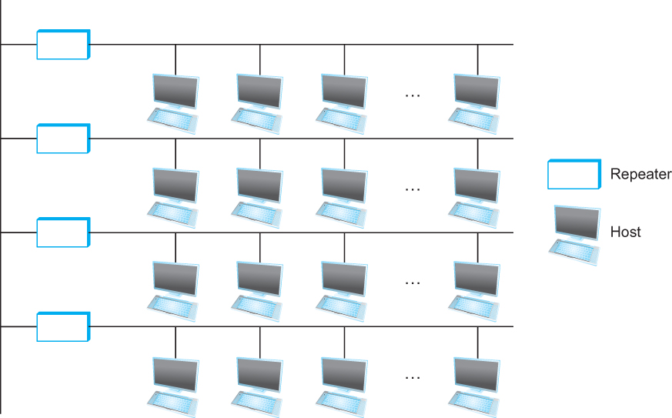
Ethernet
Old Ethernet (bus topology)
Old Ethernet with up to four
repeaters

Slide 11
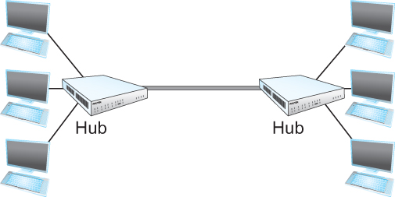
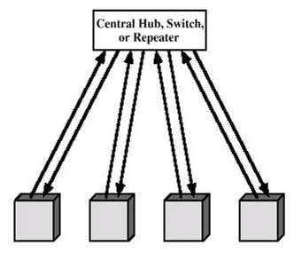
Ethernet
Old Ethernet with hubs
Current Ethernet (Switched Ethernet)
(10BASE-T, 100BASE-T, 1000BASE-T)
star topology
half-duplex
full-duplex (no collisions)
Switch

Slide 12
Wireless LANs
IEEE 802.11 protocol family
Medium Access Control
  Wireless channel is a shared medium
  Need access control mechanism to avoid interference
  Why not CSMA/CD?
MU CS4850/7850
Notes:
802.11 IR defines 1Mbps and 2Mbps operation by bouncing light off ceilings and walls to provide connectivity within a room or small office.
802.11a operates in 5G band.

Slide 13
CSMA/CD in WLANs?
Most (if not all) radios are half-duplex
  Listening while transmitting is not possible
Collision might not occur at sender
  Collision at receiver might not be detected by sender!
Sender transmits with higher power that might mask other signals -> cannot detect collision
MU CS4850/7850

Slide 14
MACA
(Multiple Access with Collision Avoidance)
Sender transmits RequestToSend (RTS) frame
  Contains length of data frame to be transmitted
Receiver replies with ClearToSend (CTS) frame
  Echo the length field back
Neighbors…
  see CTS: keep quiet for length of field long
  see RTS but not CTS: ok to transmit
Receiver sends ACK when has frame
  neighbors silent until see ACK
Collisions (of RTS)
  no collisions detection
  known when don’t receive CTS for their sent RTS
  exponential backoff before trying again
MU CS4850/7850
Notes:
MACA? Multiple Access with Collision Avoidance
How about CTS? no collision of CTSs, as two senders will not be able to hear both CTS simultaneously.

Slide 15
Shared Access Networks
Summary:
  Bus (Ethernet)
    CSMA/CD
  Wireless (802.11)
    MACA
MU CS4850/7850

