Slide 1
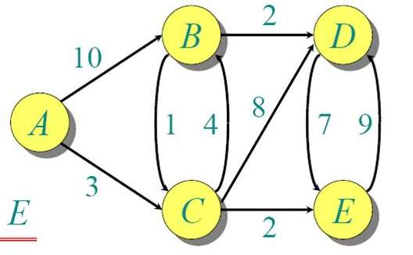
Dijkstra Forward Search
Spring 2016
 | Confirmed | Tentative
1 | (A,0,-)
2 | (A,0,-) | (B,10,B) (C,3,C)
3 | (A,0,-) (C,3,C) | (B,7,C) (D,11,C) (E,5,C)
4 | (A,0,-) (C,3,C) (E,5,C) | (B,7,C) (D,11,C)
5 | (A,0,-) (C,3,C) (E,5,C) (B,7,C) | (D,9,C)
6 | (A,0,-) (C,3,C) (E,5,C) (B,7,C) (D,9,C)

