Slide 1
Direct Link Networks
Slides adapted from Larry Peterson and B. Farouzan
  Point-to-Point Links
  Shared Access Networks
FTP
HTTP
NV
TFTP
Our goals:
understand principles behind data link layer services:
TCP
UDP
IP
NET
NET
■ ■ ■
NET
1
2
n
MU CS4850/7850

Slide 2
Point-to-Point Links
Slides adapted from Larry Peterson
Outline
  Encoding
  Framing
  Error Detection
  Sliding Window Algorithm
Reading:
Chapter 2: 2.2, 2.3, 2.4 (2.4.2, 2.4.3), 2.5
MU CS4850/7850

Slide 3
Point-to-Point Links
Slides adapted from Larry Peterson
Outline
  Encoding
  Framing
  Error Detection
  Sliding Window Algorithm
MU CS4850/7850

Slide 4
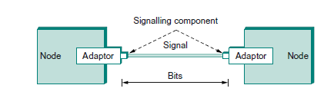
Signalling

Slide 5
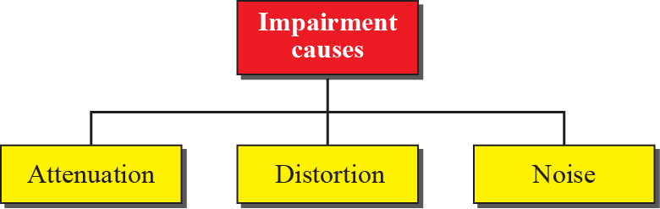
Transmission impairment
Spring 2016
CMP_SC 4850/7850

Slide 6
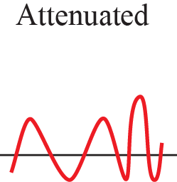
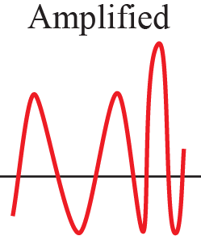
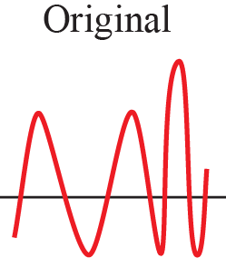
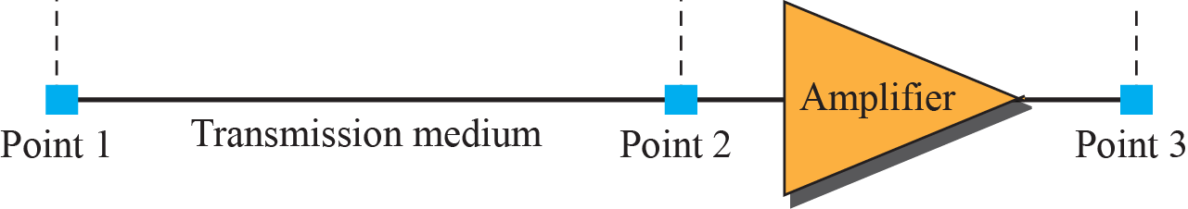
Attenuation
Spring 2016
CMP_SC 4850/7850
Attenuation means a loss of energy. When a signal, simple or composite, travels through a medium, it loses some of its energy in overcoming the resistance of the medium.

Slide 7
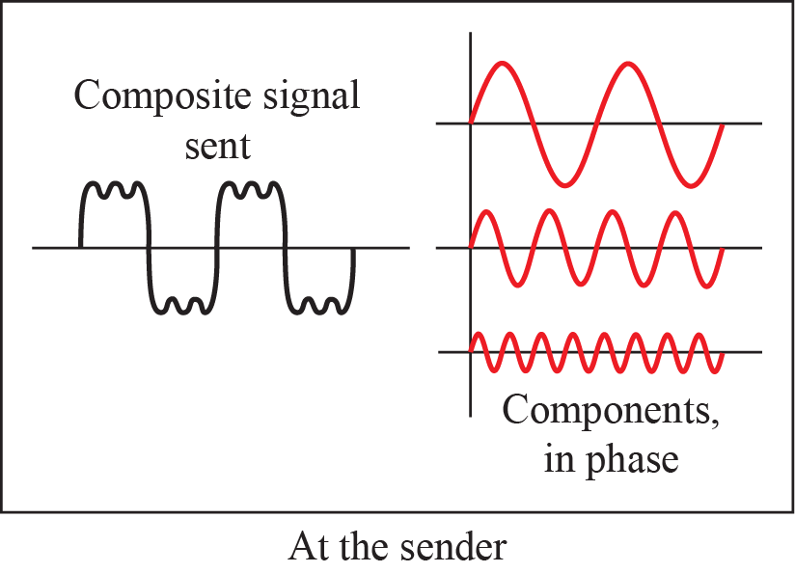
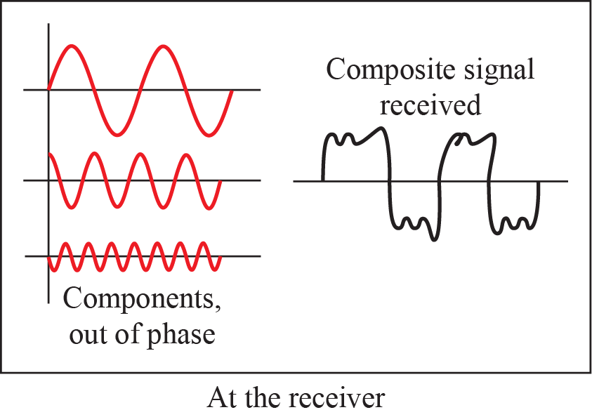
Spring 2016
CMP_SC 4850/7850
Distortion
Distortion means that the signal changes its form or shape. Distortion can occur in a composite signal made of different frequencies. Each signal component has its own propagation speed through a medium and, therefore, its own delay in arriving at the final destination. Differences in delay may create a difference in phase if the delay is not exactly the same as the period duration.
Notes:
1.#

Slide 8
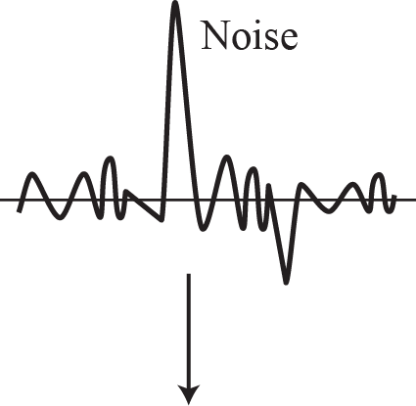
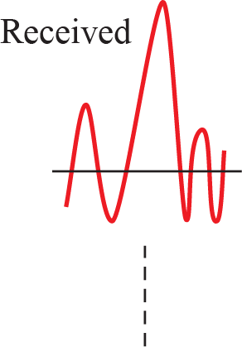
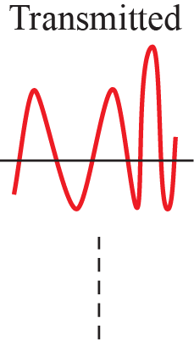
Spring 2016
CMP_SC 4850/7850
Noise
Noise is another cause of impairment. Several types of noise, such as thermal noise, induced noise, crosstalk, and impulse noise, may corrupt the signal. Thermal noise is the random motion of electrons in a wire, which creates an extra signal not originally sent by the transmitter. Induced noise comes from sources such as motors. Crosstalk is the effect of one wire on the other.
Notes:
1.#

Slide 9
Synchronization
Sender/Receiver Clock Synchronization
  both the encoding and the decoding processes are driven by a clock
  every clock cycle the sender transmits a bit and the receiver recovers a bit
  sender and the receiver clocks have to be precisely synchronized in order for the receiver to recover the same bits the sender transmits
  If the receiver’s clock is even slightly faster or slower than the sender’s clock, then it does not correctly decode the signal
  Need to somehow encode sender clock into signal
MU CS4850/7850
Notes:
Baseline wander: average signal biased to low or high.
Frequent transition is necessary for clock recovery/synchronization, to avoid clock drift.

Slide 10
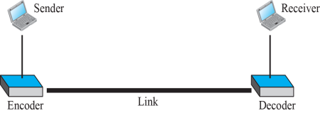
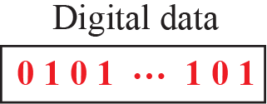
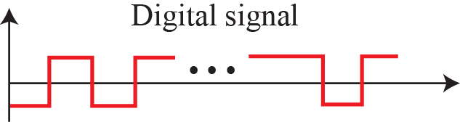
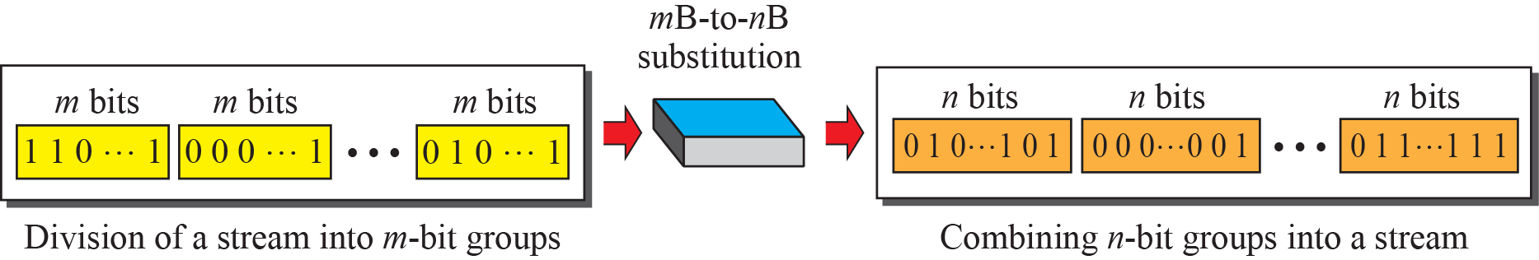
Encoding: Line and block
Spring 2016
CMP_SC 4850/7850
Line coding converts a sequence of bits to a digital signal. At the sender, digital data are encoded into a digital signal; at the receiver, the digital data are recreated by decoding the digital signal.
Block coding changes a block of m bits into a block of n bits, where n is larger than m. Block coding is referred to as an mB/nB encoding technique. Block coding provides redundancy for error detection and improve the performance of line coding.

Slide 11
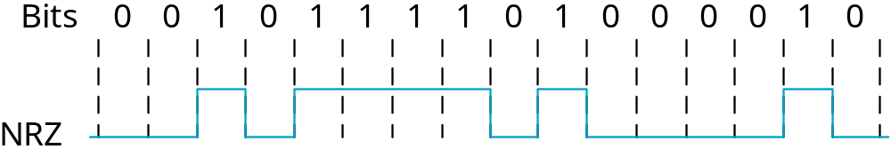
Line Encoding
Signals propagate over a physical medium
  modulate electromagnetic waves
  e.g., vary voltage
Encode binary data onto signals
  e.g., 0 as low signal and 1 as high signal
  known as Non-Return to zero (NRZ)
MU CS4850/7850

Slide 12
Problem: Consecutive 1s or 0s
Low signal (0) may be interpreted as no signal
High signal (1) leads to baseline wander
  the receiver keeps an average of the signal it has seen so far and then uses this average to distinguish between low and high signals.
  Too many consecutive 0’s and 1’s cause this average to change, making it difficult to detect
The problem, of course, is that too many consecutive 1s or 0s cause this average to change, making it more difficult to detect a significant change in the signal
Unable to recover clock on the receiver side
MU CS4850/7850
Notes:
Baseline wander: average signal biased to low or high.
Frequent transition is necessary for clock recovery/synchronization, to avoid clock drift.

Slide 13
Alternative Line Encodings
Non-return to Zero Inverted (NRZI)
  make a transition from current signal to encode a one; stay at current signal to encode a zero
  solves the problem of consecutive ones (but not consecutive zeros)
Manchester
  transmit XOR of the NRZ encoded data and the clock
  able to recover clock
  only 50% efficient
MU CS4850/7850
Notes:
Baud rate: the rate at which signal changes.

Slide 14
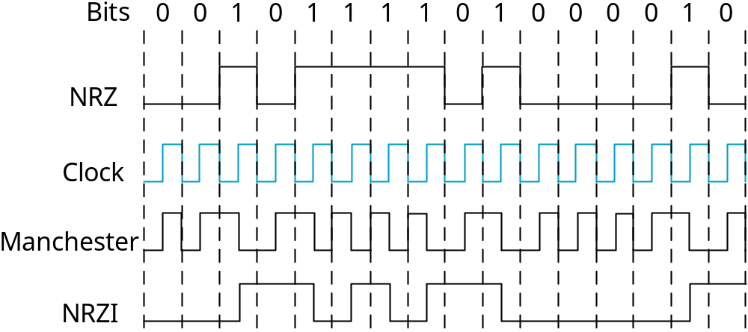
Line Encodings (cont)
MU CS4850/7850

Slide 15
Alternative Line Encodings
Non-return to Zero Inverted (NRZI)
  make a transition from current signal to encode a one; stay at current signal to encode a zero
  solves the problem of consecutive ones (but not consecutive zeros)
Manchester
  transmit XOR of the NRZ encoded data and the clock
  able to recover clock
  only 50% efficient
MU CS4850/7850
Notes:
Baud rate: the rate at which signal changes.

Slide 16
Line Encodings (cont)
MU CS4850/7850

Slide 17
Block Encoding
4B/5B
  every 4 bits of data encoded in a 5-bit code
  5-bit codes selected to have no more than one leading 0 and no more than two trailing 0s
  thus, never get more than three consecutive 0s
  resulting 5-bit codes are transmitted using NRZI
  enough transitions to recover clock
  achieves 80% efficiency
  Block encoding used in Ethernet protocol
MU CS4850/7850

Slide 18
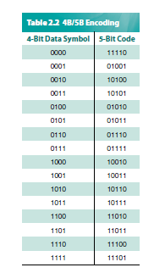
4B/5B Block encoding
Spring 2016
CMP_SC 4850/7850
Notes:
The University of Adelaide, School of Computer Science
Chapter 2 — Instructions: Language of the Computer

Slide 19
Point-to-Point Links
Slides adapted from Larry Peterson
Outline
  Encoding
  Framing
  Error Detection
  Sliding Window Algorithm
MU CS4850/7850

Slide 20
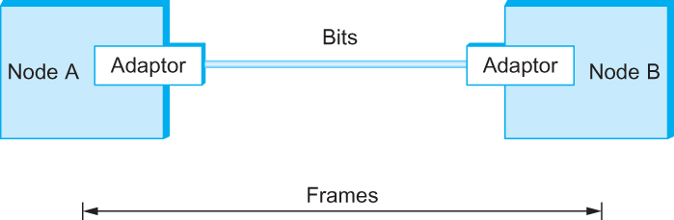
Framing
Spring 2016
CMP_SC 4850/7850
We are focusing on packet-switched networks, which means that blocks of data (called frames at this level), not bit streams, are exchanged between nodes.
It is the network adaptor that enables the nodes to exchange frames.
Bits flow between adaptors, frames between hosts
Notes:
The University of Adelaide, School of Computer Science
Chapter 2 — Instructions: Language of the Computer

Slide 21
Framing
Spring 2016
CMP_SC 4850/7850
When node A wishes to transmit a frame to node B, it tells its adaptor to transmit a frame from the node’s memory. This results in a sequence of bits being sent over the link.
The adaptor on node B then collects together the sequence of bits arriving on the link and deposits the corresponding frame in B’s memory.
Framing Challenge
  Recognizing exactly what set of bits constitute a frame - that is, determining where the frame begins and ends - is the central challenge faced by the adaptor

Slide 22
Why Framing is important
Thequickbrownfoxjumpsoverthelazydogandiwatchedthewholethingandlaughed
The quick brown fox jumps over the lazy dog and I watched the whole thing and laughed.

Slide 23
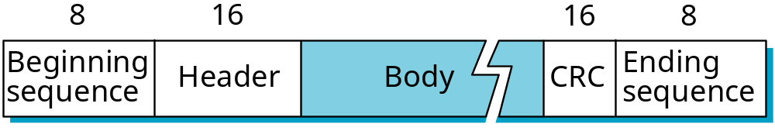
Approaches
Sentinel-based
  delineate frame with special pattern: 01111110
  e.g., HDLC, SDLC, PPP
  problem: special pattern appears in the payload
  solution: bit stuffing
    sender: (always) insert 0 after five consecutive 1s
    receiver: delete 0 that follows five consecutive 1s
MU CS4850/7850
Notes:
HDLC, SDLC? High-level data link control, synchronous data link control

Slide 24
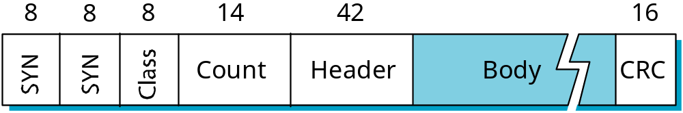
Approaches (cont)
Counter-based
  include payload length in header
  e.g., DDCMP (digital data communication message protocol)
  problem: count field corrupted
  solution: catch when CRC fails (see later)
MU CS4850/7850
Notes:
DDCMP:digital data communication message protocol

Slide 25
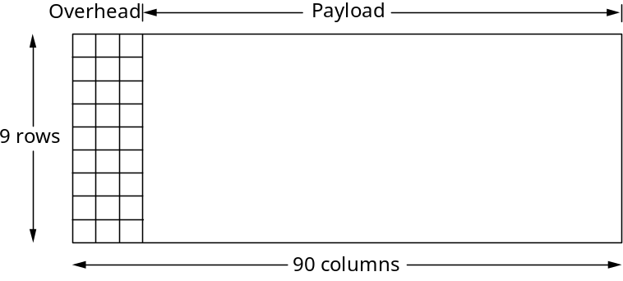
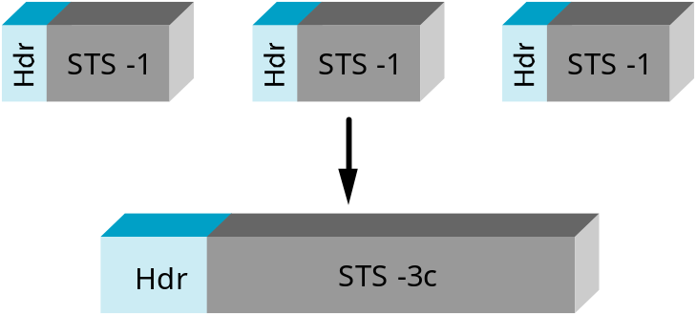
Approaches (cont)
Clock-based
  each frame is 125us long
  e.g., SONET: Synchronous Optical Network
    Standardized protocol to transfer bit streams over fiber links
  STS-n (STS-1 = 51.84 Mbps)
    STS = Synchronous Transport Signal
MU CS4850/7850
Notes:
STS: synchronous transport signal
810 bytes

Slide 26
Point-to-Point Links
Slides adapted from Larry Peterson
Outline
  Encoding
  Framing
  Error Detection
  Sliding Window Algorithm
MU CS4850/7850

Slide 27
What Can Go Wrong When Sending a
Message Frame Over a Link?
Bit-level errors (electrical interference)
Errors need to be detected so frames can be discarded when error occurred
Error Detection through addition of redundant information to frame
  Parity
  CRC (Cyclic Redundancy Check)
  Checksum
Challenge
  Error detection probability vs. Overhead
MU CS 4850/7850

Slide 28
Cyclic Redundancy Check
(Error Detection)
Add k bits of redundant data to an n-bit message
  want k << n
  e.g., k = 32 and n = 12,000 (1500 bytes)
Represent n-bit message as n-1 degree polynomial
  e.g., MSG=10011010 as M(x) = x⁷ + x⁴ + x³ + x¹
Let k be the degree of some divisor polynomial
  e.g., C(x) = x³ + x² + 1
MU CS4850/7850

Slide 29
CRC (cont)
Transmit polynomial P(x) that is evenly divisible by C(x)
  shift left k bits, i.e., M(x)x^{k}
  subtract remainder of M(x)x^{k} / C(x) from M(x)x^{k}
  i.e., P(x)= M(x)x^{k} – (remainder of M(x)x^{k} / C(x))
Receiver polynomial P(x) + E(x)
  E(x) = 0 implies no errors
Divide (P(x) + E(x)) by C(x); remainder zero if:
  E(x) was zero (no error), or
  E(x) is exactly divisible by C(x)
MU CS4850/7850

Slide 30
CRC Example
(k = 3)
Message M(x): x³+x⁰ 1001
C(x)=1011
Multiply Message by X³ -> 1001000
Binary division of 1001000 with C(x)
Concatenate remainder to original message and send that out
MU CS4850/7850

Slide 31
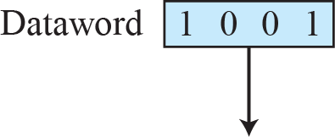
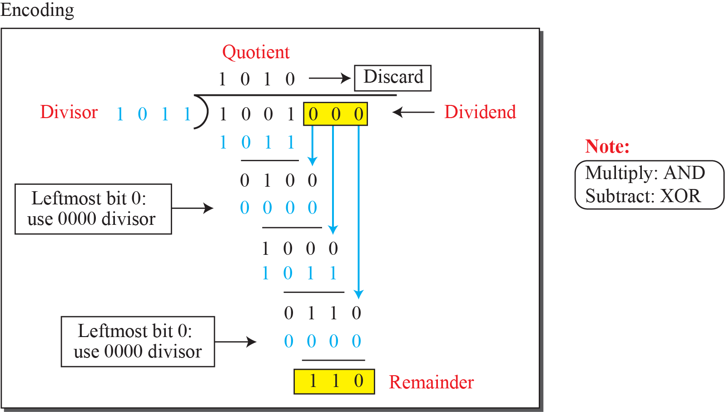
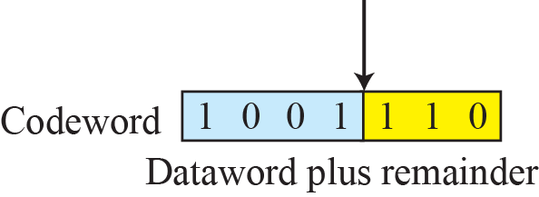
Spring 2016
CMP_SC 4850/7850
CRC Encoding
Notes:
10.#

Slide 32
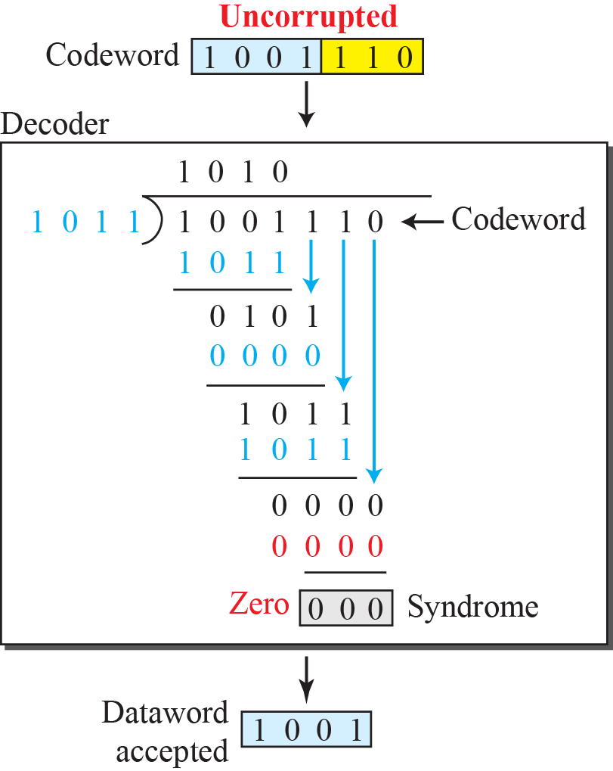
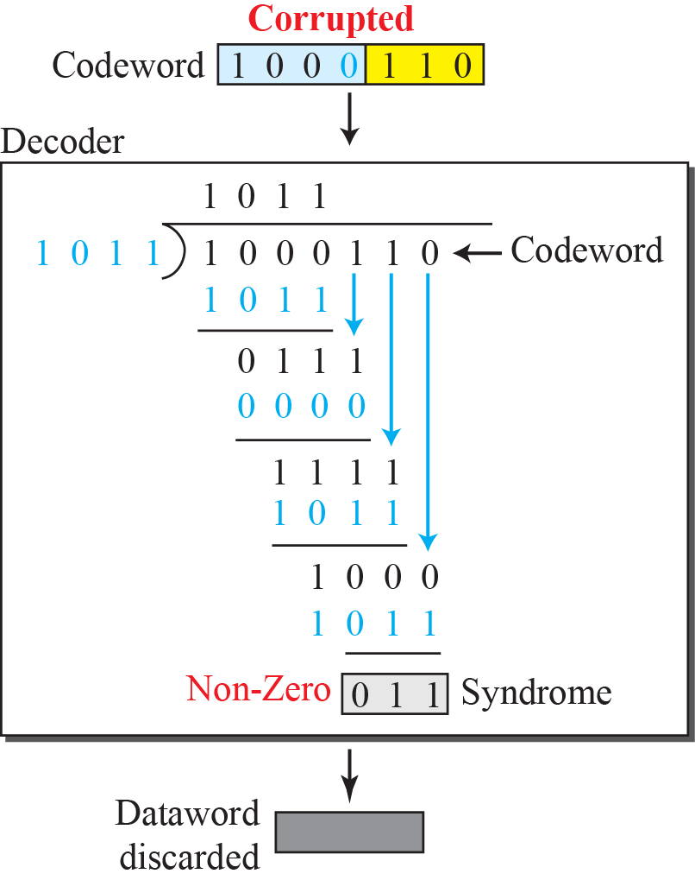
Spring 2016
CRC Decoding
CMP_SC 4850/7850
Notes:
10.#

Slide 33
Selecting C(x)
(with degree of k)
Can detect all single-bit errors, as long as the x^{k} and x⁰ terms have non-zero coefficients.
Can detect all double-bit errors, as long as C(x) contains a factor with at least three terms
Can detect any odd number of errors, as long as C(x) contains the factor (x + 1)
Can detect any ‘burst’ error (i.e., sequence of consecutive error bits) for which the length of the burst is less than k bits.
Most burst errors of larger than k bits can also be detected
See Table 2.3 on page 102 for common C(x)
  Ethernet uses CRC-32
MU CS4850/7850

Slide 34
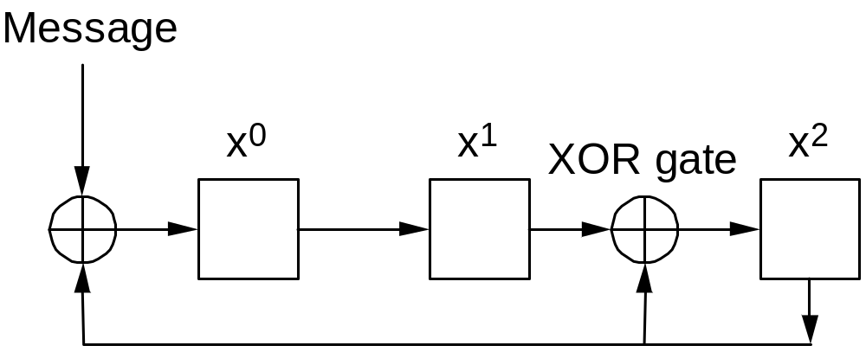
Hardware Implementation
Feedback Shift Register
C(x) = x³ + x² + 1; k = 3
Clock

Slide 35
Internet Checksum Algorithm
View message as a sequence of 16-bit integers; sum using 16-bit ones-complement arithmetic; take ones-complement of the result.
Attach the checksum with the original message
u_short
cksum(u_short *buf, int count)
{
register u_long sum = 0;
while (count--)
{
sum += *buf++;
if (sum & 0xFFFF0000)
{
/* carry occurred, so wrap around */
sum &= 0xFFFF;
sum++;
}
}
return ~(sum & 0xFFFF);
}
MU CS4850/7850

Slide 36
Point-to-Point Links
Slides adapted from Larry Peterson
Outline
  Encoding
  Framing
  Error Detection
  Sliding Window Algorithm
MU CS4850/7850

Slide 37
Reliable Transmission
Some error codes are strong enough also to correct errors, in practice the overhead is typically too large to handle the range of bit and burst errors
Even when error-correcting codes are used (e.g., on wireless links) some errors will be too severe to be corrected.
Some corrupt frames must be discarded
A link level protocol that wants to deliver frames reliably must somehow recover from these discarded (lost) frames.

Slide 38
Reliable Transmission
Reliability is handled at varying layers but the principles are consistent
  Handles by acknowledgements and timeouts
  An ACK is a control frame…header only
  Using ACK’s and timeouts is often called Automatic Repeat Requests
MU CS4850/7850

Slide 39
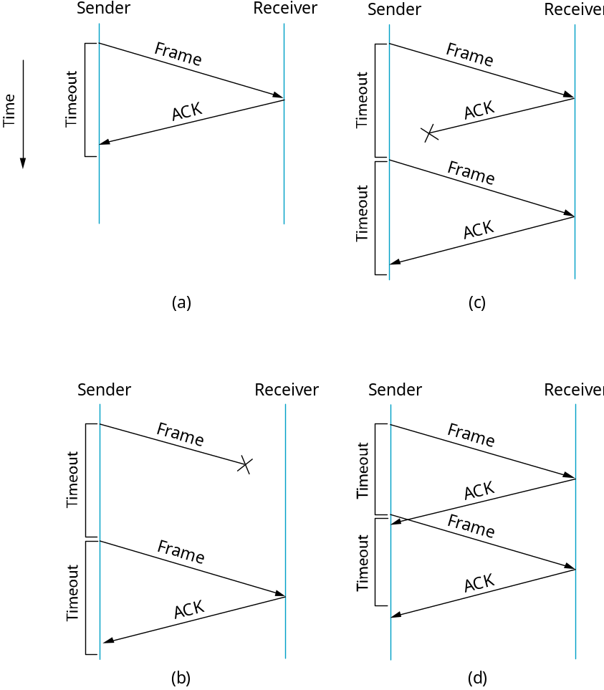
Acknowledgements & Timeouts
Duplicated frame
Duplicated frame
include 1-bit sequence number
MU CS4850/7850

Slide 40
Stop and Wait Algorithm
Simplest ARQ scheme
After transmitting one frame, the sender waits for an acknowledgment before transmitting the next frame
If the acknowledgment does not arrive after a certain period of time
  sender times out and retransmits the original frame
Potential to cause duplicate copies of a frame to be delivered
header for a stop-and-wait protocol usually includes a 1-bit sequence number
Sequence numbers alternate

Slide 41
Stop-and-Wait
Sender
Receiver
Problem: keeping the pipe full
Example
  1.5Mbps link x 45ms RTT = 67500 bits (8KB)
  1KB frames implies 1/8th link utilization
MU CS4850/7850

Slide 42

How can we improve Stop and Wait

Slide 43
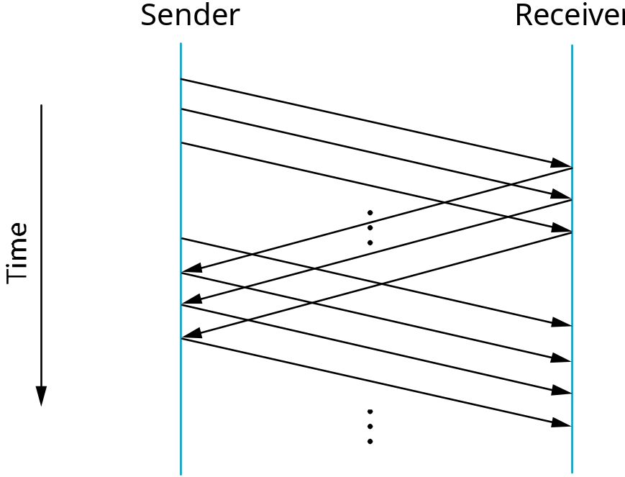
Sliding Window
Allow multiple outstanding (un-ACKed) frames
Upper bound on un-ACKed frames, called window
How to determine the value of “window”?
  Filling the pipe
MU CS4850/7850
Notes:
Needs to keep track of # of outstanding packets.

Slide 44
SW: Sender
Assign sequence number to each frame (SeqNum)
Maintain three state variables:
  send window size (SWS): bound on # of outstanding/unAcked frames
  last acknowledgment received (LAR)
  last frame sent (LFS)
Maintain invariant: LFS - LAR <= SWS
Advance LAR when ACK arrives
Buffer up to SWS frames (for retransmission if necessary)
<
SWS
─
■ ■ ■
■ ■ ■
LAR
LFS
MU CS4850/7850

Slide 45
SW: Receiver
Maintain three state variables
  receive window size (RWS<=SWS): bound on # of out-of-order frames
  largest acceptable frame (LAF)
  last frame received & Acked (LFR)
Maintain invariant: LAF - LFR <= RWS
Frame SeqNum arrives:
  if LFR < SeqNum < = LAF accept
  if SeqNum < = LFR or SeqNum > LAF discarded
Send cumulative ACKs
  Ack only the last received frame whose previous frames have all been received.
<
─
RWS
■ ■ ■
■ ■ ■
LFR
LAF
MU CS4850/7850

Slide 46
Timeline Diagram for Sliding Window
Error: Receiver down
Sender
Receiver
sent [1,2,3]
SWS=RWS=3 frames
Timeout= 2 RTT
1 RTT
2 RTT
3 RTT
4 RTT
MU CS4850/7850

Slide 47
Timeline Diagram for Sliding Window
Error: No Error
Sender
Receiver
expecting [1,2,3]
sent [1,2,3]
1 RTT
SWS=RWS=3 frames
Timeout= 2 RTT
2 RTT
3 RTT
MU CS4850/7850

Slide 48
Timeline Diagram for Sliding Window
Timeline Diagram for Sliding Window
Error: Frame 4 lost
Error: Frame 4 lost
Sender
Receiver
expecting [1,2,3]
sent [1,2,3]
SWS=RWS=3 frames
Timeout= 2 RTT
1 RTT
2 RTT
3 RTT
MU CS4850/7850

Slide 49
Example
Draw a timeline diagram for the sliding window algorithm with SWS = RWS = 4 frames in the following two situations. Assume the receiver sends a duplicate acknowledgment if it does not receive the expected frame. For example, it sends DUPACK[2] when it expects to see Frame[2] but receives Frame[3] instead. Also, the receiver sends a cumulative acknowledgment after it receives all the outstanding frames. For example, it sends ACK[5] when it receives the lost frame Frame[2] after it already received Frame[3], Frame[4], and Frame[5]. Use a timeout interval of about 2×RTT
Frame 2 is lost. Retransmission takes place upon timeout (as usual).
Frame 2 is lost. Retransmission takes place either upon receipt of the first DUPACK or upon timeout. Does this scheme reduce the transaction time?
MU CS4850/7850

Slide 50
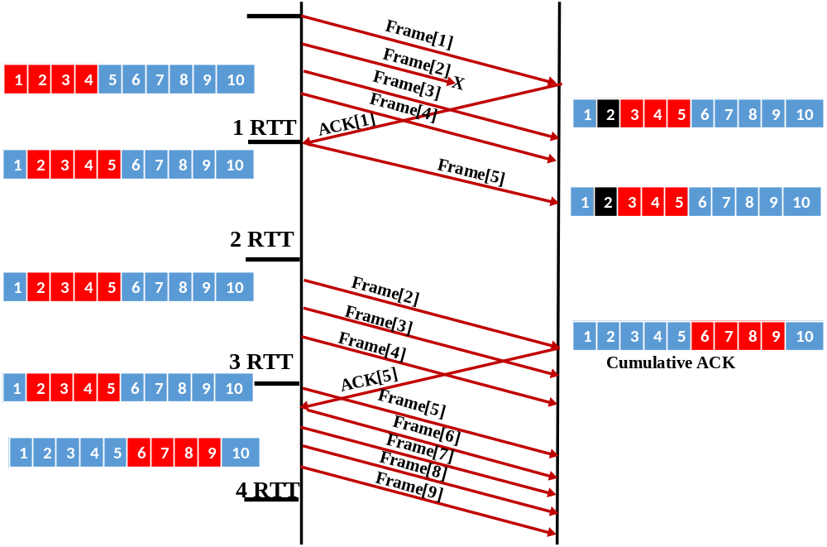
Timeline Diagram for Sliding Window
SWS=RWS=4 frames
Timeout= 2 RTT
MU CS4850/7850

Slide 51
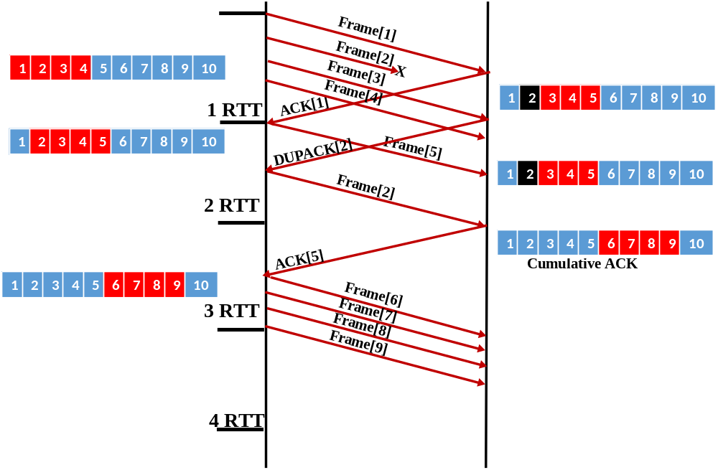
Timeline Diagram for Sliding Window
SWS=RWS=4 frames
Timeout= 2 RTT
MU CS4850/7850

Slide 52
Sequence Number Space
SeqNum field is finite; sequence numbers wrap around
Sequence number space must be larger than number of outstanding frames
SWS <= MaxSeqNum-1 is not sufficient
  suppose 3-bit SeqNum field (0..7)
  SWS=RWS=7
  sender transmit frames 0..6
  arrive successfully, but ACKs lost
  sender retransmits 0..6
  receiver expecting 7, 0..5, but receives first incarnation of 0..5
SWS <(MaxSeqNum+1)/2 is correct rule (if SWS=RWS)
Intuitively, SeqNum “slides” between two halves of sequence number space
MU CS4850/7850

Slide 53
Point-to-Point Links
Summary of supported functions:
  Encoding
  Framing
  Error Detection
  Sliding Window Algorithm
MU CS4850/7850

