Slide 1
Internetworking
Slides adapted from Larry Peterson
Outline
  Best Effort Service Model
  Global Addressing Scheme
  Subnetting/Supernetting
  ARP
  DHCP
  VPN
  ICMP
Reading:
Chapter 3: 3.2
FTP
HTTP
NV
TFTP
TCP
UDP
IP
NET
NET
■ ■ ■
NET
1
2
n
MU CS 4850/7850

Slide 2
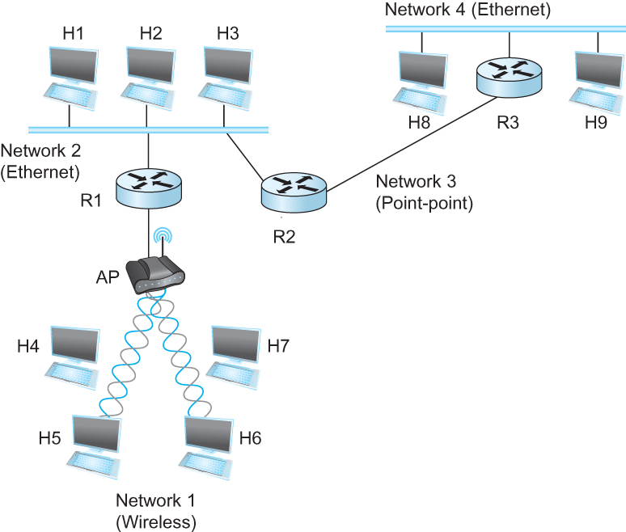
IP Internet
Concatenation of Networks
MU CS 4850/7850

Slide 3
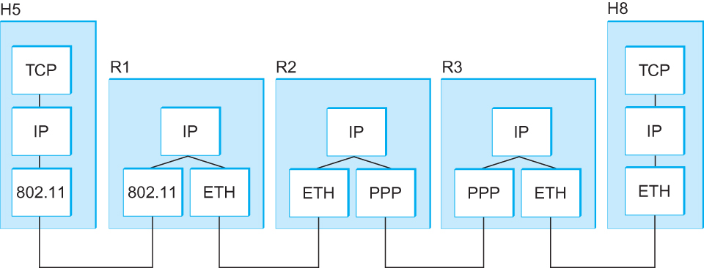
Internetworking
What is IP
  IP stands for Internet Protocol
  Key tool used today to build scalable, heterogeneous internetworks
  It runs on all the nodes in a collection of networks and defines the infrastructure that allows these nodes and networks to function as a single logical internetwork
  A simple internetwork showing the protocol layers
MU CS 4850/7850
Notes:
The University of Adelaide, School of Computer Science
Chapter 2 — Instructions: Language of the Computer

Slide 4
The Internet Network Layer
Host, router network layer functions:
Transport layer: TCP, UDP
Routing protocols
path selection
RIP, OSPF, BGP
IP protocol
addressing conventions
datagram format
packet handling conventions
Network
layer
forwarding
table
ICMP protocol
error reporting
router “signaling”
Link layer
physical layer
RIP = Routing Information Protocol; OSPF = Open Shortest Path First;
BGP = Border Gateway Protocol; ICMP = Internet Control Message Protocol
MU CS 4850/7850

Slide 5
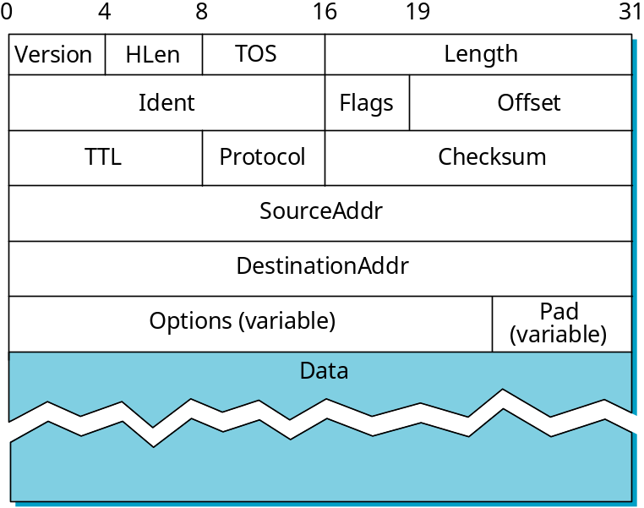
Service Model
Connectionless (datagram-based)
Best-effort delivery (unreliable service)
  packets are lost
  packets are delivered out of order
  duplicate copies of a packet are delivered
  packets can be delayed for a long time
Datagram format
  20 byte header
MU CS 4850/7850
Notes:
HLen: header length in 32 bit words; ToS: type of service: differentiated service
Length: size of datagram in bytes. TTL:default 64. Protocol:demultiplexing.

Slide 6
Fragmentation and Reassembly
Each network has some MTU (max. transmission unit)
  Largest payload (IP header + Data) a frame can carry
Design decisions
  fragment when necessary (if MTU < Datagram)
  try to avoid fragmentation at source host
  fragments are self-contained datagrams
  delay reassembly until destination host
  do not recover from lost fragments
datagram hdr
datagram data area
FRAME
FRAME DATA AREA
HEADER
Maximum transmission unit (MTU)
MU CS 4850/7850

Slide 7
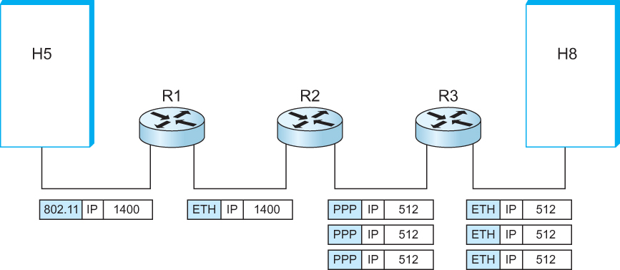
Example
Start of header
Ident = x
0
Offset = 0
Rest of header
Send a 1400 byte message
(a)
1400 data bytes
Start of header
Ident = x
1
Offset = 0
Rest of header
512 data bytes
(b)
Start of header
Ident = x
1
Offset = 64
Rest of header
MTU = 1500
MTU = 1500
MTU = 532
MTU = 1500
512 data bytes
Start of header
Ident = x
0
Offset = 128
Offset: counts 8 byte chunk.
Rest of header
376 data bytes
MU CS 4850/7850
Notes:
Offset: counts 8 byte chunk.

Slide 8
Dealing with Failure
Re-assembly at destination may fail if some fragments get lost
Need to detect failure
Re-assembly time out
  Assigned to first fragment to arrive
  If timeout expires before all fragments arrive, discard partial data

Slide 9
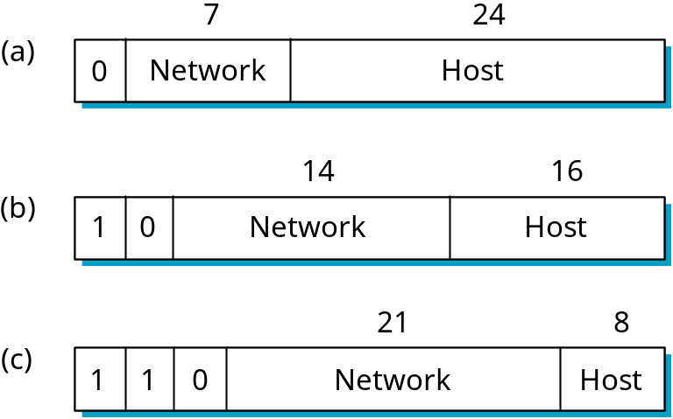
Global Addresses
IP address: 32-bit identifier for host, router interface
Properties
  globally unique
  hierarchical: network + host
  4 Billion IP address, half are A type, ¼ is B type, and 1/8 is C type
Dot Notation
  20.3.2.4
  128.96.33.81
  190.12.69.77
Private Addresses
  10.x.x.x
  172.x.x.x
  192.x.x.x
“class-full” addressing:
class
MU CS 4850/7850

Slide 10
IP Address Classes
Class A: 126 networks with 16 million hosts each
Class B: 16K networks with 64K hosts each
Class C: 2 million networks with 254 hosts each
Internet consists of:
  small number of wide area networks = Class A
  modest number of site-sized networks = Class B
  large number of local area networks = Class C
IP Addresses issued/assigned by:
  IANA (Internet Assigned Numbers Authority)

Slide 11
Class Masks
How to extract network number from flat IP address:
-> AND IP address with Class Mask
Class A networks: Mask = 255.0.0.0
Class B networks: Mask = 255.255.0.0
Class C networks: Mask = 255.255.255.0
Class mask is fixed
MU CS 4850/7850

Slide 12
Class Mask
Example: Flat B Class IP address: 128.96.255.10
? What is network number?
-> AND IP address with Mask 255.255.0.0 (for Class B addresses)
128.96.255.10 = 1000 0000 | 0110 0000 | 1111 1111 | 0000 1010
255.255.0.0 = 1111 1111 | 1111 1111 | 0000 0000 | 0000 0000
AND 1000 0000 | 0110 0000 | 0000 0000 | 0000 0000
Network number: 128.96.0.0
Host number: 255.10 (65290)
MU CS 4850/7850

Slide 13
Datagram Forwarding
Strategy
  every datagram contains destination’s address
  if connected to destination network, then forward to host
  if not directly connected, then forward to some router
  forwarding table maps network number into next hop
  each host has a default router
  each router maintains a forwarding table
MU CS 4850/7850

Slide 14
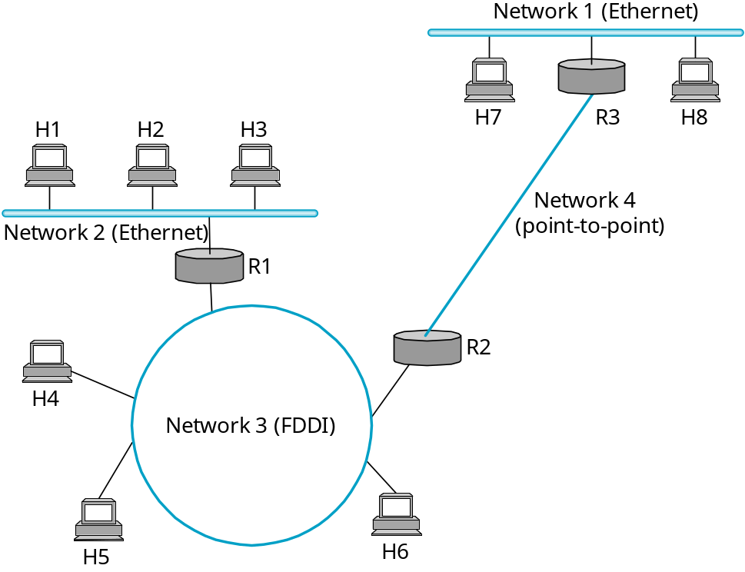
Datagram Forwarding
Network Number Next Hop
Example (R2) 1 R3
2 R1
3 interface 1
4 interface 0
MU CS 4850/7850

Slide 15
How to Make Routing Scale
Flat versus Hierarchical Addresses
Inefficient use of Hierarchical Address Space
  class C with 2 hosts (2/255 = 0.78% efficient)
  class B with 256 hosts (256/65535 = 0.39% efficient)
Still Too Many Networks
  routing tables do not scale
  route propagation protocols do not scale
Solutions
  Subnetting
  Supernetting
MU CS 4850/7850

Slide 16
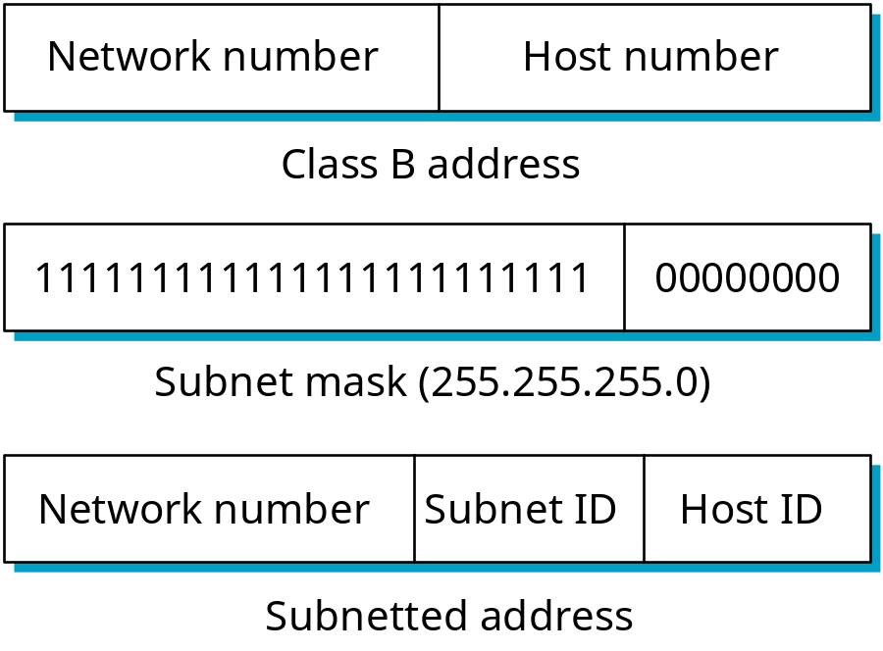
Subnetting
Add another level to address/routing hierarchy: subnet
Subnet masks define variable partition of host part
  Extension of class mask to the right
Subnets visible only within site
known to world
known to site only
MU CS 4850/7850

Slide 17
Subnetting
Subnet masks define variable partition of host part
  Extension of class mask to the right
IP address
Network number
Host number
Class mask
1111111111111111
00000000000000
-> one internal network
subnet mask
1111111111111111
10000000000000
-> two internal networks
subnet mask
1111111111111111
11000000000000
-> four internal networks
MU CS 4850/7850

Slide 18
Forwarding Algorithm
D = destination IP address
for each entry (SubnetNum, SubnetMask, NextHop)
D1 = SubnetMask & D
if D1 = SubnetNum
if NextHop is an interface
deliver datagram directly to D
else
deliver datagram to NextHop
else deliver datagram to default router
Not necessary for all 1s in subnet mask to be contiguous
Subnets not visible from the rest of the Internet
MU CS 4850/7850
Notes:
Multiple subnets on one physical network to force hosts to talk to each other through a router to provide traffic isolation.

Slide 19
Subnet Example
Network #: 128.96
64K hosts
HS
R1
R2
R3
HD IP:
128.96.255.10
128.96.255.10
Network # | Out
128.10 | R5
128.96 | R2
128.250 | R0
Network # | Out
128.10 | R4
128.96 | R3
128.250 | R0
HD
Destination Network:
128.96
Destination Host:
255.10 = 65290
MU CS 4850/7850

Slide 20
Subnet Example
Subnet #: 128.96.0.0
Subnet Mask: 255.255.0.0
64K hosts
HD
128.96.255.10
0
R3
Network # | Out
128.96.0.0 255.255.0.0 | Interf. 0
MU CS 4850/7850

Slide 21
Subnet Example
Subnet #: 128.96.0.0
Subnet Mask: 255.255.128.0
32K hosts
0
Subnet #: 128.96.128.0
Subnet Mask: 255.255.128.0
1
32K hosts
R3
Network # | Out
128.96.0.0 255.255.128.0 | Interf. 0
128.96.128.0 255.255.128.0 | Interf. 1
MU CS 4850/7850

Slide 22
Subnet Example
Subnet #: 128.96.0.0
Subnet Mask: 255.255.128.0
32K hosts
0
Subnet #: 128.96.128.0
Subnet Mask: 255.255.128.0
1
32K hosts
R3
Network # | Out
128.96.0.0 255.255.128.0 | Interf. 0
128.96.128.0 255.255.128.0 | Interf. 1
HD
128.96.255.10
MU CS 4850/7850

Slide 23
Subnet Example
Subnet #: 128.96.0.0
Subnet Mask: 255.255.128.0
32K hosts
0
Subnet #: 128.96.128.0
Subnet Mask: 255.255.192.0
1
16K hosts
R3
2
Network # | Out
128.96.0.0 255.255.128.0 | Interf. 0
128.96.128.0 255.255.192.0 | Interf. 1
128.96.192.0 255.255.192.0 | Interf. 2
Subnet #: 128.96.192.0
Subnet Mask: 255.255.192.0
16K hosts
HD
128.96.255.10
MU CS 4850/7850

Slide 24
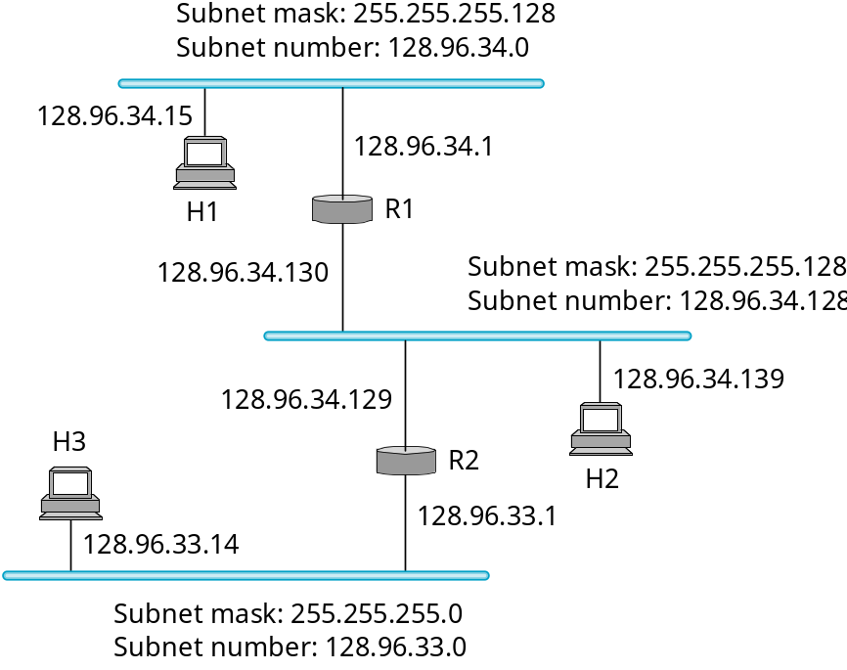
Subnet Example
Forwarding table at router R1
Subnet Number Subnet Mask Next Hop
128.96.34.0 255.255.255.128 interface 0
128.96.34.128 255.255.255.128 interface 1
128.96.33.0 255.255.255.0 R2
MU CS 4850/7850

Slide 25
Subnet Example
if want to split into 2 networks
Router R1:
Subnet mask: 255.255.255.192
Subnet #: 128.96.34.64
Subnet mask: 255.255.255.192
Subnet #: 128.96.34.0
Subnet mask: 255.255.255.128
Subnet #: 128.96.34.128
MU CS 4850/7850

Slide 26
Advantages of Subnetting
Helps solve scalability problems
  Improve address assignment efficiency
    Don’t need to use up an entire Class C or Class B address every time we add a new physical network
  Helps aggregate information (help routing).
    A collection of physical networks can be made to look like a single network from a reasonable distance
  Only works within an autonomous system (AS) with same administration
MU CS 4850/7850

Slide 27
Supernetting
Subnetting does not get around the fact that any AS with more than 255 hosts wants a class B address
Supernetting helps address two scaling concerns
  The growth of backbone routing tables
    Too many networks have been assigned
  The potential for the 32-bit IP address space to be exhausted well before the 4-billionth host is attached to the Internet.
  Tries to balance the desire to minimize the # of routes that a router needs to know against the need to hand out addresses efficiently.
MU CS 4850/7850

Slide 28
Supernetting
Assign block of contiguous network numbers to nearby networks
CIDR: Classless InterDomain Routing
  network portion of address of arbitrary length
  address format: a.b.c.d/x, where x is # bits in network portion of address
  All routers must understand CIDR addressing
network
part
host
part
11001000 00010111 00010000 00000000
200.23.16.0/23
MU CS 4850/7850

Slide 29
Supernetting
CIDR masks define variable partition of network part
  Shrinking class mask towards the left
IP address
Network number
Host number
Class mask
1111111111111111
00000000000000
CIDR
IP address
Network number
Host number
CIDR mask
111111111000000
00000000000000
Aggregated Networks
MU CS 4850/7850

Slide 30
Hierarchical Addressing: Route Aggregation
Hierarchical addressing allows efficient advertisement of routing
information:
Organization 0
200.23.16.0/23
Organization 1
200.23.18.0/23
“Send me anything
with addresses
beginning
200.23.16.0/20”
Organization 2
200.23.20.0/23
.
Fly-By-Night-ISP
.
.
.
.
Internet
Organization 7
.
200.23.30.0/23
ISPs-R-Us
“Send me anything
with addresses
beginning
199.31.0.0/16”
MU CS 4850/7850

Slide 31
Routing Table Using CIDR
NetMaskLength NextHop
C4.50.0.0/12 A
C4.5E.10.0/20 B
C4.60.0.0/12 C
80.0.0.0/1 D
40.0.0.0/2 E
00.0.0.0/2 F
Example:
A packet with IP address
C4.5E.13.87 will be delivered
to B
Address bytes are in hexadecimal
The notation “/12” in C4.50.0.0/12 denotes a netmask with 12 leading 1 bits, i.e., FF.F0.0.0
Last 3 entries cover every address, serve as default routers
Principle of “Longest match” in case there are more than one prefix match
MU CS 4850/7850

Slide 32
Routing Table Using CIDR
NetMaskLength NextHop
C4.50.0.0/12 A
C4.5E.10.0/20 B
C4.60.0.0/12 C
80.0.0.0/1 D
40.0.0.0/2 E
00.0.0.0/2 F
Example:
A packet with IP address
C4.5E.13.87 will be delivered
to B
C4.5E.13.87 = 1100 0100 | 0101 1110 | 0001 0011 | 1000 0111
C4.5E.13.87/12 =
C4.5E.13.87/20 =
C4.5E.13.87/1 =
C4.5E.13.87/2 =
MU CS 4850/7850

Slide 33
Supernetting vs Subnetting
Differences
  Subnetting is used to share one network address among multiple physical networks within an organization (AS)
  CIDR aims to collapse the multiple network addresses that would be assigned to a single or multiple AS onto one (supernet) address.
MU CS 4850/7850

Slide 34
Address Translation
How to determine node’s MAC address knowing
node’s IP address?
  destination host
  next hop router
Techniques
  encode physical address in host part of IP address (x)
  table-based
    ARP (Address Resolution Protocol)
      table of IP to physical address bindings
      broadcast request if IP address not in table
      target machine responds with its physical address
      table entries are discarded if not refreshed
MU CS 4850/7850

Slide 35
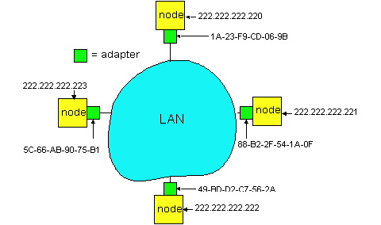
ARP: Address Resolution Protocol
Each IP node (Host, Router) on LAN has ARP table
ARP Table: IP/MAC address mappings for some LAN nodes
< IP address; MAC address; TTL>
  TTL (Time To Live): time after which address mapping will be forgotten (typically 20 min)
MU CS 4850/7850

Slide 36
ARP Protocol
A wants to send datagram to B, and A knows B’s IP address.
Suppose B’s MAC address is not in A’s ARP table.
A broadcasts ARP query packet, containing B's IP address
  all machines on LAN receive ARP query
B receives ARP packet, replies to A with its (B's) MAC address
  frame sent to A’s MAC address (unicast)
A caches (saves) IP-to-MAC address pair in its ARP table until information becomes old (times out)
  soft state: information that times out (goes away) unless refreshed
ARP is “plug-and-play”:
  nodes create their ARP tables without intervention from net administrator
MU CS 4850/7850

Slide 37
DHCP: Dynamic Host Configuration Protocol
Goal: allow host to dynamically obtain its IP address from network server when it joins network
  Can renew its lease on address in use
  Allows reuse of addresses (only hold address while connected an “on”)
  Support for mobile users who want to join network
DHCP overview:
  host broadcasts “DHCP discover” msg
  DHCP server responds with “DHCP offer” msg
  host requests IP address: “DHCP request” msg
  DHCP server sends address: “DHCP ack” msg
MU CS 4850/7850

Slide 38
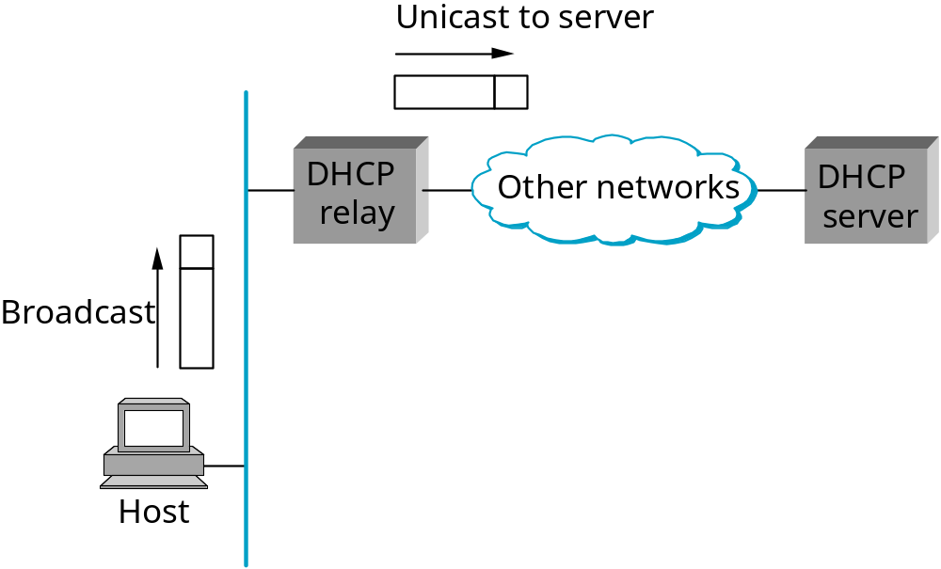
Dynamic Host Configuration Protocol (DHCP)
MU CS 4850/7850

Slide 39
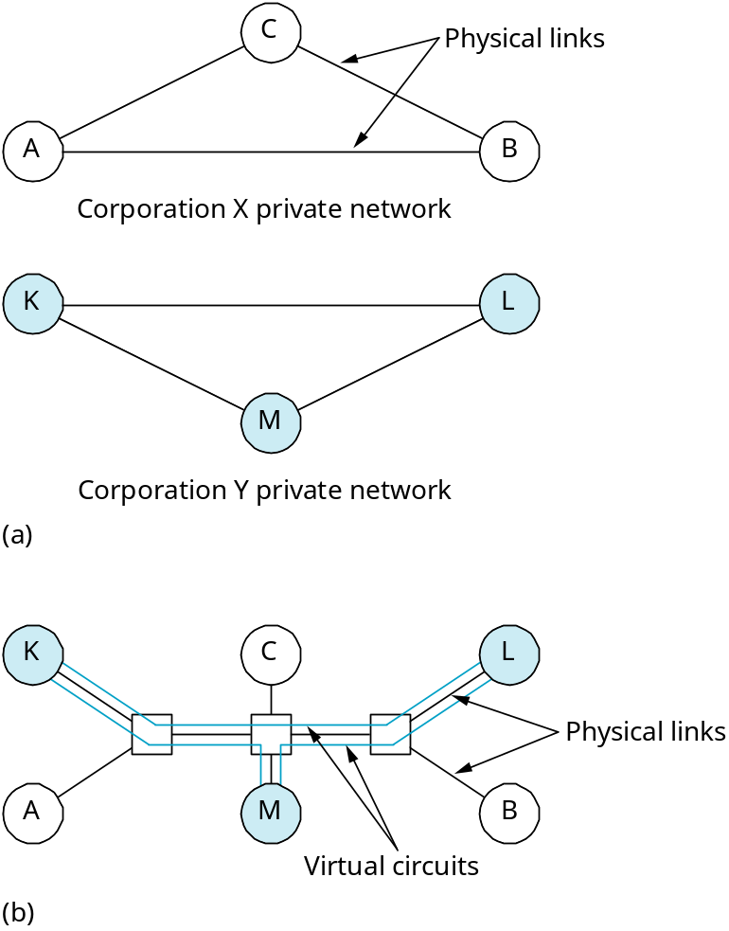
Virtual Private Networks (VPN)
MU CS 4850/7850

Slide 40
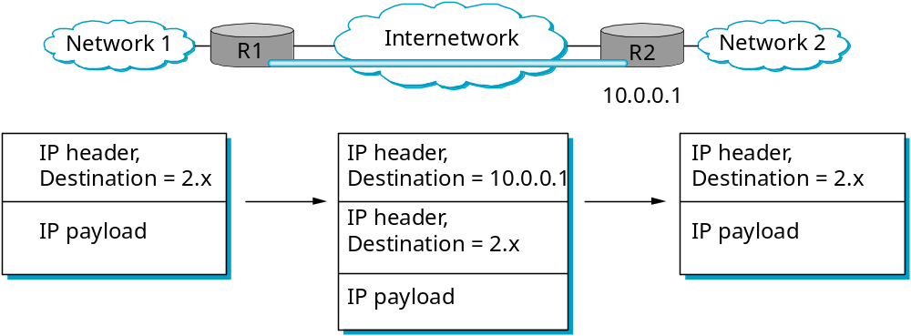
Tunneling
(virtual Point-to-Point link)
Combined with encryption
MU CS 4850/7850

Slide 41
ICMP: Internet Control Message Protocol
used by hosts, routers, gateways to communication network-level information
  error reporting: unreachable host, network, port, protocol
  echo request/reply (used by ping)
network-layer “above” IP:
  ICMP msgs carried in IP datagrams
ICMP message: type, code plus first 8 bytes of IP datagram causing error
Type Code description
0 0 echo reply (ping)
3 0 dest. network unreachable
3 1 dest host unreachable
3 2 dest protocol unreachable
3 3 dest port unreachable
3 6 dest network unknown
3 7 dest host unknown
4 0 source quench (congestion
control - not used)
8 0 echo request (ping)
9 0 route advertisement
10 0 router discovery
11 0 TTL expired
12 0 bad IP header
MU CS 4850/7850

Slide 42
Internetworking
Summary
  Best Effort Service Model
  Global Addressing Scheme
  Subnetting/Supernetting
  ARP
  DHCP
  VPN
  ICMP
FTP
HTTP
NV
TFTP
TCP
UDP
IP
NET
NET
■ ■ ■
NET
1
2
n
MU CS 4850/7850

