Slide 1
End-to-End Protocols
Slides adapted from Larry Peterson
Outline
  IP Address vs. Port Number
  UDP
  TCP
    Connection Establishment/Termination
    Sliding Window Revisited
      Flow Control
      Adaptive Timeout
  NAT/PAT/NAPT
FTP
HTTP
NV
TFTP
TCP
UDP
IP
NET
NET
■ ■ ■
NET
1
2
n
MU CS 4850/7850

Slide 2
Problem and Goal
Problem
  How to turn this host-to-host packet delivery service into a process-to-process communication channel
Chapter Goal
  Understanding the demultipexing service (UDP)
  Discussing simple byte stream protocol (TCP)
Reading:
  Chapters 5.1, 5.2
MU CS 4850/7850
Notes:
The University of Adelaide, School of Computer Science
Chapter 2 — Instructions: Language of the Computer

Slide 3
End-to-End Protocols
Slides adapted from Larry Peterson
Outline
  IP Address vs. Port Number
  UDP
  TCP
    Connection Establishment/Termination
    Sliding Window Revisited
      Flow Control
      Adaptive Timeout
  NAT/PAT/NAPT
FTP
HTTP
NV
TFTP
TCP
UDP
IP
NET
NET
■ ■ ■
NET
1
2
n
MU CS 4850/7850

Slide 4
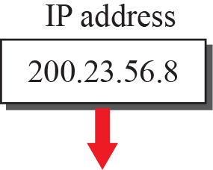
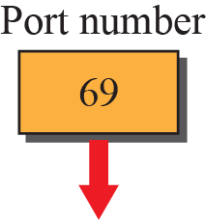
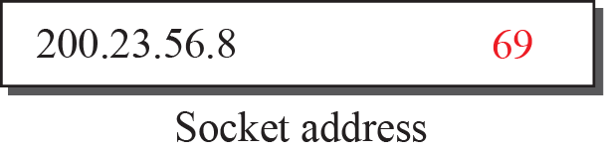
Spring 2016
CMP_SC 4850/7850
Transport Layer
Transport Layer adds port number
IP address + port number = socket
Notes:
23.#

Slide 5
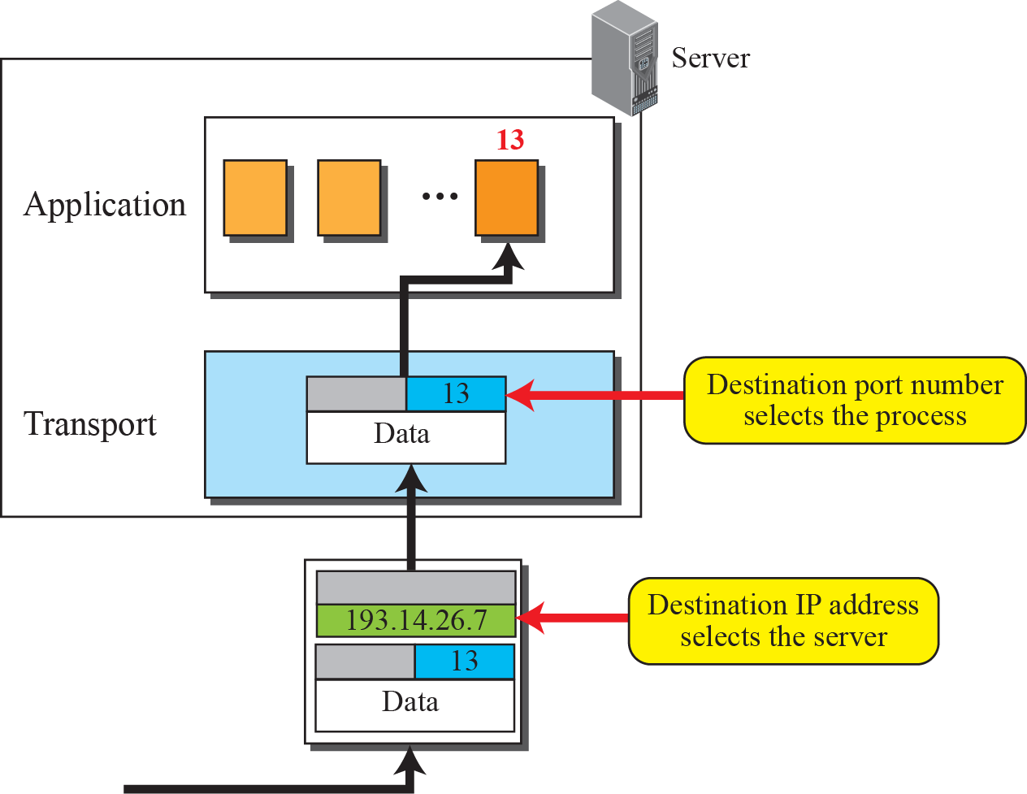
Spring 2016
CMP_SC 4850/7850
IP Address vs. Port Number
Notes:
23.#

Slide 6
Reserved Port Numbers
How can a host computer know the protocol port used at a remote machine?
First approach uses central authority - universal assignment of port numbers, these are called well-known ports
  in Unix look at /etc/services file
Second approach is to use dynamic binding
TCP/IP designers adopted a hybrid approach
PORT NUM
SERVICE
DESCRIPTION
7
21
23
25
ECHO
FTP
TELNET
SMTP
Pinging a host
FTP
TELNET
Simple Mail Transfer Protocol
53
DOMAIN NAME
Domain name server
80
HTTP
HTTP server

Slide 7
End-to-End Protocols
Underlying best-effort network (read IP)
  drop messages
  re-orders messages
  delivers duplicate copies of a given message
  limits messages to some finite size
  delivers messages after an arbitrarily long delay
Common end-to-end services expected
  guarantee message delivery
  deliver messages in the same order they are sent
  deliver at most one copy of each message
  support arbitrarily large messages
  support synchronization between sender and receiver
  allow the receiver to flow control the sender
  support multiple application processes on each host
MU CS 4850/7850

Slide 8
End-to-End Protocols
Slides adapted from Larry Peterson
Outline
  IP Address vs. Port Number
  UDP
  TCP
    Connection Establishment/Termination
    Sliding Window Revisited
      Flow Control
      Adaptive Timeout
  NAT/PAT/NAPT
FTP
HTTP
NV
TFTP
TCP
UDP
IP
NET
NET
■ ■ ■
NET
1
2
n
MU CS 4850/7850

Slide 9
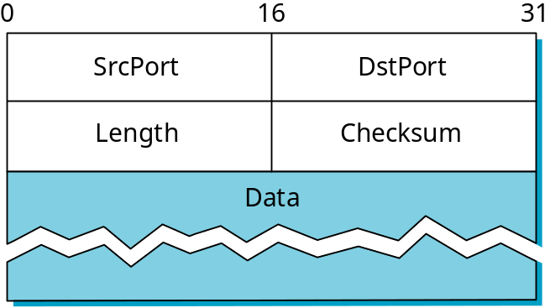
User Datagram Protocol (UDP)
Unreliable and unordered datagram service
Adds multiplexing: (port, host) pair
  allows multiple application processes on each host to share the network
No flow control
Endpoints identified by ports
  Use well-known port
Header format
Checksum
  pseudo header + UDP header + data
  Pseudo header: protocol #, source IP address, destination IP address, UDP length field
MU CS 4850/7850
Notes:
protocol #？

Slide 10
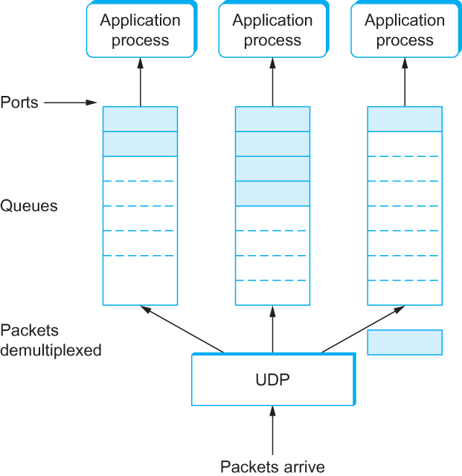
UDP Demultiplexing
Spring 2016
CMP_SC 4850/7850
UDP Message Queue

Slide 11
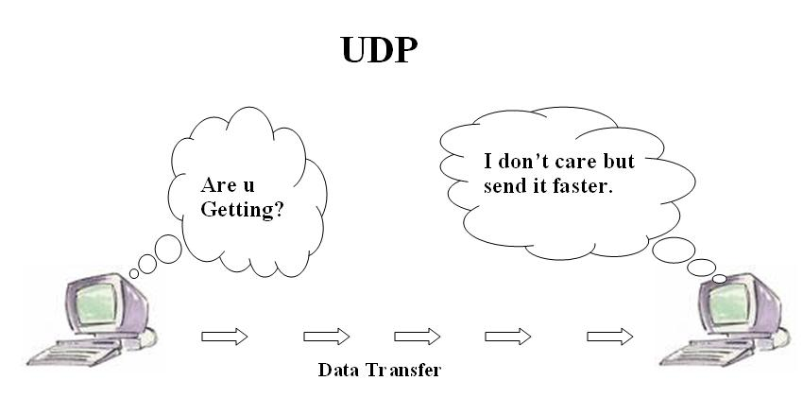
UDP: No Flow Control
UDP does not use ACKs
Does not use congestion control
Is most concerned with speed
No retransmissions. Does not care if packets lost, dropped, or corrupted.
MU CS 4850/7850

Slide 12
Why Would Anyone Use UDP?
Finer control over what data is sent and when
  As soon as an application process writes into the socket
  … UDP will package the data and send the packet
No delay for connection establishment
  UDP just blasts away without any formal preliminaries
  … which avoids introducing any unnecessary delays
No connection state
  No allocation of buffers, parameters, sequence #s, etc.
  … making it easier to handle many active clients at once
Small packet header overhead
  UDP header is only eight-bytes long
MU CS 4850/7850

Slide 13


Popular Applications that use UDP
Multimedia streaming
  Retransmitting lost/corrupted packets is not worthwhile
  By the time the packet is retransmitted, it’s too late
  E.g., telephone calls, video conferencing, gaming
  Any bandwidth intensive apps with loss tolerance
Simple query protocols like Domain Name System
  Overhead of connection establishment is overkill
  Easier to have application retransmit if needed
“Address for www.cnn.com?”
“12.3.4.15”
MU CS 4850/7850

Slide 14
End-to-End Protocols
Slides adapted from Larry Peterson
Outline
  IP Address vs. Port Number
  UDP
  TCP
    Connection Establishment/Termination
    Sliding Window Revisited
      Flow Control
      Adaptive Timeout
  NAT/PAT/NAPT
FTP
HTTP
NV
TFTP
TCP
UDP
IP
NET
NET
■ ■ ■
NET
1
2
n
MU CS 4850/7850

Slide 15
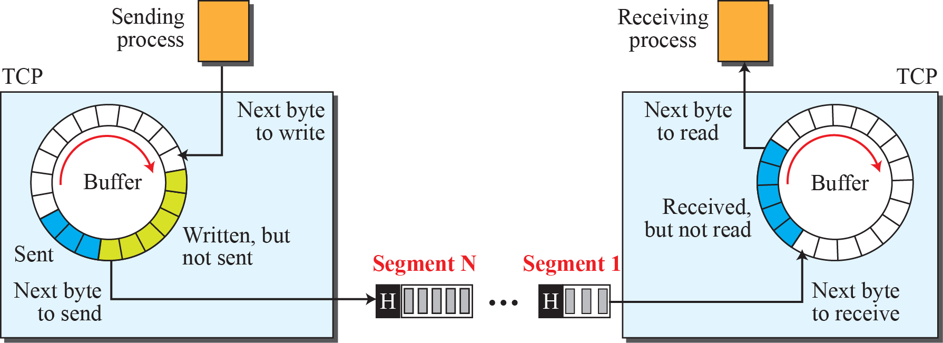
Transmission Control Protocol (TCP)
Spring 2016
CMP_SC 4850/7850
Connection-oriented
Reliable
Flow control: keep sender from overrunning receiver
  TCP needs to know the storage capacity at the receiver
  Solutions? Something we already know
Congestion control: keep sender from overrunning network
  TCP needs to know the capacity of the network
Byte-stream
  Sender app writes bytes
  TCP stores bytes into buffer
  Once enough bytes stored, TCP
  sends segments (collection of bytes)
  Receiver stores segments as bytes
  app reads bytes

Slide 16
Point-to-Point Data Link vs End-to-End Transport
At the heart of TCP is the sliding window algorithm , but it needs to address
Potentially connects many different hosts
  need explicit connection establishment and termination
Potentially different RTT
  need adaptive timeout mechanism
Potentially long delay in network
  need to be prepared for arrival of very old packets
Potentially different capacity at destination
  need to accommodate different node capacity
Potentially different network capacity
  need to be prepared for network congestion
MU CS 4850/7850

Slide 17
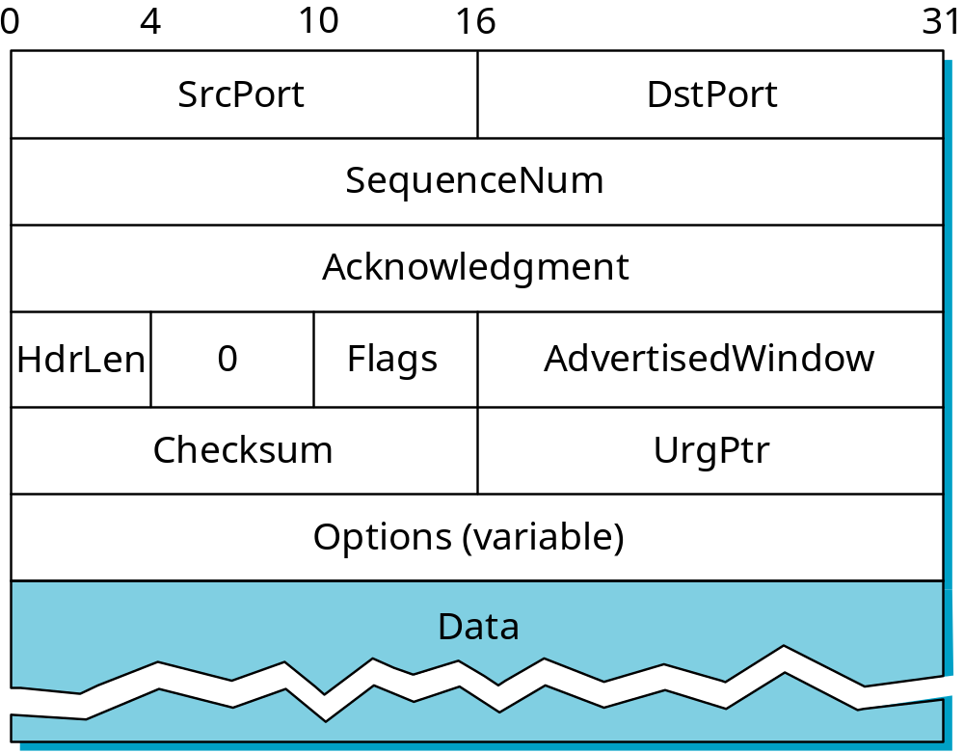
Segment Format
MU CS 4850/7850

Slide 18
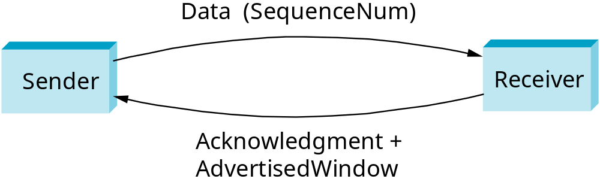
Segment Format (cont)
Each connection identified with 4-tuple:
  (SrcPort, SrcIPAddr, DsrPort, DstIPAddr)
Sliding window + flow control
  acknowledgment, SequenceNum, AdvertisedWinow
  SequenceNum: sequence # of the first byte
Flags (6 bits)
  SYN, FIN, RESET, PUSH, URG, ACK
Checksum
  pseudo header + TCP header + data
MU CS 4850/7850

Slide 19
End-to-End Protocols
Slides adapted from Larry Peterson
Outline
  IP Address vs. Port Number
  UDP
  TCP
    Connection Establishment/Termination
    Sliding Window Revisited
      Flow Control
      Adaptive Timeout
  NAT/PAT/NAPT
FTP
HTTP
NV
TFTP
TCP
UDP
IP
NET
NET
■ ■ ■
NET
1
2
n
MU CS 4850/7850

Slide 20
Connection Establishment and Termination
Active participant
Passive participant
(client)
(server)
SYN, SequenceNum =
x
SYN+ACK, SequenceNum=y,
Acknowledgment =x+1
ACK, Acknowledgment =y+1
MU CS 4850/7850

Slide 21
Connection Establishment and Termination cont’d
Why ACK the sequence number +1?
  Acknowledgement field identifies the next sequence number expected
Why do client and server have to exchange sequence numbers…Why not start at 0?
  TCP requires each side to select a number at random
  Protects against two incarnations of the same connection reusing the same seqnums too soon
MU CS 4850/7850

Slide 22
Example: Simple Socket Program
Server
/*setup passive open */
s=socket(…);
bind(s, …);
listen(s, MAX_PENDING);
while(1){
new_s=accept(s, …);
while (len=recv(new_s, buf,…)
fputs(buf, stdout);
close(new_s);
}
Client
/*setup active open */
s=socket(…);
connect(s,…);
/*send text */
send(s, buf, ...);
close(s);
MU CS 4850/7850

Slide 23
State Transition Diagram
CLOSED
Active open
/SYN
Passive open
Close
Server: listen()
Close
Client: connect()
LISTEN
Server: accept()
SYN/SYN + ACK
Send
/
SYN
SYN_RCVD
SYN/SYN + ACK
SYN_SENT
ACK
SYN + ACK/ACK
Server: connected
Close
/FIN
ESTABLISHED
Client: connected
Server: close()
Close
/FIN
FIN/ACK
FIN_WAIT_1
CLOSE_WAIT
ACK
FIN/ACK
Close
/FIN
Client: close()
ACK + FIN/ACK
FIN_WAIT_2
CLOSING
LAST_ACK
ACK
Timeout after two
ACK
FIN/ACK
segment lifetimes
TIME_WAIT
CLOSED
MU CS 4850/7850
Notes:
Event/action

Slide 24
End-to-End Protocols
Slides adapted from Larry Peterson
Outline
  IP Address vs. Port Number
  UDP
  TCP
    Connection Establishment/Termination
    Sliding Window Revisited
      Flow Control
      Adaptive Timeout
  NAT/PAT/NAPT
FTP
HTTP
NV
TFTP
TCP
UDP
IP
NET
NET
■ ■ ■
NET
1
2
n
MU CS 4850/7850

Slide 25
Sliding Window Revisited
TCP’s variant of the sliding window algorithm, which serves several purposes:
  (1) it guarantees the reliable delivery of data,
  (2) it ensures that data is delivered in order, and
  (3) it enforces flow control between the sender and the receiver.
  (4) it enforces congestion control to avoid overwhelming the network.
TCP has variable Maximum Segment Size (MSS)
  Sends out segment as soon as it has collected MSS bytes from sending process
MU CS 4850/7850

Slide 26
Variable Window Size
TCP’s sliding-window protocol is slightly different since TCP allows the window size to vary over time.
Each ACK, which specifies how many bytes have been received, contains a window advertisement.
This WINDOW field specifies how many additional bytes of data the receiver is prepared to accept.
We think of window advertisement as specifying the receiver’s current buffer size.
Variable window size provides flow control as well as reliable transfer.
Notes:
9

Slide 27
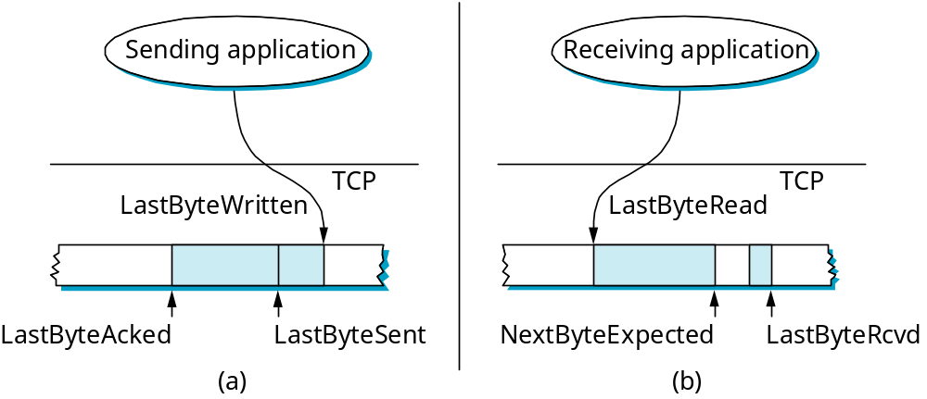
Sliding Window Revisited
Sending side
  LastByteAcked < = LastByteSent
  LastByteSent < = LastByteWritten
  buffer bytes between LastByteAcked and LastByteWritten
Receiving side
  LastByteRead < NextByteExpected
  NextByteExpected < = LastByteRcvd +1
  buffer bytes between NextByteRead and LastByteRcvd
MU CS 4850/7850

Slide 28
Flow Control
Send buffer size: MaxSendBuffer
Receive buffer size: MaxRcvBuffer
Receiving side
  LastByteRcvd - LastByteRead < = MaxRcvBuffer
  AdvertisedWindow = MaxRcvBuffer - (NextByteExpected - NextByteRead)
Sending side
  LastByteSent - LastByteAcked < = AdvertisedWindow
  EffectiveWindow = AdvertisedWindow - (LastByteSent - LastByteAcked)
  LastByteWritten - LastByteAcked < = MaxSendBuffer
  block sender if (LastByteWritten - LastByteAcked) + y > MaxSenderBuffer
Receiver always send ACK segment (with latest valid Acknowledge and AdvertisedWindow field value) in response to each arriving data segment
Sender persists in sending 1 byte segment when AdvertisedWindow = 0
MU CS 4850/7850
Notes:
Y? # of bytes to write to TCP

Slide 29
Triggering Transmission
What factors governs the decision of transmission
  Ignore flow control: window is wide open, as would be the case when the connection starts
  TCP has 3 mechanisms to trigger transmission of a segment
    1) TCP maintains a variable MSS and sends a segment as soon as it has collected MSS bytes from the sending process
      MSS is usually set to the size of the largest segment TCP can send without causing local IP to fragment.
      MSS: MTU of directly connected network – (TCP header + IP header)
    2) Sending process has explicitly asked TCP to send it
      TCP supports push operation
    3) When a timer fires
      Resulting segment contains as many bytes as are currently buffered for transmission
MU CS 4850/7850

Slide 30
Silly Window Syndrome
How aggressively does sender exploit open window?
Receiver-side solutions
  after advertising zero window, wait for space equal to a maximum segment size (MSS) before advertising an open window
  delayed acknowledgements to coalesce small segments
Sender
Receiver
MU CS 4850/7850
Notes:
Receiver-side solution is only partial solution.

Slide 31
Nagle’s Algorithm
(sender-side solution)
How long does sender delay sending data?
  too long: hurts interactive applications
  too short: poor network utilization
  strategies: timer-based vs self-clocking
When application generates additional data
  if fills a max segment (and window open >=MSS): send it
  else
    if there is unack’ed data in transit: buffer it until ACK arrives (self-clocking) (e.g., Telnet)
    else: send it
  Can be turned off in socket interface
MU CS 4850/7850

Slide 32
Data Link Versus Transport
Potentially connects many different hosts
  need explicit connection establishment and termination
Potentially different capacity at destination
  need to accommodate different node capacity
Potentially long delay in network
  need to be prepared for arrival of very old packets
MU CS 4850/7850

Slide 33
Protection Against Wrap Around
32-bit SequenceNum
Bandwidth Time Until Wrap Around
T1 (1.5 Mbps) 6.4 hours
Ethernet (10 Mbps) 57 minutes
T3 (45 Mbps) 13 minutes
FDDI (100 Mbps) 6 minutes
STS-3 (155 Mbps) 4 minutes
STS-12 (622 Mbps) 55 seconds
STS-24 (1.2 Gbps) 28 seconds
Should >= max. segment lifetime =120s
MU CS 4850/7850
Notes:
Maximum segment time: 120 s

Slide 34
Keeping the Pipe Full
16-bit AdvertisedWindow (max: 64 KB)
Bandwidth Delay x Bandwidth Product
T1 (1.5 Mbps) 18KB
Ethernet (10 Mbps) 122KB
T3 (45 Mbps) 549KB
FDDI (100 Mbps) 1.2MB
STS-3 (155 Mbps) 1.8MB
STS-12 (622 Mbps) 7.4MB
STS-24 (1.2 Gbps) 14.8MB
assuming 100ms RTT
MU CS 4850/7850

Slide 35
Data Link Versus Transport
Potentially connects many different hosts
  need explicit connection establishment and termination
Potentially different capacity at destination
  need to accommodate different node capacity
Potentially long delay in network
  need to be prepared for arrival of very old packets
Potentially different RTT
  need adaptive timeout mechanism
MU CS 4850/7850

Slide 36
Adaptive Retransmission
(Original Algorithm)
Why adaptive retransmission?
  Adaptive timeout
Measure SampleRTT for each segment / ACK pair
Compute weighted average of RTT
  EstRTT = α x EstRTT + β x SampleRTT
  where α + β = 1
  α between 0.8 and 0.9
  β between 0.1 and 0.2
Set timeout based on EstRTT
  TimeOut = 2 x EstRTT (very conservative)
MU CS 4850/7850

Slide 37
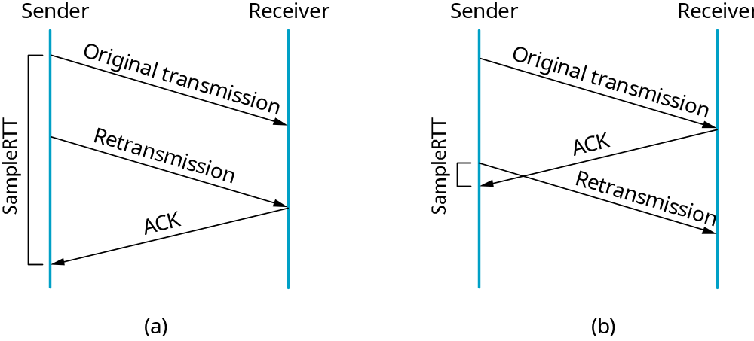
Karn/Partridge Algorithm
Problem: when retransmission is incurred, which transmission (first or second or …) the ACK corresponds ?
Solution (Karn/Partridge Algorithm)
  Do not sample RTT when retransmitting
  Double timeout after each retransmission (exponential backoff)
MU CS 4850/7850

Slide 38
Jacobson/ Karels Algorithm
New Calculations for average RTT
Diff = SampleRTT - EstRTT
EstRTT = EstRTT + (δ x Diff)
Dev = Dev + δ ( |Diff| - Dev)
  where δ is a factor between 0 and 1
Consider variance when setting timeout value
TimeOut = μ x EstRTT + φ x Dev
  where μ = 1 and φ = 4
Notes
  algorithm only as good as granularity of clock used to read the time (500ms on Unix), and only one sample RTT measurement per RTT
    TCP extension can improve
  accurate timeout mechanism important to congestion control (later)
    Why?
MU CS 4850/7850

Slide 39
TCP Extensions
Implemented as header options
Improve timeout mechanism
  Read actual system clock when about to send segment
  Store timestamp in outgoing segments
  Echoed back by receiver for calculation of RTT
Extend sequence space with 32-bit timestamp
Shift (scale) advertised window
  Each unit represents 2^{k} bytes as opposed to only 1 byte.
MU CS 4850/7850

Slide 40
End-to-End Protocols
Slides adapted from Larry Peterson
Outline
  IP Address vs. Port Number
  UDP
  TCP
    Connection Establishment/Termination
    Sliding Window Revisited
      Flow Control
      Adaptive Timeout
  NAT/PAT/NAPT
FTP
HTTP
NV
TFTP
TCP
UDP
IP
NET
NET
■ ■ ■
NET
1
2
n
MU CS 4850/7850

Slide 41
More Address Scalability Issues
Subnetting
  Aggregate hosts on network
  Forward datagrams to destination network
Supernetting
  Aggregate networks
  Forward datagrams to network close to destination network
NAT/PAT/NAPT
  Aggregate hosts on network
  Assign multiple hosts to single IP address
  NAT: Network Address Translation
  PAT: Port Address Translation
  NAPT: Network Address and Port Translation
MU CS 4850/7850

Slide 42
NAT/PAT/NAPT
Network address translation (NAT)
  Remapping one IP address space into another by modifying network address information in IP datagram packet headers
    One-to-One translation of IP addresses
    Remapping done while packets traverse NAT box (layer-3 router)
  No need to change any internal network/host nodes when changing ISPs
MU CS 4850/7850

Slide 43

NAT: Network Address Translation
rest of
Internet
local network
(e.g., home network)
128.69.5/24
128.69.5.1
138.76.29.0
128.69.5.0
128.69.5.2
138.76.29.1
128.69.5.1
138.76.29.2
128.69.5.2
128.69.5.3
138.76.29.3
128.69.5.3
Adapted from Kurose & Rose
MU CS 4850/7850

Slide 44
NAPT: Network Address & Port Translation
Motivation: local network uses just one IP address as far as outside word is concerned:
  no need to be allocated range of addresses from ISP: - just one IP address is used for all devices
  can change addresses of devices in local network without notifying outside world
  can change ISP without changing addresses of devices in local network
  devices inside local net not explicitly addressable, visible by outside world (a security plus).
Adapted from Kurose & Rose
MU CS 4850/7850

Slide 45
NAT: Network Address & Port Translation
rest of
Internet
local network
(e.g., home network)
128.69.5/24
128.69.5.1
138.76.29.0
128.69.5.2
138.76.29.0:1040
128.69.5.1
138.76.29.0:2052
128.69.5.2
128.69.5.3
138.76.29.0:5011
128.69.5.3
138.76.29.0:5011 = IP Address: Port Number
Adapted from Kurose & Rose
MU CS 4850/7850

Slide 46
NAPT: Network Address & Port Translation
Implementation: NAPT router must:
  outgoing datagrams: replace (source IP address, port #) of every outgoing datagram to (NAT IP address, new port #)
    . . . remote clients/servers will respond using (NAT IP address, new port #) as destination addr.
  remember (in NAT translation table) every (source IP address, port #) to (NAT IP address, new port #) translation pair
  incoming datagrams: replace (NAT IP address, new port #) in dest fields of every incoming datagram with corresponding (source IP address, port #) stored in NAT table
Adapted from Kurose & Rose
MU CS 4850/7850

Slide 47
NAPT: Network Address & Port Translation
rest of
Internet
local network
(e.g., home network)
128.69.5/24
Web Server
192.5.10.4
128.69.5.1
138.76.29.0
128.69.5.2
128.69.5.3
Dest: 192.5.10.4:80
Src: 138.76.29.0:6123
Dest: 192.5.10.4:80
Src: 128.69.5.2:5012
NAT Translation Table
Source address:Port | New Port
128.69.5.2:5012 | 6123

Slide 48
Problem: Server on local network
rest of
Internet
local network
(e.g., home network)
128.69.5/24
128.69.5.1
Web Client
192.5.10.4
138.76.29.0
Web Server
128.69.5.2
128.69.5.3
Dest: 138.76.29.0:80
Src: 192.5.10.4:990
Dest: 128.69.5.2:80
Src: 192.5.10.4:990
Solution: Port Forwarding
  Manually add 80->128.69.5.2 mapping to router’s Port
  Forwarding table for incoming packets

Slide 49
NAPT: Network Address & Port Translation
16-bit port-number field:
  60,000 simultaneous connections with a single LAN-side address!
NAPT is controversial:
  higher layer protocol may carry IP address
  routers should only process up to layer 3, yet with NAPT they need to process higher layer protocols to change Port numbers
  violates end-to-end argument
    NAPT possibility must be taken into account by app designers, eg, P2P applications
  address shortage should instead be solved by IPv6
Adapted from Kurose & Rose
MU CS 4850/7850

Slide 50
Summary
We have discussed how to convert host-to-host packet delivery service to process-to-process communication channel.
We have discussed UDP
We have discussed TCP
We have discussed NAT/PAT/NAPT
MU CS 4850/7850

