Slide 1
Congestion Control
Slides adapted from Larry Peterson
Outline
  Issues in Resource Allocation
  Queuing Discipline
  Reacting to Congestion
  Avoiding Congestion
Reading:
Chapter 6: 6.1 – 6.4
FTP
HTTP
NV
TFTP
TCP
UDP
IP
NET
NET
■ ■ ■
NET
1
2
n
Resource allocation?
MU CS 4850/7850
Notes:
Resource allocation is a problem that spans the entire protocol stack. How to effectively and fairly allocate resource among competing hosts?

Slide 2
Problem
We have seen enough layers of protocol hierarchy to understand how data can be transferred among processes across heterogeneous networks
Problem
  How to effectively and fairly allocate resources among a collection of competing users?
  Resources
    Bandwidth of the links
    Buffers at the routers and switches
MU CS 4850/7850
Notes:
The University of Adelaide, School of Computer Science
Chapter 2 — Instructions: Language of the Computer

Slide 3
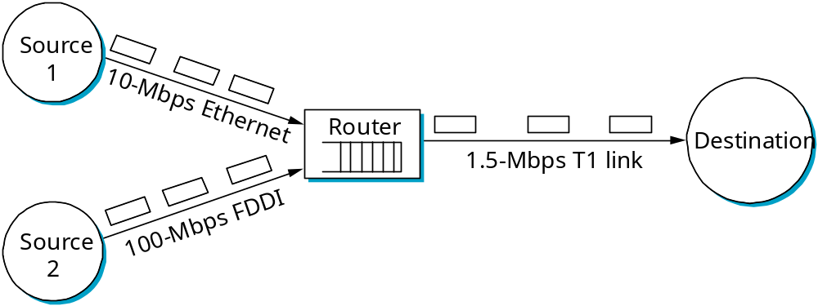
Issues
Two sides of the same coin
  pre-allocate resources so as to avoid congestion - difficult
  control congestion if (and when) it occurs
Two points of implementation
  hosts at the edges of the network (transport protocol)
  routers inside the network (queuing discipline)
Underlying service model
  best-effort (assume for now)
  multiple qualities of service (not to be covered)
Bottleneck router
MU CS 4850/7850

Slide 4
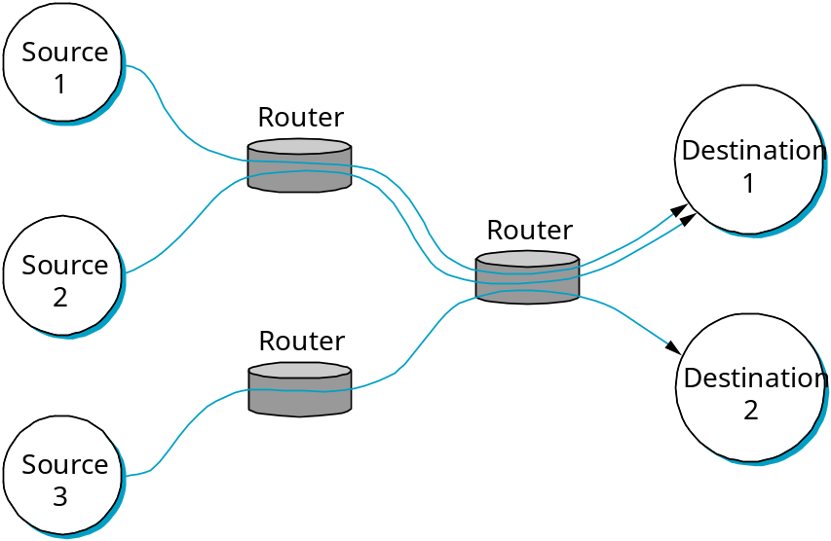
Framework
Connectionless flows
  sequence of packets sent between source/destination pair
    E..g, router observes the source/destination IP addresses
  maintain soft state at the routers
MU CS 4850/7850
Notes:
Soft state needs not always be explicitly created and removed by signaling.
Reservation-based implies router-centric.
Feedback-based can be either router-centric or host-centric.

Slide 5
Network Model
Connectionless Flows
  One of the powers of the flow abstraction is that flows can be defined at different granularities. For example, a flow can be host-to-host (i.e., have the same source/destination host addresses) or process-to-process (i.e., have the same source/destination host/port pairs).
  In the latter case, a flow is essentially the same as a channel. But a flow is visible to the routers inside the network, whereas a channel is an end-to-end abstraction.
  It sometimes makes sense to maintain some state information for each flow, information that can be used to make resource allocation decisions. This state is sometimes called soft state.
  The main difference between soft state and “hard” state is that soft state need not always be explicitly created and removed by signalling.
MU CS 4850/7850
Notes:
The University of Adelaide, School of Computer Science
Chapter 2 — Instructions: Language of the Computer

Slide 6
Types of Flows
Implicit
  Router watches for packets traveling between the same source/dest pair
  For congestion control the router treats these packets as belonging to the same flow
Explicit
  Source sends a flow setup message across the network stating that a flow is about to start
A Flow is similar to a connection oriented network connection, however, does not imply end-to-end semantics, reliable, or ordered delivery like a VC would
MU CS 4850/7850

Slide 7
Flow Taxonomy: Router vs Host Centric
Router Centric – Router responsible for
  Deciding when packets are forwarded
  Deciding when packets are dropped
  Informing sending hosts how many packets they can send
Host Centric – end hosts observe network conditions and adjust behavior accordingly
Regardless of the design both routers and hosts will implement some level of flow/congestion control
MU CS 4850/7850

Slide 8
Flow Taxonomy: Reservation vs Feedback Based
Reservation Based
  Host explicitly asks for a certain capacity to be allocated to its flow
  Routers allocate requested resources
  If router cannot fulfill the request it is rejected
  Always Router centric
Feedback Based
  Host sends data without making a request for capacity first
  Adjusts sending rate based on feedback
    Explicit – Router sends message to “Slow Down”
    Implicit – adjusts due to observable behavior such as packet loss
    Either Host or Router centric
MU CS 4850/7850

Slide 9
Flow Taxonomy: Window vs Rate Based
Window Based
  Like TCP’s sliding window algorithm…can be used in the network
  Router uses it to reserve buffer space for the sender
Rate Based
  Receiver advertises how many bits/second the network can absorb
  Makes sense for multimedia applications
MU CS 4850/7850

Slide 10
Flow Taxonomy
Underlying service model
  best-effort
    Host-centric, feedback-based, window-based
  multiple qualities of service
    Router-centric, reservation-based, rate-based
MU CS 4850/7850

Slide 11
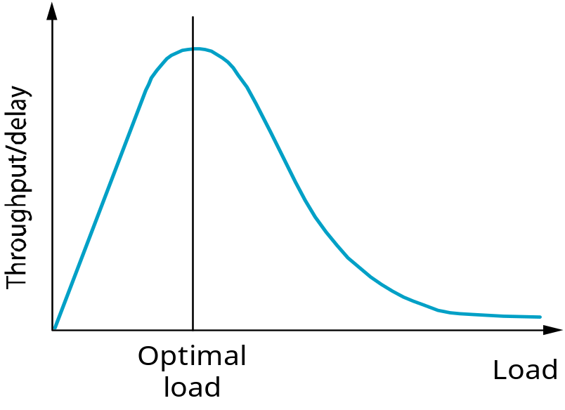
Evaluation
Knowing a resource allocation is good or not
Fairness – all users/flows share the same pain
Maximize “Power of the network” (ratio of throughput to delay)
  Increasing throughput might introduce delays as length of queues at each router can increase with the number of packets in the network
  Thus, “Power of the network” is a good metric for evaluating the Effectiveness of a resource allocation scheme
Too many packets into the network
High buffer delay
Not enough packets into the network
Low throughput
MU CS 4850/7850

Slide 12
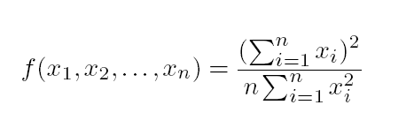
Evaluation
Fairness of a congestion control mechanism (Introduced by Raj Jain)
  Assuming that fair implies equal and that all paths are of equal length
  Given a set of flow throughputs (x₁, x₂, . . . , x_{n}) (measured in consistent units such as bits/second), the following function assigns a fairness index to the flows:
  The Jain’s fairness index always results in a number between 0 and 1, with 1 representing greatest fairness
Q: What is the fairness index when all n flows receive a throughput of 1 unit per second?
Q: What is the fairness index when only k of n flows receive equal throughput, and remaining n – k users receive zero throughput?
MU CS 4850/7850
Notes:
Example 1: if all n flows receive the same throughput, then f = 1
Example 2: if k of the n flows receive equal throughput and the remaining flows receive zero throughput, then f = k/n

Slide 13
Router Buffer Queuing Disciplines
First-In-First-Out (FIFO)
Fair Queuing (FQ)
Weighted Fair Queuing (WFQ)
MU CS 4850/7850
Notes:
Allocating both bandwidth and buffer.

Slide 14
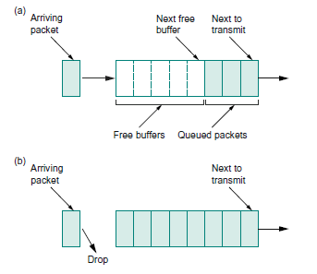
Queuing Discipline: FIFO
First arriving packet is the first that leaves (FCFS)
  If buffer is full the packet is dropped without regard to flow
  Tail drop
FIFO and Tail Drop are 2 separate ideas
  FIFO: scheduling
  Tail Drop: Drop policy
FIFO with tail drop most widely used
  What implications does this have on where
  congestion control happens?
Priority Queuing
  Mark packets with levels of priority
  Transmit high priority packets first
  Problem?
MU CS 4850/7850

Slide 15
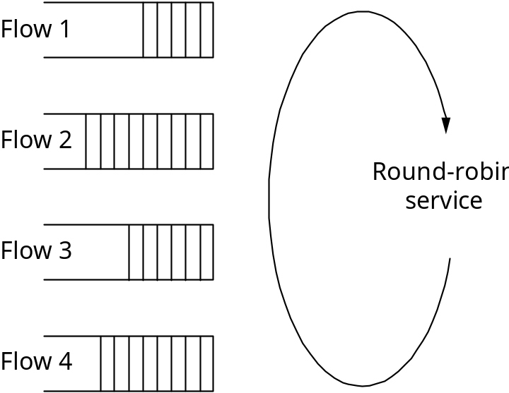
Queuing Discipline: Fair Queuing
Fair Queuing (FQ)
  explicitly segregates traffic based on flows
  ensures no flow captures more than its share of capacity
  variation: weighted fair queuing (WFQ)
Problem?
  Packet length variation
  Needs virtually bit-by-bit round-robin.
MU CS 4850/7850
Notes:
Allocating both bandwidth and buffer.

Slide 16
FQ Algorithm – 1 flow
Suppose clock ticks each time a bit is transmitted
Let P_{i} denote the length of packet i
Let S_{i} denote the time when start to transmit packet i
Let F_{i} denote the time when finish transmitting packet i
F_{i} = S_{i} + P_{i}
When does router start transmitting packet i?
  if arrive before router finished packet i - 1 from this flow, then immediately after last bit of i - 1 (F_{i-1})
  if no current packets for this flow, then start transmitting when arrives (call this A_{i})
Thus: F_{i} = MAX (F_{i - 1}, A_{i}) + P_{i}
MU CS 4850/7850

Slide 17
FQ Algorithm (cont)
For multiple flows
  calculate F_{i} for each packet that arrives on each flow
  treat all F_{i}’s as timestamps
  next packet to transmit is one with lowest timestamp
Not perfect: can’t preempt current packet
FQ is work conserving
Example
Flow 1
Flow 2
Flow 1
Flow 2
Output
(arriving)
(transmitting)
Output
F = 8
F = 10
F = 10
F = 5
F = 2
(a)
(b)
MU CS 4850/7850

Slide 18
Queuing Discipline: WFQ
Assign a weight to each flow denoting how many bits to transmit each round
Could assign weights based on class of packets
Router would need to learn how to assign weights
  Manual configuration
  Signalling (resembles a reservation based system)
MU CS 4850/7850

Slide 19
TCP Congestion Control
TCP congestion control was introduced into the Internet in the late 1980s by Van Jacobson, roughly eight years after the TCP/IP protocol stack had become operational.
Immediately preceding this time, the Internet was suffering from congestion collapse
  hosts would send their packets into the Internet as fast as the advertised window would allow, congestion would occur at some router (causing packets to be dropped), and the hosts would time out and retransmit their packets, resulting in even more congestion
MU CS 4850/7850

Slide 20
TCP Congestion Control
Idea
  assumes best-effort network (FIFO or FQ routers), each source determines network capacity for itself
  uses implicit feedback
  ACKs pace transmission (self-clocking)
Challenge
  determining the available capacity in the first place
  adjusting to changes in the available capacity
MU CS 4850/7850

Slide 21
Additive Increase/Multiplicative Decrease (AIMD)
Objective: adjust to changes in the available capacity
New state variable per connection: CongestionWindow
  limits how much data source has in transit
  MaxWin = MIN(CongestionWindow, AdvertisedWindow)
  EffWin = MaxWin - (LastByteSent - LastByteAcked)
Idea:
  increase CongestionWindow when congestion goes down
  decrease CongestionWindow when congestion goes up
MU CS 4850/7850

Slide 22
AIMD (cont)
Question: how does the source determine whether or not the network is congested?
Answer: a timeout occurs
  timeout signals that a packet was lost
  packets are seldom lost due to transmission error
  lost packet implies congestion
MU CS 4850/7850

Slide 23
AIMD (cont)
Source
Destination
Algorithm
  increment CongestionWindow by MSS (= one packet) per RTT of Congestion Window (linear increase)
  divide CongestionWindow by two whenever a timeout occurs (multiplicative decrease)
In practice: increment a little for each ACK
Increment = MSS / (# of packets in Window)
CongestionWindow += Increment
MU CS 4850/7850

Slide 24
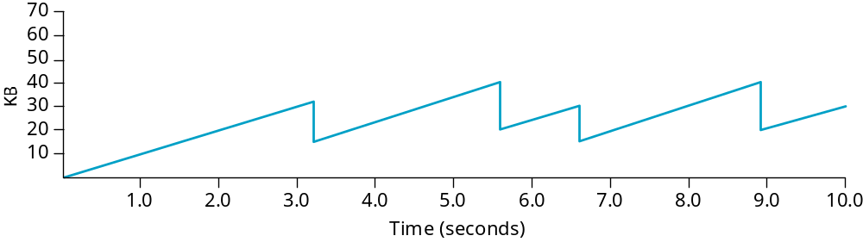
AIMD (cont)
Trace: typical sawtooth behavior
CongestionWindow
MU CS 4850/7850

Slide 25
TCP Congestion Control
Slow Start
  The additive increase mechanism just described is the right approach to use when the source is operating close to the available capacity of the network, but it takes too long to ramp up a connection when it is starting from scratch.
  TCP therefore provides a second mechanism, ironically called slow start, that is used to increase the congestion window rapidly from a cold start.
  Slow start effectively increases the congestion window exponentially, rather than linearly.
MU CS 4850/7850

Slide 26
Slow Start
Source
Destination
Objective: determine the available capacity in the first place
Idea:
  begin with CongestionWindow = 1 packet
  double CongestionWindow each RTT (increment by 1 packet for each ACK)
MU CS 4850/7850

Slide 27
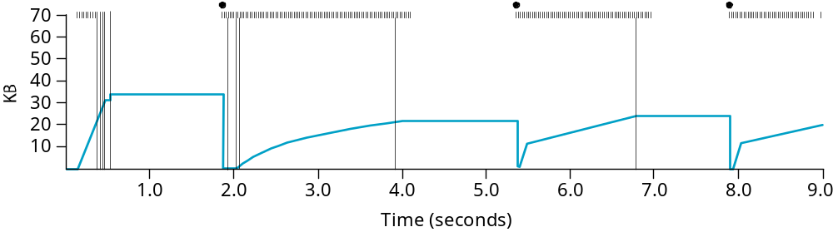
Slow Start (cont)
Exponential growth, but slower than all at once
Used…
  when first starting connection
  when connection goes dead waiting for timeout;
  after timeout: slow start to last CW/2, then additive increase
Trace
Problem: lose up to half a CongestionWindow’s worth of data
CongestionThreshold:
half the last successful
CongestionWindow
MU CS 4850/7850
Notes:
Solid bullets at top: timeouts
Hash marks at top: time when each packet is transmitted.
Vertical bars: time when a packet that was eventually retransmitted was first transmitted.

Slide 28
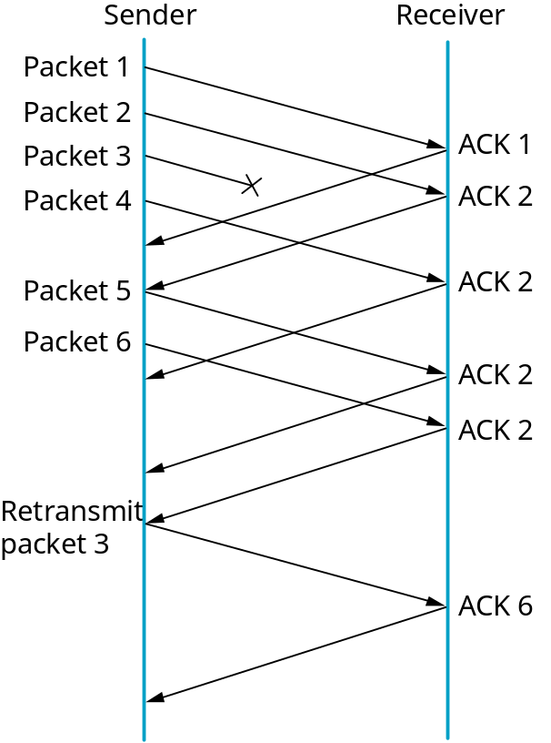
Fast Retransmit and Fast Recovery
Problem: coarse-grain TCP timeouts lead to idle periods
Fast retransmit: use duplicate ACKs to trigger retransmission
  Recall one ACK segment per arriving data packet in TCP
  3 duplicate ACKs trigger retransmission
  Eliminate about half of timeouts->20% throughput improvement
MU CS 4850/7850
Notes:
Sometimes may not have enough (3) ACKs to trigger fast retransmission

Slide 29
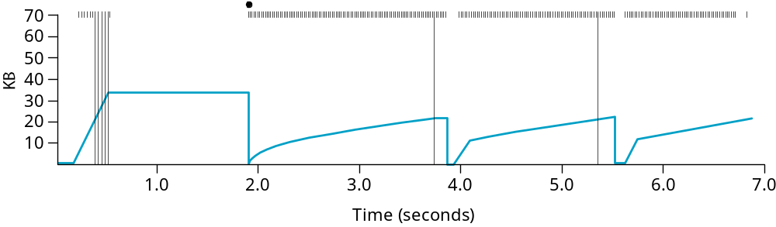
Results
Fast retransmission
Previous
Fast recovery (not shown above)
  skip the slow start phase
  go directly to half the last successful CongestionWindow
MU CS 4850/7850

Slide 30
Congestion Avoidance
TCP’s strategy
  control congestion once it happens
  repeatedly increase load in an effort to find the point at which congestion occurs, and then back off
Alternative strategy (not yet widely adopted)
  predict when congestion is about to happen
  reduce rate before packets start being discarded
  call this congestion avoidance, instead of congestion control
Two possibilities
  router-centric: DECbit and RED Gateways
  host-centric: TCP Vegas
MU CS 4850/7850

Slide 31
Congestion Avoidance
Two possibilities
  router-centric: DECbit and RED Gateways
  host-centric: TCP Vegas
MU CS 4850/7850

Slide 32
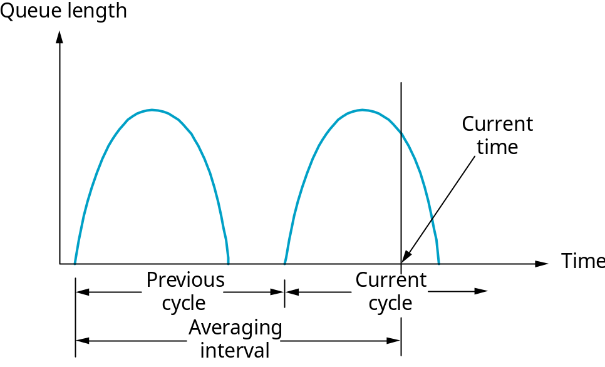
DECbit
Add binary congestion bit to each packet header
Router
  monitors average queue length over last busy+idle cycle, plus current busy cycle
  set congestion bit if average queue length > 1
  attempts to balance throughout against delay
MU CS 4850/7850
Notes:
DECbit?

Slide 33
End Hosts
Destination echoes bit back to source
Source records how many packets resulted in set bit
If less than 50% of last window’s worth had bit set
  increase CongestionWindow by 1 packet
If 50% or more of last window’s worth had bit set
  decrease CongestionWindow to 0.875 of previous value
MU CS 4850/7850
Notes:
Why 0.875? By observation

Slide 34
Random Early Detection (RED)
Notification is implicit
  just drop the packet (TCP will timeout)
  could make explicit by marking the packet
Early random drop
  rather than wait for queue to become full, drop each arriving packet with some drop probability whenever the queue length exceeds some drop level
MU CS 4850/7850
Notes:
ECN: explicit congestion notification

Slide 35
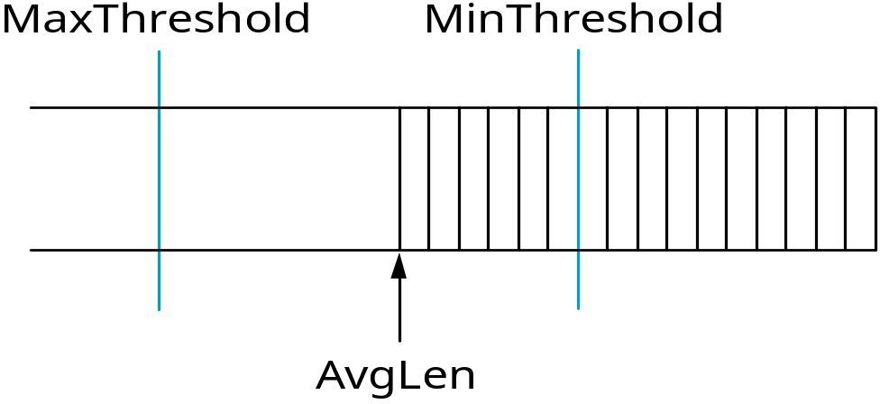
RED Details
Compute average queue length
  AvgLen = (1 - Weight) * AvgLen +
  Weight * SampleLen
    0 < Weight < 1 (usually 0.002)
    SampleLen is queue length each time a packet arrives
Captures long-term congestion; filters out short-term bursts
drop all packets
drop packets with
probability p
MU CS 4850/7850

Slide 36
RED Details (cont)
Two queue length thresholds
  if AvgLen <= MinThreshold then
  enqueue the packet
  if MinThreshold < AvgLen < MaxThreshold then
  calculate probability P
  drop arriving packet with probability P
  if MaxThreshold <= AvgLen then
  drop arriving packet
MU CS 4850/7850

Slide 37
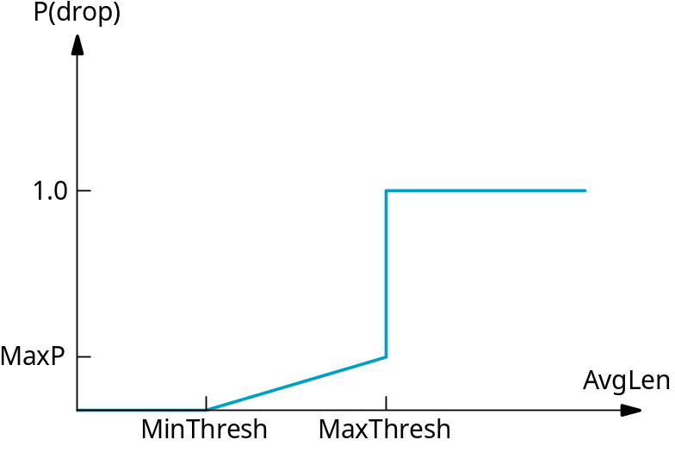
RED Details (cont)
Computing probability P
    TempP = MaxP * (AvgLen - MinThreshold)/ (MaxThreshold - MinThreshold)
    P = TempP/(1 - count * TempP)
    Count: # of newly arriving packets that have been queued.
Drop Probability Curve (TempP)
TempP
MU CS 4850/7850

Slide 38
Tuning RED
Probability of dropping a particular flow’s packet(s) is roughly proportional to the share of the bandwidth that flow is currently getting -> fairness
MaxP is typically set to 0.02, meaning that when the average queue size is halfway between the two thresholds, the gateway drops roughly one out of 100 packets.
If traffic is bursty, then MinThreshold should be sufficiently large to allow link utilization to be maintained at an acceptably high level
Difference between two thresholds should be larger than the typical increase in the calculated average queue length in one RTT; setting MaxThreshold to twice MinThreshold is reasonable for traffic on today’s Internet
Penalty Box for Offenders
  Drop packets from flows that do not adhere to congestion control
MU CS 4850/7850
Notes:
Need additional enforcement mechanism

Slide 39
Congestion Avoidance
Two possibilities
  router-centric: DECbit and RED Gateways
  host-centric: TCP Vegas
MU CS 4850/7850

Slide 40
Congestion Avoidance
Host-centric
  Observe increase in RTT for each successive packet
  Observe flattening of the sending rate
  Compare measured throughput to expected throughput
    TCP Vegas
MU CS 4850/7850

Slide 41
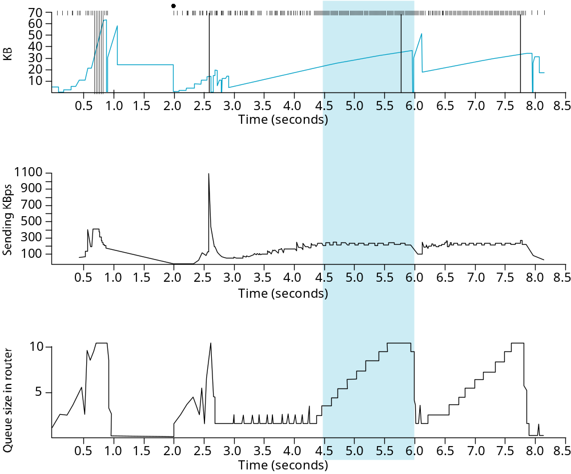
TCP Vegas
Idea: source watches for some sign that router’s queue is building up and congestion will happen too; e.g.,
  RTT grows but throughput flattens (pump more data into network but don’t get them through -> packets stuck in router buffers)
Congestion window
size
Throughput rate
Queue length
MU CS 4850/7850
Notes:
Ack-based transmission

Slide 42
Algorithm
Let BaseRTT be the minimum of all measured RTTs (commonly the RTT of the first packet)
If not overflowing the connection, then
ExpectRate = CongestionWindow/BaseRTT
Source calculates sending rate (ActualRate) once per RTT
Source compares ActualRate with ExpectRate
Diff = ExpectedRate – ActualRate >=0
if Diff < α
increase CongestionWindow linearly
else if Diff > β
decrease CongestionWindow linearly
else
leave CongestionWindow unchanged
Diff = extra bytes in network
  Diff too high: congestion possible
  Diff too low: bandwidth not fully utilized
MU CS 4850/7850

Slide 43
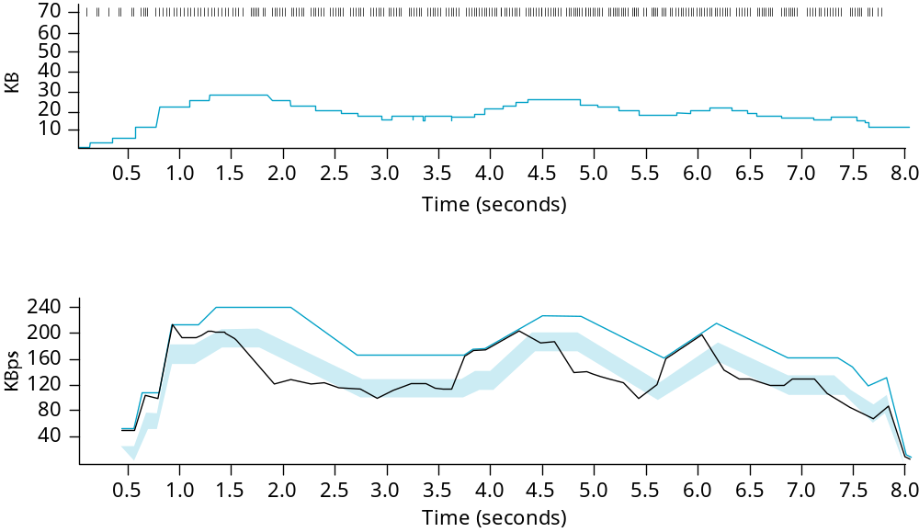
Algorithm (cont)
Parameters
  α = 1 packet
  β = 3 packets
Goal: keep Actual Rate between the two thresholds (within the shaded region)
Expected Rate
ActualRate
MU CS 4850/7850
Notes:
Even faster retransmit?

Slide 44
Summary
We have discussed different resource allocation mechanisms
We have discussed different queuing mechanisms
We have discussed TCP Congestion Control mechanisms
We have discussed Congestion Avoidance mechanisms
MU CS 4850/7850

