Slide 1
Application Layer
Slides adapted from Kurose and Ross
FTP
HTTP
NV
TFTP
Reading:
Chapter 9: 9.1, 9.4
TCP
UDP
IP
NET
NET
■ ■ ■
NET
1
2
n

Slide 2
Our Goals
Conceptual aspect of network application protocols
  transport-layer service models
  client-server paradigm
  peer-to-peer paradigm
learn about protocols by examining popular application-level protocols
  HTTP
  DNS

Slide 3
Outline
Content distribution
  Network Web caching
  Content distribution networks
  P2P file sharing
  Overlay Networks
Principles of app layer protocols
  clients and servers
Web and HTTP
DNS

Slide 4
Network applications: some jargon
Process: program running within a host.
within same host, two processes communicate using interprocess communication (defined by OS).
processes running in different hosts communicate with an application-layer protocol
user agent: interfaces with user “above” and network “below”.
implements user interface & application-level protocol
  Web: browser
  E-mail: mail reader
  streaming audio/video: media player

Slide 5





Applications and application-layer protocols
Application: communicating, distributed processes
  e.g., e-mail, Web, P2P file sharing, instant messaging
  running in end systems (hosts)
  exchange messages to implement application
Application-layer protocols
  one “piece” of an app
  define messages exchanged by apps and actions taken
  use communication services provided by lower layer protocols (TCP, UDP)
application
transport
network
data link
physical
application
transport
network
data link
physical
application
transport
network
data link
physical

Slide 6
App-layer protocol defines
Types of messages exchanged, eg, request & response messages
Syntax of message types: what fields in messages & how fields are delineated
Semantics of the fields, ie, meaning of information in fields
Rules for when and how processes send & respond to messages
Public-domain protocols:
defined in RFCs
allows for interoperability
eg, HTTP, SMTP
Proprietary protocols:
eg, KaZaA
Notes:
KaZaA: file sharing protocol

Slide 7
Client-server paradigm
Typical network app has two pieces: client and server
application
transport
network
data link
physical
Client:
initiates contact with server (“speaks first”)
typically requests service from server,
Web: client implemented in browser; e-mail: in mail reader
request
reply
application
transport
network
data link
physical
Server:
provides requested service to client
e.g., Web server sends requested Web page, mail server delivers e-mail

Slide 8
Internet apps: application, transport protocols
Application
layer protocol
SMTP [RFC 2821]
Telnet [RFC 854]
HTTP [RFC 2616]
FTP [RFC 959]
RTSP, or proprietary
(e.g. RealNetworks)
proprietary
(e.g., Skype, Dialpad)
Underlying
transport protocol
TCP
TCP
TCP
TCP
RTP/TCP/UDP
typically UDP
Application
e-mail
remote terminal access
Web
file transfer
streaming multimedia
Internet telephony

Slide 9
Outline
Content distribution
  Network Web caching
  Content distribution networks
  P2P file sharing
  Overlay Networks
Principles of app layer protocols
  clients and servers
Web and HTTP
DNS

Slide 10
Web and HTTP
First some jargon
HTTP: Hypertext Transfer Protocol
HTML: Hypertext Markup Language
Web page consists of objects
Object can be HTML file, JPEG image, Java applet, audio file,…
Web page consists of base HTML-file which includes several referenced objects
Each object is addressable by a URL
Example URL:
www.someschool.edu/someDept/pic.gif
host name
path name

Slide 11
HTTP overview (continued)
Uses TCP:
client initiates TCP connection (creates socket) to server, port 80
server accepts TCP connection from client
HTTP messages (application-layer protocol messages) exchanged between browser (HTTP client) and Web server (HTTP server)
TCP connection closed
HTTP is “stateless”
server maintains no information about past client requests
aside
Protocols that maintain “state” are complex!
past history (state) must be maintained
if server/client crashes, their views of “state” may be inconsistent, must be reconciled

Slide 12
HTTP connections
Nonpersistent HTTP
At most one object is sent over a TCP connection.
HTTP/1.0 uses nonpersistent HTTP
Persistent HTTP
Multiple objects can be sent over single TCP connection between client and server.
HTTP/1.1 uses persistent connections in default mode

Slide 13
Nonpersistent HTTP
(contains text,
references to 10
jpeg images)
Suppose user enters URL www.someSchool.edu/someDepartment/home.index
1a. HTTP client initiates TCP connection to HTTP server (process) at www.someSchool.edu on port 80
1b. HTTP server at host www.someSchool.edu waiting for TCP connection at port 80. “accepts” connection, notifying client
2. HTTP client sends HTTP request message (containing URL) into TCP connection socket. Message indicates that client wants object someDepartment/home.index
3. HTTP server receives request message, forms response message containing requested object, and sends message into its socket
time

Slide 14
Nonpersistent HTTP (cont.)
4. HTTP server closes TCP connection.
5. HTTP client receives response message containing html file, displays html. Parsing html file, finds 10 referenced jpeg objects
time
6. Steps 1-5 repeated for each of 10 jpeg objects

Slide 15
Response time modeling
Response time:
one RTT to initiate TCP connection
one RTT for HTTP request and first few bytes of HTTP response to return
file transmission time
total = 2RTT+transmit time
initiate TCP
connection
RTT
request
file
RTT
time to
transmit
file
file
received
time
time

Slide 16
Persistent HTTP
Nonpersistent HTTP issues:
requires 2 RTTs per object
OS must work and allocate host resources for each TCP connection
but browsers often open parallel TCP connections to fetch referenced objects
Persistent HTTP
server leaves connection open after sending response
subsequent HTTP messages between same client/server are sent over connection
Persistent without pipelining:
client issues new request only when previous response has been received
one RTT for each referenced object
Persistent with pipelining:
default in HTTP/1.1
client sends requests as soon as it encounters a referenced object
as little as one RTT for all the referenced objects

Slide 17
HTTP request message
two types of HTTP messages: request, response
HTTP request message:
  ASCII (human-readable format)
request line
(GET, POST,
HEAD commands)
GET /somedir/page.html HTTP/1.1
Host: www.someschool.edu
User-agent: Mozilla/4.0
Connection: close
Accept-language:fr
(extra carriage return, line feed)
header
lines
Carriage return,
line feed
indicates end
of message

Slide 18
HTTP response message
status line
(protocol
status code
status phrase)
HTTP/1.1 200 OK
Connection close
Date: Thu, 06 Aug 1998 12:00:15 GMT
Server: Apache/1.3.0 (Unix)
Last-Modified: Mon, 22 Jun 1998 …...
Content-Length: 6821
Content-Type: text/html
data data data data data ...
header
lines
data, e.g.,
requested
HTML file

Slide 19
HTTP response status codes
In first line in server->client response message.
A few sample codes:
200 OK
  request succeeded, requested object later in this message
301 Moved Permanently
  requested object moved, new location specified later in this message (Location:)
400 Bad Request
  request message not understood by server
404 Not Found
  requested document not found on this server
505 HTTP Version Not Supported

Slide 20
Conditional GET: client-side caching
client
server
Goal: don’t send object if client has up-to-date cached version
client: specify date of cached copy in HTTP request
  If-modified-since: <date>
server: response contains no object if cached copy is up-to-date:
  HTTP/1.0 304 Not Modified
HTTP request msg
If-modified-since: <date>
object
not
modified
HTTP response
HTTP/1.0
304 Not Modified
HTTP request msg
If-modified-since: <date>
object
modified
HTTP response
HTTP/1.0 200 OK
<data>

Slide 21
Outline
Content distribution
  Network Web caching
  Content distribution networks
  P2P file sharing
  Overlay Networks
Principles of app layer protocols
  clients and servers
Web and HTTP
DNS

Slide 22
Infrastructure Services
There are some protocols that are essential to the smooth running of the Internet, but that don’t fit neatly into the strictly layered model.
One of these is the Domain Name System (DNS)—not an application that users normally invoke explicitly, but rather a service that almost all other applications depend upon.
This is because the name service is used to translate host names into host addresses; the existence of such an application allows the users of other applications to refer to remote hosts by name rather than by address.
Notes:
The University of Adelaide, School of Computer Science
Chapter 2 — Instructions: Language of the Computer

Slide 23
Infrastructure Services
Name Service (DNS)
  While perfectly suited for processing by routers, addresses are not exactly user-friendly.
  It is for this reason that a unique name is also typically assigned to each host in a network.
  Host names differ from host addresses in two important ways.
    First, they are usually of variable length and mnemonic, thereby making them easier for humans to remember.
    Second, names typically contain no information that helps the network locate (route packets toward) the host.
  Need a service that translates Name into IP address -> DNS
Notes:
The University of Adelaide, School of Computer Science
Chapter 2 — Instructions: Language of the Computer

Slide 24
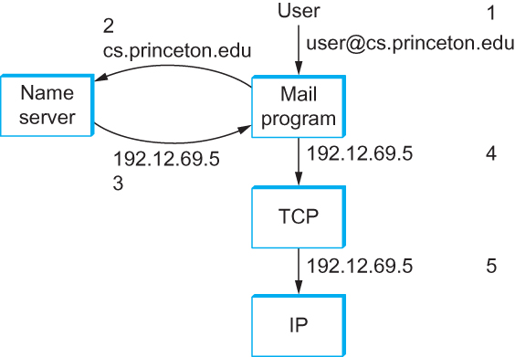
Infrastructure Services
Name Service (DNS)
Names translated into addresses, where the numbers 1–5 show the sequence of steps in the process
Notes:
The University of Adelaide, School of Computer Science
Chapter 2 — Instructions: Language of the Computer

Slide 25
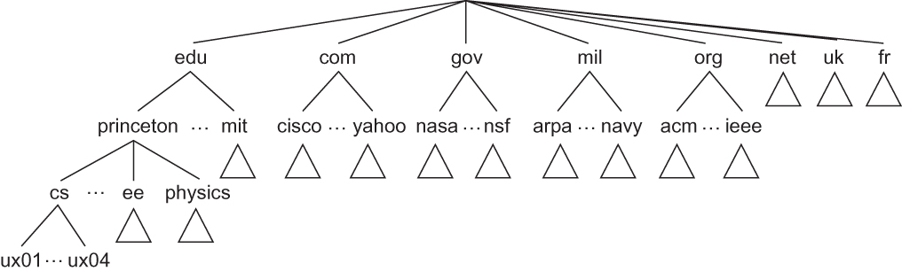
Infrastructure Services
Domain Hierarchy (e.g.,: engineering.missouri.edu)
  DNS implements a hierarchical name space for Internet objects. Unlike Unix file names, which are processed from left to right with the naming components separated with slashes, DNS names are processed from right to left and use periods as the separator.
Example of a domain hierarchy
Notes:
The University of Adelaide, School of Computer Science
Chapter 2 — Instructions: Language of the Computer

Slide 26
Infrastructure Services
Name Servers
The complete domain name hierarchy exists only in the abstract.
  We now turn our attention to the question of how this hierarchy is actually implemented.
  The first step is to partition the hierarchy into subtrees called zones.
  Each zone can be thought of as corresponding to some administrative authority that is responsible for that portion of the hierarchy.
  For example, the top level of the hierarchy forms a zone that is managed by the Internet Corporation for Assigned Names and Numbers (ICANN).
Notes:
The University of Adelaide, School of Computer Science
Chapter 2 — Instructions: Language of the Computer

Slide 27
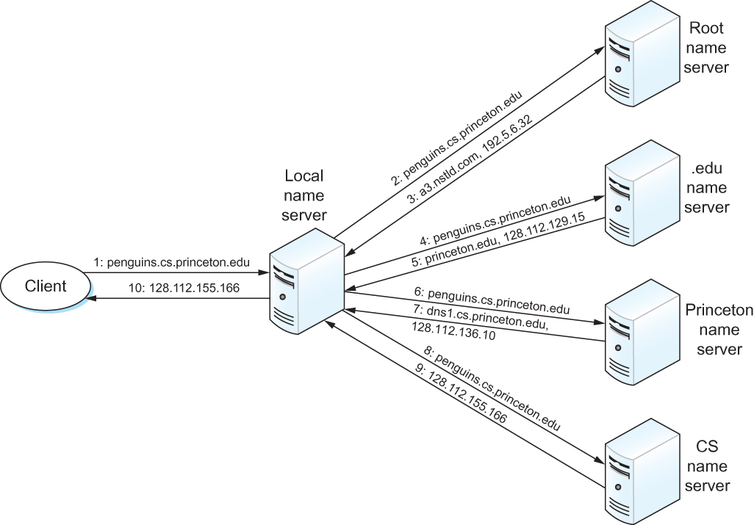
Infrastructure Services
Name Resolution
Name resolution in practice, where the numbers 1–10 show the sequence of steps in the process.
Notes:
The University of Adelaide, School of Computer Science
Chapter 2 — Instructions: Language of the Computer

Slide 28
Outline
Content distribution
  Network Web caching
  Content distribution networks
  P2P file sharing
  Overlay Networks
Principles of app layer protocols
  clients and servers
Web and HTTP
DNS

Slide 29
Web caches (proxy server)
Goal: satisfy client request without involving origin server
user sets browser: Web accesses via cache
browser sends all HTTP requests to cache
  object in cache: cache returns object
  else cache requests object from origin server, then returns object to client
origin
server
Proxy
server
HTTP request
HTTP request
client
HTTP response
HTTP response
HTTP request
HTTP response
client
origin
server

Slide 30
More about Web caching
Cache acts as both client and server
Cache can do up-to-date check using If-modified-since HTTP header
  Issue: should cache take risk and deliver cached object without checking?
  Heuristics are used.
Typically cache is installed by ISP (university, company, residential ISP)
Why Web caching?
Reduce response time for client request.
Reduce traffic on an institution’s access link.
Internet dense with caches enables “poor” content providers to effectively deliver content

Slide 31
Caching example (1)
origin
servers
Assumptions
average object size = 100,000 bits
avg. request rate from institution’s browser to origin serves = 15/sec
delay from institutional router to any origin server and back to router = 2 sec
Consequences
utilization on LAN = 15%
utilization on access link = 100%
total delay = Internet delay + access delay + LAN delay
= 2 sec + minutes + milliseconds
public
Internet
1.5 Mbps
access link
institutional
network
10 Mbps LAN
institutional
cache

Slide 32
Caching example (2)
origin
servers
Possible solution
increase bandwidth of access link to, say, 10 Mbps
Consequences
utilization on LAN = 15%
utilization on access link = 15%
Total delay = Internet delay + access delay + LAN delay
= 2 sec + msecs + msecs
often a costly upgrade
public
Internet
10 Mbps
access link
institutional
network
10 Mbps LAN
institutional
cache

Slide 33
Caching example (3)
origin
servers
Install cache
suppose hit rate is .4
Consequence
40% requests will be satisfied almost immediately
60% requests satisfied by origin server
utilization of access link reduced to 60%, resulting in negligible delays (say 10 msec)
total delay = Internet delay + access delay + LAN delay
= .6*2 sec + .6*.01 secs + milliseconds < 1.3 secs
public
Internet
1.5 Mbps
access link
institutional
network
10 Mbps LAN
institutional
cache

Slide 34
Content distribution networks (CDNs)
origin server
in North America
The content providers are the CDN customers.
Content replication
CDN company installs hundreds of CDN servers throughout Internet
  in lower-tier ISPs, close to users
CDN replicates its customers’ content in CDN servers. When provider updates content, CDN updates servers
CDN distribution node
CDN server
in S. America
CDN server
in Asia
CDN server
in Europe

Slide 35
CDN example
HTTP request for
www.foo.com/sports/sports.html
1
Origin server
2
DNS query for www.cdn.com
CDNs authoritative
DNS server
3
HTTP request for
www.cdn.com/www.foo.com/sports/ruth.gif
Nearby
CDN server
origin server
www.foo.com
distributes HTML
Replaces:
http://www.foo.com/sports.ruth.gif
with http://www.cdn.com/www.foo.com/sports/ruth.gif
CDN company
cdn.com
distributes gif files
uses its authoritative DNS server to route redirect requests

Slide 36
More about CDNs
routing requests
CDN creates a “map”, indicating distances from leaf ISPs and CDN nodes
when query arrives at authoritative DNS server:
  server determines ISP from which query originates
  uses “map” to determine best CDN server
not just Web pages
streaming stored audio/video
streaming real-time audio/video
  CDN nodes create application-layer overlay network

Slide 37
P2P file sharing
Alice chooses one of the peers, Bob.
File is copied from Bob’s PC to Alice’s notebook: HTTP
While Alice downloads, other users uploading from Alice.
Alice’s peer is both a Web client and a transient Web server.
All peers are servers = highly scalable!
Example
Alice runs P2P client application on her notebook computer
Intermittently connects to Internet; gets new IP address for each connection
Asks for “Hey Jude”
Application displays other peers that have copy of Hey Jude.

Slide 38


P2P: centralized directory
original “Napster” design
1) when peer connects, it informs central server:
  IP address
  content
2) Alice queries for “Hey Jude”
3) Alice requests file from Bob
Bob
centralized
directory server
1
peers
1
1
3
2
1
Alice

Slide 39
P2P: problems with centralized directory
Single point of failure
Performance bottleneck
Copyright infringement
file transfer is decentralized, but locating content is highly centralized

Slide 40

P2P: decentralized directory
Each peer is either a group leader or assigned to a group leader.
Group leader tracks the content in all its children.
Peer queries group leader; group leader may query other group leaders.

Slide 41
More about decentralized directory
overlay network
peers are nodes
edges between peers and their group leaders
edges between some pairs of group leaders
virtual neighbors
bootstrap node
connecting peer is either assigned to a group leader or designated as leader
advantages of approach
no centralized directory server
  location service distributed over peers
  more difficult to shut down
disadvantages of approach
bootstrap node needed
group leaders can get overloaded
Notes:
a looped strap sewed at the side or the rear top of a boot to help in pulling it on

Slide 42
P2P: Query flooding
Gnutella
no hierarchy
use bootstrap node to learn about others
join message
Send query to neighbors
Neighbors forward query
If queried peer has object, it sends message back to querying peer
join

Slide 43
P2P: more on query flooding
Pros
peers have similar responsibilities: no group leaders
highly decentralized
no peer maintains directory info
Cons
excessive query traffic
query radius: may not have content when present
bootstrap node
maintenance of overlay network

Slide 44
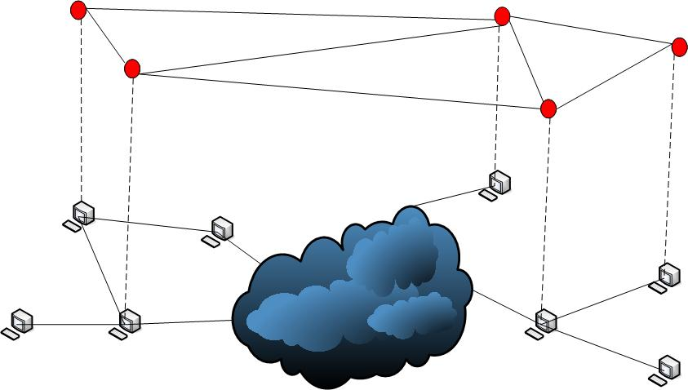
Overlay Networks
Participating node
Participating node
Overlay network
Participating node
IP network
Notes:
Because, sometimes, the Internet doesn't quite work

Slide 45
Overlay Networks
A virtual topology composed of a set of cooperative nodes running the same overlay networking application over conventional IP networks
Relies on existing network infrastructure to support its functions, and does not intend to replace or intervene with the underlying networks operations
Builds another layer of (logical) network on top of the IP networks that may or may not be consistent with the physical network infrastructure
Usually has a simple architecture designed to provide a specific service to a well defined group of users

Slide 46
Potentials of Overlay Networks
Overlay networks have been considered as effective alternative solutions to address some fundamental and challenging networking problems
  Peer-to-peer (P2P) systems
    For file sharing, content distribution, storage
    Napster, Kazaa, BitTorrent
  Resilient routing (MIT’s RON)
  Multicasting
    End system multicast
  Quality of Service (e.g., multipath between two nodes)
  IP Security (e.g. help address DoS attacks, routing attacks)
  IPv6 deployment
  …
Notes:
RON is an architecture that allows a small group of distributed Internet applications to detect and recover from path outages and periods of degraded performance within several seconds, improving over today's wide-area routing protocols that take at least several minutes to recover. optimizing application-specific routing metrics
Differentiated Services (DiffServ)

Slide 47
Attractive Features
Flexibility
  Overlay networks can be constructed on demand and be dissolved after the task completed
  Can support non-standard, user defined functions and service models
Scalability
  Avoid bandwidth bottleneck, incremental growth and self-scaling
Ease of deployment
  Do not require modifications to existing network infrastructure
  Do not require support from ISPs
  Can handle heter. network infrastructure, esp. with legacy systems
An infrastructure for collaboration among hosts
Consistent with Internet design philosophy – simple best effort architecture
  Let application layer handle more complex tasks

Slide 48
Disadvantages
May incur extra traffic overhead and end-to-end latency when establishing and maintaining the overlay system
May appear to be less efficient than similar functions implemented at the network layer
  E.g., IP Multicast vs. End System Multicast
Require every participating node to support certain networking functions and other high level functionalities
  e.g., each node may have to relay data packets for other nodes
  transcoding

