Slide 1
Routing
Slides adapted from Larry Peterson and Rose
Outline
  Algorithms
  Distance Vector (RIP)
  Link State (OSPF)
  Interdomain (BGP)
  IPv6
Reading:
Chapter 3: 3.4
Chapter 4: 4.1
FTP
HTTP
NV
TFTP
TCP
UDP
IP
NET
NET
■ ■ ■
NET
1
2
n
MU CS 4850/7850

Slide 2
Routing
Slides adapted from Larry Peterson and Rose
Outline
  Algorithms
  Distance Vector (RIP)
  Link State (OSPF)
  Interdomain (BGP)
  IPv6
FTP
HTTP
NV
TFTP
TCP
UDP
IP
NET
NET
■ ■ ■
NET
1
2
n
MU CS 4850/7850

Slide 3
The Internet Network layer
Host, router network layer functions:
Transport layer: TCP, UDP
Routing protocols
path selection
RIP, OSPF, BGP
IP protocol
addressing conventions
datagram format
packet handling conventions
Network
layer
forwarding
table
ICMP protocol
error reporting
router “signaling”
Link layer
physical layer
MU CS 4850/7850

Slide 4
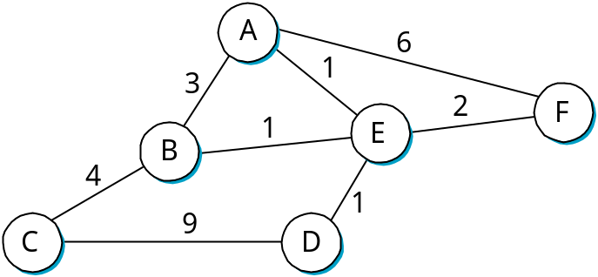
Overview
Forwarding vs Routing
  forwarding: to select an output port based on destination address and routing table
  routing: process by which routing table is built
Network as a Graph
Problem: Find lowest cost path between two nodes
Factors
  static: topology
  dynamic: load
Need a distributed and dynamic protocol
MU CS 4850/7850

Slide 5
Routing Algorithm Classification
Global or decentralized information?
Global:
all routers have complete topology, link cost info
“link state” algorithms
OSPF
Send neighbor info to all nodes
Decentralized:
router knows physically-connected neighbors, link costs to neighbors
iterative process of computation, exchange of info with neighbors
“distance vector” algorithms
RIP
Send whole routing table to neighbor nodes
Static or dynamic?
Static:
routes change slowly over time
Dynamic:
routes change more quickly
  periodic update
  in response to link cost changes
MU CS 4850/7850

Slide 6
Routing
Slides adapted from Larry Peterson and Rose
Outline
  Algorithms
  Distance Vector (RIP)
  Link State (OSPF)
  Interdomain (BGP)
  IPv6
FTP
HTTP
NV
TFTP
TCP
UDP
IP
NET
NET
■ ■ ■
NET
1
2
n
MU CS 4850/7850

Slide 7
Distance Vector Routing Algorithm
(decentralized approach)
Each node maintains a set of triples
  (Destination, Cost, NextHop)
Directly connected neighbors exchange updates
  periodically (on the order of several seconds)
  whenever table changes (called triggered update)
Each update is a list of pairs:
  (Destination, Cost)
Update local table if receive a “better” route
  smaller cost
  came from next-hop
Refresh existing routes; delete if they time out
MU CS 4850/7850

Slide 8
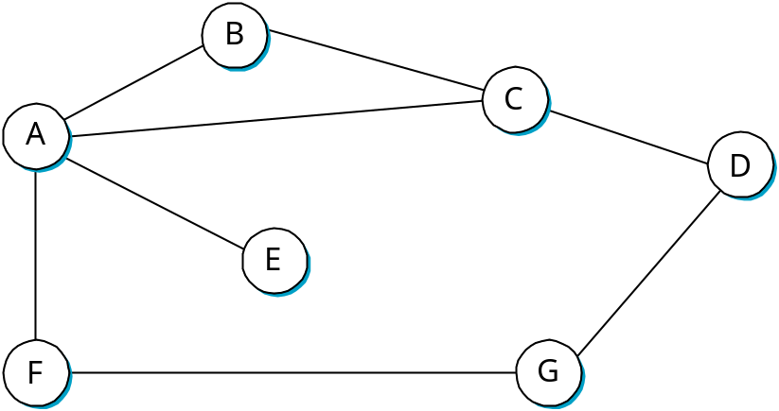
Example
Destination Cost NextHop
A 1 A
C 1 C
D ∞ −
E ∞ −
F ∞ −
G ∞ −
Destination Cost NextHop
A 1 A
C 1 C
D 2 C
E 2 A
F 2 A
G 3 A
Node B’ Initial Table
Node B’ Final Table
MU CS 4850/7850

Slide 9
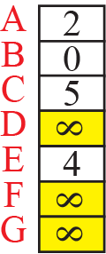
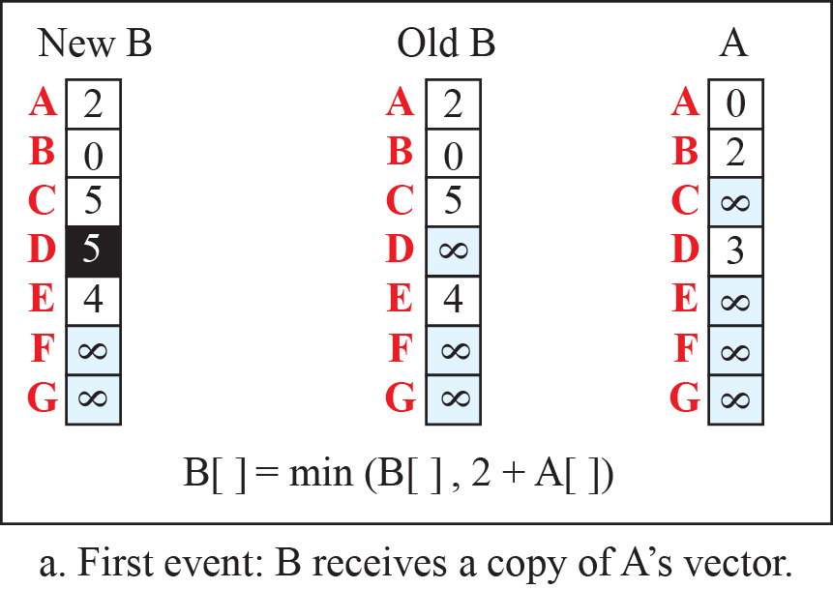
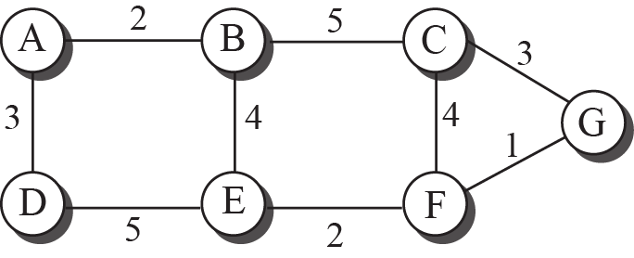
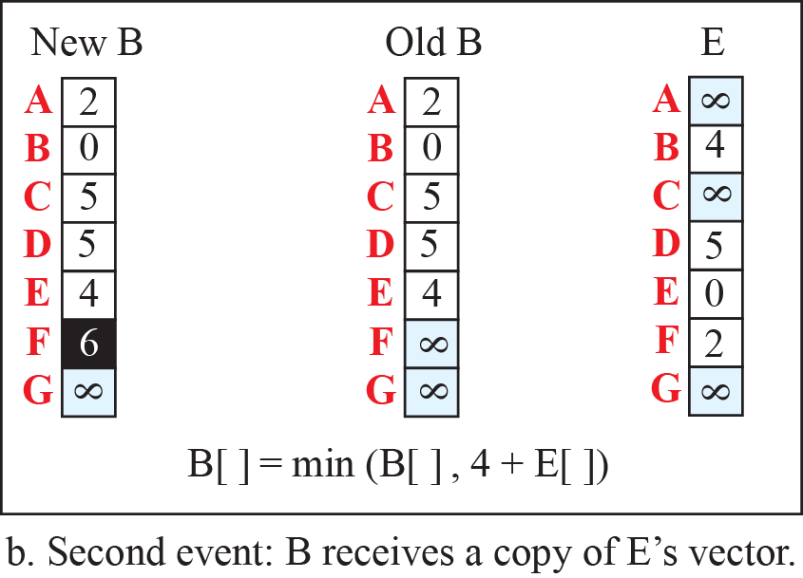
Distance Vector Example
Spring 2016
CMP_SC 4850/7850

Slide 10
Routing Loops
Example 1 (alternate route in case of failure)
  F detects that link to G has failed
  F sets distance to G to infinity and sends update t o A
  A sets distance to G to infinity since it uses F to reach G
  A receives periodic update from C with 2-hop path to G
  A sets distance to G to 3 and sends update to F
  F decides it can reach G in 4 hops via A
Example 2 (count to infinite problem)
  link from A to E fails
  A advertises distance of infinity to E
  B and C advertise a distance of 2 to E
  B decides it can reach E in 3 hops; advertises this to A
  A decides it can read E in 4 hops; advertises this to C
  C decides that it can reach E in 5 hops…
MU CS 4850/7850

Slide 11
Loop-Breaking Heuristics
(Partial Solutions)
Set infinity to 16
Split horizon
  Don’t send routes learned from each neighbor back to that neighbor
  Only works for routing loops involving two nodes
Split horizon with poison reverse
  B actually sends the route back to neighbor A, but put negative information in the route to make sure A will not eventually use B to get to target node.
  Only works for routing loops involving two nodes
Other measures for larger routing loops
  Delays convergence of protocol
MU CS 4850/7850
Notes:
Split horizon? Not send routes learn from neighbor to that neighbor.

Slide 12
Routing
Slides adapted from Larry Peterson and Rose
Outline
  Algorithms
  Distance Vector (RIP)
  Link State (OSPF)
  Interdomain (BGP)
  IPv6
FTP
HTTP
NV
TFTP
TCP
UDP
IP
NET
NET
■ ■ ■
NET
1
2
n
MU CS 4850/7850

Slide 13
Link State Routing Algorithm
Strategy
  send to all nodes (not just neighbors) information about directly connected links (not entire routing table)
Link State Packet (LSP)
  id of the node that created the LSP
  cost of link to each directly connected neighbor
  sequence number (SEQNO)
  time-to-live (TTL) for this packet
MU CS 4850/7850

Slide 14
Link State (cont)
Reliable flooding
  store most recent LSP from each node
  forward LSP to all nodes but one that sent it
  generate new LSP periodically
    increment SEQNO
  start SEQNO at 0 when reboot
  decrement TTL of each stored LSP
    discard when TTL=0
MU CS 4850/7850

Slide 15
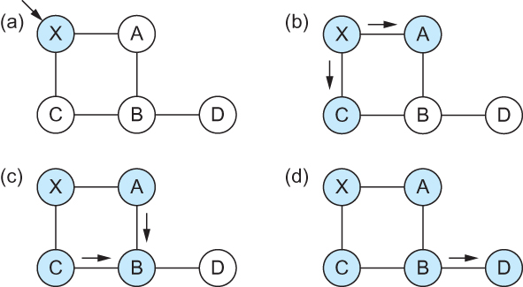
Link State (cont)
Reliable Flooding
Flooding of link-state packets. (a) LSP arrives at node X; (b) X floods LSP to A and C; (c) A and C flood LSP to B (but not X); (d) flooding is complete
MU CS 4850/7850
Notes:
The University of Adelaide, School of Computer Science
Chapter 2 — Instructions: Language of the Computer

Slide 16
Shortest path - Dijkstra's algorithm
Spring 2016
CMP_SC 4850/7850
Dijkstra's algorithm - is a solution to the single-source shortest path problem in Link State Routing.
Works on both directed and undirected graphs. However, all edges must have nonnegative weights.
Approach: Greedy
Input: Weighted graph G={E,V} and source vertex v∈V, such that all edge weights are nonnegative
Output: Lengths of shortest paths (or the shortest paths themselves) from a given source vertex v∈V to all other vertices

Slide 17
Dijkstra’s Algorithm
Spring 2016
CMP_SC 4850/7850
dist[s] ←0 (distance to source vertex is zero)
for all v ∈ V–{s}
do dist[v] ←∞ (set all other distances to infinity)
S←∅ (S, the set of visited vertices is initially empty)
Q←V (Q, the queue initially contains all vertices)
while Q ≠∅ (while the queue is not empty)
do u ← mindistance(Q,dist) (select the element of Q with the min. distance)
S←S∪{u} (add u to list of visited vertices)
for all v ∈ neighbors[u]
do if dist[v] > dist[u] + w(u, v) (if new shortest path found)
then d[v] ←d[u] + w(u, v) (set new value of shortest path)
return dist

Slide 18
Dijkstra’s Forward Search Algorithm
Spring 2016
CMP_SC 4850/7850
Modified version of Dijkstra’s algorithm that builds routes directly from LSPs
  Doesn’t require creation of graph from LSPs
  Maintains two lists, Tentative and Confirmed
    Each list has entries (Dest, Cost, NextHop)
Algorithm
1. Initialize Confirmed with entry for current node (S, 0, -)
2. For node just added, Next, select its LSP
3. For each neighbor N of Next, cost(s,N) = cost(s,Next) + cost(Next,N)
1. If N not in Confirmed or Tentative, add (N, Cost, NextHop) to
Tentative
2. If N in Tentative and cost<current cost, replace with new entry
4. If Tentative empty, stop. Otherwise, pick Tentative entry with least cost, move to Confirmed, select as Next, and go to 2

Slide 19
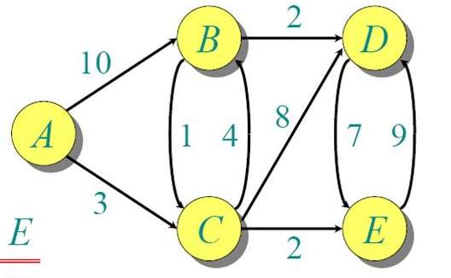
Dijkstra Forward Search
Spring 2016
 | Confirmed | Tentative

Slide 20
Popular Interior Gateway Protocols
Spring 2016
CMP_SC 4850/7850
RIP: Route Information Protocol
  distributed with Unix
  distance-vector algorithm
  based on hop-count
OSPF: Open Shortest Path First
  recent Internet standard
  uses link-state algorithm
  supports load balancing
  supports authentication of routing messages

Slide 21
Routing
Slides adapted from Larry Peterson and Rose
Outline
  Algorithms
  Distance Vector (RIP)
  Link State (OSPF)
  Interdomain (BGP)
  IPv6
FTP
HTTP
NV
TFTP
TCP
UDP
IP
NET
NET
■ ■ ■
NET
1
2
n
MU CS 4850/7850

Slide 22
Route Propagation
Know a smarter router
  hosts know local router
  local routers know site routers
  site routers know core router
  core routers know everything
Autonomous System (AS)
  corresponds to an administrative domain
  examples: University, company, backbone network
  assign each AS a 16-bit number
Two-level route propagation hierarchy
  interior gateway protocol (each AS selects its own; RIP, OSPF)
  exterior gateway protocol (Internet-wide standard; BGP)
  Border/Gateway Routers connect ASs; run both interior & exterior gateway protocols
MU CS 4850/7850

Slide 23

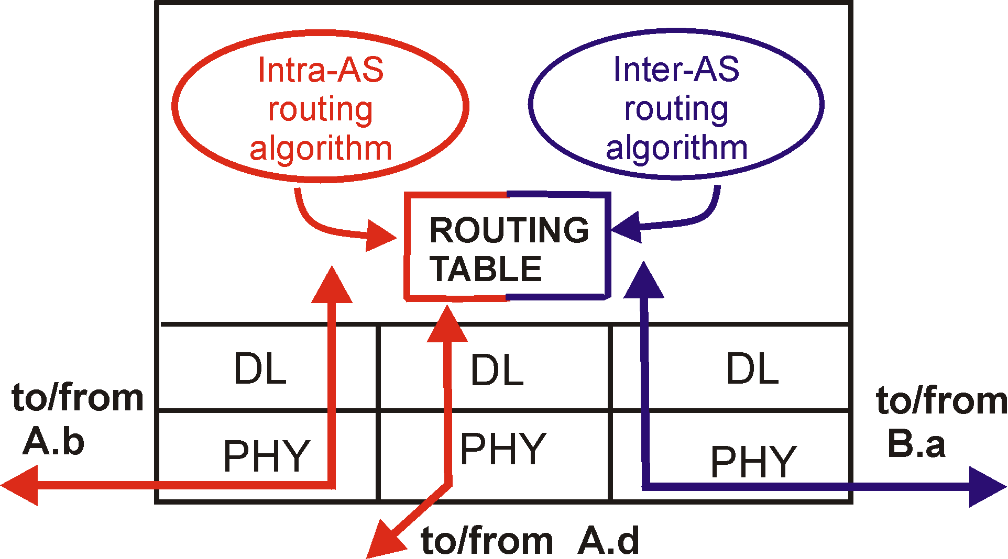
Intra-AS and Inter-AS routing
Inter-AS
routing
between
A and B
C.b
B.a
A.a
Host
h2
b
A.c
c
a
C
a
b
a
B
Host
h1
d
c
Intra-AS routing
within AS B
A
b
Intra-AS routing
within AS A
inter-AS, intra-AS routing in gateway A.c
MU CS 4850/7850

Slide 24
Path-Vector Routing
A key feature of BGP is that it uses a technique known as path-vector routing.
  Neither a distance-vector protocol, such as used by RIP, nor a link-state protocol, such as used by OSPF, is effective for an exterior routing protocol.
Each block of routing information lists all of the ASs visited in order to reach the destination network by this route (to avoid routing loops).
Notes:
12

Slide 25
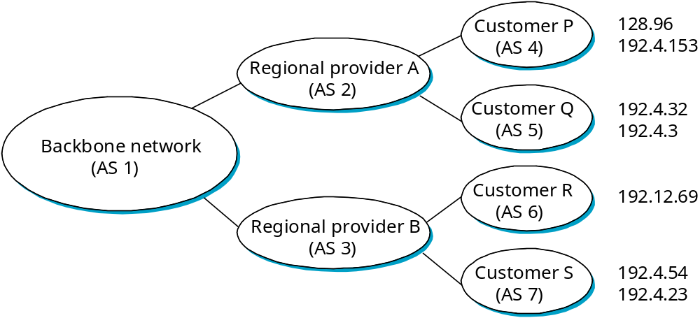
BGP Example
Speaker for AS2 advertises reachability to P and Q
  network 128.96, 192.4.153, 192.4.32, and 192.4.3, can be reached directly from AS2
Speaker for backbone advertises
  networks 128.96, 192.4.153, 192.4.32, and 192.4.3 can be reached along the path (AS1, AS2).
Speaker can cancel previously advertised paths
MU CS 4850/7850

Slide 26
Routing
Slides adapted from Larry Peterson and Rose
Outline
  Algorithms
  Distance Vector (RIP)
  Link State (OSPF)
  Interdomain (BGP)
  IPv6
FTP
HTTP
NV
TFTP
TCP
UDP
IP
NET
NET
■ ■ ■
NET
1
2
n
MU CS 4850/7850

Slide 27
IP Version 6
Features
  128-bit addresses (classless): e.g., 47CD:1234:4422:AC02:0022:1234:A456:0124
  multicast
  real-time service (QoS)
  authentication and security
  autoconfiguration (plug-and-play)
  end-to-end fragmentation
  protocol extensions， e.g., support for mobile hosts
Header
  40-byte “base” header
  extension headers (fixed order, mostly fixed length)
    fragmentation
    source routing
    authentication and security
    other options
MU CS 4850/7850

Slide 28
IPv6 Provider-based Unicast Address
3
m
n
o
p
125
-
m
-
n
-
o
-
p
010
RegistryID
ProviderID
SubscriberID
SubnetID
InterfaceID
Address aggregation
Assign an address prefix to a direct provider and then for that direct provider to assign longer prefixes that begin with that prefix to its subscribers
E.g, RegistryID for continental address registry
MU CS 4850/7850

Slide 29
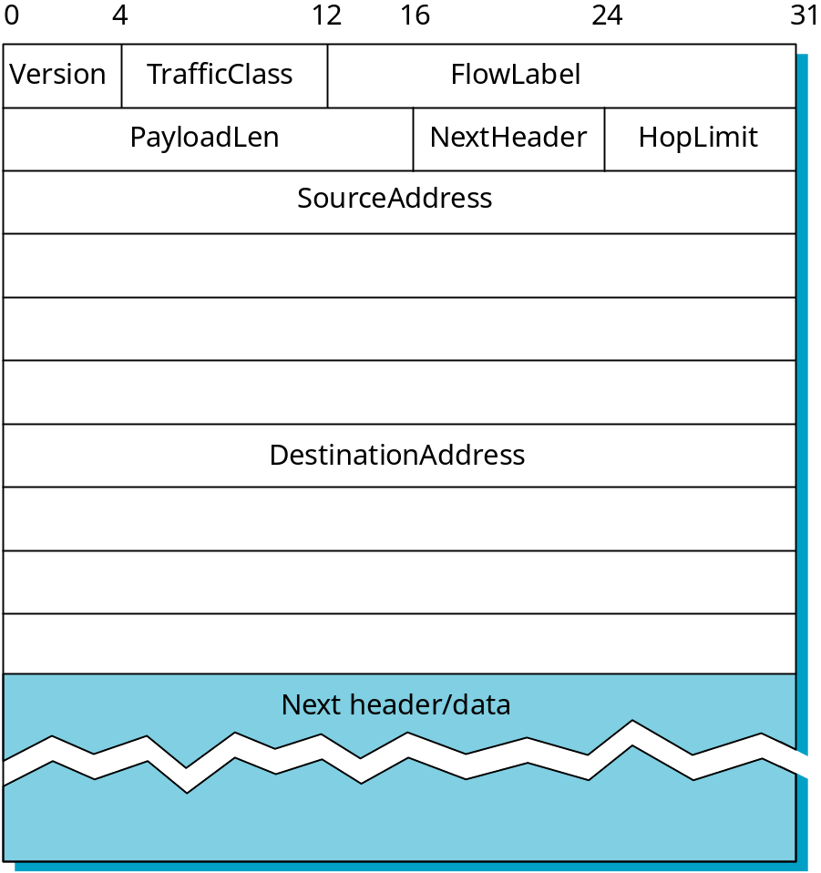
IPv6 Packet Header
MU CS 4850/7850

Slide 30
Dual Stack Approach
IPv4 to IPv6 transition: Dual-stack vs. tunneling
A
B
C
D
E
F
IPv6
IPv6
IPv4
IPv4
IPv6
IPv6
Flow: X
Src: A
Dest: F
data
Src:A
Dest: F
data
Src:A
Dest: F
data
Flow: ??
Src: A
Dest: F
data
A-to-B:
IPv6
B-to-C:
IPv4
B-to-C:
IPv4
B-to-C:
IPv6
Adapted from Kurose & Rose
MU CS 4850/7850
Notes:
With appropriate address mapping (IPV6 to V4 or vise versa) at node B and E.

Slide 31
Tunneling
A
B
E
F
Logical view:
tunnel
IPv6
IPv6
IPv6
IPv6
A
B
C
D
E
F
Physical view:
IPv6
IPv6
IPv4
IPv4
IPv6
IPv6
Flow: X
Src: A
Dest: F
data
Src:B
Dest: E
Src:B
Dest: E
Flow: X
Src: A
Dest: F
data
Flow: X
Src: A
Dest: F
data
Flow: X
Src: A
Dest: F
data
A-to-B:
IPv6
B-to-C:
IPv6 inside
IPv4
B-to-C:
IPv6 inside
IPv4
E-to-F:
IPv6
Adapted from Kurose & Rose
MU CS 4850/7850

Slide 32
Routing
Slides adapted from Larry Peterson and Rose
Summary
  Algorithms
  Distance Vector (RIP)
  Link State (OSPF)
  Interdomain (BGP)
  IPV6
FTP
HTTP
NV
TFTP
TCP
UDP
IP
NET
NET
■ ■ ■
NET
1
2
n
MU CS 4850/7850

