Slide 1


COMPANY PROFILE
PT. PLAKOIN TECHNOLOGY INDONESIA
Accuracy, Innovation, Customer - oriented, Long-term relationship

Slide 2



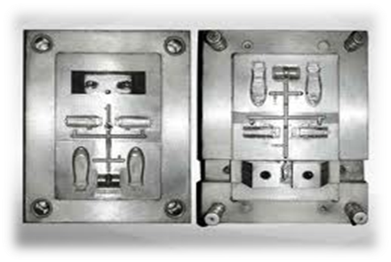

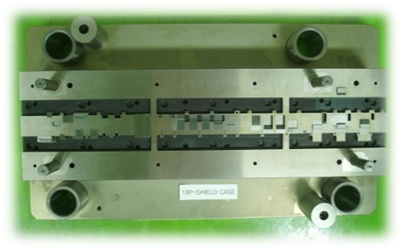

INTRODUCE
PT. PLAKOIN TECHNOLOGY INDONESIA
Foundation an office and factory
Date: November 2019( Indonesia )
Address : Jl. Jababeka III G Blok C17 BS,
Kawasan Industri Jababeka
Desa Pasir Gombong – Cikarang Utara
Bekasi
Main Products:
Standard parts ( mold part and stamping part)
Precision Mold, Dies, Casting spare Part
Injection Mold & Die Stamping Maker
Plastic Injection
Accuracy, Innovation, Customer - oriented, Long-term relationship

Slide 3

STRUCTURE ORGANIZATION
DIRECTOR
COMMISSARI
HRD & HEAD
MARKETING
SUPERVISOR
PRODUKSI
PURCHASING
ACCOUNTING
DESIGN
PPIC
LEADER
PRODUKSI
INJECTION
GRINDING
WIRE CUT
EDM
CNC
MILLING
ASSY
QUALITY
CONTROL
Accuracy, Innovation, Customer - oriented, Long-term relationship

Slide 4

SAMPLE PRODUCT
Spare part
Press mold
Die casting
Spare part
Injection mold
Spare part
Accuracy, Innovation, Customer - oriented, Long-term relationship

Slide 5
MACHINE LIST
NO | MACHINE NAME | INDONESIA | KOREA
 |  | UNIT | UNIT
1 | PROFILE GRINDING M/C | PLAN 2022 | 3 UNIT
2 | CNC MILLING M/C | 2 UNIT | 3 UNIT
3 | WEDM M/C | 2 UNIT | 10 UNIT
4 | EDM M/C | 6 UNIT | 5 UNIT
5 | SURFACE GRINDING M/C | 8 UNIT | 7 UNIT
6 | EXTERNAL GRINDING M/C | 2 UNIT | 5 UNIT
7 | INTERNAL GRINDING M/C | 1 UNIT | 5 UNIT
8 | CNC LATHE M/C | PLAN 2022 | 15 UNIT
9 | LASER MARKING | 1 UNIT | 2 UNIT
10 | SUPERDRILL | 1 UNIT | 2 UNIT
11 | INJECTION PLASTIC M/C | 12 UNIT | 10 UNIT
Accuracy, Innovation, Customer - oriented, Long-term relationship

Slide 6
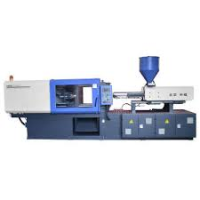
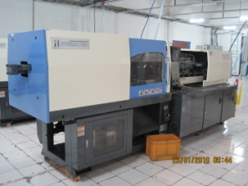
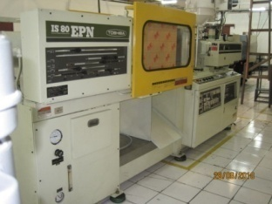
MACHINE INJECTION LIST
NO | MAKER | TONAGE | QTY
1 | SONLY | 160 TON | 1 UNIT
2 | HYUNDAI | 110 TON | 8 UNIT
3 | TOSHIBA | 80 TON | 1 UNIT
4 | JINHWA | 120 TON | 1 UNIT
5 | JINHWA | 85 TON | 1 UNIT
Accuracy, Innovation, Customer - oriented, Long-term relationship

Slide 7
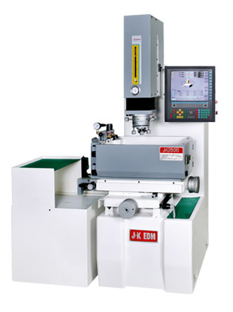
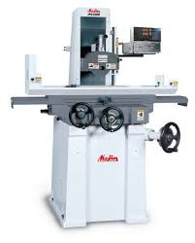
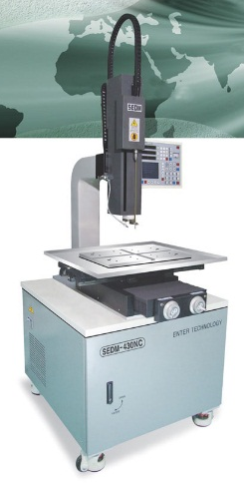
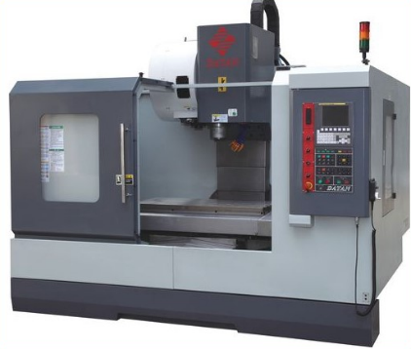
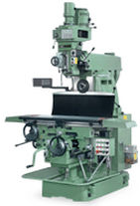
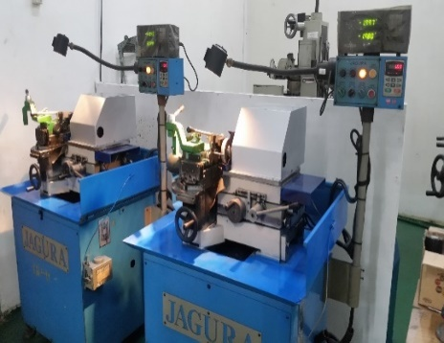
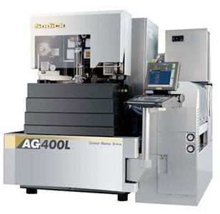
MACHINE LIST
Accuracy, Innovation, Customer - oriented, Long-term relationship

Slide 8
COMPANY HISTORY
2014 YEAR
Establish a Company Indonesia
PT. PLAKOIN TECHNOLOGY INDONESIA
2014-2015 YEAR
Register PT. Shinsei Denshi Indonesia, PT. Smep Pacific Indonesia
Press Mold and injection Mold special spare part
2016-2018 YEAR
Register PT. Panasonic Gobel Life Solutions, ,PT.KMK, PT.Advanex Presicion Indonesia, PT. Matsuo Precision Indonesia, PT.IKPI ,PT. TSB DLL
2018 – 2020 YEAR
* Partnership bukwang.co.ltd (south korea) www.bkind.co.kr Supply Standard part mold and stamping
* Register PT. Tokai Rika Indonesia, PT. Hirose Electric Indonesia, PT. Nanbu Plastics Indonesia, PT. KEPI, PT. Global Shinsei Indonesia,
PT. Plasess Indonesia, PT. Omron Manufacturing Indonesia, PT. Toyodenso Indonesia, PT. Oriental Electronics Indonesia
New Progress Moldset
Change the name from PT. Micro fabricationTec to PT. Plakoin Technology Indonesia
Accuracy, Innovation, Customer - oriented, Long-term relationship

Slide 9
MEASURING INSTRUMENT LIST
No | Machine Name | Qty | Maker
1 | Profile Projector | 1 unit | Sunpoc
2 | Optical Vision VML | 1 unit | 3D Family
3 | Microscope | 1 unit | Mitutoyo
4 | Digital Micro Meter | 4 unit | Mitutoyo
5 | Hight Gauge | 1 unit | Mitutoyo
6 | Dial Indicator | 7 unit | Mitutoyo
7 | Digital Calipers | 10 unit | Mitutoyo
8 | Caliper | 2 unit | Mitutoyo
9 | Pin Gauge | 7 set | Mitutoyo
10 | Block Gauge | 1 set | Select
11 | Block Gauge | 2 set | Taiwan
12 | CNC CMM | 1 Unit | Mitutoyo
Accuracy, Innovation, Customer - oriented, Long-term relationship

Slide 10
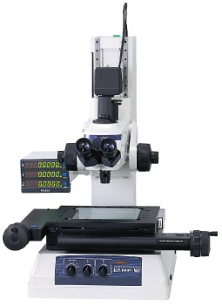
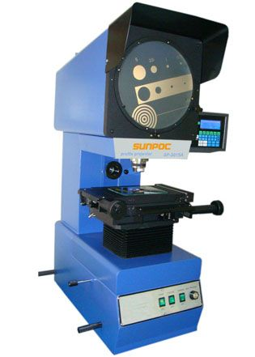
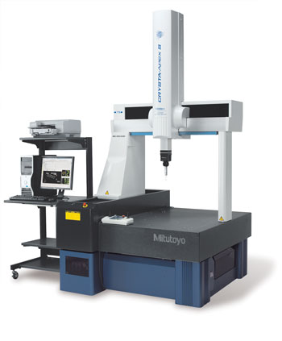
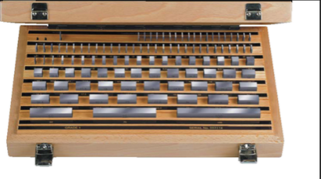
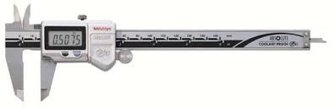
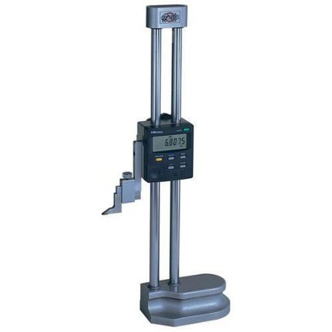
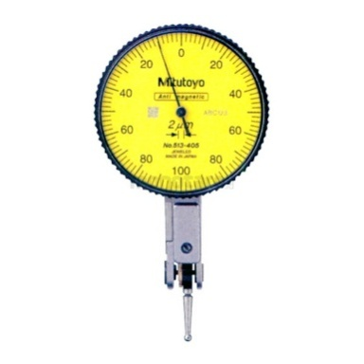
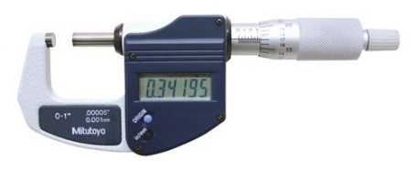
MEASURING INSTRUMENT LIST
Accuracy, Innovation, Customer - oriented, Long-term relationship

Slide 11
CUSTOMER LIST
NO | NAME | COMPANY OWNER | MAIN PRODUCT | ADDRESS
1 | PT. SHINSEI DENSHI INDONESIA | JAPAN | OTOMOTIVE PARTS | KAWASAN INDUSTRI MM 2100
2 | PT. PANASONIC GOBEL LIFE SOLUTIONS | JAPAN | ELECTRICAL PARTS | BOGOR & PASURUAN
3 | PT. OMRON MANUFACTURING INDONESIA | JAPAN | ELECTRONICS PARTS | KAWASAN INDUSTRI EJIP
4 | PT. ADVANEX PRECISION INDONESIA | JAPAN | OTOMOTIVE PARTS | BEKASI INTERNATIONAL INDUSTRIAL ESTATE
5 | PT. MATSUO PRECISION INDONESIA | JAPAN | AUTOMOTIVE PARTS | KAWASAN INDUSTRI GIIC
6 | PT. TOKAI RIKA INDONESIA | JAPAN | AUTOMOTIVE PARTS | KAWASAN INDUSTRI MM2100
7 | PT. TOYODENSO INDONESIA | JAPAN | AUTOMOTIVE PARTS | KAWASAN INDUSTRI MM2100
8 | PT. NANBU PLASTIC INDONESIA | JAPAN | AUTOMOTIVE PARTS | KAWASAN INDUSTRI MM2100
9 | PT. ORIENTAL ELECTRONIC INDONESIA | KOREA | ELECTRONIC PARTS | KAWASAN INDUSTRI HYUNDAI
10 | PT. GLOBAL SHINSEI INDONESIA | JAPAN | AUTOMOTIVE PARTS | KAWASAN INDUSTRI EJIP
11 | PT. HIROSE ELECTRIC INDONESIA | JAPAN | ELECTRICAL PARTS | KAWASAN INDUSTRI EJIP
Accuracy, Innovation, Customer - oriented, Long-term relationship

Slide 12














CUSTOMER LIST
Accuracy, Innovation, Customer - oriented, Long-term relationship

Slide 13
OUR VISION
Accuracy,
Innovation,
Customer – oriented,
Long-term relationship.

