Slide 1
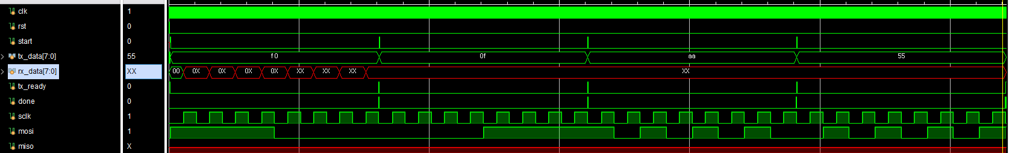
write
1111_0000
0000_1111
1010_1010
0101_0101
1
1
1
1
0
0
0
0
0
0
0
0
1
1
1
1
1
0
1
0
1
0
1
0
0
1
0
1
0
1
0
1

Slide 2
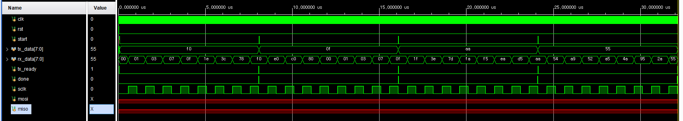
READ
1. 0000_0001
2. 0000_0011
3. 0000_0111
4. 0000_1111
5. 0001_1110
6. 0011_1100
7. 0111_1000
8. 1111_0000
1. 1110_0000
2. 1100_0000
3. 1000_0000
4. 0000_0000
5. 0000_0001
6. 0000_0011
7. 0000_0111
8. 0000_1111
1. 0001_1111
2. 0011_1110
3. 0111_1101
4. 1111_1010
5. 1111_0101
6. 1110_1010
7. 1101_0101
8. 1010_1010
1. 0000_0001
2. 0000_0011
3. 0000_0111
4. 0000_1111
5. 0001_1110
6. 0011_1100
7. 0111_1000
8. 1111_0000

Slide 3
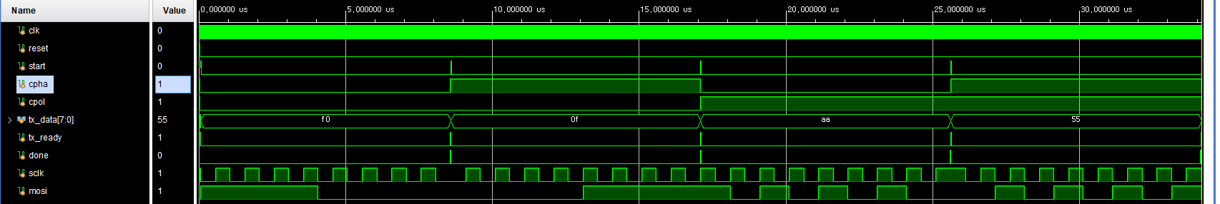
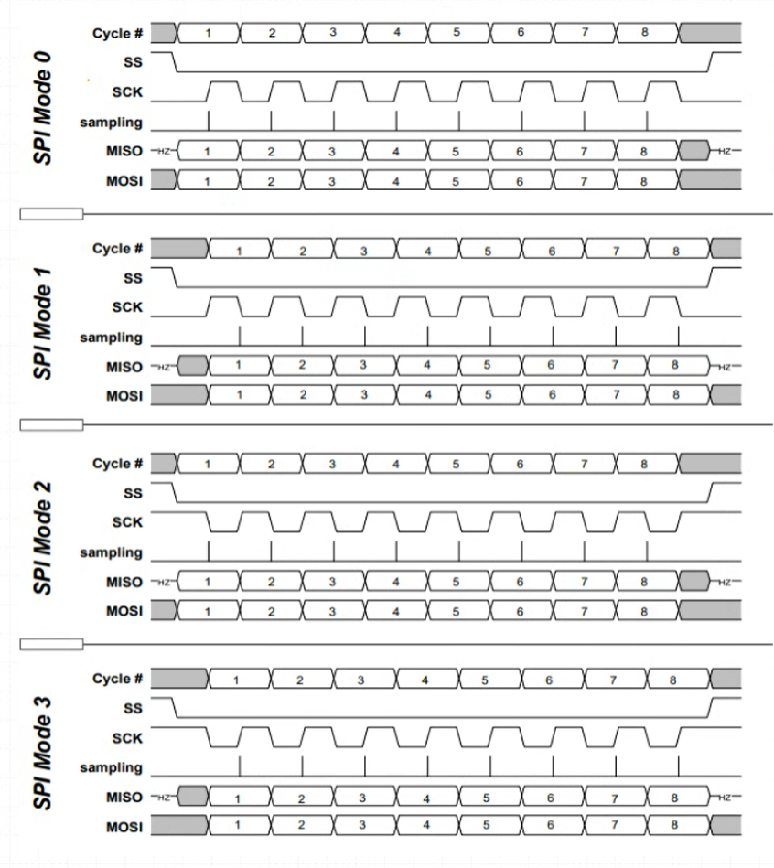
MASTER MODE
CPOL = 0
CPHA = 0
CPOL = 0
CPHA = 1
CPOL = 1
CPHA = 0
CPOL = 1
CPHA = 1
상승에서 시작하여 하강에서 캡쳐
1
1
1
1
0
0
0
0
0
0
0
0
1
1
1
1
1
0
1
0
1
0
0
0
0
1
0
1
0
1
0
1

