Slide 1
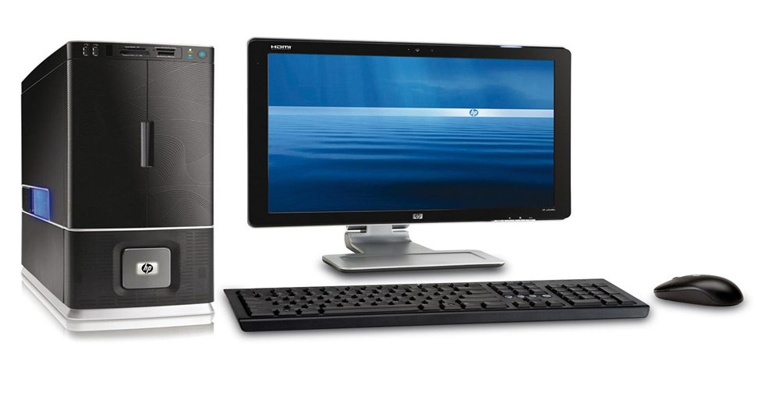
C++ PROGRAMMING
A computer is made up of
1.Hardware parts
2.Software/Programs-(System software-Operating system,drivers,antiviruses,sytem clock & Application software-excel,word processor,presentation,publisher)

Slide 2
Hardware- can not perform any task.
It has to be commanded by the Software
Software- has instruction to make the hardware perform operations.
C++ will look at the basics needed to create software programs to command the computer hardware.

Slide 3
INTRODUCTION TO COMPUTER PROGRAMMING
Computer Programming-Is a Science and Art of creating logic and accurate instructions for the hardware.
Computer Program-Is a sequence or set of instructions in a programming language for a computer to execute

Slide 4
C++ PROGRAMMING
A programmer or Software Developer is a person with the training and skills necessary to design,create and test computer programs
APPLICATIONS ( C++)
1.Adobe Photoshop 2.Winamp media player.3.MySQL(Database)
4.Games(game engines) 5.Windows 95,98-Operating System
6.Mozilla Firefox(browser) 7.Paypal ,Most parts FB,Amazon.Youtube
8.Chrome(web browser)

Slide 5
PROGRAMMING LANGUAGES
-Languages through which a user can communicate with the computer
-Predefined words and set of rules(syntax) that are used to create
instructions of a program
C
C++
Java
Python
COBOL,Fortran,Pascal

Slide 6
PROGRAMMING LANGUAGES Ctn
BASIC Beginners All-purpose Symbolic Instruction Code. A general programming language originally designed to be simple enough for beginners to learn.
FORTRAN Formula Translator. A language designed for programming complex mathematical algorithms.
COBOL Common Business-Oriented Language. A language designed for business applications.
Pascal A structured, general-purpose language designed primarily for teaching programming.

Slide 7
PROGRAMMING LANGUAGES Ctn
C++ Based on the C language, C++ offers object-oriented features not found in C. Also invented at Bell Laboratories.
C# Pronounced “C sharp.” A language invented by Microsoft for developing applications based on the Microsoft .NET platform.
Java An object-oriented language invented at Sun Microsystems. Java may be used to develop programs that run over the Internet, in a Web browser.

Slide 8
JavaScript can be used to write small programs that run in Web pages. Despite its name, JavaScript is not related to Java.
Python is a general-purpose language created in the early 1990s. It has become popular in both business and academic applications.
Ruby is a general-purpose language that was created in the 1990s. It is increasingly becoming a popular language for programs that run on Web servers.

Slide 9
Visual Basic
A Microsoft programming language and software development environment that allows programmers to quickly create Windows-based applications.
C++
is popular not only because of its mixture of low- and high-level features, but also because of its portability.
Portability means that a C++ program can be written on one type of computer and then run on many other types of operating systems. This usually requires the program to be recompiled on each type of system, but the program itself may need little or no change.

Slide 10
LOW LEVEL (MACHINE) LANGUAGE
The only language which can be understood by the computer and is written
in binary (1,0).

Slide 11
MIDDLE LEVEL LANGUAGE
Instructions are created using symbols such as letters, digits and special characters (mnemonics and operands).
Requires an Assembler to translate to
Machine code ADD A,B

Slide 12
HIGH-LEVEL PROGRAMMING LANGUAGE
Uses english words that are easier for humans to understand.Some words used in programming language are not normal English words used everyday.
C++ also has many low-level features. C++ is based on
the C language, which was invented for purposes such as writing operating systems and compilers. Since C++ evolved from C, it carries all of C’s low-level capabilities with it.
Similar to the human languages and require to be converted into low level language using a Compiler or interpreter

Slide 13
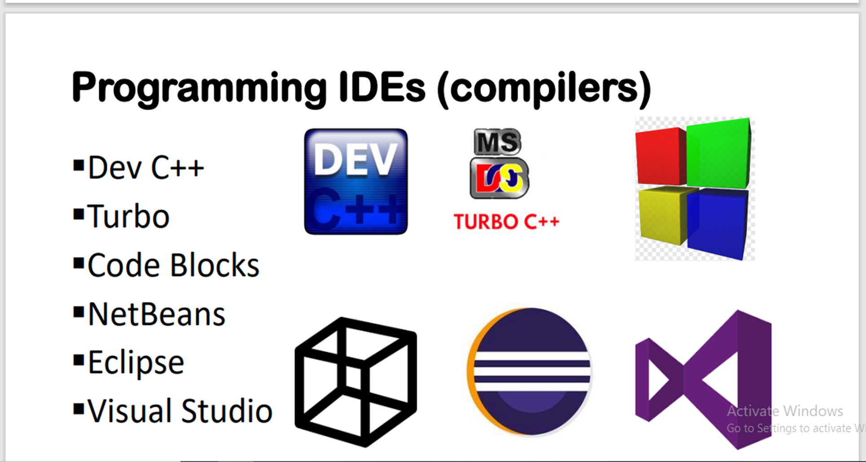



Slide 14
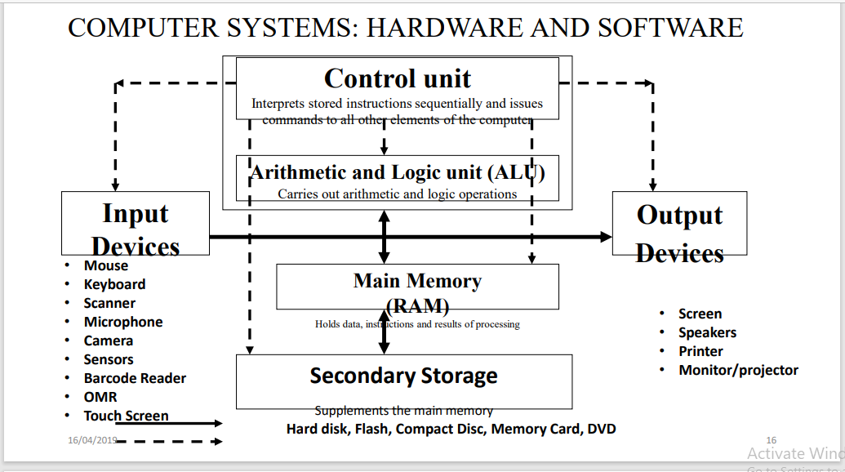


Slide 15
COMPILER-Converts the high –level programming language source code into machine language
MACHINE LANGUAGE –are a series of 0s and 1s(binary code) used to operate a computer at the most basic(TEXT TO BINARY CONVERTER)
Bits-Smallest basic unit of storing data
Byte-Made up of 8 bits and a byte can store one character either a letter,numeral or symbol(coding schemes)
INTERPRETER-A program that is able to execute high-level programming instructions

Slide 16
WHAT IS A PROGRAM MADE OF?
KEY WORDS (RESERVED WORDS)
Words that have a special meaning. Key words may only be used for their intended purpose.
PROGRAMMER-DEFINED IDENTIFIERS: Words or names defined by the programmer.
They are symbolic names that refer to
variables or programming routines.

Slide 17
Operators -perform operations on one or more operands. - + = / %
An operand -is usually a piece of data, like a number. 2+5= 7
Punctuation -characters that mark the beginning or ending of a statement, or separate items in a list. // ;

Slide 18
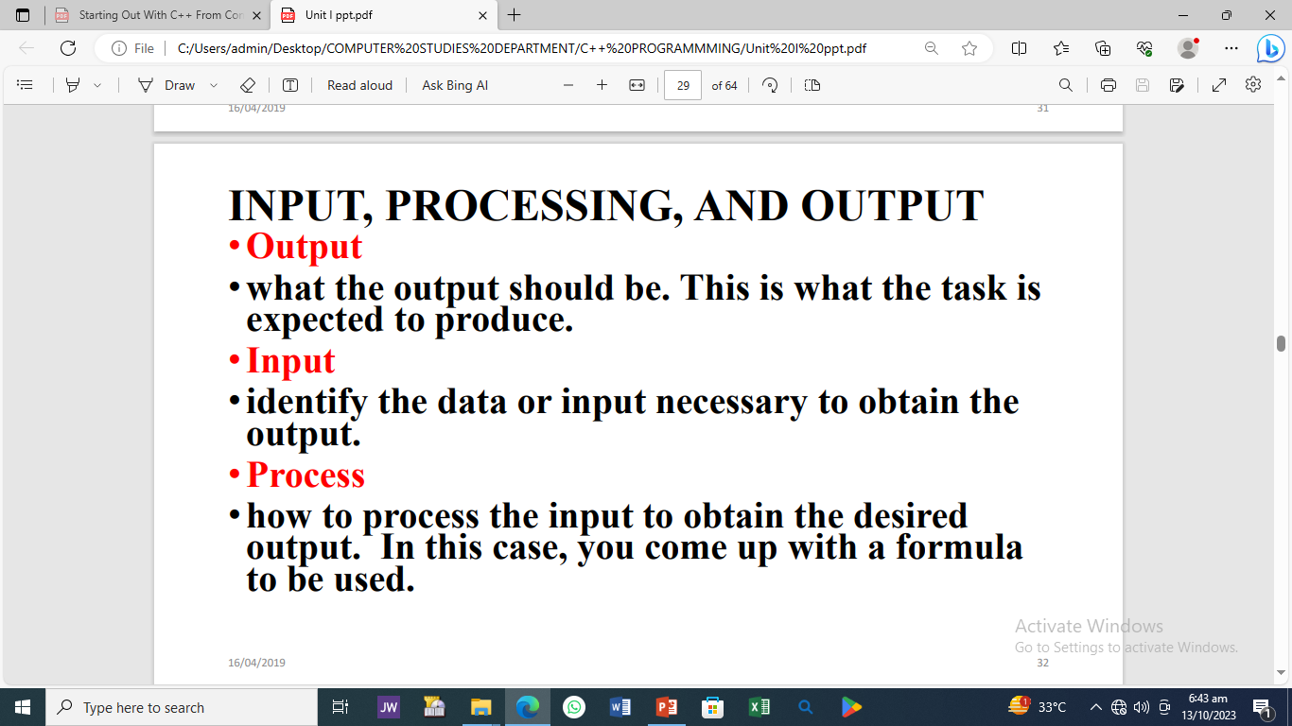

Slide 19
How fast is a car travelling if it goes 50
Kilometers in two hours?
Output
•Speed ?
Input
•Time (2hrs) and distance (50km)
Process
•Speed = distance/time speed =50/2
25Km/h

Slide 20
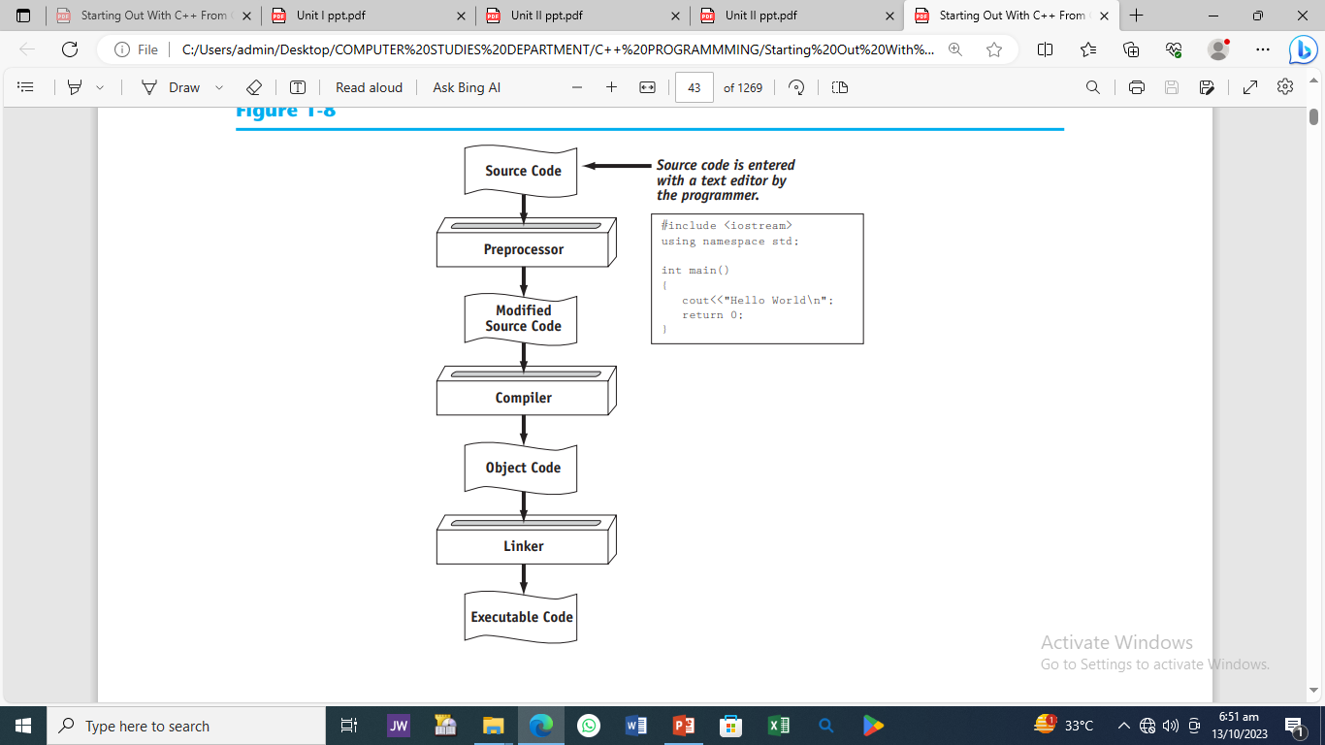
PROGRAM COMPILATION PROCESS

Slide 21
SOURCE CODE, OBJECT CODE, AND EXECUTABLE CODE
When a C++ program is written, it must be typed into the computer and saved to a file.
A text editor, which is similar to a word processing program, is used for this task.
The statements written by the programmer are called source code, and the file they are saved in is
called the source file.

Slide 22
PREPROCESSOR
After the source code is saved to a file, the process of translating it to machine language can begin.
During the first phase of this process, a program called the Preprocessor reads the source code.
The preprocessor searches for special lines that begin with the # symbol.
These lines contain commands that cause the preprocessor to modify the source code in way.

Slide 23
COMPILER
During the next phase the compiler steps through the preprocessed source code, translating each source code instruction into the appropriate machine language instruction.
This process will uncover any syntax errors that may be in the program.
Syntax errors are illegal uses of key words, operators, punctuation, and other language elements.
If the program is free of syntax errors, the compiler stores the translated machine language instructions, which are called object code, in an object file.

Slide 24
THE RUN-TIME LIBRARY AND LINKER
Although an object file contains machine language instructions, it is not a complete program because it does not have any run-time library routines
C++ is conveniently equipped with a library of prewritten code for performing common operations or sometimes-difficult tasks. For example, the library contains hardware-specific code for displaying messages on the screen and reading input from the keyboard.
It also provides routines for mathematical functions, such as calculating the square root of a number. This collection of code, called the run-time library, is extensive.
When the compiler generates an object file, however, it does not include machine code for any run-time library routines
During the last phase of the translation process, another program called the Linker combines the object file with the necessary library routines. Once the linker has finished with this step, an executable file is created. The executable file contains machine language instructions, or executable code, and is ready to run on the computer.

Slide 25
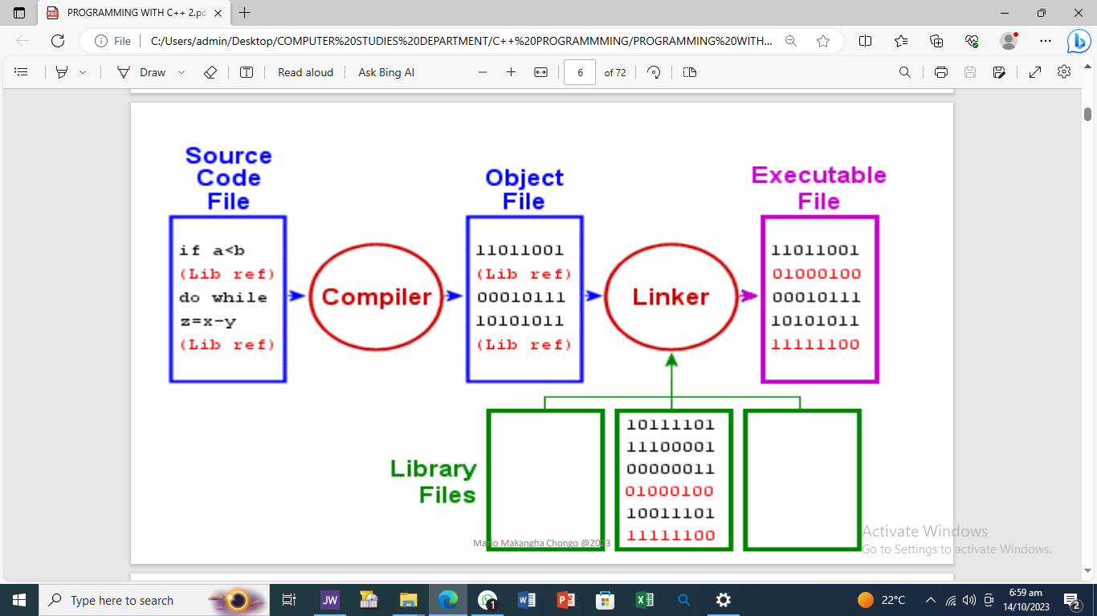

Slide 26
FLOW CHARTS AND PSEUDOCODES
PROGRAM DESIGN TOOLS
•Pseudocode is a method of writing out computer code in the English language before creating it in a specific computer language. There is no standard way to write pseudocode.
(Pseudocode)
• READ height of rectangle
• READ width of rectangle
• COMPUTE area as height times width
• Display the Area

Slide 27
READ HoursWorked
READ NormalMax
IF HoursWorked > NormalMax
THEN
Display overtime message
ELSE
Display regular time message
ENDIF

Slide 28
PROGRAM DESIGN TOOLS Cont. FLOW CHARTS
•A flowchart graphically depicts the logical steps to carry out a task and show how the steps relate to each other.
•shows the logical flow of a program
•It consists of special symbols connected by
arrows. Within each symbol is a phrase
presenting the activity.
•The shape of the symbol indicates the type
of operation that is to occur.

Slide 29
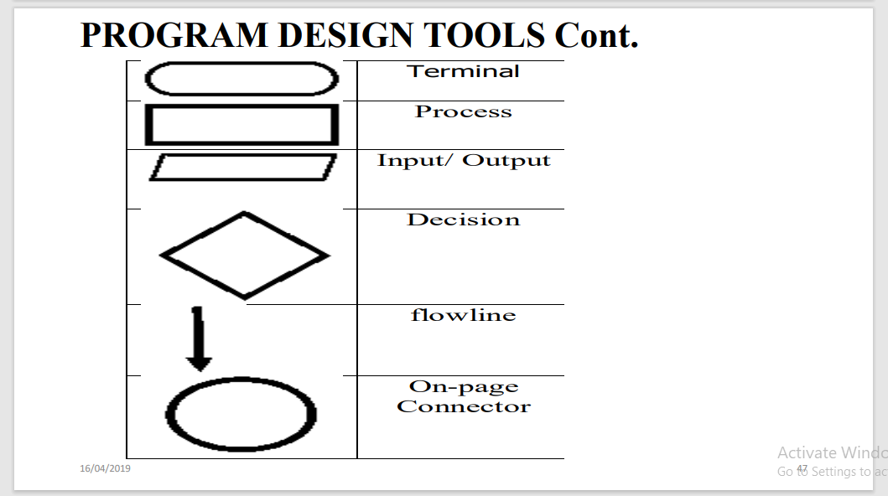

Slide 30
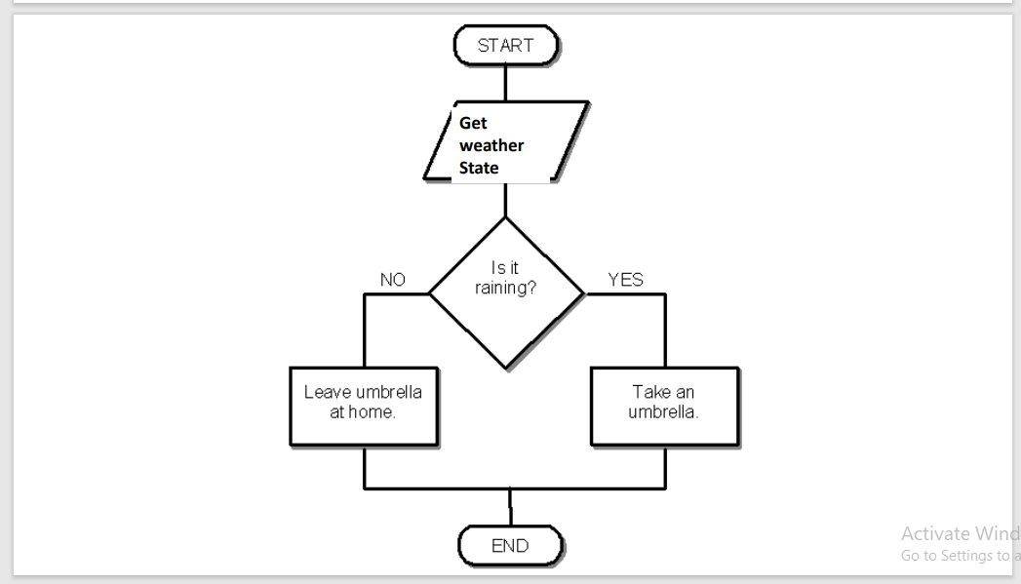

Slide 31
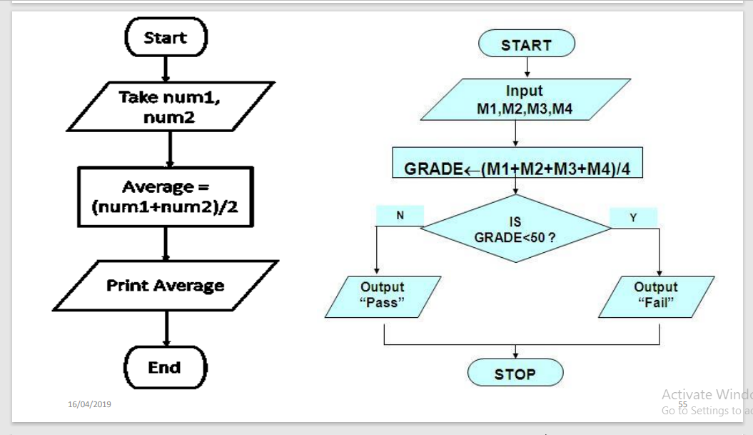

Slide 32
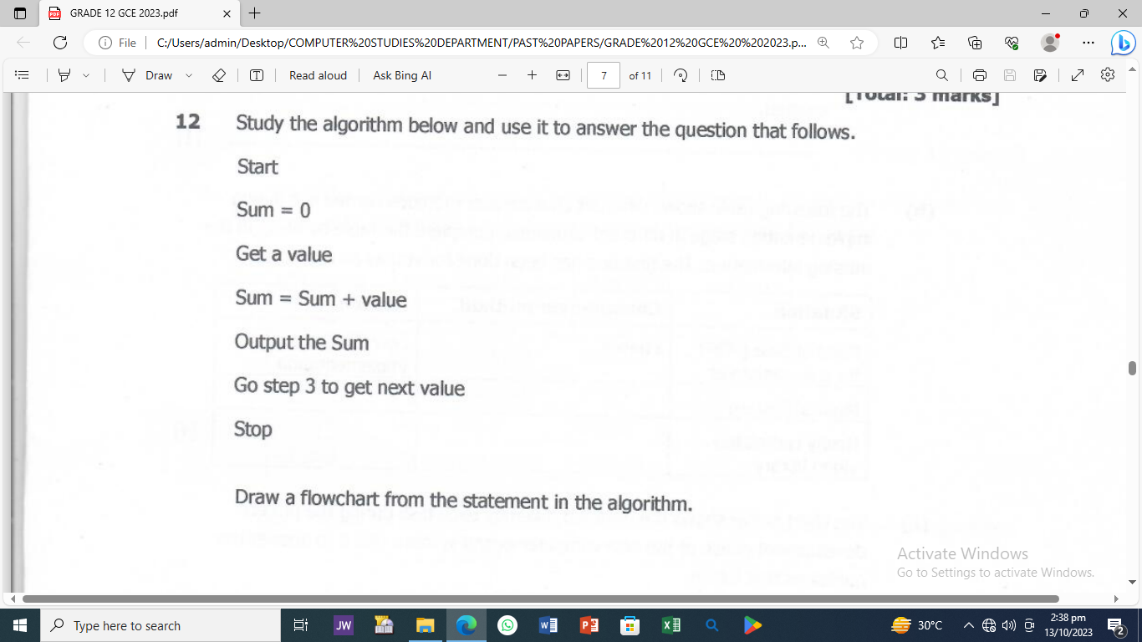
GRADE 12 2023 GCE ECZ PAPER-7010/1

Slide 33
DEVELOPMENT SYSTEMS
These have integrated development environments (IDEs). These environments consist of a text editor, compiler, debugger, and other utilities integrated into a package with a single set of menus.
Preprocessing, compiling, linking, and even executing a program is done with a single click of a button, or by selecting a single item from a menu.

Slide 34
THE PROGRAMMING PROCESS
1. Problem Definition- we define the purpose of the program. In this phase we need to understand the problem statement.
2. Problem Analysis-we determine the requirements like variables,functions, etc. to solve the problem.
3. Algorithm Development-write the solution in step by step statements. An algorithm is a step-bystep description of how to arrive at a
solution in the easiest way. Program Design tools such as pseudocode, flowcharts, and hierarchy charts help map out program logic
4. Coding and Documentation-This phase uses a programming language
(C, C++, pascal) to write or implement actual programming instructions for the steps defined in the previous phase.
5. Testing and Debugging-Program giving desired output or not? Debugging is a process of finding and correcting errors.

Slide 35
6. Maintenance-
During this phase, the program is actively used by the users. If any enhancements are required in this phase, all the phases are to be
repeated again to make the enhancements.
•Perfective
•Corrective
•Adaptive
•Preventive

Slide 36
Types of errors
•Syntax errors: They represent failure of program code to meet syntax rules of programming language; can be discovered automatically by compiler. (compile time)
•Semantic errors: They represent “failure” of program when syntactically correct program attempts to perform activities beyond the allowed meaning e.g division by zero 5/0
•Logical errors: They arise when a computer program does not match its specification and can be trapped by running the program with suitable test
data. (run time)

Slide 37
SOURCE CODE-Code written by a programmer in high-level language which is readable by people but not the computer
#include <iostream.h>
using namespace std;
//main () is where the program execution begins
int main ()
{
cout<< “Hello World!”;
return 0;
}

Slide 38
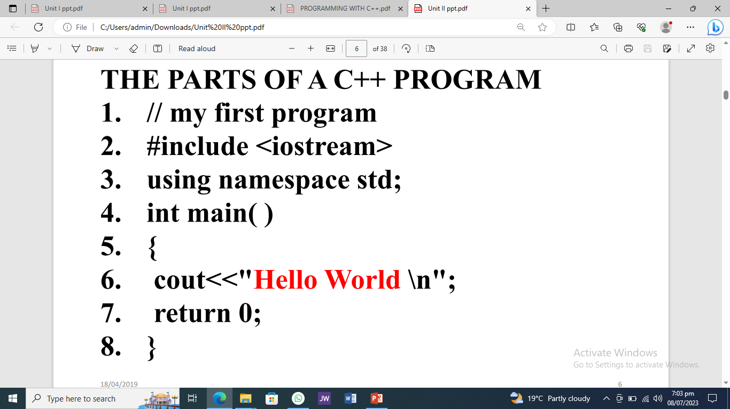
THE NEW PARTS OF A C++ PROGRAM

Slide 39
WELCOME TO C++ PROGRAMMING

