Slide 1


Phishing Awareness
Cybersecurity Training – Prepared by:
Aguda Jesse Atiewin (A.J)

Slide 2
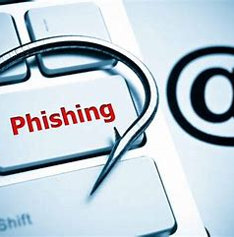
What is Phishing?
Phishing is a form of cyber attack where attackers impersonate legitimate organizations to steal sensitive information like usernames, passwords, and credit card numbers.

Slide 3
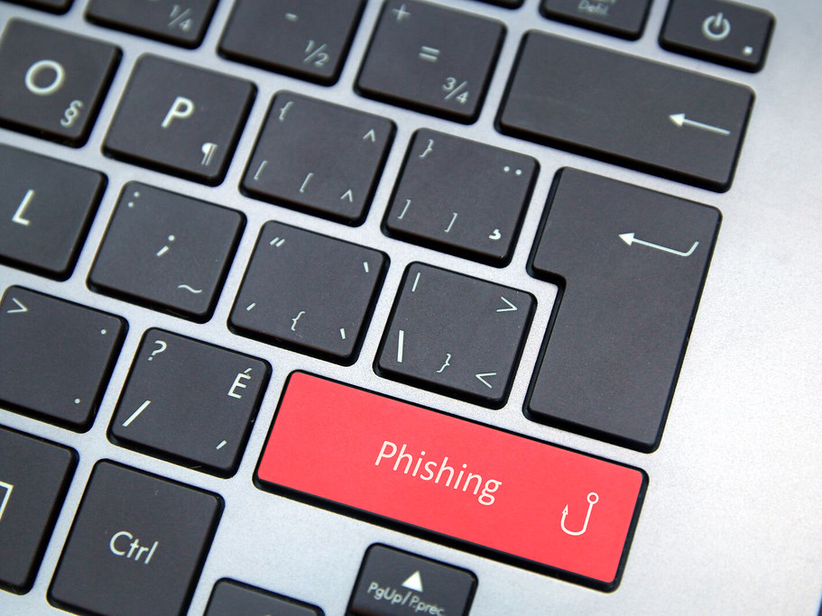
Common Types of Phishing
- Email Phishing: Phishing sent through emails(very common).
- Spear Phishing: is a highly targeted phishing attack aimed at a specific individual, organization, or business.
- Whaling: is a subtype of spear phishing, but targets high-level executives
- Smishing (SMS Phishing): involves text messages sent directly to your mobile device.
- Vishing (Voice Phishing): basically a voice call phishing attack.
This Photo by Unknown Author is licensed under CC BY

Slide 4
How to Identify a Phishing Attempt
- Suspicious email addresses or domains
- Urgent or threatening language
- Unexpected attachments or links
- Requests for personal or financial info
- Generic greetings like 'Dear user'

Slide 5

Best Practices to Avoid Phishing
- Do not click on suspicious links
- Verify sender email addresses
- Use multi-factor authentication (MFA)
- Report suspicious emails
- Keep software and antivirus updated

Slide 6
What to Do if You Suspect a Phishing Attack
- Do not respond to the message
- Do not open any links or attachments
- Report it to your IT/security team
- Run a full antivirus scan on your system

Slide 7
Conclusion
Phishing attacks are increasingly sophisticated and common.
Awareness and vigilance are your best defense.
Stay alert, think before you click, and report anything suspicious.

