Slide 1
MY INTRODUCTION

Slide 2
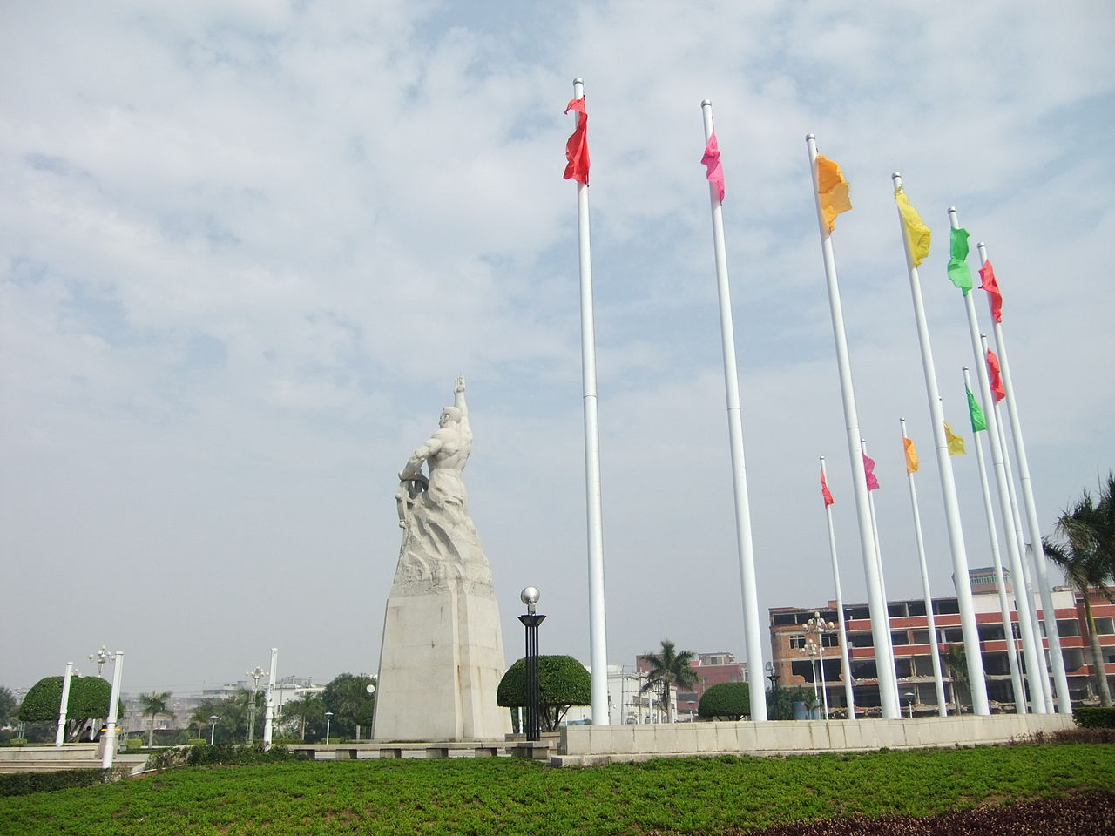
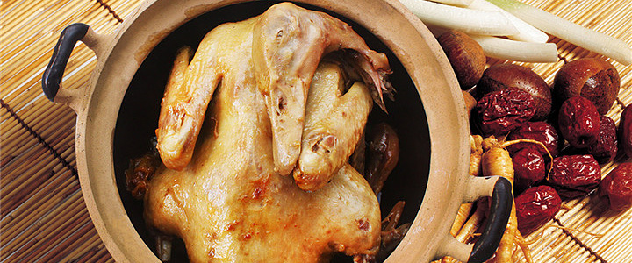
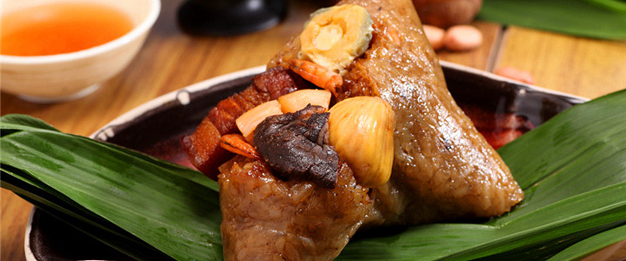
MY OWN INTRODUCTION
HELLO,GUYS!GLAD TO SEE YOU!MY NAME IS HONGLIBIN,MAJORED IN CST.I’M FROM JINJIANG,A SMALL TOWN IN FUJIAN PROVINCE.IT’S A VERY NICE TOWN,NO TRAFFIC JAMS OFTEN,PEOPLE ARE ALL KIND,AND OF COURSE,THE MOST IMPORTANT THING IS,IN THERE,YOU CAN TASTE VARIOUS SNACKS.I THINK YOU WILL FALL FOR THEM.ANYWAY,HOPING THAT YOU CAN COME TO VISIT JINJIANG.

Slide 3
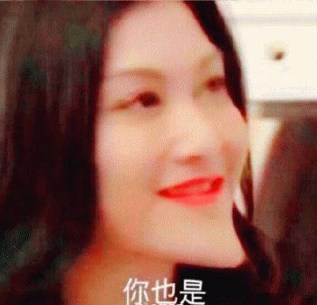
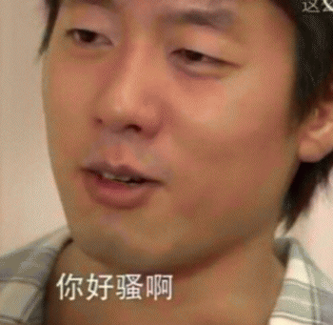
OK,NOW,IT’S TIME TO INTRODUCE MYSELF.MY NAME IS HONG LI BIN,YOU CAN ALSO CALL ME Dick.I SELDOM SPEAK WITH OTHERS ACTIVELY,SO MAY BE FROM SOMEONE’S EYES.I’M NOT VERY EASY TO MAKE FRIEND.BUT IN FACT,I’M VERY OUTGOING AND FUNNY,AND I’M QUITE GOOD AT TALKING JOKES.I’M VERY HAPPY TO BE YOUR FRIEND.

