Slide 1
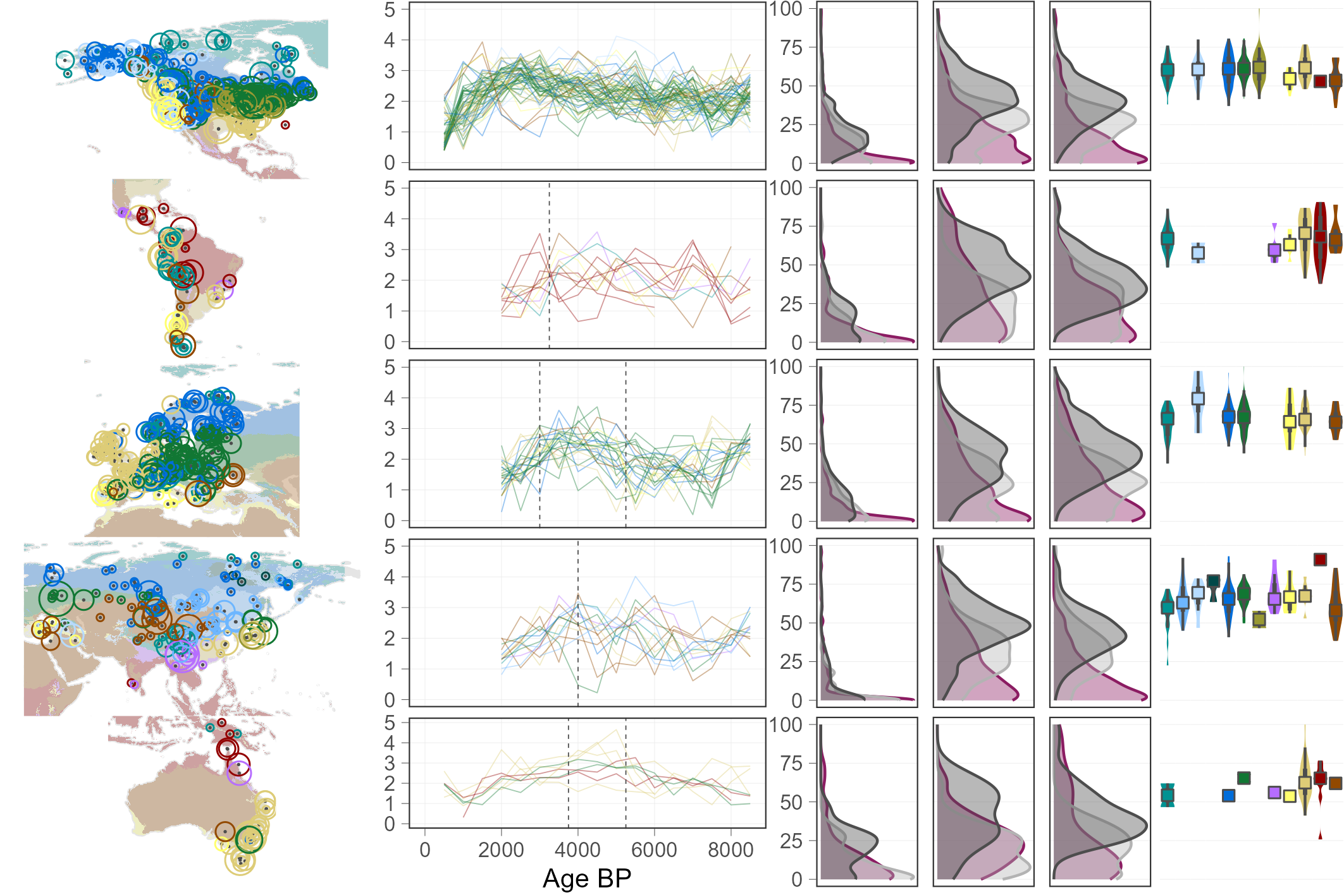
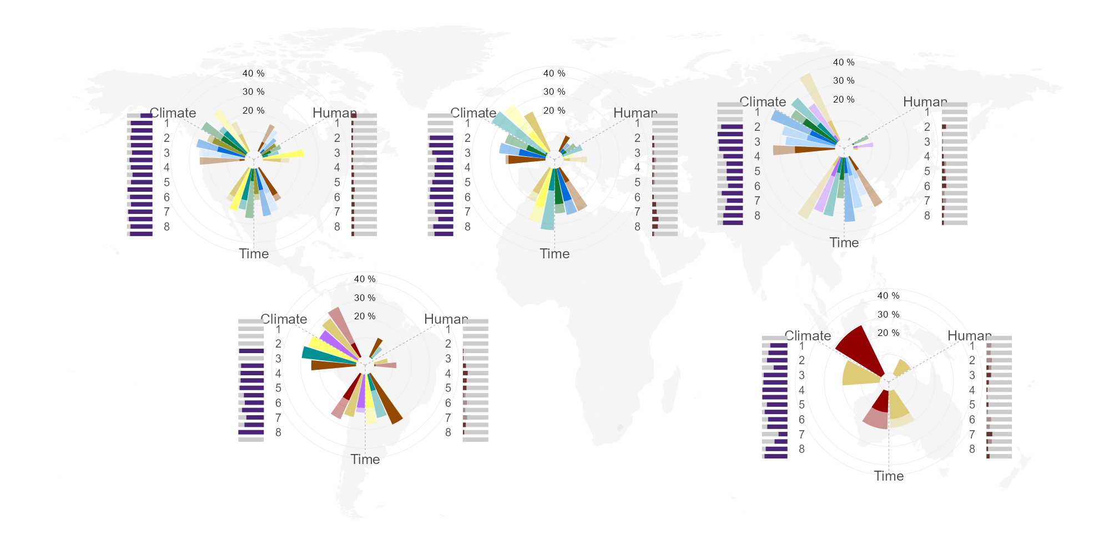




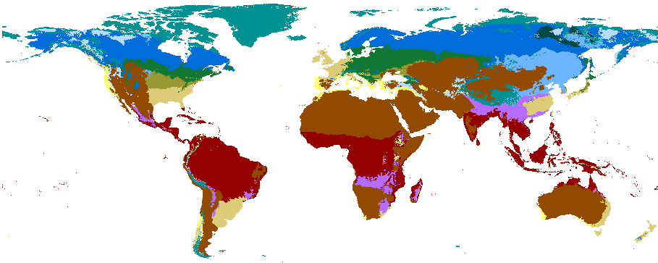

FIGURE 2
humans
climate
time
humans
climate
time
humans
climate
time
humans
climate
time
Ecozones
Proportion variability (%) explained by predictors summed per ecozone
Proportion variability (%) explained by predictors summed per time slice
Density of proportion variability (%) explained by predictors per continent
humans
climate
time
total
Time (ka)
shared
total
shared
unique
100%
unique

