Slide 1



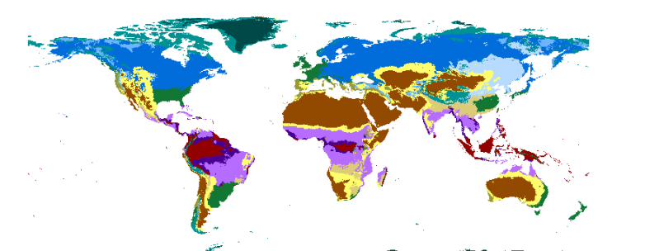
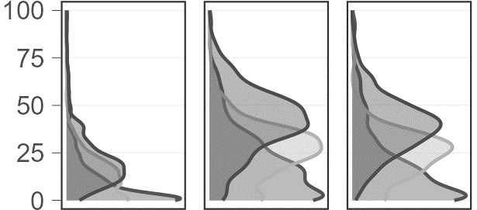


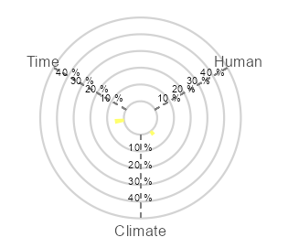
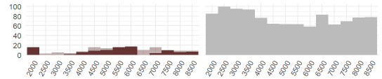
Fossil pollen dataset compilation (n = 1263)
1. Composition of ecosystem properties
Pollen biodiversity indices
continent/ecozone
*1
Evenness
Diversity
RoC
Etc
Summed continent
*3
Variance analysis
Unique, shared, total variance explained
Summed by ecozone
Archeological artefacts
Temporal stochasticity
Summed by time slice
Human presence
PREDICTORS
SPDs
2. Interplay among ecosystem properties
Human events
Climate
Multidimensional shifts among pollen biodiversity indices through time
continent/ecozone
*2
Variance analysis
UNIQUE
SHARED
General trends per
continent/ecozone through time
Humans
Climate
Time
Humans * Climate * Time
Notes:
Make additional zoomed in conceptual figures here *
*1: Detection of past human presence
*2: FOSSILPOL workflow, filtering, harmonization etc
*3: PAPS, change point detection and density estimates
All conceptual figures in the same style
Idea: Use this exact same outline but replace all content by only the names of the numerical analysis methods/approaches used. E.g. Rfossilpol, Recopol, Rratepol, PCA, MRT, HGAM, etc (good way to flash our packages also!)

