Slide 1
Table execution

Slide 2
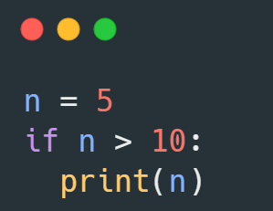
Draw table execution
step | n | n > 10 | output
1 | 5
2 |  | 5>10:fale

Slide 3
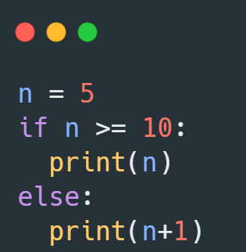
Draw table execution
step | n | n >= 10 | output
1 | 5
2 | 5 | 5>=10:fals
3 | 5+1=6 |  | 6

Slide 4
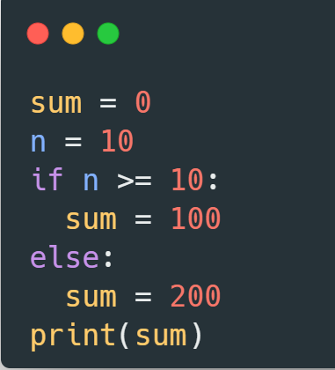
Draw table execution
step | sum | n | n >= 10 | output
1 | 0
2 | 0 | 10
3 | 0 | 10 | 10>=10:true
4 | 100 | 10
5 | 100 | 10 |  | 100

Slide 5
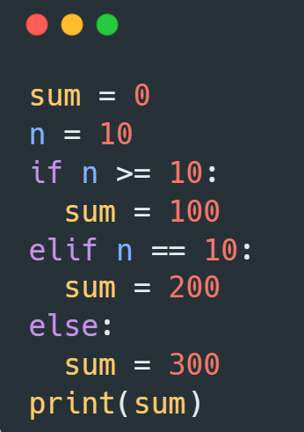
Draw table execution
step | sum | n | n >= 10 | n==10 | output
1 | 0
2 | 0 | 10
3 | 0 | 10 | 10>=10:true
4 | 100 | 10
5 | 100 | 10 |  |  | 100

Slide 6
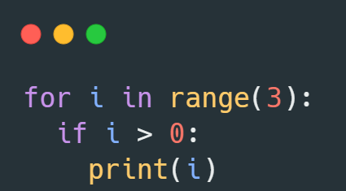
Draw table execution
step | i | i < 3 | i > 0 | output
1 | 0
2 | 0 | 0<3:true
3 | 0 |  | 0>0:false
4 | 1
5 | 1 | 1<3:true
6 | 1 |  | 1>0:true
7 | 1 |  | i=1 | 1
8 | 2
9 | 2 | 2<3:true
10 | 2 |  | 2>0:true
11 | 2 |  | i=2 | 2

Slide 7
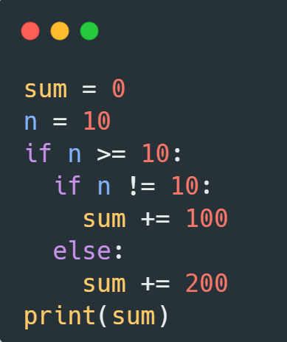
Draw table execution
step | sum | n | n >= 10 | n!=10 | output
1 | 0
2 | 0 | 10
3 | 0 | 10 | 10>=10:true
4 | 0 | 10 |  | 10!=10:false
5 | 200 | 10 |  |  | 200

Slide 8
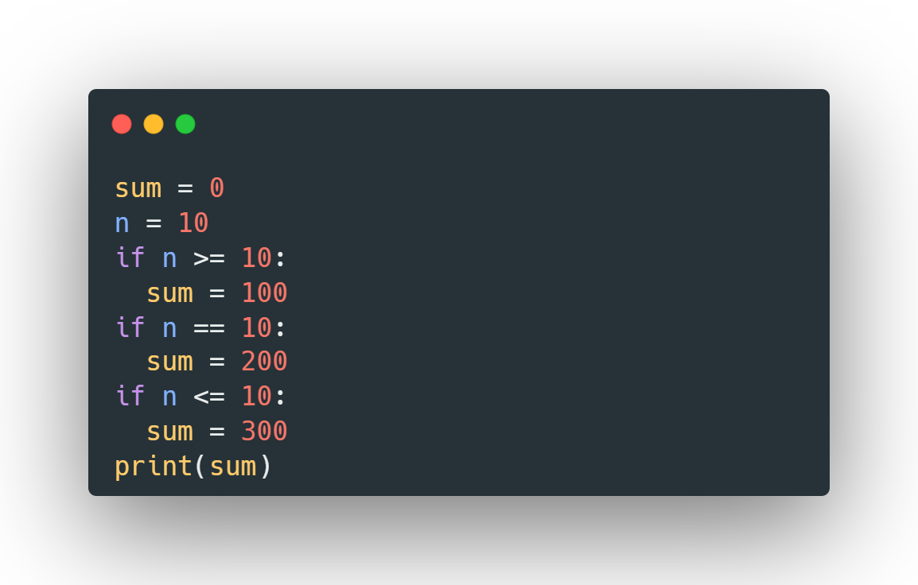
Draw table execution
step | sum | n | n >= 10 | n==10 | n<=10 | output
1 | 0
2 | 0 | 10
3 | 0 | 10 | 10>=10:true
4 | 100 | 10 |  | 10!=10:fals
5 | 200 | 10 |  |  | 10<=10
6 | 300 | 10 |  |  |  | 300

Slide 9
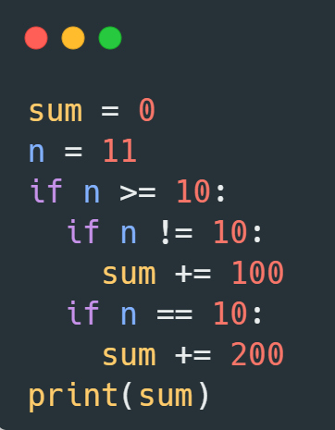
Draw table execution
step | sum | n | n >= 10 | n!=10 | n==10 | output
1 | 0
2 | 0 | 11
3 | 0 | 11 | 11>=10:true
4 | 100 | 11 |  | 11!=10:true
5 | 100 | 11 |  |  | 11==10:false
6 | 100 | 11 |  |  |  | 100

Slide 10
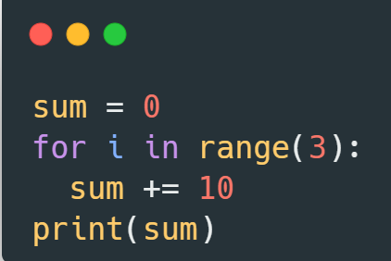
Draw table execution
step | sum | i | i <3 | output
1 | 0
2 |  | 0
3 |  | 0 | 0<3:true
4 | sum+=10 sum=10 | 0
5 | 10 | 1
6 |  | 1 | 1<3:true
7 | Sum+=10 Sum=20 | 1
8 | 20 | 2
9 |  | 2 | 2<3:true
10 | Sum+=10 Sum=30 | 2 |  | 30

Slide 11
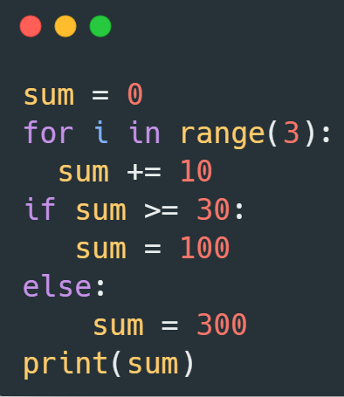
Draw table execution
step | sum | i | i <3 | Sum>=30 | output
1 | 0
2 |  | 0
3 |  | 0 | 0<3:true
4 | sum+=10 sum=10 | 0
5 | 10 | 0 |  | 10>=30:false
 | 300 | 0
6 |  | 1 | 1<3:true
7 | Sum+=10 Sum=20 | 1
8 | 20 | 1 |  | 20>=30:false
 | 300 | 1
9 |  | 2 | 2<3:true
10 | Sum+=10 Sum=30 | 2 |  |  | 30
 | 30 | 2 |  | 30>=30:true
 | 100 | 2 |  |  | 100

Slide 12
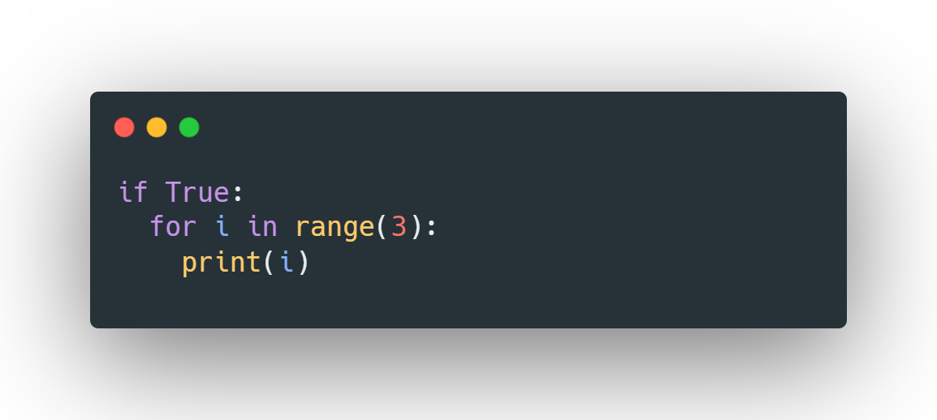
Draw table execution
step | i | i <3 | output
1 | 0
2 | 0 | 0<3:true
3 | 0 | i=0 | 0
4 | 1
5 | 1 | 1<3:true
6 | 1 | i=1 | 1
7 | 2
8 | 2 | 2<3:true
9 | 2 | i=2 | 2

Slide 13
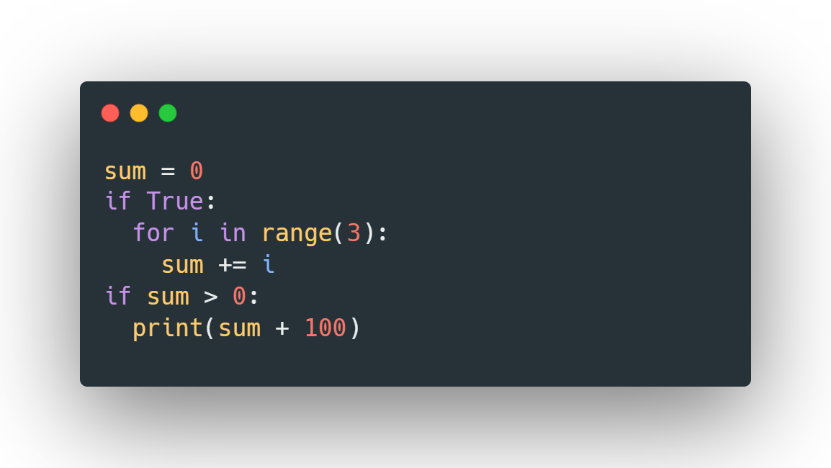
Draw table execution
step | sum | i | i <3 | sum>0 | output
1 | 0
2 |  | 0
3 |  | 0 | 0<3:true
4 | sum+=i sum=0 | 0
5 | 0 | 1
6 |  | 1 | 1<3:true
7 | Sum+=i Sum=1 | 1
8 | 1 | 2
9 |  | 2 | 2<3:true
10 | Sum+=2 Sum=3 | 2 |  |  | 3
11 | 3 | 2 |  | 3>0:true
12 | Sum+100 =103 | 2 |  |  | 103

Slide 14
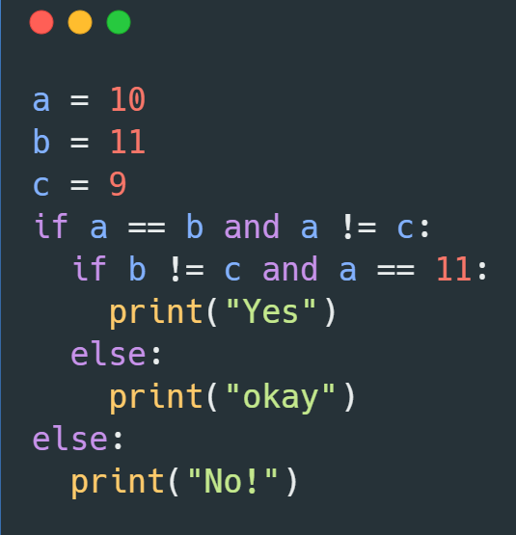
Draw table execution
step | a | b | c | a==b and a!=c | b!=c and a==11 | output
1 | 10
2 | 10 | 11
3 | 10 | 11 | 9
4 | 10 | 11 | 9 | 10==11 and 10!=9:false
5 | 10 | 11 | 9 |  | 11!=9 and 10==11:fale
6 | 10 | 11 | 9 |  |  | No!

Slide 15
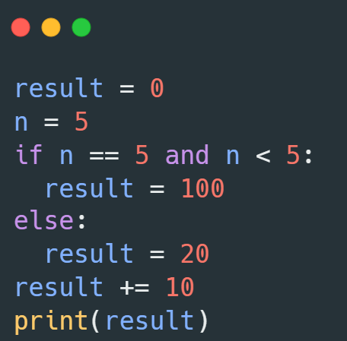
Draw table execution
step | result | n | i <3 | output
1 | 0
2 | 0 | 5
3 |  |  | 5==5 and n<5:false
4 | 20
5 | Result+=10 Result=30 |  |  | 30

Slide 16
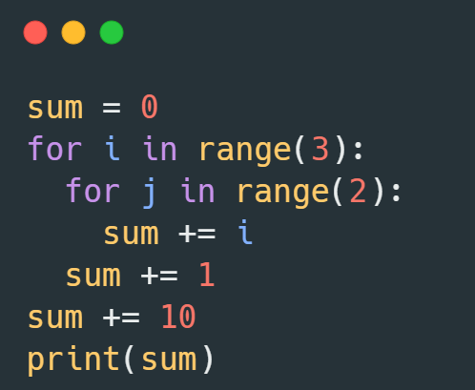
step | sum | i | i <3 | j | j<2 | output
1 | 0
2 |  | 0
3 |  | 0 | 0<3:true
4 | sum+=1 sum=1 | 0
5 | 1 | 0 |  | 0
6 | 1 | 0 |  | 0 | 0<2:true
7 | Sum+=j Sum=1 | 0 |  | 0
8 | 0 | 0 |  | 1 | 1<2:true
9 | Sum+=j Sum=2 | 0 |  | 1
10 | 2 | 1 |  | 1
11 | 2 | 1 | 1<3:true
12 | sum+=1 sum=3 | 1 |  | 0
13 | 3 | 1 |  | 0
14 | 3 | 1 |  | 0 | 0<2:true
15 | sum+=j sum=3 | 1 |  | 0
16 | 3 | 1 |  | 1
17 | 3 | 1 |  | 1 | 1<2:true
18 | sum+=j sum=4 | 1 |  | 1
19 | 4 | 2 |  | 1
20 | 4 | 2 | 2<3:true
21 | sum+=1 sum=5 | 2
22 | 5 | 2 |  | 0
23 | 5 | 2 |  | 0 | 0<2:true
24 | sum+=j sum=5 | 2 |  | 0
25 | 5 | 2 |  | 1
26 | 5 | 2 |  | 1 | 1<2:true
27 | sum+=j sum=6 | 2 |  | 1
28 | sum+=10 Sum=16 | 2 |  | 1
29 | 16 | 2 |  | 1 |  | 16
Draw table execution

Slide 17
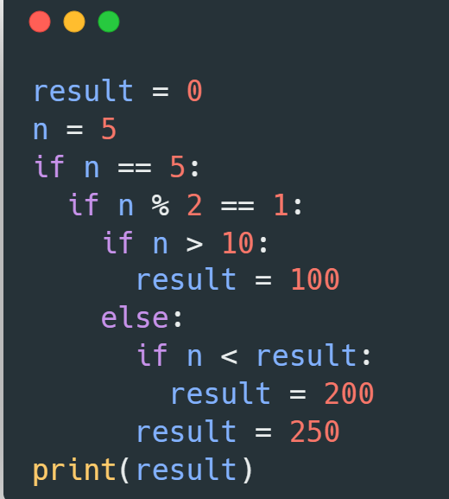
Draw table execution
step | result | N | n==5 | n%2==1 | n>10 | n<result | output
1 | 0 | 5
2 | 0 | 5 | 5==5:true
3 | 0 | 5 |  | 5%2==1:T
4 | 0 | 5 |  |  | 5>10:false
5 | 0 | 5 |  |  |  | 5<0:false
6 | 250 | 5 |  |  |  |  | 250

