Slide 1
Block

Slide 2
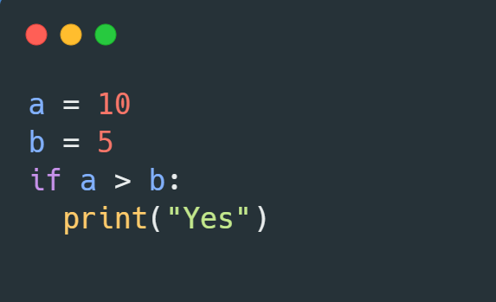
a = 10
b = 5
If a > b:
Print(“Yes”)

Slide 3
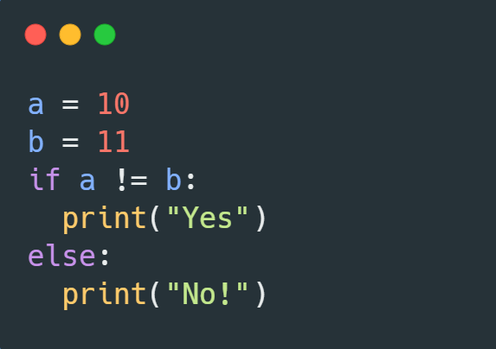
a = 10
b = 11
If a != b:
Print(“Yes”)
Else:
Print(“No!”)

Slide 4
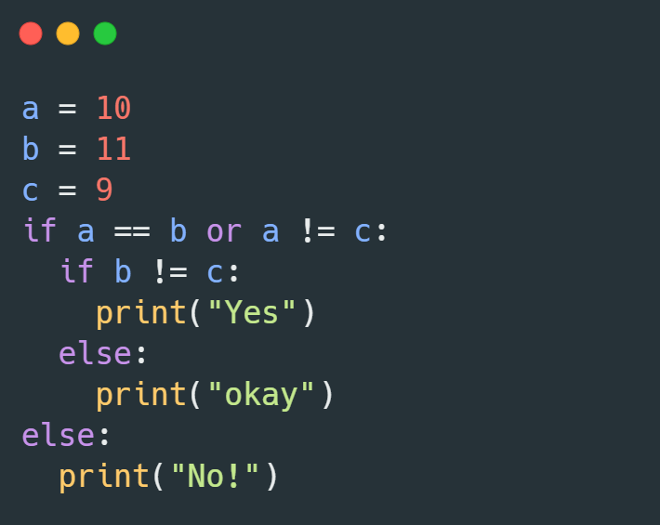
a = 10
b = 11
c = 9
If a == b or a != c:
If b != c:
V
Print(“Yes”)
Else:
Print(“Okay”)
Else:
Print(“No!”)

Slide 5
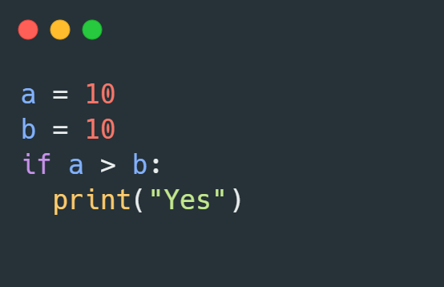
a = 10
B = 10
if a > b :
Print (“yes”)

Slide 6
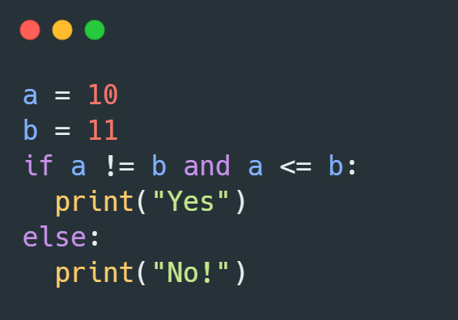
a = 10
B = 11
if a != b and a <=b :
print (“yes”)
else:
print (“No!”)

Slide 7
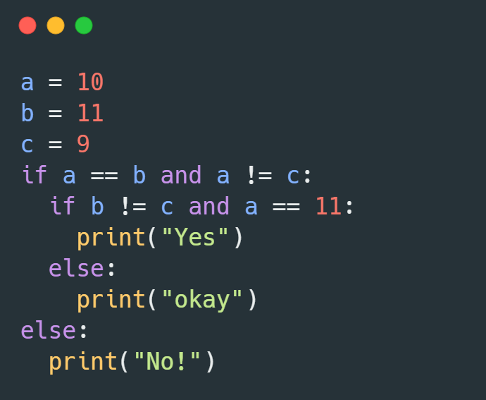
a = 10
b = 10
c = 9
if a == b and a != c:
if b != c and a == 11:
Print(“yes”)
else:
Print(“okay”)
else:
Print(“No!”)

Slide 8
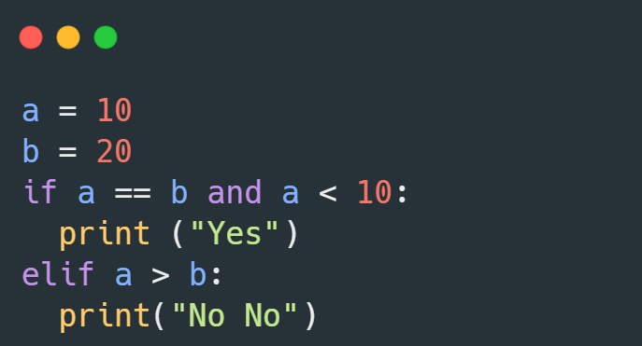
a = 10
b = 20
if a == b and a < 10:
print (“yes”)
elif a > b:
print (“No No”)

Slide 9
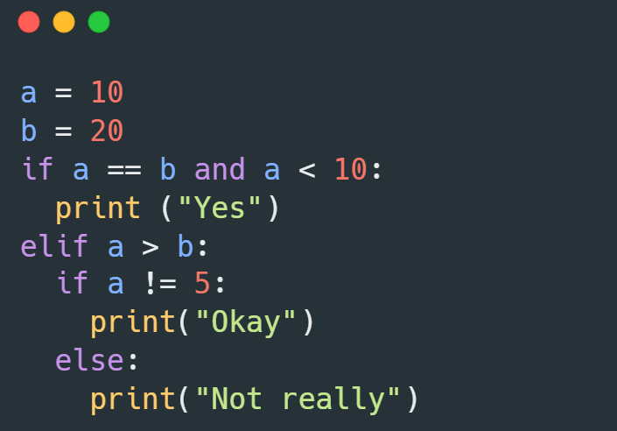
a = 10
a = 10
b = 20
If a == b and a < 10:
if a == b and a < 10:
print (“yes”)
elif a > b:
elif a > b:
if a !=5 :
print (“okay”)
else:
print (“Not really”)

Slide 10
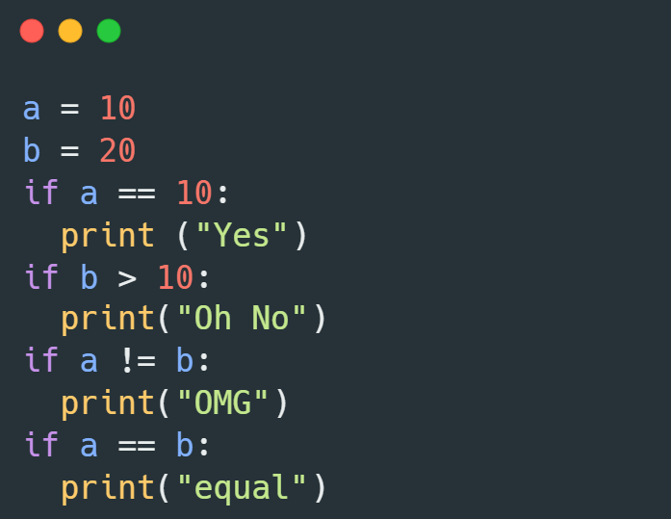
a = 10
b = 20
if a == 10:
print (“yes”)
if b > 10:
print (“ho No”)
if a != b:
print (“OMG”)
if a == b:
print (“equal”)

Slide 11
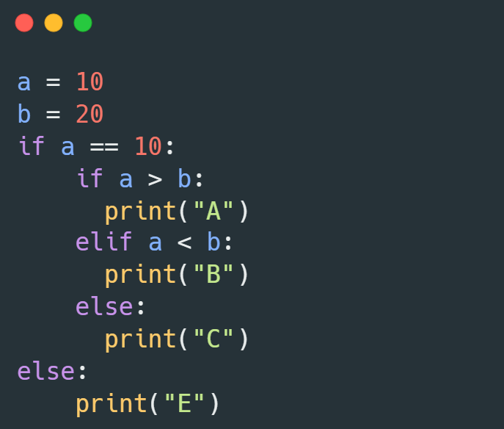
a = 10
b = 20
if a == 10:
if a > b :
print (“A”)
elif a < b:
print (“B”)
else :
print (“C”)
else:
Print (“E”) :

Slide 12
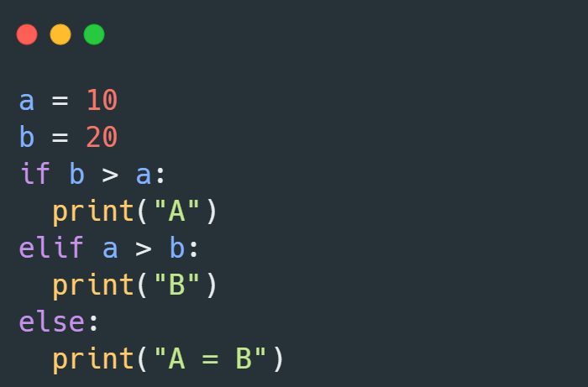
a = 10
b = 20
if a > b :
print (“A”)
elif a > b:
elif a > b:
print (“B”)
else:
print (“A = B”)

Slide 13
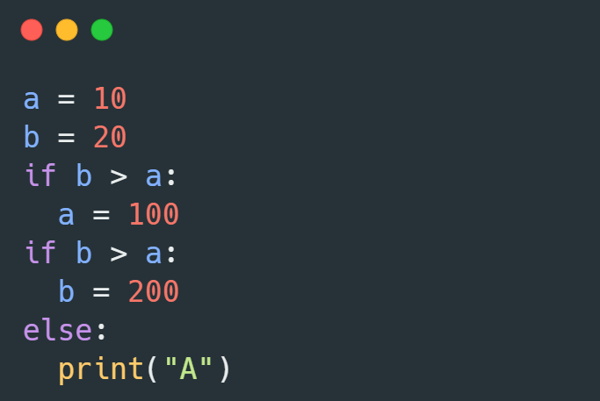
a = 10
b = 20
if b > a:
a = 100
if b > a:
b = 200
else:
print (“A”)

Slide 14
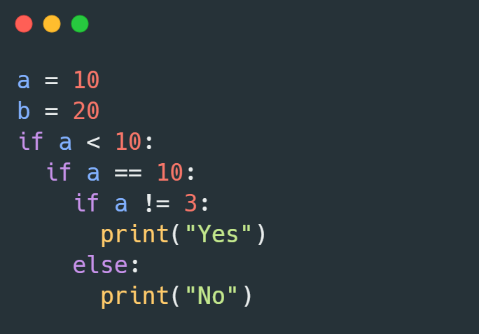
a = 10
b = 20
if a < 10:
if a == 10:
if a != 3:
print (“yes”)
else:
print (“ No”)

