Slide 1
Practice 4

Slide 2
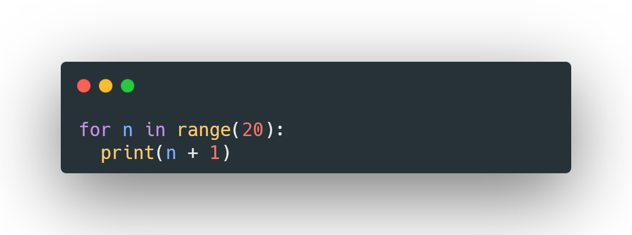
1
STEP | n | n < 20 | OUTPUT
1 | 0 | 0 < 20: TRUE
2 | 0 | N+1 | 1
3 | 1 | 1 < 20: TRUE
4 | 1 | N+1 | 2
5 | 2 | 2 < 20: TRUE
6 | 2 | N+1 | 3
7 | 3 | 3 < 20 : TRUE
8 | 3 | N+1 | 4
… | …. | ….. | …..
…. | ….. | ….. | …..
37 | 18 | 18>20: TRUE
38 | 18 | N+1 | 19
39 | 19 | 19>20:TRUE
40 | 19 | N+1 | 20

Slide 3

2
STEP | n | n < 10 | OUTPUT
1 | 0 | 0 < 10: TRUE
2 | 0 | N % 2 | 0
3 | 1 | 1 < 10: TRUE
4 | 1 | N % 2 | 0.5
5 | 2 | 2 < 10: TRUE
6 | 2 | N % 2 | 1
7 | 3 | 3 < 10 : TRUE
8 | 3 | N % 2 | 1.5
… | …. | ….. | …..
…. | ….. | ….. | …..
17 | 8 | 8 > 10: TRUE
18 | 8 | N % 2 | 4
19 | 9 | 9 > 10:TRUE
20 | 9 | N % 2 | 4.5

Slide 4

3
STEP | n | n < 5 | OUTPUT
1 | 0 | 0 < 5: TRUE
2 | 0 | N -1 | -1
3 | 1 | 1 < : 5TRUE
4 | 1 | N-1 | 0
5 | 2 | 2 < 5: TRUE
6 | 2 | N-1 | 1
7 | 3 | 3 < 5 : TRUE
8 | 3 | N-1 | 2
9 | 4 | 4 < 5 : TRUE
10 | 4 | N-1 | 3

Slide 5

4
STEP | n | n < 5 | OUTPUT
1 | 0 | 0 < 5: TRUE
2 | 0 | N + 5 | 5
3 | 1 | 1 < : 5TRUE
4 | 1 | N + 5 | 6
5 | 2 | 2 < 5: TRUE
6 | 2 | N + 5 | 7
7 | 3 | 3 < 5 : TRUE
8 | 3 | N + 5 | 8
9 | 4 | 4 < 5 : TRUE
10 | 4 | N + 5 | 9

Slide 6
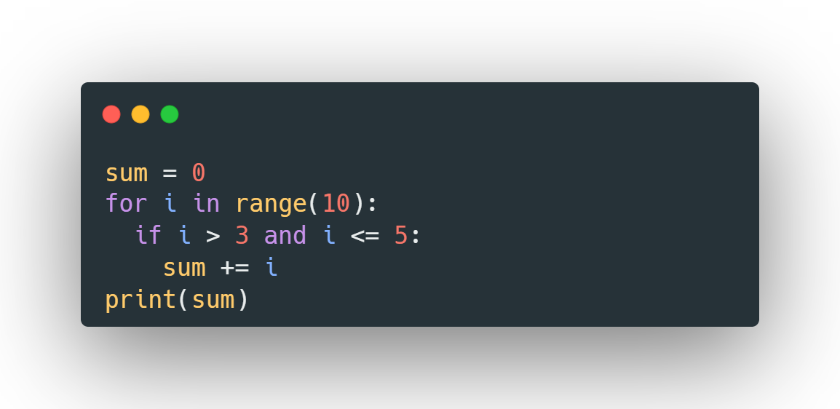
STEP | i | i >10 | i>3 and i <=5 | sum | OUTPUT
1 |  |  |  | 0
2 | 0 | 0 >10:TRUE |  | 0
3 | 0 |  | 0 >3 and 0<=5: FALS | 0
4 | 1 | 1 >10:TRUE |  | 0
5 | 1 |  | 1>3 and 1<=5: FALS | 0
6 | 2 | 2 >10:TRUE |  | 0
7 | 2 |  | 2>3 and 2<=5: FALS | 0
8 | 3 | 3 > 10:TRUE |  | 0
9 | 3 |  | 3>3 and 3<=5: FALS | 0
10 | 4 | 4 > 10:TRUE |  | 0
11 | 4 |  | 4 > 3and 4<= 5:True | 0
12 | 4 |  |  | Sum+=4 sum=4
13 | 5 | 5 > 10:TRUE |  | 4
14 | 5 |  | 5 >3 and 5<= 5:True | 4
15 | 5 |  |  | Sum+=5 sum=9
16 | 6 | 6 > 10:TRUE |  | 9
17 | 6 |  | 6>3 and 6<= 5:FALS | 9
18 | 7 | 7 > 10 : TRUE |  | 9
19 | 7 |  | 7> 3 and 7<= 5: FALS | 9
20 | 8 | 8 > 10 : TRUE |  | 9
21 | 8 |  | 8> 3 and 8<= 5: FALS | 9
22 | 9 | 9 > 10 : TRUE |  | 9
23 | 9 |  | 9> 3 and 9<= 5: FALS | 99 | 9
5

Slide 7
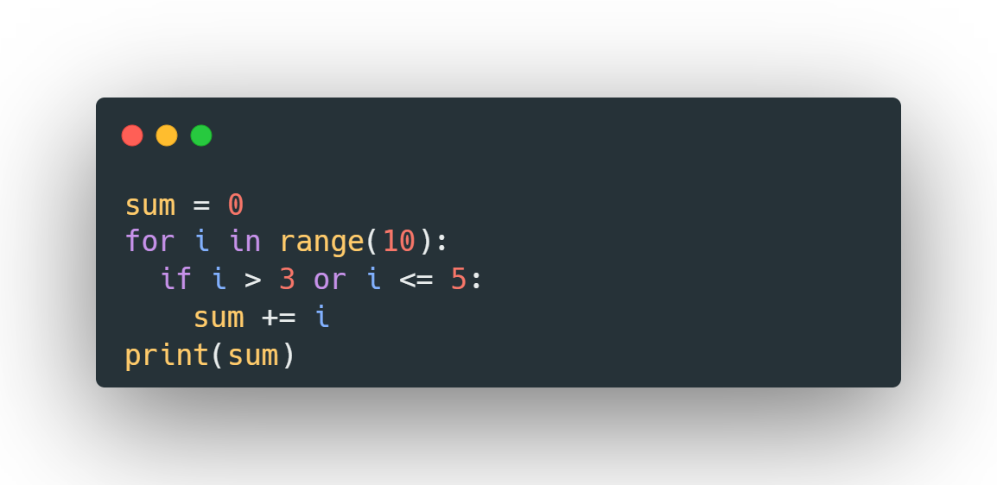
6
STEP | i | i < 10 | i>3 or i<= 5 | sum | OUTPUT
1 | 0 | 0 < 10: TRUE |  | 0
2 | 0 |  | 0>3 or 0<=5 True | 0
3 | 0 |  |  | Sum+=i Sum=0
4 | 1 | 1 < 10: TRUE |  | 0
5 | 1 |  | 1>3 or 1<=5 True | 0
6 | 1 |  |  | Sum+=i Sum=1
7 | 2 | 2 < 10 : TRUE |  | 1
8 | 2 |  | 2>3 or 2<=5 True | 1
9 | 2 |  |  | Sum+=i Sum =3
10 | 3 | 3<10:True |  | 3
11 | 3 |  | 3>3 or 3<=5 True | 3
12 | 3 |  |  | sum+=i Sum=6
13 | 4 | 4<10: True |  | 6
14 | 4 |  | 4>3 or 4<=5 True | 6
15 | 4 |  |  | Sum+=i Sum=10
……….. | ….... | ……………………………………………….. | …………………………………………………………… | ……………………………………….. | ………………………………
25 | 8 | 8<10 :True |  | 28
26 | 8 |  | 8>3 or 8<=5 :True | 28
27 | 8 |  |  | Sum+=i Sum=36
28 | 9 | 9<10 :True |  | 36
29 | 9 |  | 9>3 and 9<=5: True | 36
30 | 9 |  |  | Sum+=i Sum=45 | 45

Slide 8
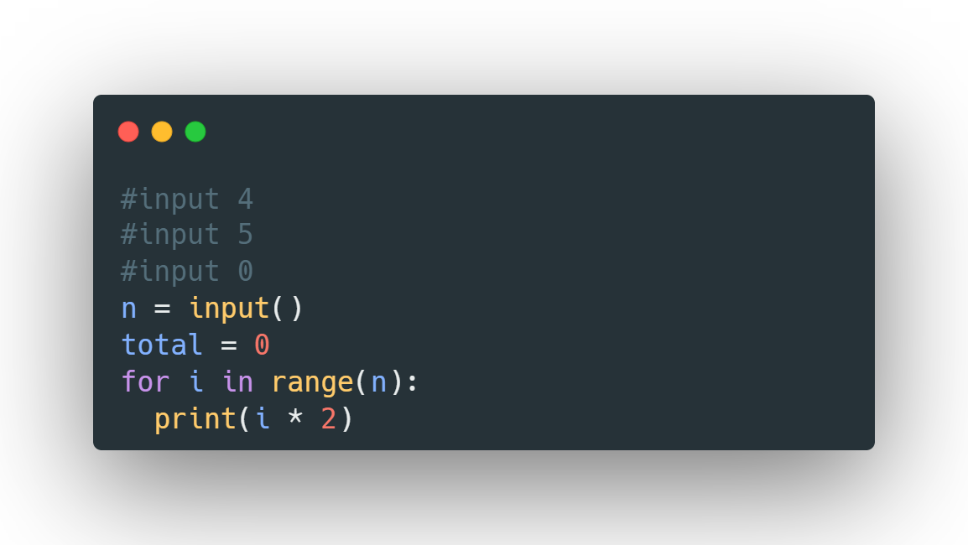
7
STEPc | i | i < 4 | total | OUTPUT
1 |  |  | 0
2 | 0 | 0 < 4:True
3 | 0 | 0*2 |  | 0
4 | 1 | 1<4:True
5 | 1 | 1*2 |  | 2
6 | 2 | 2<4:True
7 | 2 | 2*2 |  | 4
8 | 3 | 3<4:True
9 | 3 | 3*2 |  | 6

Slide 9
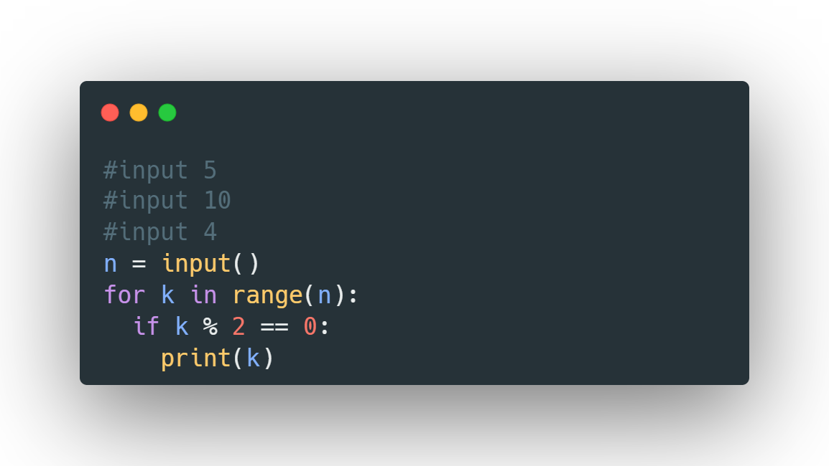
8
STEP | k | k < 4 | K%2==0 | OUTPUT
1 | 0 | 0<4:True
2 | 0 |  | 0%2==0:Fals
3 | 1 | 1<4:True
4 | 1 |  | 1%2==0:Fals
5 | 2 | 2<4:True
6 | 2 |  | 2%2==0:True
7 | 2 |  | k=2 | 2
8 | 3 | 3<4:True
9 | 3 |  | 3%2==0:Fals

Slide 10
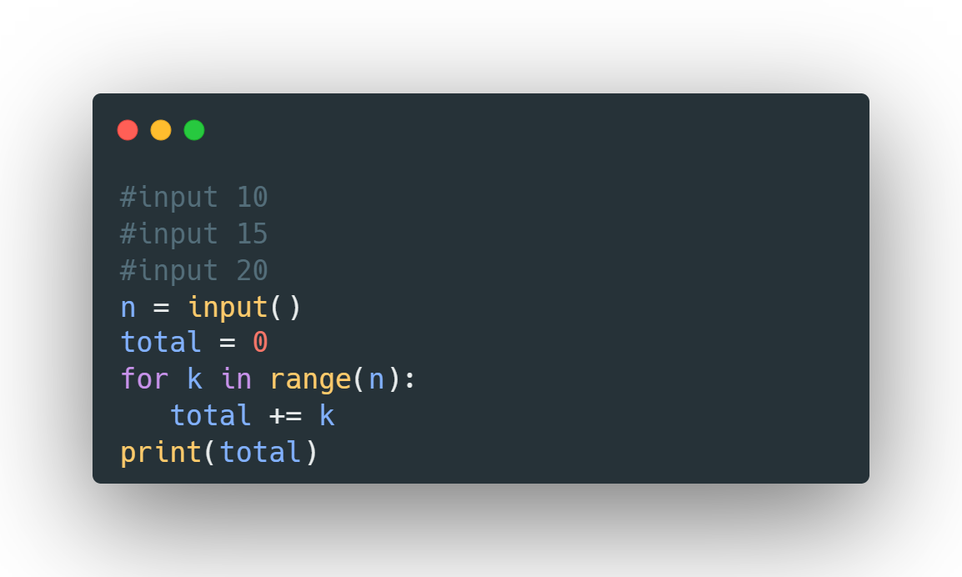
9
STEP | k | k < 10 | total | OUTPUT
1 |  |  | 0
2 | 0 | 0<10:True
3 | 0 |  | Total+=k Total=0
4 | 1 | 1<10:True | 0
5 | 1 |  | Total+=k Total=1
6 | 2 | 2<10:True | 1
7 | 2 |  | Total+=k Total=3
………... | …………. | ………… | ………….. | …………………
17 | 8 | 8<10:True | 28
18 |  |  | Total+=k Total=36
19 |  | 9<10:True | 36
20 |  |  | Total+=k Total=45 | 45

Slide 11
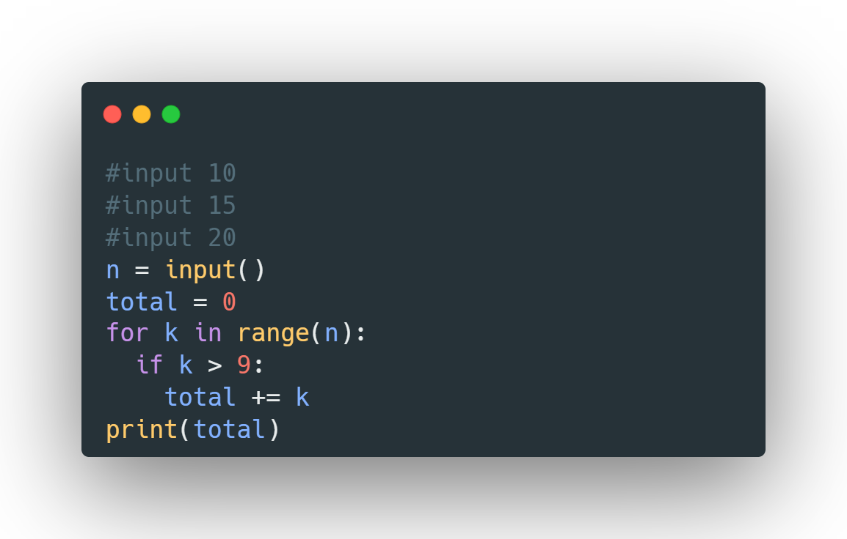
10
STEP | k | k < 10 | K>9 | total | OUTPUT
1 |  |  |  | 0
2 | 0 | 0<10:True
3 | 0 |  | 0>9:Fals
4 | 1 | 1<10:True |  | 0
5 | 1 |  | 1>9:Fals
6 | 2 | 2<10:True |  | 0
 |  |  | 2>9Fale
………... | …………. | ………… |  | ………….. | …………………
17 | 8 | 8<10:True |  | 0
18 |  |  | 8>9:Fale
19 |  | 9<10:True |  | 0
20 |  |  | 9>9:Fale |  | 0

Slide 12
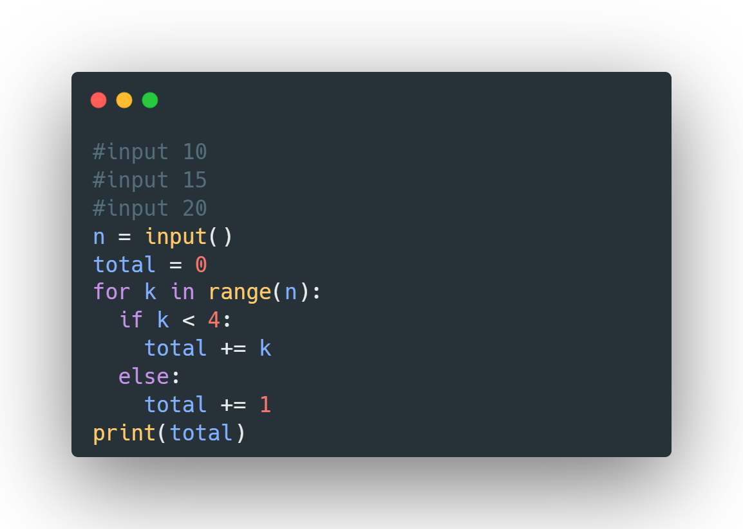
11
STEP | k | k < 10 | K<4 | total | OUTPUT
1 |  |  |  | 0
2 | 0 | 0<10:True |  | 0
3 | 0 |  | 0<4:true
4 | 0 |  |  | Total+=0 Total=0
5 | 1 | 1<10:True |  | 0
6 | 1 |  | 1<4:true | 0
7 |  |  |  | Total+=1 Total=1
8 | 2 | 2<10:True |  | 1
9 |  |  | 2<4:true | 1
10 |  |  |  | Total+=2 Total=3
11 |  | 3<10:true |  | 2
12 |  |  | 3<4:true | 2
13 |  |  |  | Total+=3 Total=5
14 | 4 | 4<10:True |  | 5
15 |  |  | 4<4:false | 5
16 |  |  |  | Total+=1 Total=6
17 |  | 5<10:true |  | 6
18 |  |  | 5<4:false | 6
19 |  |  |  | Total+=1 Total=7
………….. | ………………. | …………………. | …………………………… | ………………….. | …………………………
28 | 9 | 9<10:true |  | 10
29 | 9 |  | 9<4:false | 10
30 | 9 |  |  | Total+=1 Total=11
31 | 9 |  |  | 11 | 11

Slide 13
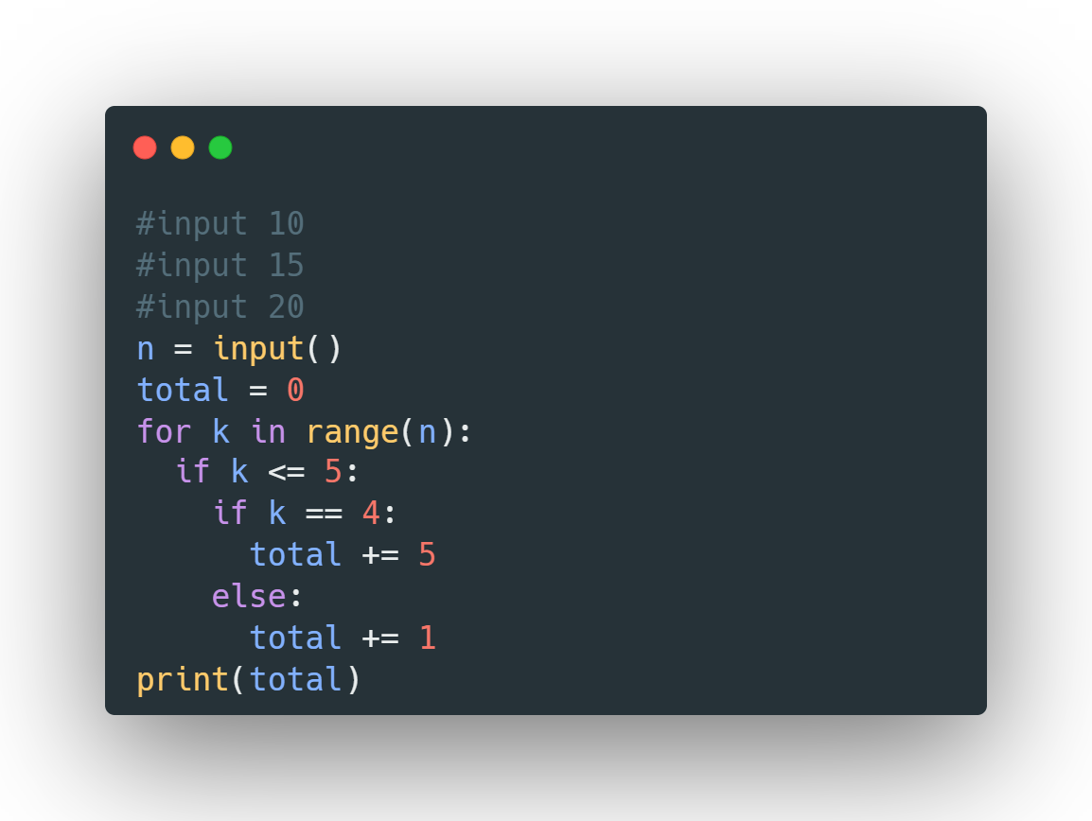
STEPt | k | k < 10 | K<=5 | K==5 | total | OUTPUT
1 |  |  |  |  | 0
2 | 0 | 0<10:True
3 | 0 |  | 0<=5:true
4 | 0 |  |  | 0==4:false
5 | 1 |  |  |  | total+=1 Total=1
6 | 1 | 1<10:True | :t |  | 1
7 |  |  | 1<=5:true |  | 1
8 | 2 |  |  | 1==4:false | 1
9 |  |  |  |  | total+=1 Total=2
10 |  | 2<10:True |  |  | 2
11 |  |  | 2<=5:true |  | 2
12 |  |  |  | 2==4:false | 2
13 |  |  |  |  | total+=1 Total=3
14 | 4 | 3<10:True |  |  | 3
15 |  |  | 3<=5:true |  | 3
16 |  |  |  | 3==4:false | 3
17 |  |  |  |  | total+=1 Total=4
18 |  | 4<10:true |  |  | 4
19 |  |  | 4<=5:true |  | 4
 |  |  |  | 4==4:true | 4
28 |  |  |  |  | total+=5 Total=9
29 |  | 5<10:true |  |  | 9
30 |  |  | 5<=5:true |  | 9
31 |  |  |  | 5==4:false | 9
 |  |  |  |  | total+=1 Total=10
 |  | 6<10:true |  |  | 10
 |  |  | 6<=5:fale |  | 10
………… | …………… | ………………………….. | ……………………………… | ………………………….. | …………… | …………………….
 |  | 9<10:true |  |  | 10
 |  |  | 9<=5:false |  | 10 | 10
12

Slide 14
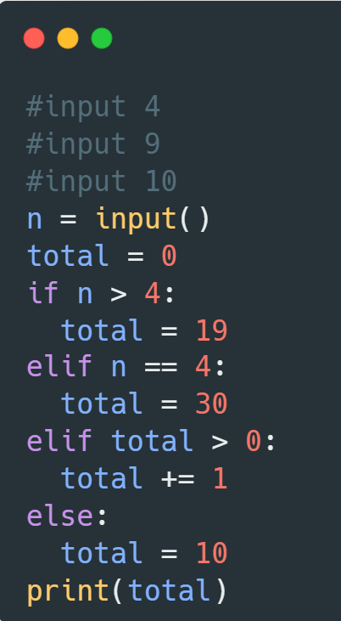
13
STEP | n | n>4 | N==4 | Total>0 | N!=10 | total | OUTPUT
1 |  |  |  |  |  | 0
2 | 4 | 4>4:false |  |  |  | 0
3 | 4 |  | 4==4:true |  |  | 0
4 | 4 |  |  |  |  | 30 | 30

Slide 15
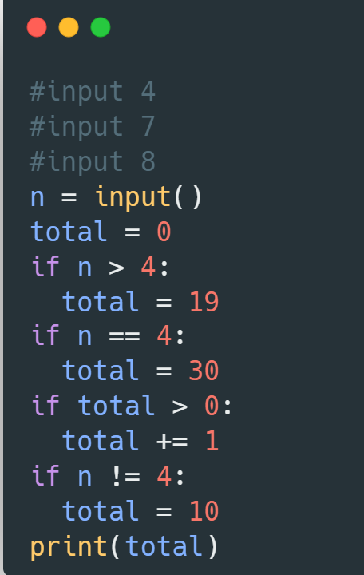
14
STEP | n | n>4 | N==4 | Total>0 | N!=10 | total | OUTPUT
1 |  |  |  |  |  | 0
2 | 4 | 4>4:false |  |  |  | 0
3 | 4 |  | 4==4:true |  |  | 0
4 | 4 |  |  |  |  | 30
5 | 4 |  |  | 30>0:true |  | 30
6 | 4 |  |  |  |  | Total+=1 Total=31
7 | 4 |  |  |  | 4!=10:true | 31
8 | 4 |  |  |  |  | 10 | 10

Slide 16
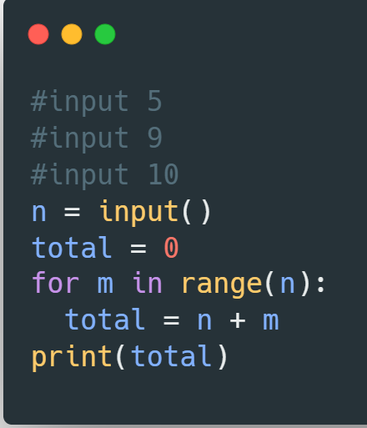
15
STEP | n | m | m<5 | total | OUTPUT
1 | 5
2 | 5 |  |  | 0
3 | 5 | 0 | 0<5:true
4 | 5 | 0 |  | 5+0=5
5 | 5 | 1 | 1<5:true | 5
6 | 5 | 1 |  | 5+1=6
7 | 5 | 2 | 2<5:true | 6
8 | 5 | 2 |  | 5+2=7
9 | 5 | 3 | 3<5:true | 7
10 | 5 | 3 |  | 5+3=8
11 | 5 | 4 | 4<5:True | 8
12 | 5 | 4 |  | 5+4=9
13 | 5 | 4 |  | 9 | 9

Slide 17
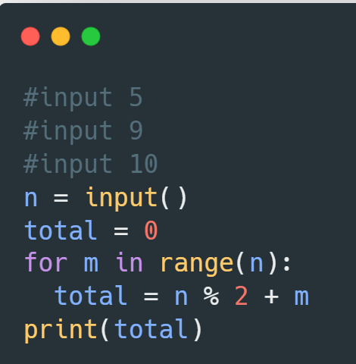
16
STEP | n | m | m<5 | total | OUTPUT
1 | 5
2 | 5 |  |  | 0
3 | 5 | 0 | 0<5:true
4 | 5 | 0 |  | 5%2+0=2.5
5 | 5 | 1 | 1<5:true | 2.5
6 | 5 | 1 |  | 5%2+1=3.5
7 | 5 | 2 | 2<5:true | 3.5
8 | 5 | 2 |  | 5%2+2=4.5
9 | 5 | 3 | 3<5:true | 4.5
10 | 5 | 3 |  | 5%2+3=5.5
11 | 5 | 4 | 4<5:True | 5.5
12 | 5 | 4 |  | 5%2+4=6.5
13 | 5 | 4 |  | 6.5 | 9

Slide 18
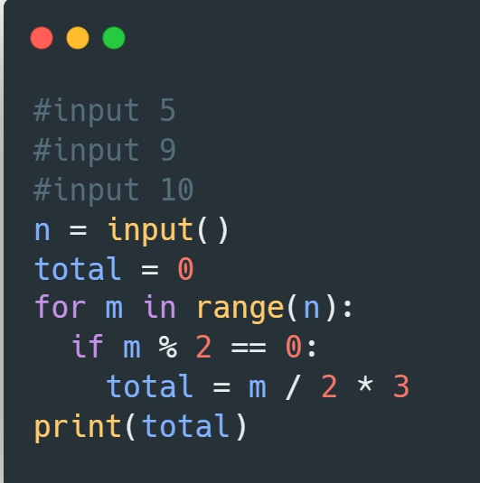
17
STEP4 | n | m | m<5 | m%2==0 | total | OUTPUT
1 | 5
2 | 5 |  |  |  | 0
3 | 5 | 0 | 0<5:true |  | 0
4 | 5 | 0 |  | 0%2==0:false | 0
5 | 5 | 1 | 1<5:true |  | 0
6 | 5 | 1 |  | 1%2==0:false | 0
7 | 5 | 2 | 2<5:true |  | 0
8 | 5 | 2 |  | 2%2==0:True | 0
9 | 5 | 3 |  |  | 2/2*3=3
10 | 5 | 3 | 3<5:true |  | 3
11 | 5 | 4 |  | 3%2==0:false | 3
12 | 5 | 4 | 4<5:True |  | 3
13 | 5 | 4 |  | 4%2==0:false | 3
14 | 5 | 4 |  |  | 4/2*3=6
15 | 5 | 4 |  |  | 6 | 6

Slide 19
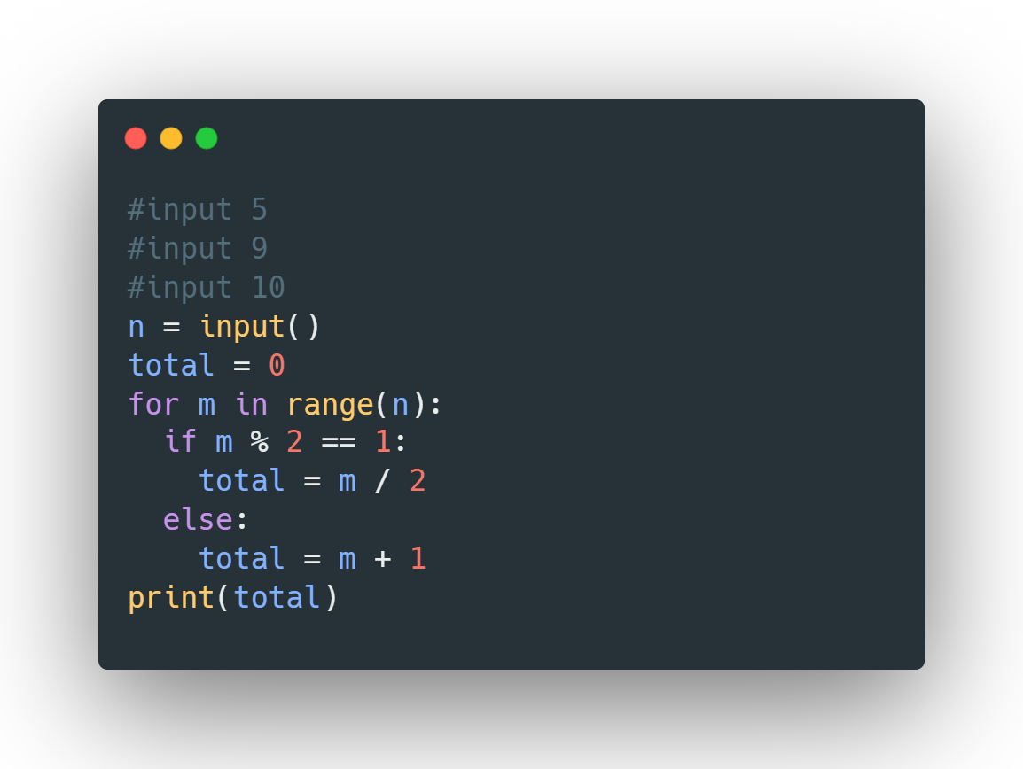
18

Slide 20
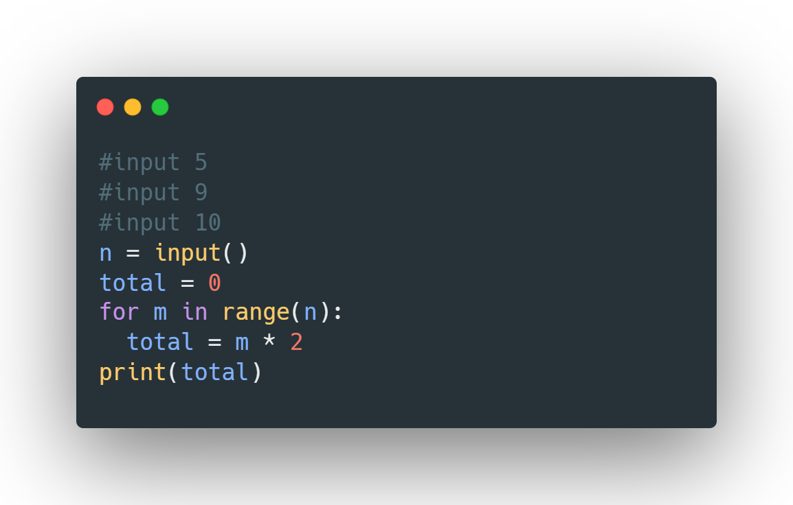
19

Slide 21
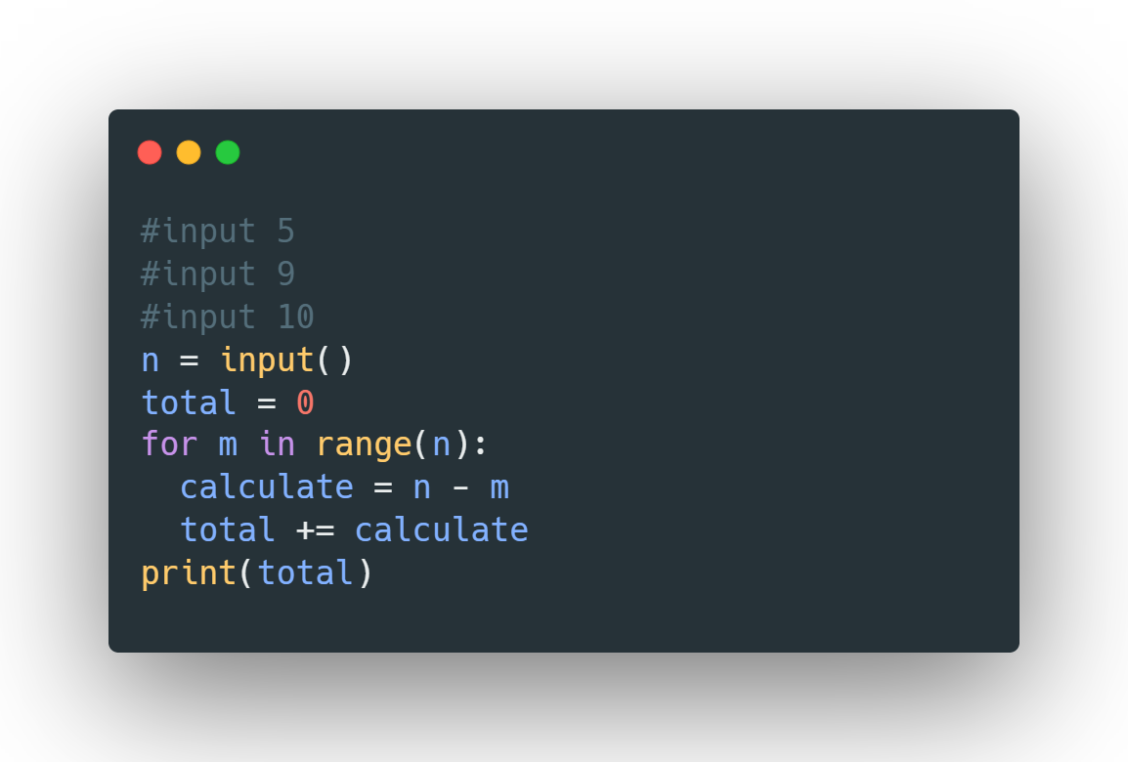
20

Slide 22
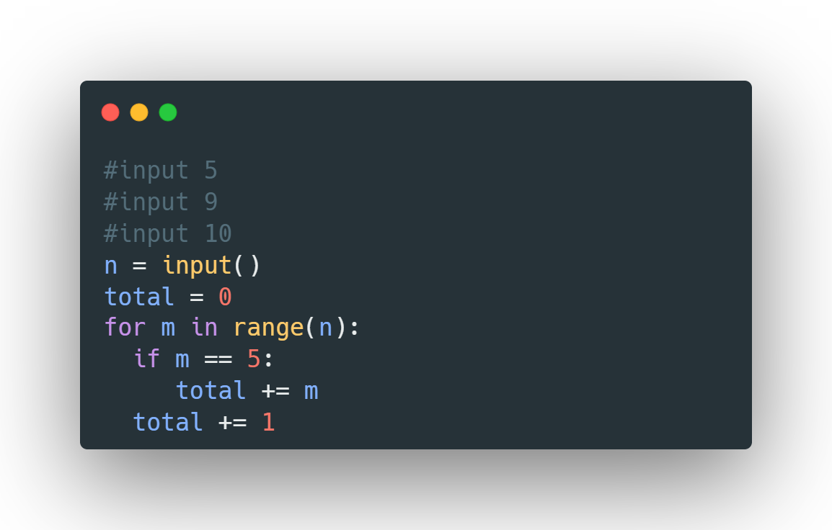
21

Slide 23
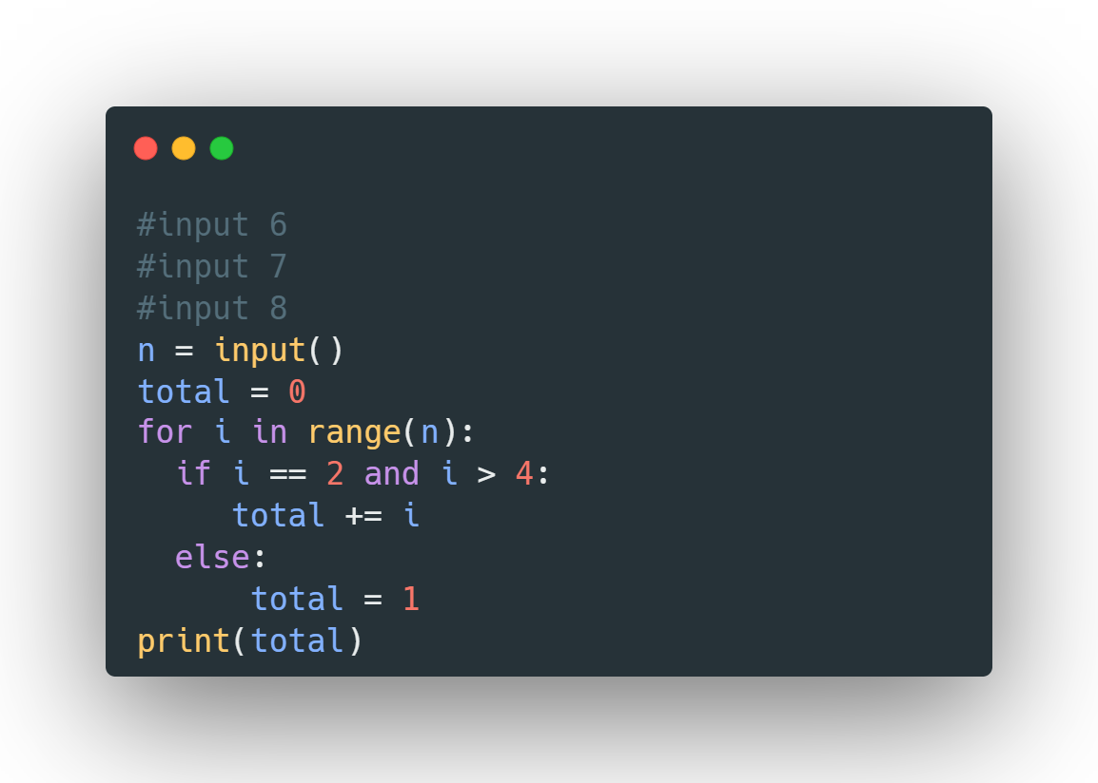
22

Slide 24

23

Slide 25
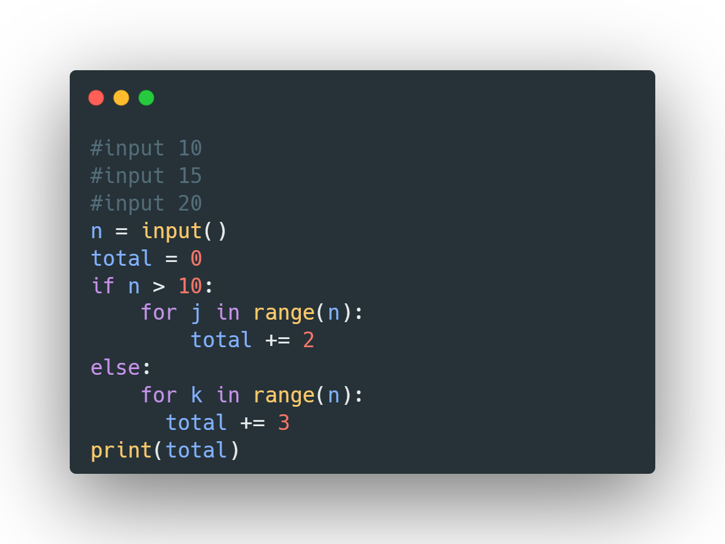
24

Slide 26
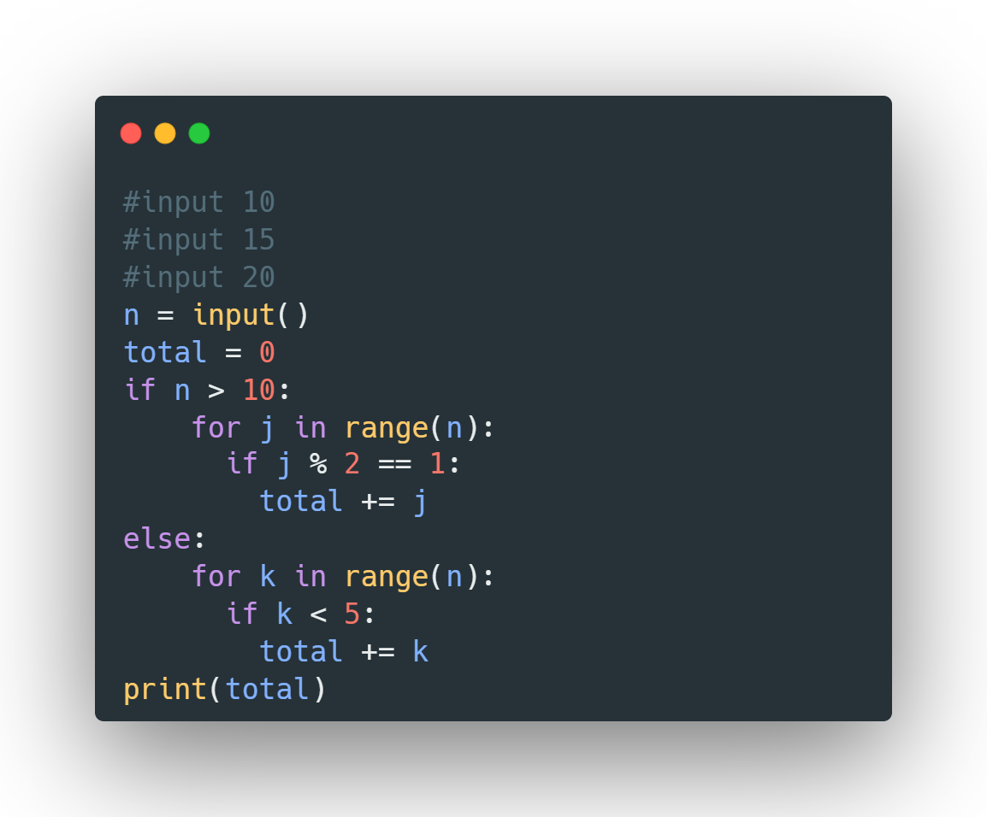
25

