Slide 1

Class Activity 01
Mathematical Reduction of Set Covering Problem
October 20, 2023
313884 Hossein Khodadadi
123456 Abolfazl Javidian
Computational Intelligence
2023/2024

Slide 2


Slide 4
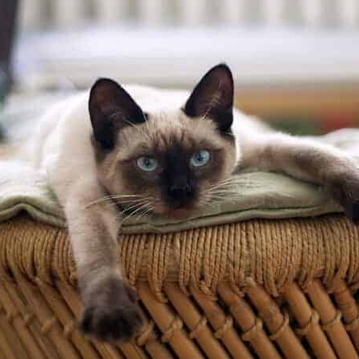
Cur
cur

Slide 5
Problem with the current solutions?
MANY FALSE POSITIVES!
Why?
Independent comparisons
Domain bias
Task bias

Slide 6
Thank you!
Any questions?
313884 Hossein Khodadadi
123456 Abolfazl Javidian
Computational Intelligence
2023/2024
Information Theory for DS 2023/2024

