Slide 1
OCR-Projet 3
Dynamisez une page web avec des animations CSS

Slide 2
Animation du coeur SASS
#toggle-heart:checked + .homepage-heart,
#toggle-heart:checked + .secondary-page-heart,
#toggle-heart2:checked + .homepage-heart,
#toggle-heart2:checked + .secondary-page-heart,
#toggle-heart3:checked + .homepage-heart,
#toggle-heart3:checked + .secondary-page-heart,
#toggle-heart4:checked + .homepage-heart,
#toggle-heart4:checked + .secondary-page-heart {
background-image: url(../Assets/Status=Liked.svg);
transition-duration: 1s;
&:hover {
transform: scale(1.3);
transition: all 1s;
}
} #toggle-heart + .secondary-page-heart,
#toggle-heart + .homepage-heart,
#toggle-heart2 + .secondary-page-heart,
#toggle-heart2 + .homepage-heart,
#toggle-heart3 + .secondary-page-heart,
#toggle-heart3 + .homepage-heart,
#toggle-heart4 + .secondary-page-heart,
#toggle-heart4 + .homepage-heart {
background-image: url(../Assets/Status=Default.svg);
&:hover {
transform: scale(1.3);
transition: all 1s;
}
}
<label class="labelsecondary" for="toggle-heart">
<input id="toggle-heart” type="checkbox"/>
<i class="secondary-page-heart"></i>
</label>
Notes:
Ligne 777 – style.scss

Slide 3
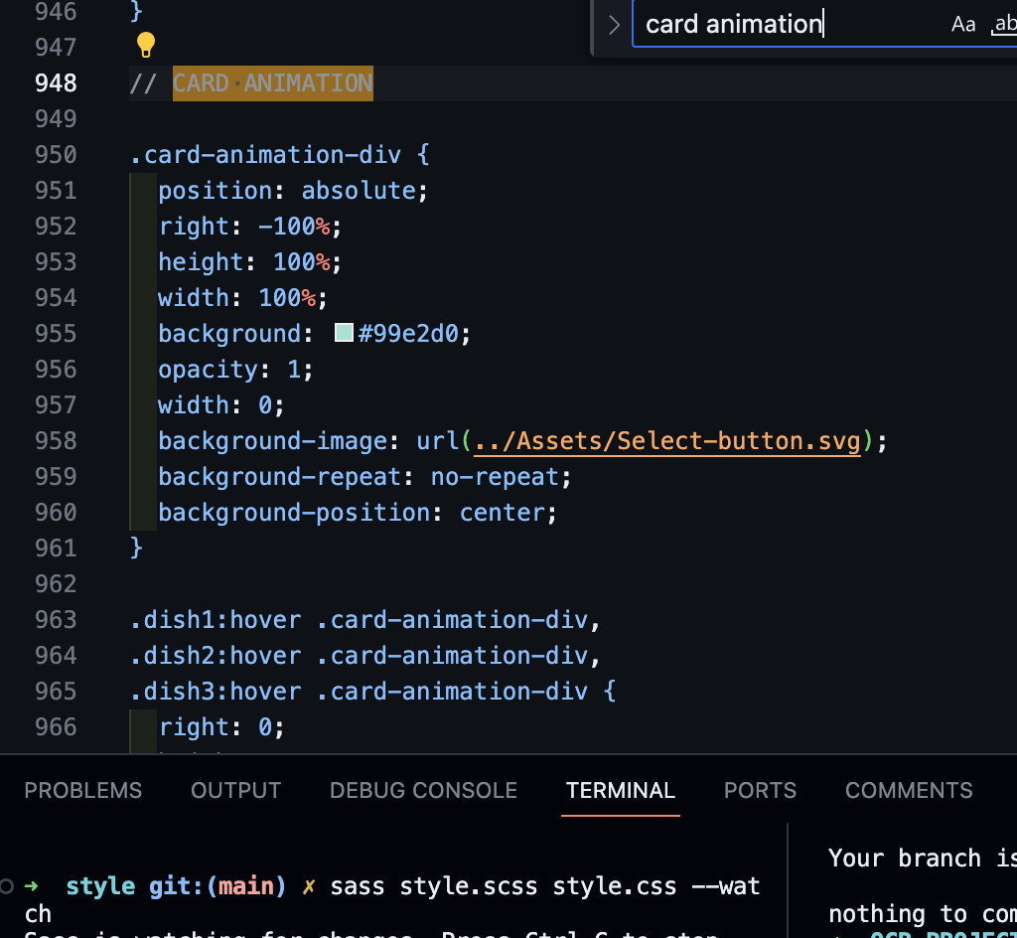
Sélecteur de plat SASS
Notes:
Hover on dish card
translateX on dish price
Elipsis on dish spec
Width change on checkbox div

Slide 4
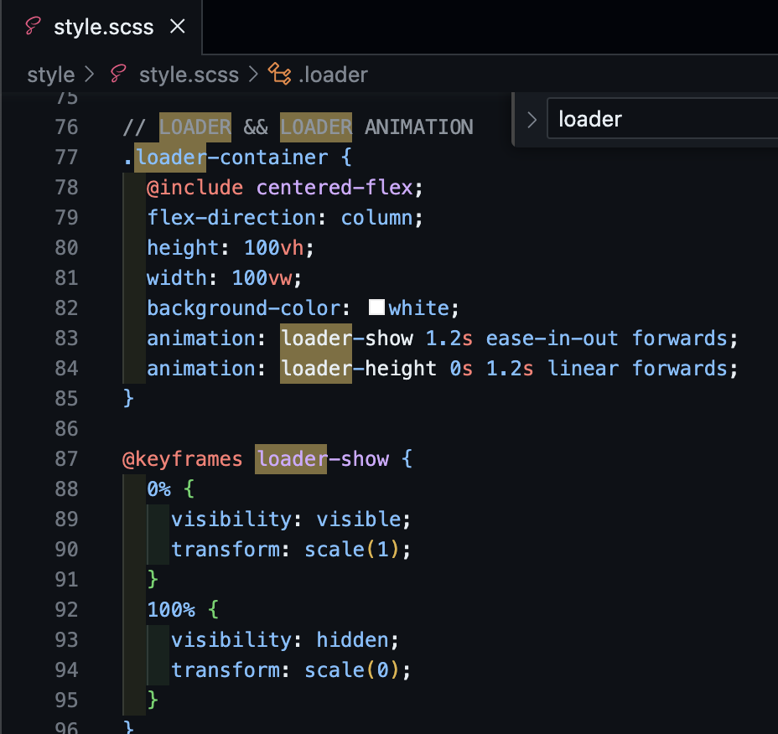
loader de la page d’accueil SASS

Slide 5
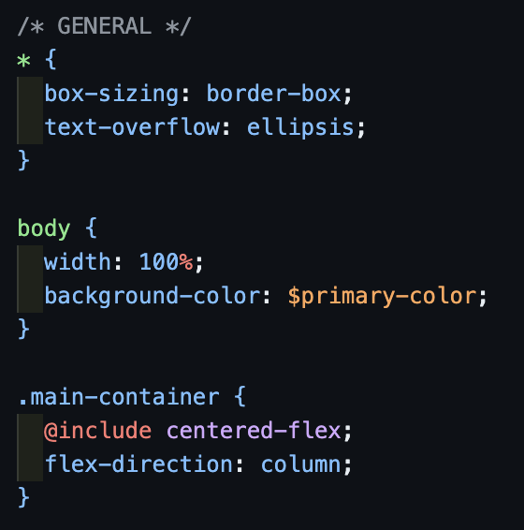
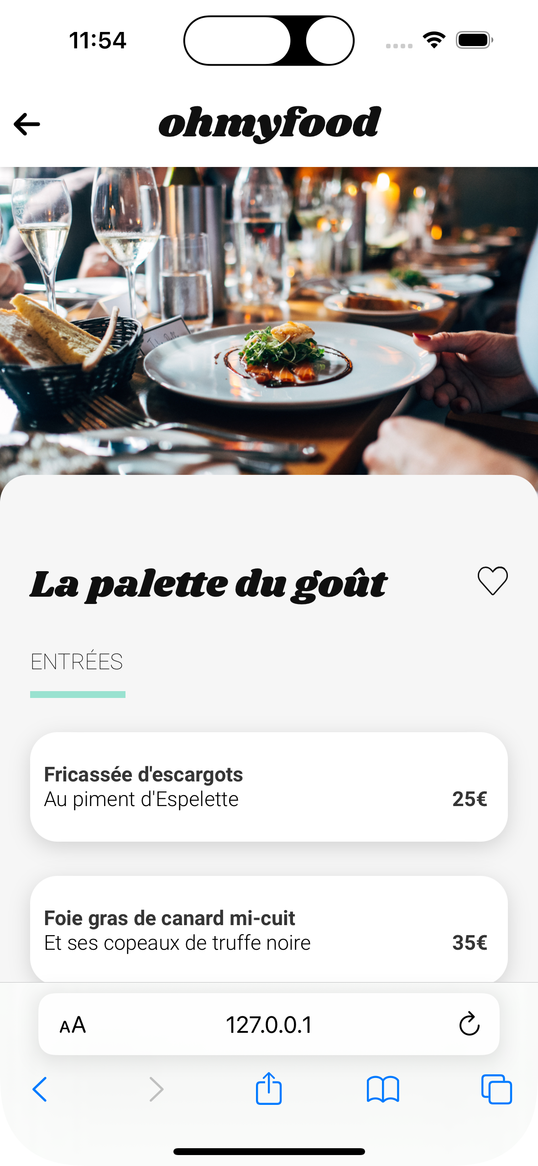
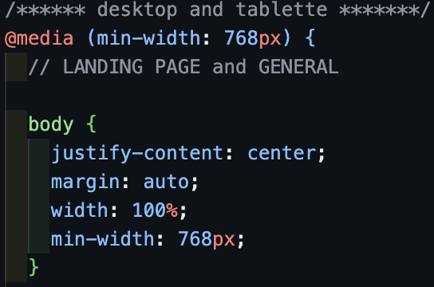
mobile first
breakpoint

