Slide 1
Blackjack-Copilot
Assistance of the Blackjack Card game
Notes:
Hello this is embedded team 4, and Hohyeon Cha as announcer
I’ll introduce about our project “blackjack-copilot”

Slide 2
Introduction
When we are trying to play card games
There are so many rules to memorize!
What is the winning rule?
How to do action in given situation?
Practicing the card game is an easy way to enjoy it fully
But, if once you try to play the game suddenly,
Then you might need to have some assistance.
Notes:
Have you ever played card games with friends? Playing familiar card games is enjoyable, but if someone suggests a new card game, it can be difficult to adapt to and memorize the new rules. Properly understanding and enjoying a card game requires practice. However, as mentioned earlier, suddenly trying out a card game can be challenging.
Therefore, to play card games, some form of assistance is needed.
혹시 친구들과 카드 게임을 해보신적이 있나요?
익숙한 카드 게임을 하는 것을 즐겁지만, 만약 누군가 새로운 카드 게임을 제안한다면 새로운 규칙에 적응하고 외우는 것이 어렵습니다.
카드 게임을 제대로 이해하고 즐기기 위해서는 반드시, 연습이 필요합니다. 하지만 앞서 언급한 상황처럼 카드 게임을 갑자기 시도하기에는 어려움이 존재합니다.
따라서, 카드 게임을 하기 위해서는 일종의 도움이 필요합니다.

Slide 3
Introduction
By using object detection AI,
We can specify what is the given situation in the game.
Assistance give recommended action with detected object
By using any deterministic Algorithm
By using further ai..
Thus, We can easily get recommendations in the real world
making a program with object detection ai and recommend algorithm
Notes:
Since it is difficult to receive such assistance from friends every time, I thought about implementing an application that allows one to practice and play alone. To do this, the application must be able to understand the state of the card game. It is very inconvenient to manually input the values to understand the state of the card game. Therefore, by using an object detection model called YOLOv8, we can read the card game board.
After reading the information, we need an algorithm to assist the user by suggesting what actions to take. This can be implemented using decisive algorithms or AI, among other methods.
이러한 도움을 매번 친구들에게 받기 어려우므로, 혼자서 연습하고 플레이 할 수 있도록 어플리케이션을 구현하면 어떨까라는 생각을 하였습니다.
이에, 카드 게임을 진행하면서 어플리케이션이 도움을 주기 위해서는 카드 게임의 상황을 파악할 수 있어야 합니다.
카드 게임의 상황을 파악하기 위해서, 우리가 일일이 값을 입력하는 방식은 매우 불편합니다.
그래서 YOLOv8이라는 객체 탐지 모델을 이용하여, 카드 게임 판을 읽어 들일 수 있도록 합니다.
그리고 나서, 읽어들인 정보들을 토대로, 사용자로 하여금 어떠한 행동을 취해야 하는지 알려주는 알고리즘을 통해 도움을 주어야 합니다.
이를 구현하기 위해서 결정적인 알고리즘 혹은 AI 등을 이용하여 구현할 수 있습니다.

Slide 4
Getting into Build the project
Two important feature for our project
Object Detection
Recommendation Algorithm
We are trying to get information from card game
In this project, we assume that we are playing Blackjack
Notes:
Therefore, we can provide assistance in real-world card games through object detection and recommendation algorithms.
Among various card games, we aim to demonstrate that assistance can be provided through the implementation of object detection and recommendation algorithms based on the card game Blackjack.
따라서, 우리는 실제 세계 카드 게임에서 객체 탐지와 추천 알고리즘을 통해 Assistance를 제공할 수 있다.
다양한 카드 게임 중에서, Blackjack이라는 카드 게임을 바탕으로 객체 탐지와 추천 알고리즘의 구현을 통해서, Assistance를 줄 수 있었음을 보여주고자 한다.

Slide 5
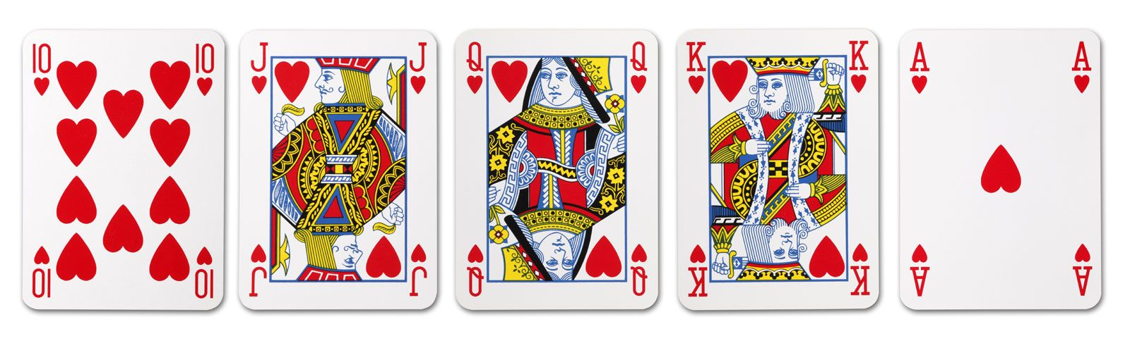
Blackjack
The goal of the game
Have a hand value closer to 21 than the dealer’s without exceeding 21
Using the basic Playing cards (Trump cards)
Notes:
Blackjack is a simple card game where you win by having a hand that is greater than the dealer's hand without exceeding 21. Essentially, Blackjack can be played using playing cards.
Blackjack은 자신이 가지고 있는 카드 패가 딜러가 가지고 있는 패보다 많으면서 21을 넘지 않아야 승리할 수 있는 간단한 카드 게임
기본적으로 블랙잭은 Playing card를 사용하여 게임할 수 있다.

Slide 6
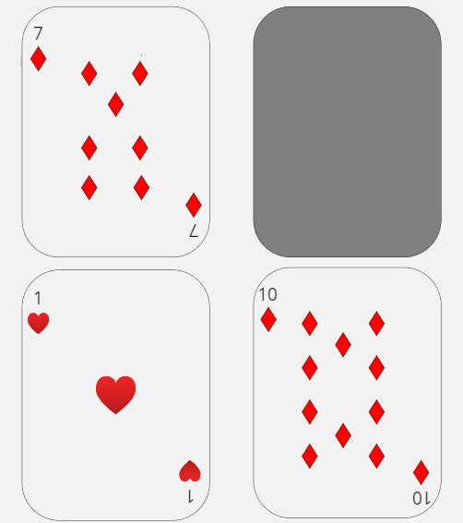
Rule Explanation
Each Player and Dealer gets 2 card
In this situation, the dealer reveals one of the two cards
Player lays down and bets for winning.
For Dealer
For Player
Notes:
When the game starts, both the dealer and the player receive two cards each, with the dealer revealing only one card. Based on the two cards they have, the player can choose to take actions such as Hit, Stand, or Split.
For instance, hitting means taking one more card. Standing means not taking any more cards and directly comparing with the dealer.
게임이 시작하면, 딜러와 플레이어는 각각 카드 두 장을 받고 딜러는 한 장만 카드를 공개한다.
플레이어는 가지고 있는 카드 두 장을 통해서 Hit, Stand, Split 등의 행동을 취할 수 있다.
대표적으로 설명하자면, 힛을 하는 경우, 카드를 한 장 더 받는 것을 의미한다.
스탠드는 카드를 받지 않고 딜러와 바로 비교한다.

Slide 7
Rule Explanation
Special Counting Rule for Ace card
Ace can be considered as 1 or 11
It depends on whether hand value exceeds 21 or not
When hand value doesn’t exceed, considered as 11
When hand value exceeds, considered as 1
Notes:
There is a special rule here: the Ace can be considered as either 1 or 11. If the total value of the cards exceeds 21, the Ace is considered as 1; otherwise, it can be considered as 11.
여기서 특별한 Rule이 존재하는데, Ace는 1 혹은 11로 고려 될 수 있는데, 만약 카드의 합이 21을 초과하면 1, 그렇지 않은 경우 11로 고려할 수 있다.

Slide 8
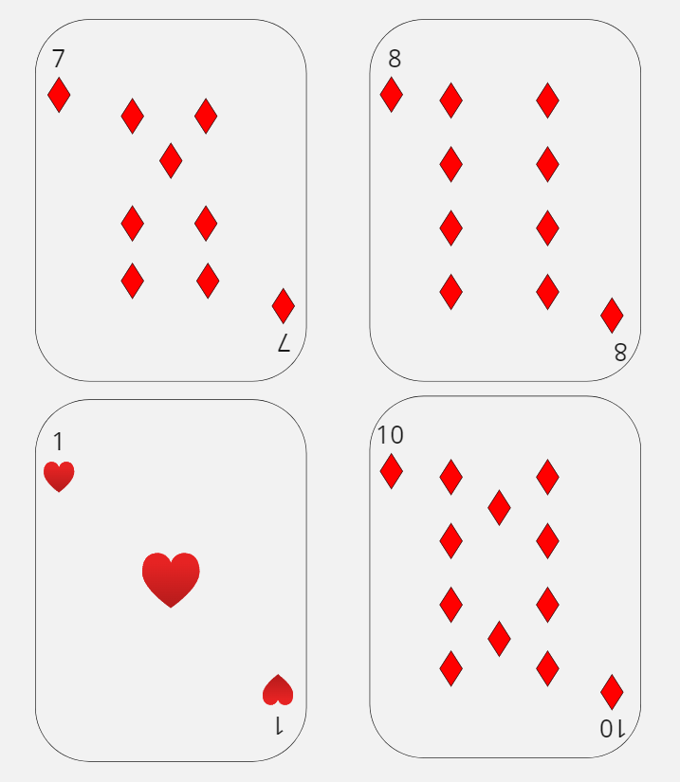
Rule Explanation
In this situation, Ace card will be consider as 11
Thus, in this case, player win (Must win case)
For Dealer
For Player
Notes:
In this case, since the player's card is 21, it is calculated as 11 because it does not exceed.
이 경우, Player의 카드가 21이므로, 초과하지 않아 11로 계산된다.

Slide 9
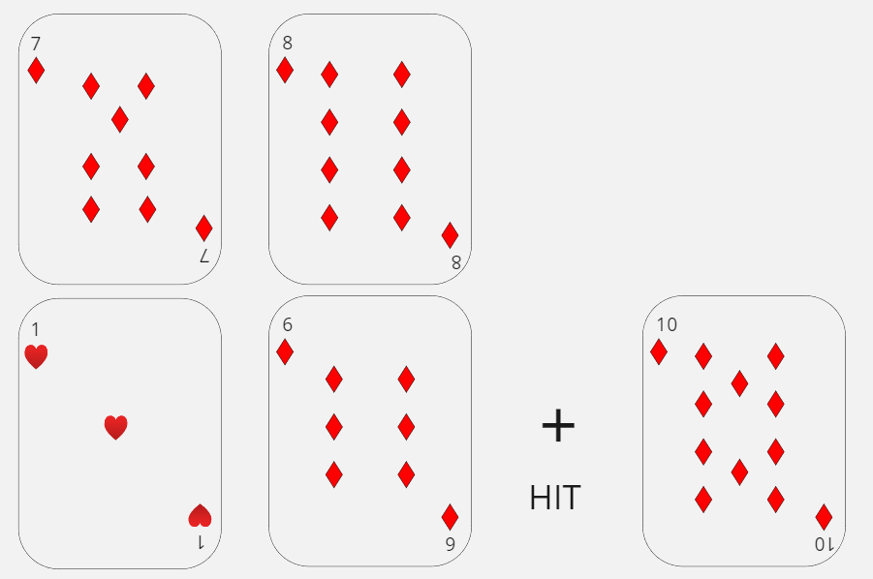
Rule Explanation
In this situation, Ace card will be considered as 1
Thus, in this case, the player wins
For Dealer
For Player
Notes:
In this case, before the Hit, the total is 17, which does not exceed 21, so the Ace is counted as 11. However, after the Hit, the total exceeds 21, so the Ace is counted as 1.
해당 경우, Hit 이전에는 17로 21을 초과하지 않으므로 Ace를 11로 계산한다. 하지만, Hit 이후에는 21을 초과하게 되므로 1로 고려한다.

Slide 10
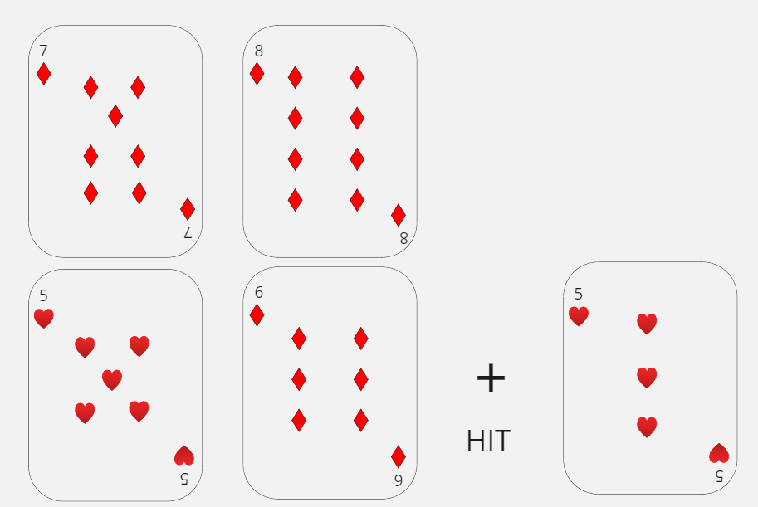
Rule Explanation
Player can get more cards whenever player hits
For Dealer
For Player

Slide 11
Rule Explanation
In Blackjack
deciding what actions to take with the initial two cards is crucial
In this situation, Blackjack Strategy Lookup table used
This table gives recommended action with initial two cards
Notes:
Therefore, in Blackjack, the decision made after receiving the first two cards is very important. For this situation, a look-up table is provided, recommending the next action based on the initial two cards and the dealer's card.
따라서, 블랙잭에서는 처음 카드 두 장을 받고 나서 내리는 결정이 매우 중요하다.
이러한 상황을 위해서, Look up table을 제공하는데 처음 카드 두 장과 딜러의 카드를 바탕으로 다음 행동을 추천한다.

Slide 12
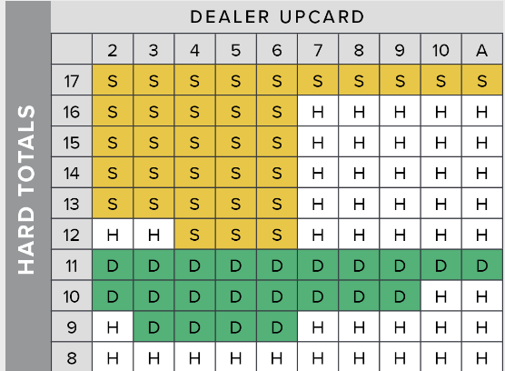
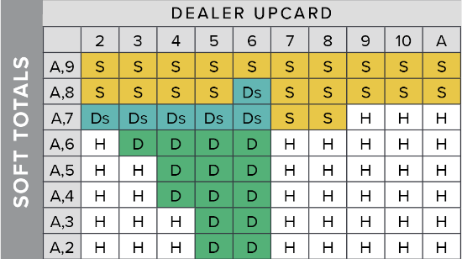
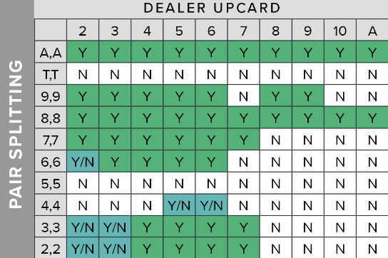
Blackjack Strategy Lookup Table
By using this precalculated table
We can give recommendation to player
Reference
https://www.blackjackapprenticeship.com/blackjack-strategy-charts/
Notes:
A lookup table calculates the most effective action probabilistically and provides a decisive action algorithm. Therefore, it does not use a separate artificial intelligence model. The lookup table used in the project can be referenced from the provided source.
Lookup table은 확률적으로 가장 효과적인 행동을 계산하여, 결정적으로 제공하는 행동 알고리즘이다.
따라서, 별도의 인공지능 모델을 사용하지 않는다.
프로젝트에서 사용한 Look up table은 reference에서 참고할 수 있다.

Slide 13
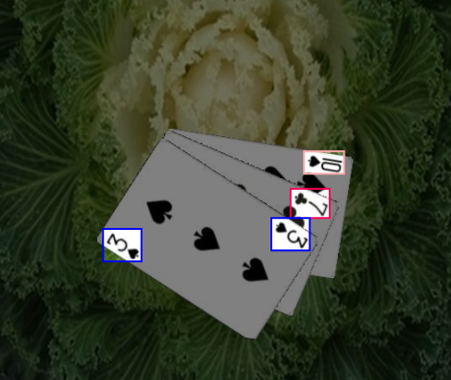
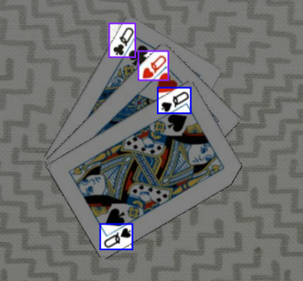
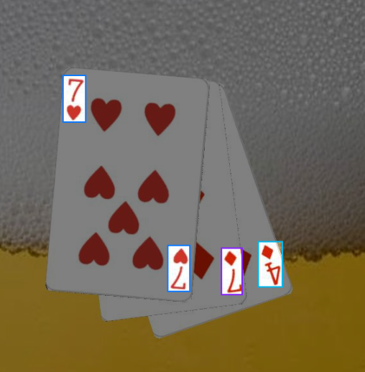
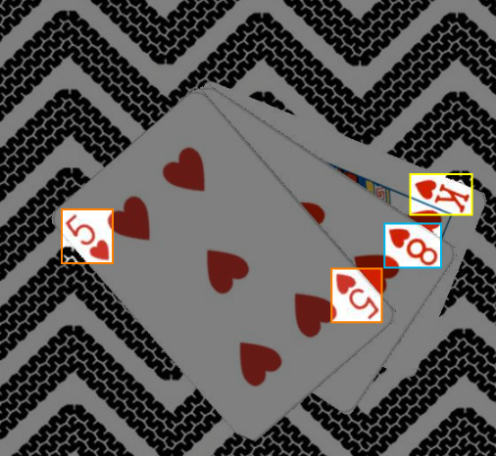
Getting into Build the project
Object Detection
Using YOLOv8 (Object Detection AI)
Dataset
Roboflow Playing Cards Dataset
https://universe.roboflow.com/augmented-startups/playing-cards-ow27d
10100 images, provided as YOLOv8 format
← Example of
the dataset image
Notes:
To build the project, we used YOLOv8 for object detection. The dataset was provided by Roboflow. The dataset contains 10,100 playing cards images, formatted to be suitable for YOLOv8 training.
프로젝트를 빌드 하기 위해서, 우리는 YOLOv8을 사용하여 객체 탐지를 진행했다.
Dataset은 Roboflow에서 제공한 데이터 셋을 사용하였다.
데이터 셋 내에는 10100개의 이미지가 존재하며, YOLOv8이 학습할 수 있도록 형식화하였다.

Slide 14
Model Train
Train the model based on pretrained model
Classes : [number][shape]
Ex. 10H, 9S, 7C, etc.
Main Argument for training model
Epochs: 13
Batch size : 16
Image Size : 416
Notes:
In the pretrained model, we initially trained for 10 epochs and then further trained for an additional 3 epochs using the same dataset. The classes of the images are composed of number-suit combinations.
The parameters used for training are as follows:
Pretrained model에서는 기본적으로 10 epoch를 훈련하였으며, 동일한 데이터 셋으로 3 epoch를 추가로 학습하였다.
이미지의 클래스는 숫자-모양으로 구성되어 있다.
학습을 위해서 사용한 파라미터는 다음과 같다.

Slide 15
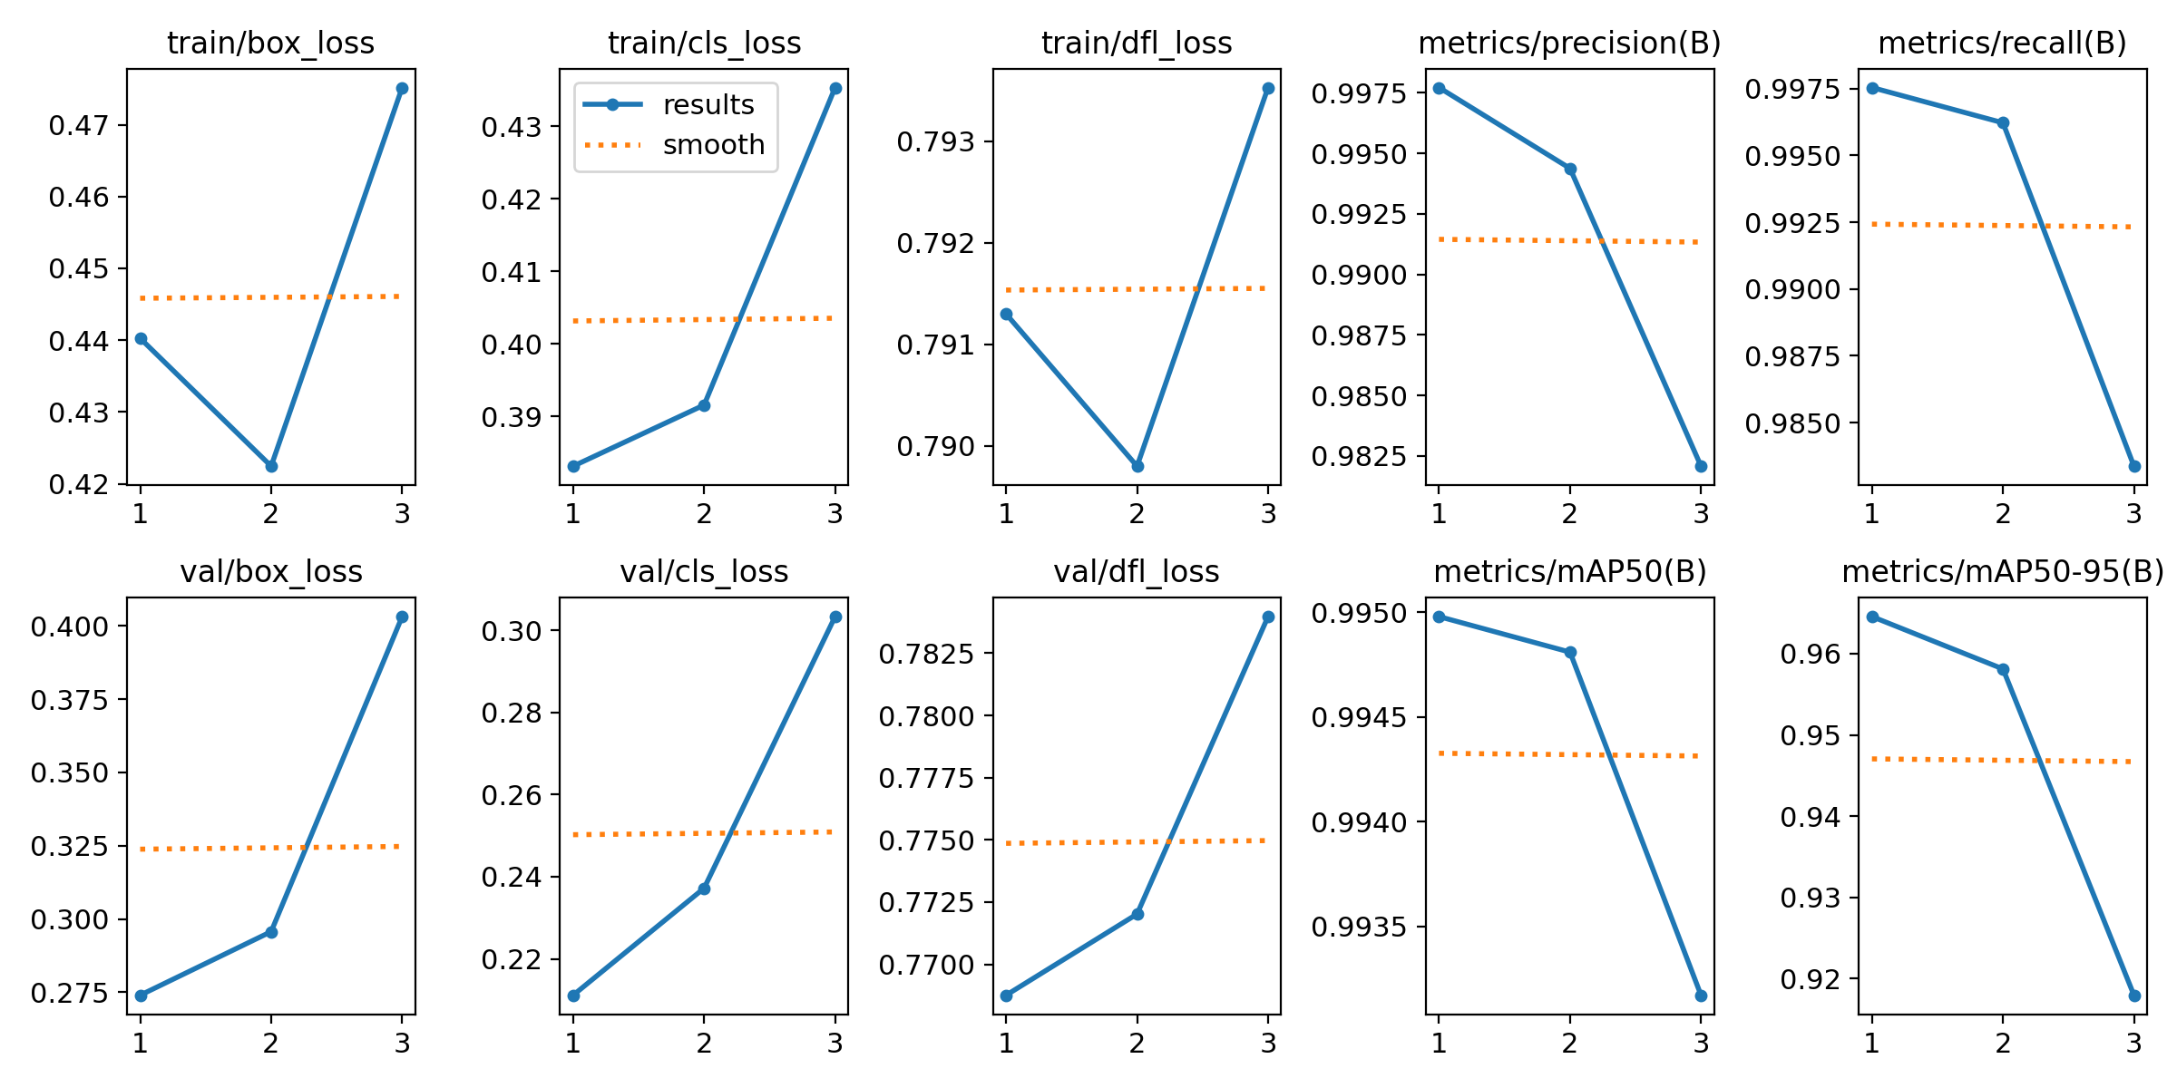
Train Result
After epoch 2, loss is slightly increased
Overfitting occurred
Notes:
As can be seen from the train results, adding 3 additional epochs resulted in overfitting, causing an increase in loss rather than improved performance.
Train result를 보면 알 수 있듯, 3 epoch를 추가로 학습하였을 때 성능 감소보다 overfitting으로 인해 loss가 발생하였다.

Slide 16
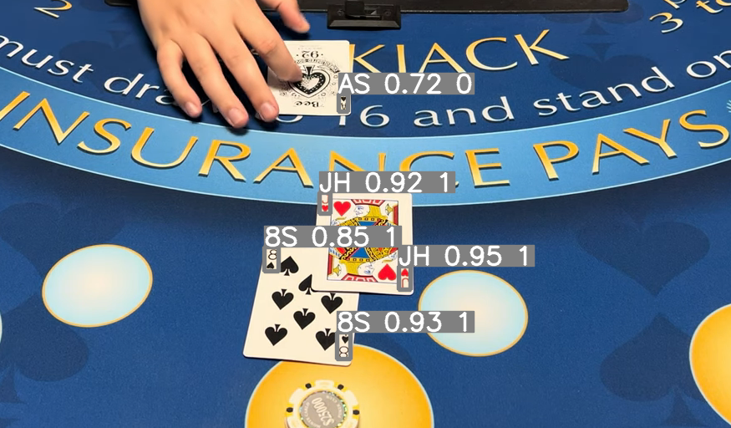
Training Result
Even though overfitting occurred,
Still works with reasonable high accuracy
Example: Result of Blackjack-copilot/ML/examples/predict_image.py
Notes:
However, although overfitting occurred, it was sufficient to draw meaningful results. This photo can be tested by running the file in the corresponding path of the repository.
하지만 overfitting이 발생하였으나, 유의미한 결과를 내리기에 충분하였다.
해당 사진은, 레포지토리의 해당 경로에 있는 파일을 실행하여 테스트할 수 있다.

Slide 17
Gathering Object Detecting Cards
Then, how do we separate dealer’s and player’s card?
We need to make each dealer and player cards separated
Notes:
Now that we can distinguish the cards in the image, we need to differentiate between the dealer's cards and the player's cards.
Therefore, some form of clustering is required.
그렇다면, 이미지에서 카드를 구분할 수 있게 되었으므로, 딜러의 카드와 플레이어의 카드를 구분할 수 있도록 해야한다.
따라서, 일종의 군집화가 필요하다.

Slide 18
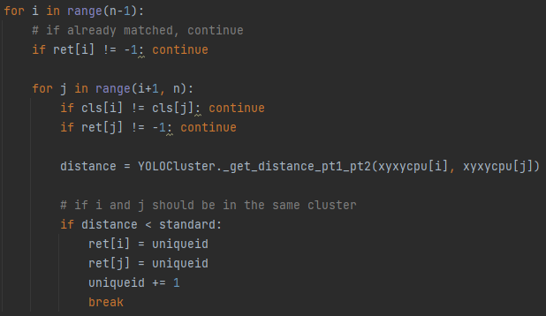
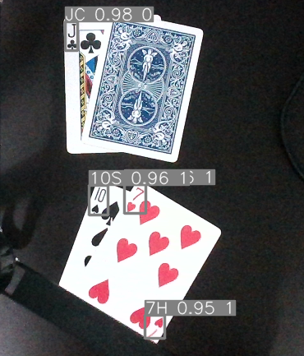
Gathering Object Detecting Cards
Applying some deterministic clustering algorithm
If the objects are closer than the threshold, then model clusterize the object into player’s or dealer’s card
Notes:
For the clustering algorithm, an AI model such as K-means can be used, but in this project, clustering was performed based on a threshold. Therefore, if two objects exist within a specific threshold, they are included in one cluster.
군집화 알고리즘의 경우, K-mean와 같은 AI 모델을 사용할 수 있으나, 해당 프로젝트에서는 임계치에 따른 군집화를 진행하였다.
따라서, 특정한 임계치 내에 두 개의 객체가 존재하는 경우, 하나의 군집에 포함하도록 한다.

Slide 19
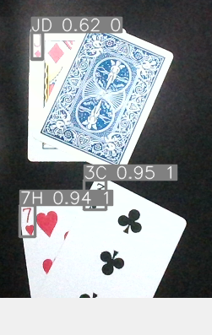
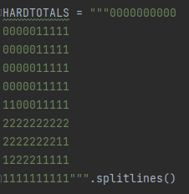
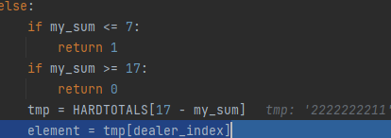
Implementing Recommend Algorithm
We are using Look-up table
For example, vertical index stands for total hand sum
Horizonal index stands for dealer’s up cards
Sum
Access
Notes:
Based on the clustered information, the get_recommended_action function returns the appropriate action. The lookup table is implemented as a string matrix, allowing the mentioned function to quickly access the table and provide the recommended action.
이렇게 군집화된 정보를 바탕으로, get_recommended_action 함수를 통해서 적절한 행동을 반환하게 된다.
Lookup table을 문자열 행렬로 구현하여, 앞서 언급한 함수에서 빠르게 table에 접근하여 recommended action을 제공할 수 있게 하였다.

Slide 20
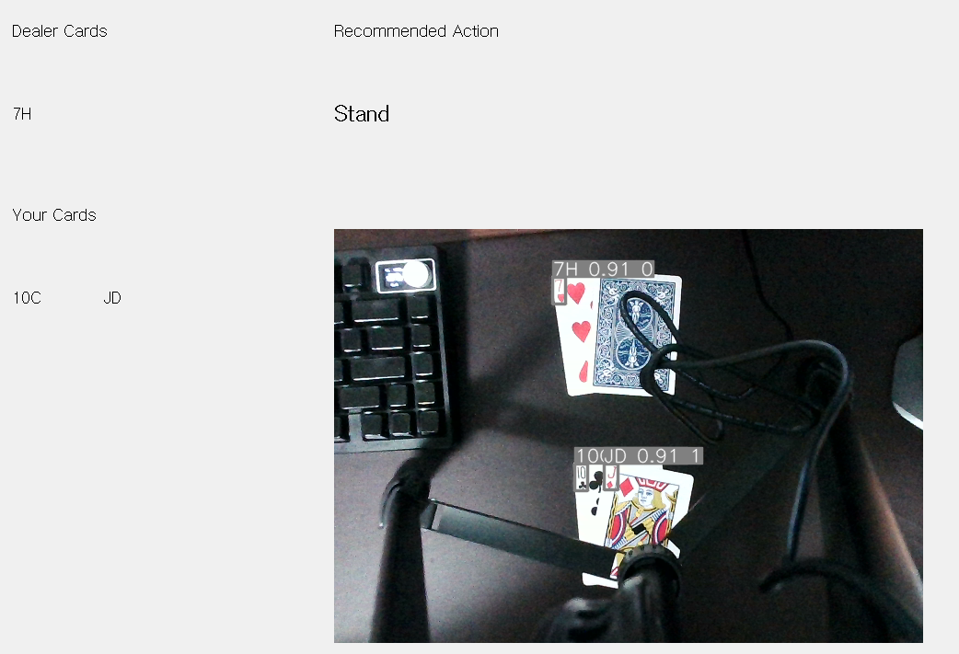
Demonstration

Slide 21
Wrapping Up This Project
The objective of the project is easy to achieve
However, Quality of the recommendation was hard to improve
Because, the Clustering Card is the thing.
Deterministic Thresold Clustering cannot separate cards when the positions of the cards are messy
Quality of the Clustering the cards determines how good this program recommends
Notes:
The objective of this project was straightforward: to assist players in card games by recommending optimal actions. However, enhancing the quality of these recommendations proved to be a significant challenge. The core of the issue lies in how we cluster the cards.
To provide accurate recommendations, our system relies on properly distinguishing between different cards on the table. This is where clustering comes into play. We used a deterministic threshold clustering method. While this method is simple and efficient, it has limitations. Specifically, it struggles when the positions of the cards are disorganized.
In practice, if the cards are neatly arranged, the clustering works well. But in real-world scenarios where cards might be scattered or overlapping, this method cannot reliably separate them. This limitation directly impacts the quality of the recommendations our system can provide.
In conclusion, the quality of card clustering is crucial. The better we can cluster the cards, the more accurate and useful our recommendations will be. Therefore, improving the clustering algorithm is essential for enhancing the overall effectiveness of our recommendation system.

Slide 22
Wrapping Up This Project
Sometimes, the Object detection model confuses the cards
We tried to gives more data augmented, binarized, and other ways.
Still hard to improve the model performance
However, the video quality give the variance to the result
Thus, to do more better detection,
we need to put camera on steady position
And finally we can get a intended result of this project.
Notes:
While developing our system, we encountered significant challenges with the object detection model occasionally confusing the cards. To address this, we employed various techniques including data augmentation and image binarization. Despite these efforts, improving the model's performance remained difficult.
A crucial factor influencing our results was the quality of the video input. Variations in video quality introduced inconsistencies in detection accuracy. To mitigate this, it's essential to position the camera steadily to ensure a clear and consistent video feed.
By stabilizing the camera and ensuring high-quality video input, we can significantly improve the accuracy of card detection. This allows us to achieve the intended results of providing accurate recommendations based on the detected cards.

Slide 23
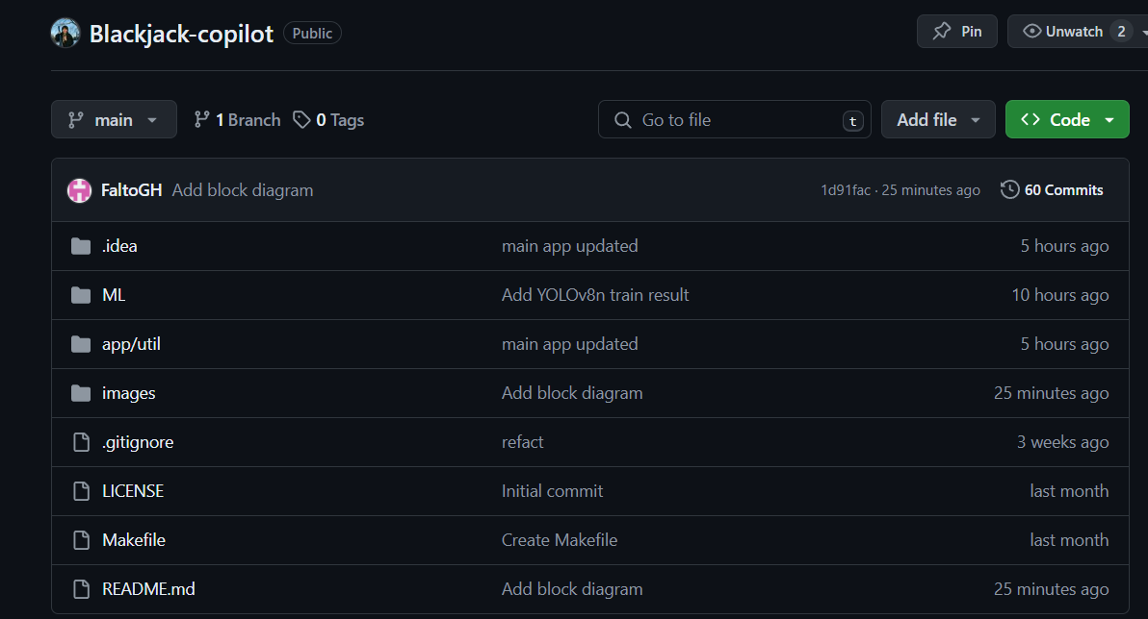
Github Repository
You can download and try this code as it works
https://github.com/HOchacha/

