Slide 1
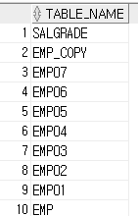
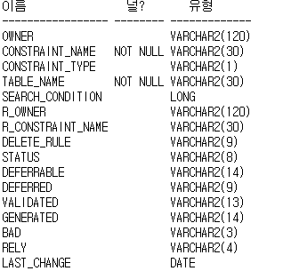
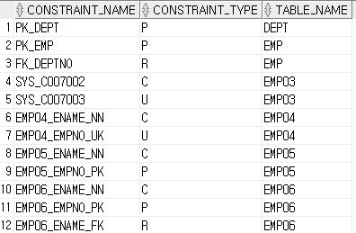
문제1
1_1. select table_name
from user_tables
order by table_name desc;
1_2. desc user_constraints;
1_3. select constraint_name,constraint_type,table_name
from user_constraints;

Slide 2
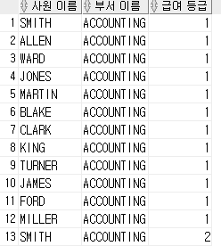
문제2
2. select ename "사원 이름", dname "부서 이름" , grade "급여 등급"
from emp , dept, salgrade;

Slide 3

문제3
3-1. create table dept01
(
deptno number (2) constraint dept01_deptno_pk primary key ,
dname varchar2 (14),
loc varchar2 (13)
);
3-2.create table emp01
(
empno number(4) constraint emo01_empno_p primary key,
ename varchar2(10),
job varchar2(9),
mgr number(4),
hiredate date,
sal number(7,2),
comm number(7,2),
deptno number(2) constraint emp01_deptno_f references dept01(deptno)
);
3-3. create table salgrade01
(
grade number,
losal number,
hisal number
);

Slide 4


문제4
4-1. INSERT into dept01
values (10, 'ACCOUNTING','YORK');
INSERT into dept01
values (20, 'RESEARCH','DALLAS');
INSERT into dept01
values (30, 'SALES','CHICAGO');
INSERT into dept01
values (40, 'OPERATIONS','BOSTON');
4-2. insert into emp01
values ('7369', 'SMITH', 'JOB', 7902, '80/12/17', 800, null, 20);
insert into emp01
values ('74499', 'ALLEN', 'SALESMAN', 7698, '81/02/20', 300, 300, 30);
insert into emp01
values ('7521', 'WARD', 'SALESMAN', 7698, '81/02/22', 1250, 500, 30);
insert into emp01
values ('7566', 'JONES', 'MANAGER', 7839, '81/04/02', 2975, null, 20);
4-3. COMMIT;
4-4. rollback;

Slide 5
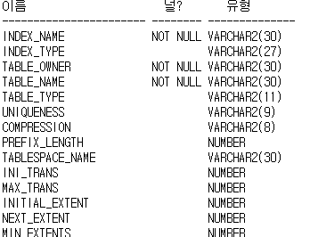
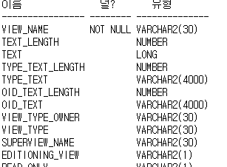
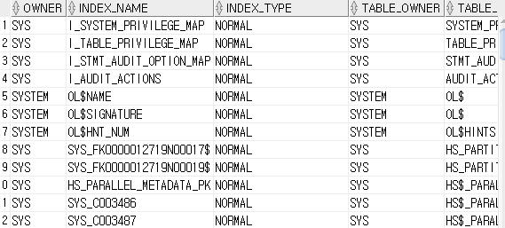
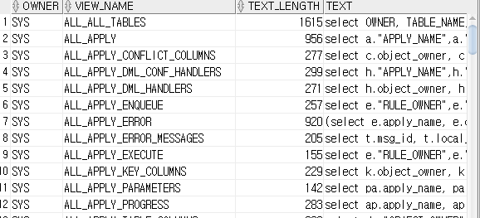
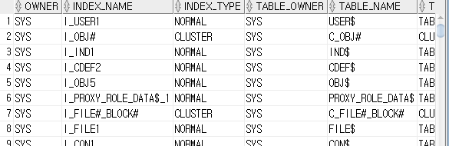
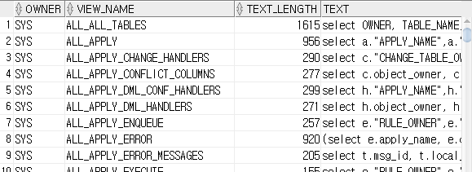
문제5
5-1. desc user_indexes;
5-1. desc user_views;
5-2. select *
from all_indexes;
5-2. select *
from all_views;
5-3. select *
from dba_indexes;
5-3. select *
from dba_views;

Slide 6

문제6
6-1. create index emp_ename
on emp(ename);
6-2. select index_name, table_name
from user_ind_columns
where table_name in('EMP');
6-3. drop index emp_ename;
6-4. 데이터의 양이 많을 때, 검색 작업의 속도를 빠르게 할 수 있다.

Slide 7
문제7
7-1. create table emp_copy
as
select * from emp;
7-2. create view emp_view
as
select * from emp;
7-3. drop table emp_copy;
7-4. drop view emp_view;

