Slide 1
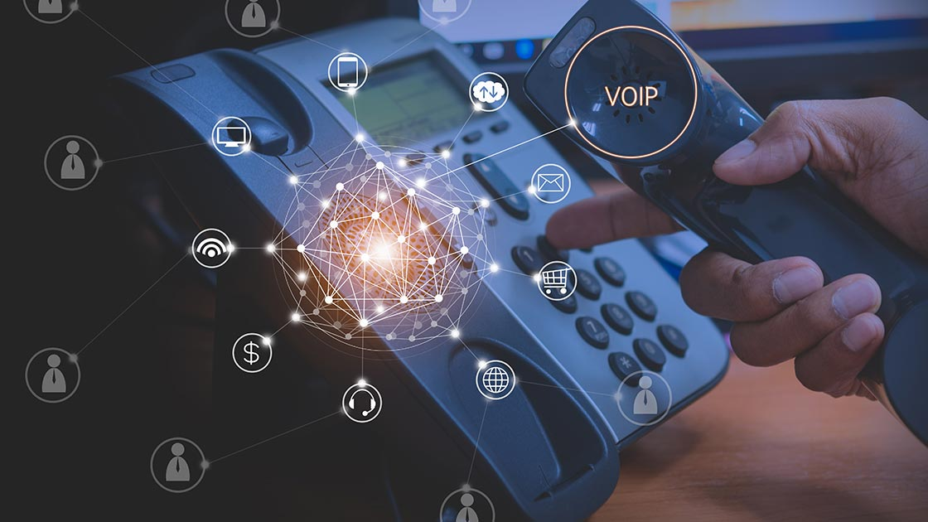
VoIP
By Hassan OULCAID
2018

Slide 2
summary
Define VOIP.
Protocols.
Advantages/Backraws.

Slide 3
What is VoIP ?
Voice over Internet Protocol.
1995 Vocaltec.

Slide 4
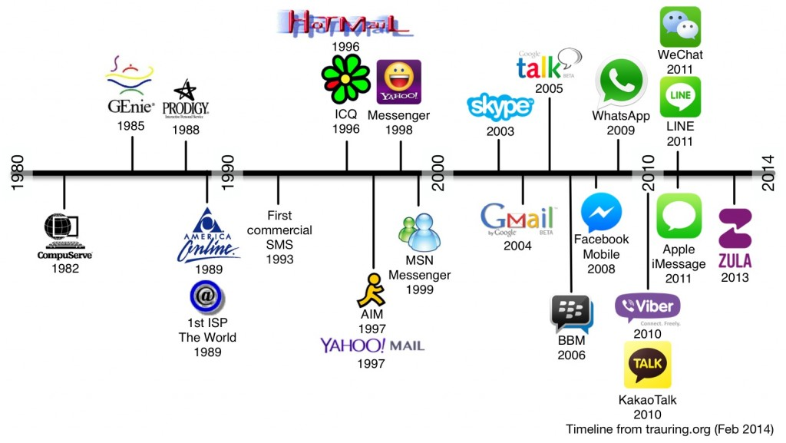
Brief history

Slide 5
APPLICATIONS
Inter-office communication.
Intercom to complex multi-point.
E-commerce.
teleconferencing/shared screen.

Slide 6
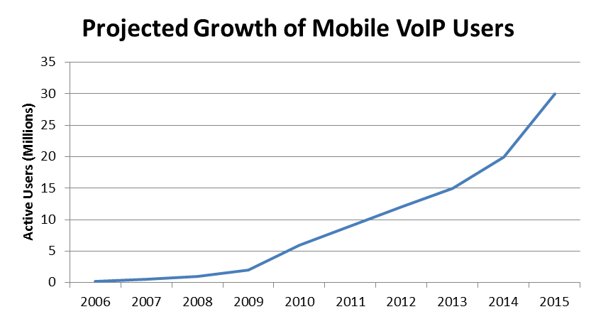

Slide 7
Protocols
H323 : ITU standard that addresses call signaling and control.
widely implemented by voice and videoconferencing equipment manufacturers.
SIP : Developped by IETF , protocol used in VoIP communications that allow people around the world to communicate.
MGCP : Media Gateway Control Protocol ,is connection management for media gateways.
RTP : Real-time Transport Protocol transport protocol for real-time audio and video data

Slide 8
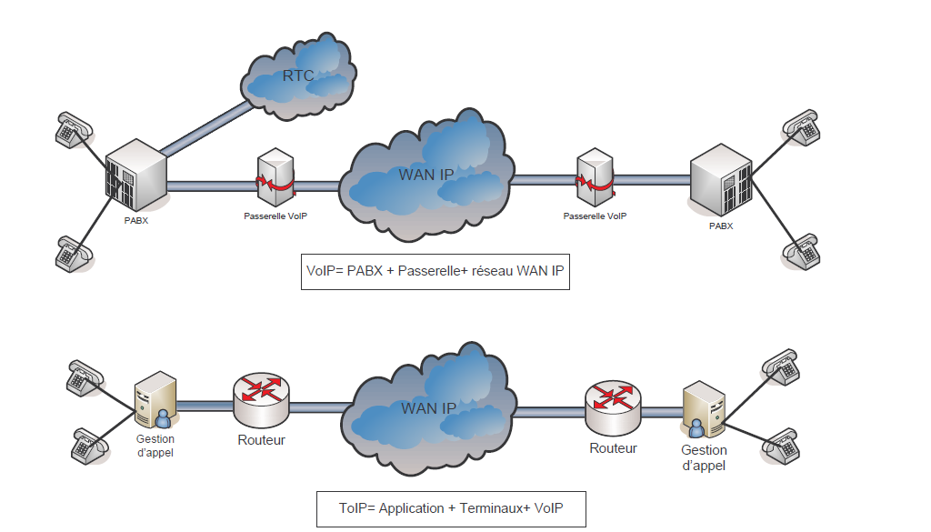
VoIP vs. ToIP

Slide 9
BENEFITS
Cost :
Free voip to voip
Low cost voip to pstn
Mobility
Voice + video

Slide 10
BACKDRAWS
QoS
Security

Slide 11
SOURCES
https://www.voip-info.org
https://whatismyipaddress.com
https://www.lifewire.com
Management, Control, and Evolution of IP Networks , book by GUY PUJOLLE

Slide 12
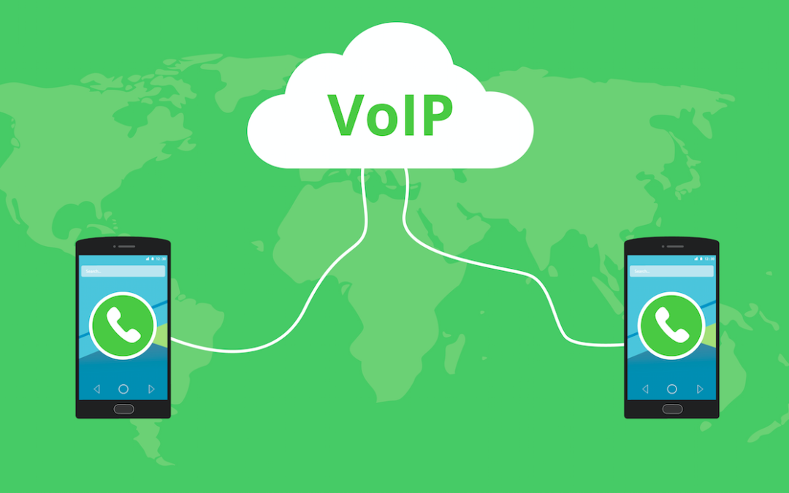
Thank you

