Slide 1

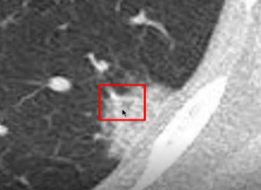
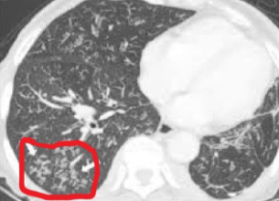
IMAGE PROCESSING PROJECT
Pattern Matching of GGO
Halime Özge KABAK 180403001

Slide 2



In my project, the class of patterns on lungs will be determined by using lung images. For this project, pattern classes are divided into three parts. These are respectively; cobblestone, budding tree and others.
Cobblestone
1
Budding Tree
2
Others
3

Slide 3
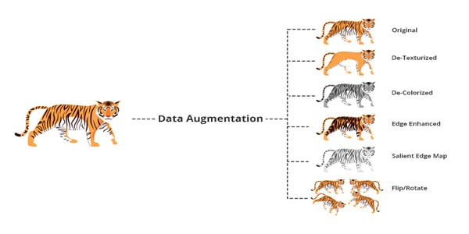
A large amount of data is needed for artificial intelligence training to take place. The number of data to be used in training for the Cobblestone class is 236, 250 for the budding tree and finally 250 for the others. However, this number of data is quite insufficient for proper training of the model. That's why I used the data augmentation method to increase the number of data as the first thing.
Data augmentation includes rotation, translation, cropping, fading, scaling of the existing training data samples for images in the preprocessing process; frequency masking, scaling for sounds; Synonym replacement for texts, random word deletion, etc. It creates artificial (artificial) copies processed with various techniques and adds these copies to the existing training data, making a large training data set ready for use.

Slide 4
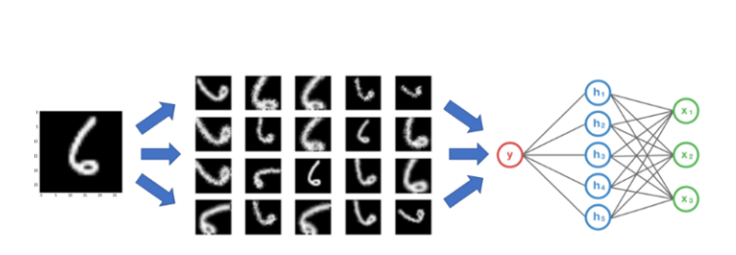
1
The main purpose of data augmentation is to support the model with sufficient data to enable it to make more accurate predictions.
Neural networks are designed to extract the properties of a given data set. However, small datasets can cause models to over-fit, resulting in low accuracy in real-life problems.
2
PPT模板 http://www.1ppt.com/moban/

Slide 5
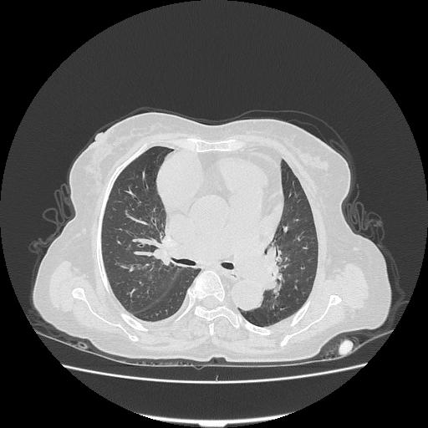
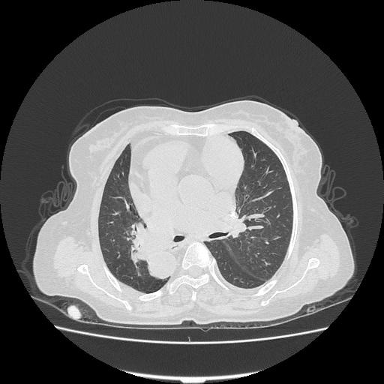
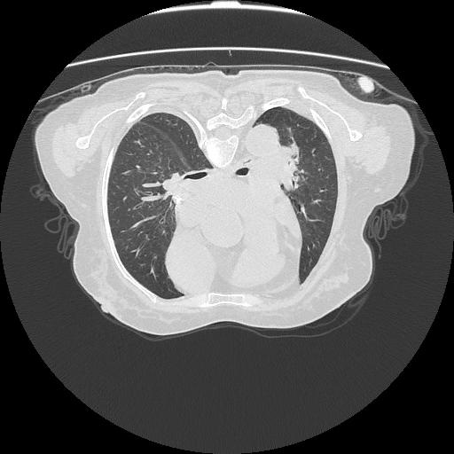
I used 4 different methods to increase my own data set. These are horizontal-vertical flip, 90 degrees rotation, brightness settings, and zooming the photo.
Horizontal-Vertical Flip:
Original Image
Horizontal Flip
Vertical Flip

Slide 6
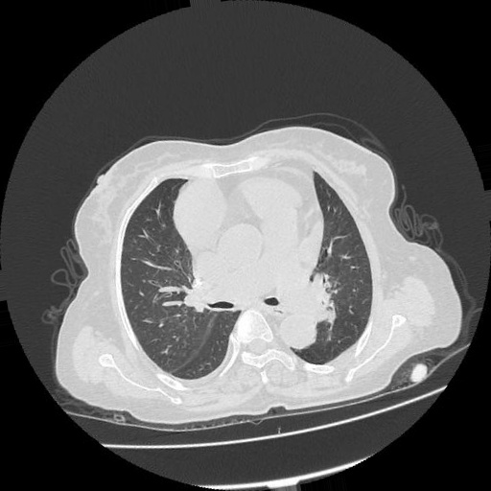
I used 4 different methods to increase my own data set. These are horizontal-vertical flip, 90 degrees rotation, brightness settings, and zooming the photo.
90 Degrees Rotation:
Original Image
Rotated Image

Slide 7
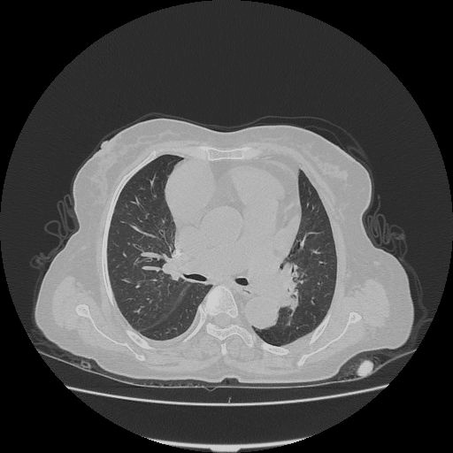
I used 4 different methods to increase my own data set. These are horizontal-vertical flip, 90 degrees rotation, brightness settings, and zooming the photo.
Brightness:
Original Image
After Brightness Arrangement

Slide 8
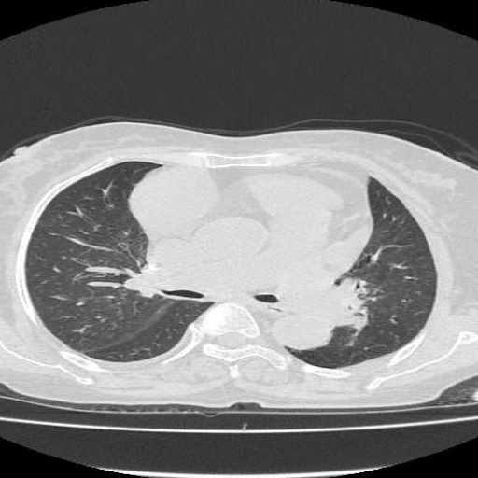
I used 4 different methods to increase my own data set. These are horizontal-vertical flip, 90 degrees rotation, brightness settings, and zooming the photo.
Zooming:
Original Image
After Zooming Arrangement

Slide 9

After performing all these operations for all three classes, I got a total of 4416 data. In this way, I created the enough numbers of data required for artificial intelligence training. In the second step, I will make my data set ready by extracting the lung parts that I will use in the data set.

Slide 10
THANKS
Halime Özge KABAK
180403001

