Slide 1
database technology

Slide 2
Database Technology
Single Table Query
Join Query
CTE
Transaction
Sub Query
Aggregating
Programming

Slide 3
Single Table Query

Slide 4
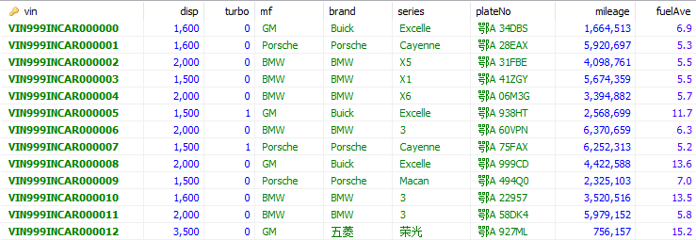
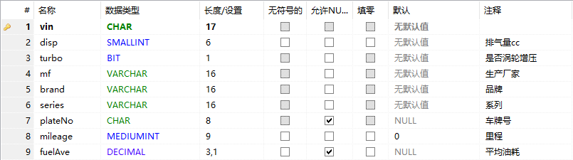
Sample Data

Slide 5
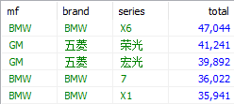
Logic Processing
9
8
SELECT mf, brand, series, count(*) as total
FROM vehicle
WHERE disp <= 2000
GROUP BY mf, brand, series
HAVING total < 50000
ORDER BY total desc
LIMIT 5
1
2 3 4
5
6
7
10
11

Slide 6
Triple Value Boolean algebra
Unknown
False
True
Not True is False
Not False is True
Not Unknown is still Unknown

Slide 7
Table & index Structure
B+ Tree
https://www.cs.usfca.edu/~galles/visualization/BPlusTree.html

Slide 8
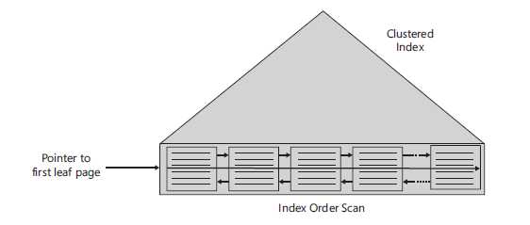
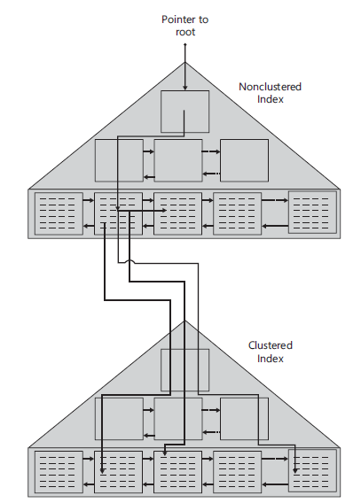
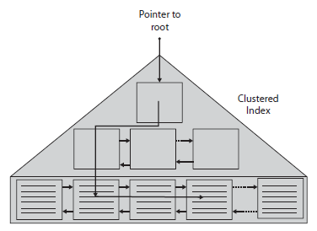
Table & index Structure

Slide 9
Table & index Structure
SELECT * FROM vehicle;
SELECT * FROM vehicle WHERE disp = 1600;
SELECT plateNo FROM vehicle WHERE fuelAve = 7.5;
SELECT mf, brand, series FROM vehicle WHERE plateNo = '鄂A 999CD’;
SELECT plateNo FROM vehicle WHERE brand='BMW' and series = 'X5’;
SELECT * FROM vehicle WHERE mileage > 1000000 and fuelAve < 10.0;

Slide 10
JOIN Query
To be continued…

