Slide 1
database technology

Slide 2
Database Technology
Single Table Query
Sub Query
Transaction
Join Query
Aggregating
Programming

Slide 3
Single Table Query

Slide 4
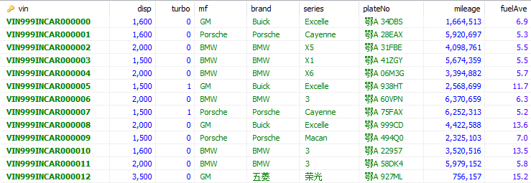
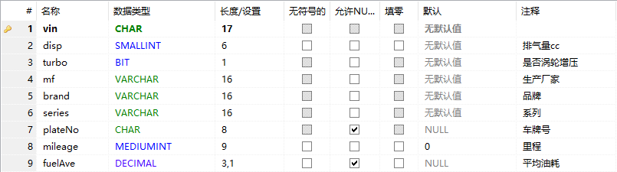
Sample Data

Slide 5
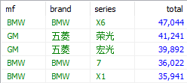
Logic Processing
9
8
SELECT mf, brand, series, count(*) as total
FROM vehicle
WHERE disp <= 2000
GROUP BY mf, brand, series
HAVING total < 50000
ORDER BY total desc
LIMIT 5
1
2 3 4
5
6
7
10
11

Slide 6
Triple Value Boolean algebra
Unknown
False
True
Not True is False
Not False is True
Not Unknown is still Unknown

Slide 7
Table & index Structure
B+ Tree
https://www.cs.usfca.edu/~galles/visualization/BPlusTree.html

Slide 8
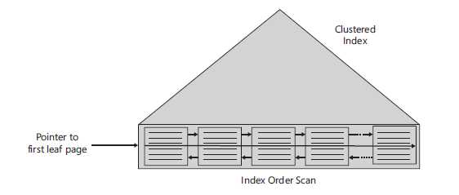
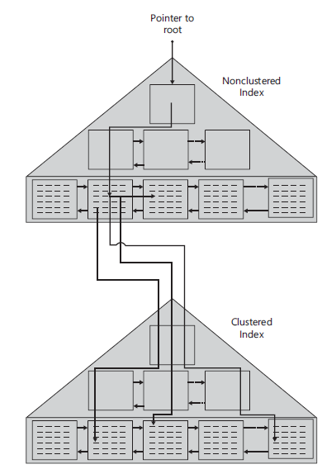
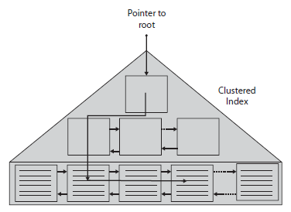
Table & index Structure

Slide 9
Table & index Structure
SELECT * FROM vehicle;
SELECT * FROM vehicle WHERE disp = 1600;
SELECT plateNo FROM vehicle WHERE fuelAve = 7.5;
SELECT mf, brand, series FROM vehicle WHERE plateNo = '鄂A 999CD’;
SELECT plateNo FROM vehicle WHERE brand='BMW' and series = 'X5’;
SELECT * FROM vehicle WHERE mileage > 1000000 and fuelAve < 10.0;

Slide 10
sUB Query

Slide 11
SUB QUERY
Self-Contained Subquery
SELECT * FROM v10k WHERE mileage =
(SELECT max(mileage) FROM v10k);
Correlated Subquery
SELECT * FROM v10k as v1
WHERE mileage =
(SELECT max(mileage) FROM v10k as v2
WHERE v1.mf = v2.mf and v1.brand = v2.brand and v1.series = v2.series);

Slide 12
SUB QUERY
Subquery - Exists
SELECT * FROM v10k as v1
WHERE not exists
(SELECT * FROM v10k as v2
WHERE v1.mf = v2.mf and v1.brand = v2.brand and v1.series = v2.series
and v1.mileage < v2.mileage);
Subquery - In
SELECT * FROM v10k as v1
WHERE mileage in
(SELECT max(mileage) FROM v10k as v2
WHERE v1.mf = v2.mf and v1.brand = v2.brand and v1.series = v2.series);

Slide 13
SUB QUERY
Derived Table & Nesting
SELECT * FROM v10k as v1
WHERE fuelAve =
(SELECT max(fuelAve) FROM v10k as v2
WHERE v1.mf = v2.mf and v1.brand = v2.brand and v1.series = v2.series);
SELECT mf, brand, series, min(vin) as min_vin FROM v10k as v1
WHERE fuelAve =
(SELECT max(fuelAve) FROM v10k as v2
WHERE v1.mf = v2.mf and v1.brand = v2.brand and v1.series = v2.series)
GROUP BY mf, brand, series;
SELECT * FROM v10k WHERE vin in(
SELECT min_vin FROM
(SELECT mf, brand, series, min(vin) as min_vin FROM v10k as v1
WHERE fuelAve =
(SELECT max(fuelAve) FROM v10k as v2
WHERE v1.mf = v2.mf and v1.brand = v2.brand and v1.series = v2.series)
GROUP BY mf, brand, series) as v3)

Slide 14
CTE(Common Table Expressions)
WITH cte1 AS (
SELECT * FROM v10k as v1
WHERE fuelAve = (
SELECT max(fuelAve) FROM v10k as v2
WHERE v1.mf = v2.mf and v1.brand = v2.brand and v1.series = v2.series)
),
cte2(mf, brand, series, max_vin) AS(
SELECT mf, brand, series, max(vin) FROM cte1
GROUP BY mf, brand, series
)
SELECT * FROM v10k
WHERE vin in (SELECT max_vin FROM cte2);

Slide 15
CTE(Common Table Expressions)
WITH cte1 AS(
SELECT mf, brand, series, max(fuelAve) as max_fuelAve FROM v10k
GROUP BY mf, brand, series
),
cte2 AS(
SELECT * FROM v10k as v1
WHERE fuelAve = (
SELECT max_fuelAve FROM cte1 as v2
WHERE v1.mf = v2.mf and v1.brand = v2.brand and v1.series = v2.series
)
),
cte3(mf, brand, series, max_vin) AS(
SELECT mf, brand, series, max(vin) FROM cte2
GROUP BY mf, brand, series
)
SELECT * FROM cte2
WHERE vin in (SELECT max_vin FROM cte3);

Slide 16
Ranking
SET @n:=0;
SELECT plateNo, mileage, @n:=@n+1 as sn
FROM v10k
ORDER BY mileage desc;
SELECT plateNo, mileage,
row_number() over (order by mileage desc) as sn
FROM v10k
ORDER BY mileage desc;
WITH cteSN AS(
SELECT mf, brand, series, plateNo, mileage,
row_number() over (partition by mf,brand,series order by mileage desc) as sn
FROM v10k
)
SELECT * FROM cteSN WHERE sn <= 3;

Slide 17
Ranking
WITH cteSN AS(
SELECT mf, brand, series, plateNo, fuelAve,
dense_rank() over
(partition by mf,brand,series
order by fuelAve desc) as sn
FROM v10k
)
SELECT * FROM cteSN WHERE sn <= 3;
rank() over

Slide 18
Ranking
SELECT *, row_number() over(order by sn) as sn_in_page FROM (
SELECT *,
ntile(1000) over w as page,
row_number() over w as sn
FROM v10k
WINDOW w AS(order by mileage desc)
) as V2
WHERE page = 999

Slide 19
join Query

Slide 20
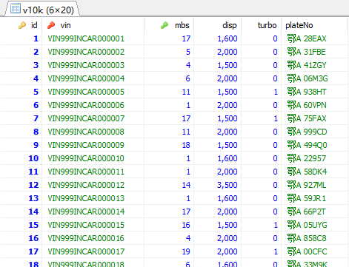
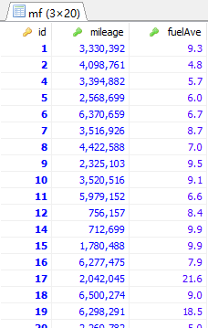
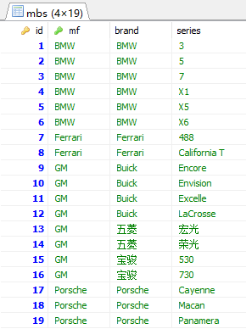
Sample Data

Slide 21
Cross Join
SELECT v.vin, v.plateNo, v.mbs,
m.id, m.mf, m.brand, m.series
FROM v10k as v, mbs as m;
SQL-89
SELECT v.vin, v.plateNo, v.mbs,
m.id, m.mf, m.brand, m.series
FROM v10k as v CROSS JOIN mbs as m;
SQL-92

Slide 22
Inner Join
SELECT v.vin, v.plateNo, v.mbs,
m.id, m.mf, m.brand, m.series
FROM v10k as v, mbs as m
WHERE v.mbs = m.id;
SELECT v.vin, v.plateNo, v.mbs,
m.id, m.mf, m.brand, m.series
FROM v10k as v JOIN mbs as m ON v.mbs = m.id;
SELECT v.vin, v.plateNo, v.mbs,
m.id, m.mf, m.brand, m.series
FROM v10k as v JOIN mbs as m
WHERE v.mbs = m.id;

Slide 23
Outer Join
SELECT v.vin, v.plateNo, v.id,
m.id, m.mileage, m.fuelAve
FROM v10k as v
LEFT OUTER JOIN mf as m ON v.id = m.id;
SELECT v.vin, v.plateNo, v.id,
m.id, m.mileage, m.fuelAve
FROM v10k as v JOIN mf as m
WHERE v.id = m.id
UNION ALL
SELECT v.vin, v.plateNo, v.id, NULL, NULL, NULL
FROM v10k as v
WHERE id not in (SELECT id FROM mf);

Slide 24
Multiple Join
SELECT v.plateNo,
a.mf, a.brand, a.series,
b.mileage, b.fuelAve
FROM v10k as v
JOIN mbs as a ON v.mbs = a.id
LEFT OUTER JOIN mf as b ON v.id = b.id;

Slide 25
Self Join
SELECT m1.id as m1id, m1.mileage as m1,
m2.id as m2id, m2.mileage as m2
FROM mf as m1
JOIN mf as m2 ON m1.mileage <= m2.mileage
WHERE m1.id = 3351;
SELECT v.plateNo, m1.mileage, count(*)
FROM mf as m1
JOIN mf as m2 ON m1.mileage <= m2.mileage
JOIN v10k as v ON m1.id=v.id
GROUP BY v.plateNo, m1.mileage
ORDER BY count(*);

Slide 26
aggregating

Slide 27
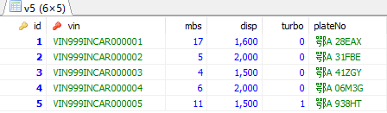
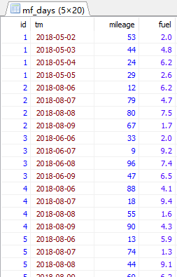
Sample Data
server: 47.97.216.205
user: incar
pwd: incar$2018
database: incar

Slide 28
问题
每辆车的总里程，以及平均油耗是多少？
每辆车每天的总里程，以及平均油耗是多少？
每辆车截止每个月1号的总里程，以及平均油耗是多少？

Slide 29
参考答案
SELECT a.id, a.tm,
sum(b.mileage) as total_mileage,
100*sum(b.fuel)/sum(b.mileage) as fuelAve
FROM mf_days as a
JOIN mf_days as b ON a.id=b.id and a.tm >= b.tm
WHERE day(a.tm)=1
GROUP BY a.id, a.tm, day(a.tm);

Slide 30
问题
每辆车连续30天的里程，以及这30天的平均油耗是多少？
SELECT a.id, a.tm,
sum(b.mileage) as total_mileage,
100*sum(b.fuel)/sum(b.mileage) as fuelAve
FROM mf_days as a
JOIN mf_days as b ON a.id=b.id and
(a.tm >= b.tm and date_sub(a.tm, interval 30 day)<=b.tm)
WHERE day(a.tm)=1
GROUP BY a.id, a.tm, day(a.tm);

Slide 31
问题
每辆车有多少天跑了0~20km，有多少天跑了20~50km,有多少天跑了50km以上？
WITH s(n, lo, hi) AS(
SELECT 1, 0, 20
UNION ALL SELECT 2, 20, 50
UNION ALL SELECT 3, 50, 1000
)
SELECT m.id, v5.vin, v5.plateNo,
concat(s.lo, '~', s.hi) as segment, count(*)
FROM mf_days as m
JOIN s ON m.mileage >= s.lo and m.mileage < s.hi
JOIN v5 ON m.id = v5.id
GROUP BY m.id, v5.vin, v5.plateNo, s.lo, s.hi;

Slide 32
programming

Slide 33
Variable
SET @i:=0;
SELECT *, @i:=@i+1 FROM mf_days;

Slide 34
View
CREATE VIEW v5mf AS
SELECT v.id, v.vin, v.plateNo, v.disp, v.turbo,
s.mf, s.brand, s.series,
m.mileage, m.fuel, m.tm
FROM v5 as v
LEFT OUTER JOIN mbs as s ON v.mbs=s.id
LEFT OUTER JOIN mf_days as m ON v.id=m.id;

Slide 35
UDF
DELIMITER $$
DROP FUNCTION IF EXISTS fuel_cost$$
CREATE FUNCTION fuel_cost(mileage integer, fuel float)
RETURNS DECIMAL(5,1) DETERMINISTIC
BEGIN
RETURN (100*fuel/mileage);
END$$
DELIMITER ;
SELECT *, fuel_cost(mileage, fuel) AS fuel100km
FROM v5mf order by mileage

Slide 36
PROCEDURE
DELIMITER $$
DROP PROCEDURE IF EXISTS v5proc$$
CREATE PROCEDURE v5proc(brd varchar(32))
BEGIN
SELECT * FROM v5mf WHERE brand = brd;
END$$
DELIMITER ;
CALL v5proc('Porsche’);

Slide 37
CURSOR
DELIMITER $$
DROP PROCEDURE IF EXISTS v5proc$$
CREATE PROCEDURE v5proc(brd varchar(32))
BEGIN
DECLARE total integer default 0;
DECLARE totalM integer default 0;
DECLARE totalF float default 0;
DECLARE m integer;
DECLARE f float;
DECLARE done integer default 0;
DECLARE cur CURSOR FOR SELECT mileage,fuel FROM v5mf WHERE brand=brd;
DECLARE CONTINUE HANDLER FOR NOT FOUND SET done = 1;
OPEN cur;
x_loop: LOOP
FETCH cur INTO m,f;
IF done THEN LEAVE x_loop;
END IF;
SET totalM := totalM+m;
SET totalF := totalF+f;
SET total := total+1;
END LOOP;
CLOSE cur;
DROP TABLE IF EXISTS tmp_v5proc;
CREATE TEMPORARY TABLE tmp_v5proc AS
SELECT brd, total, totalM, totalF, CAST(100*totalF/totalM AS decimal(5,1)) as fuel_ave;
END$$
DELIMITER ;

Slide 38
TRANSACTION

Slide 39
sample
A
START TRANSACTION;
UPDATE v5 SET plateNo='鄂A 938HT' WHERE id=6;
UPDATE v5 SET plateNo=NULL WHERE id=5;
COMMIT;
B
C
START TRANSACTION;
SELECT * FROM v5 WHERE id in(5,6);
SELECT * FROM v5 WHERE id in(5,6);
COMMIT;
D

Slide 40
CHECK POINT
CHECK POINT
NOW
time
Session X
Session Y

Slide 41
Transaction Isolation Levels
SERIALIZABLE
REPEATABLE READ
READ COMMITTED
READ UNCOMMITTED

Slide 42
Set Transaction Isolation Level
SHOW VARIABLES LIKE 'transaction_isolation';
SET TRANSACTION ISOLATION LEVEL READ UNCOMMITTED;
SET SESSION TRANSACTION ISOLATION LEVEL READ COMMITTED;
SET SESSION TRANSACTION ISOLATION LEVEL REPEATABLE READ;
SET GLOBAL TRANSACTION ISOLATION LEVEL SERIALIZABLE;
SET AUTOCOMMIT=0;

