Slide 1
“The Air we Breathe”
An observation of Air Quality in the Bay Area
Hadrien Picq, Vaishali Rao, Kim Tung

Slide 2

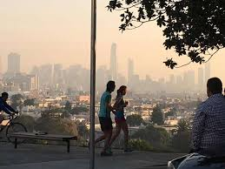
Sonoma Fire. Oct 9 - 15, 2017
Notes:
Replace picture with one of San Francisco with haze due to the fires.

Slide 3
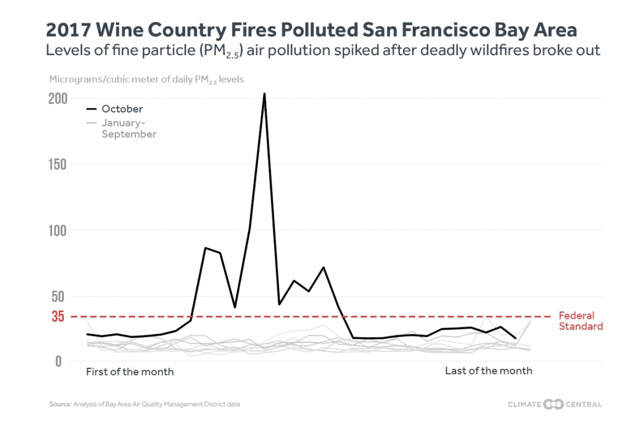
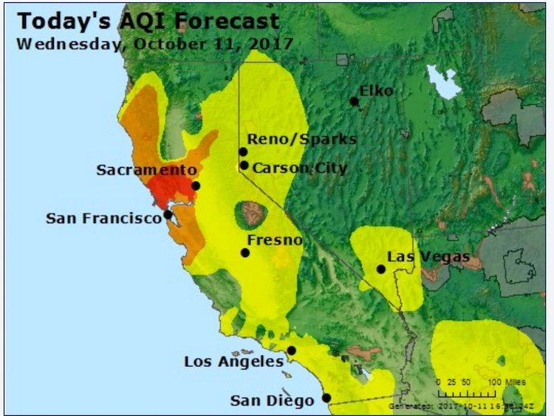
Sonoma Fire. Oct 9 - 15, 2017

Slide 4
How was air quality affected in the San Francisco Bay Area due to the October 2017 Sonoma Fires?

Slide 5
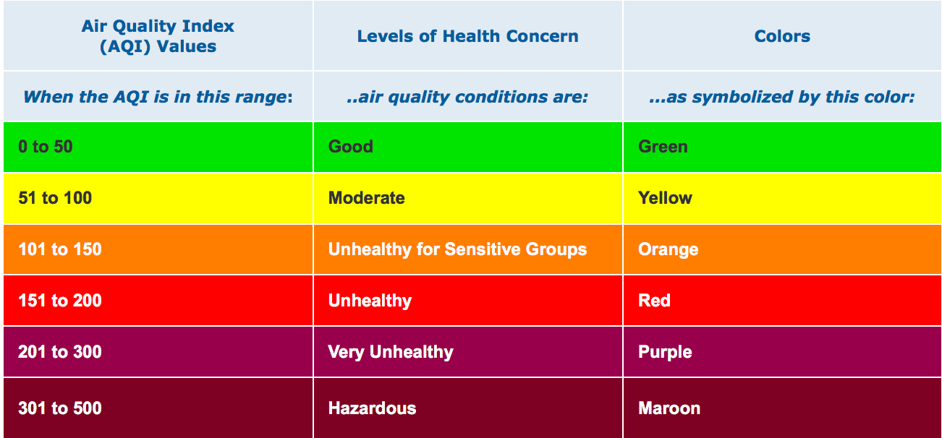
Air Quality Index
Notes:
The AQI is an index for reporting daily air quality. The higher the AQI value, the greater the level of air pollution and the greater the health concern. Smaller AQI means better air quality.
EPA calculates the AQI for five major air pollutants regulated by the Clean Air Act:
Ozone
PM (Particle pollution or particulate matter)
CO (carbon monoxide)
SO2 (sulfur dioxide)
NO2 (nitrogen dioxide)

Slide 6
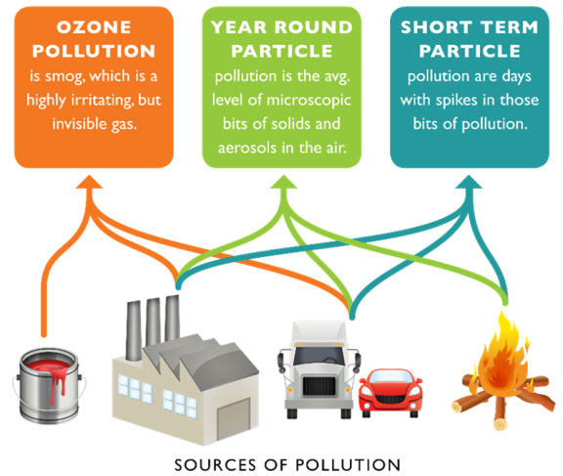
Notes:
Fine particles (PM_{2.5}) are 2.5 micrometers in diameter or smaller, and can only be seen with an electron microscope. Fine particles are produced from all types of combustion, including motor vehicles, power plants, residential wood burning, forest fires, agricultural burning, and some industrial processes
Help reduce particle pollution
Particle pollution, also called particulate matter or PM, is a mixture of solids and liquid droplets floating in the air. Some particles are released directly from a specific source, while others form in complicated chemical reactions in the atmosphere.

Slide 7
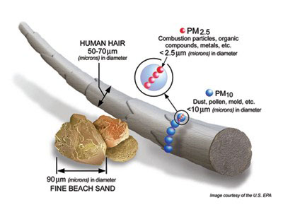
Notes:
Fine particles (PM_{2.5}) are 2.5 micrometers in diameter or smaller, and can only be seen with an electron microscope. Fine particles are produced from all types of combustion, including motor vehicles, power plants, residential wood burning, forest fires, agricultural burning, and some industrial processes
Help reduce particle pollution
Particle pollution, also called particulate matter or PM, is a mixture of solids and liquid droplets floating in the air. Some particles are released directly from a specific source, while others form in complicated chemical reactions in the atmosphere.

Slide 8
Annual Trendline in Air Quality, 2016-2017
Notes:
Data source: EPA
AirNow API: Index data for the United States.
Query by zip codes and date.
Provides air quality data based on Date, City, State, Longitude, Latitude, AQI, ParameterName, Category

Slide 9
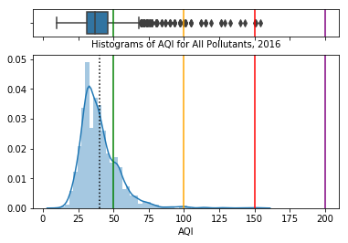
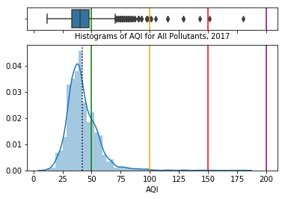

Slide 10
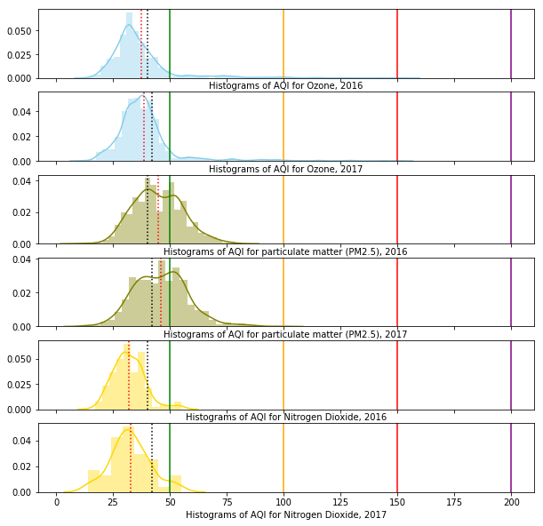
Notes:
Particles less than or equal to 10 micrometers in diameter are so small that they can get into the lungs, potentially causing serious health problems.
Ground-level ozone and airborne particles are the two pollutants that pose the greatest threat to human health in the United States.

Slide 11
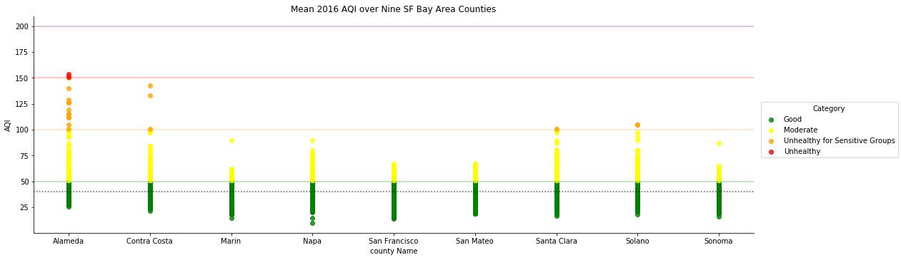
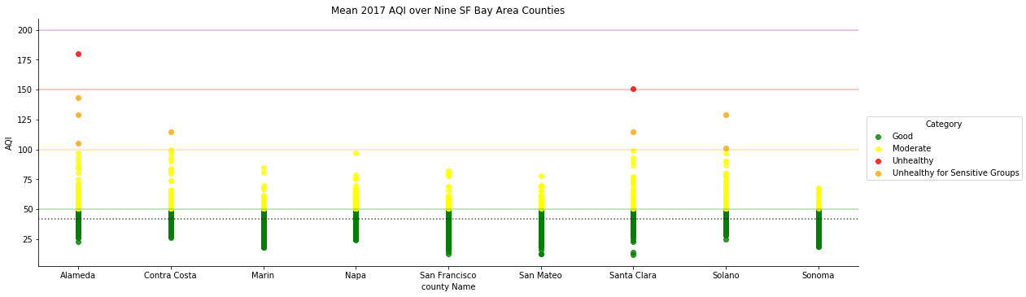

Slide 12
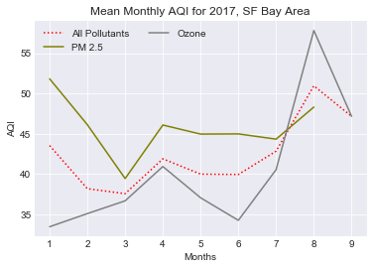

Slide 13
Case Study: 2017 East Bay Fires (Oct 9-15)

Slide 14
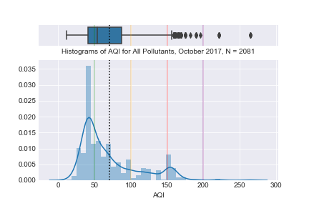
Notes:
Histogram of the AQI for all pollutants, AirNow API.
Each color line represents an air quality threshold, the black dotted line represent the AQI average for all pollutants.
Stat summary:
count 2081.000000 mean 69.847189 std 39.997857 min 11.000000 25% 41.000000 50% 54.000000 75% 87.000000 max 265.000000

Slide 15
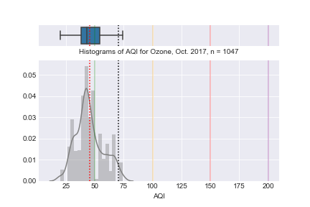

Slide 16
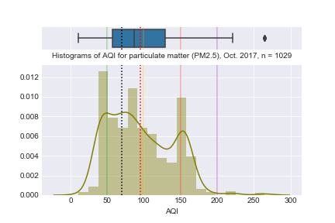

Slide 17
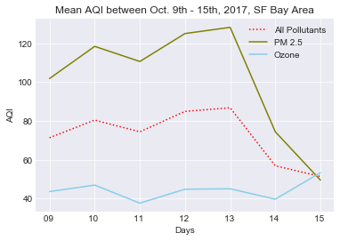

Slide 18
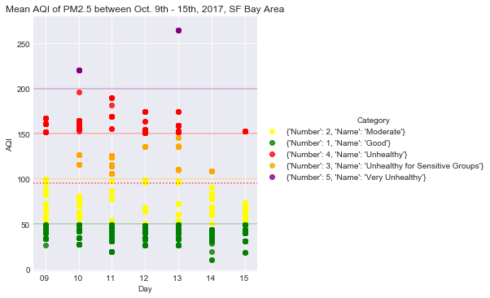

Slide 19
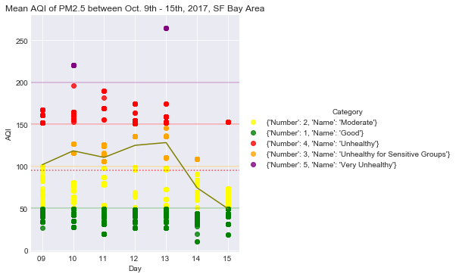

Slide 20
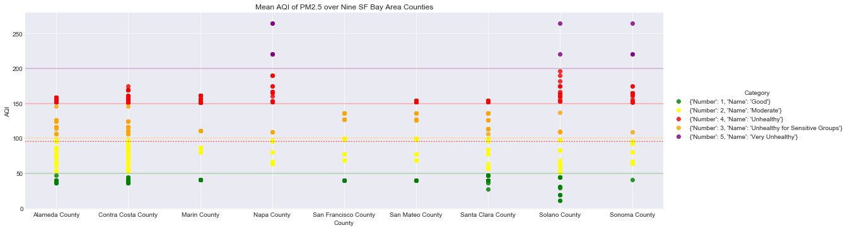

Slide 21
Conclusion

