Slide 1


ATLIQ Mart
Sales/Promotion Analysis
Insights For Promotion Success
Presented by :
Priyanka Ugale

Slide 2
Problem Statement
Atliq Mart is a retail giant with over 50 supermarkets in the southern region of India.
During the festive season of Diwali 2023 and Sankranti 2024, Atliq Mart conducted extensive Promotions on their Atliq branded products across all 50 stores.
The Sales Director wants an analysis based on promotion-level success
The primary objective is to identify which promotions did well and which promotions did not so that they can make an informed decision for their next promotional period

Slide 3
Data Overview
Fact_Events
event_id
campaign_id
store_id
product_code
promo_type
quantity sold(before_promo)
quantity_sold(after_promo)
Dim_Product
Product_code
Product_name
category
Dim_Campaigns
Campaign_id
Campaign_name
Dim_Stores
Store_id
City

Slide 4
Business Requests
Provide a list of products with a base price greater than 500 and that are featured in promo type of 'BOGOF' (Buy One Get One Free). This information will help us identify high-value products that are currently being heavily discounted, which can be useful for evaluating our pricing and promotion strategies.
Generate a report that provides an overview of the number of stores in each city. The results will be sorted in descending order of store counts, allowing us to identify the cities with the highest store presence.The report includes two essential fields: city and store count, which will assist in optimizing our retail operations
Generate a report that displays each campaign along with the total revenue generated before and after the campaign? The report includes three key fields: campaign_name, totaI_revenue(before_promotion), totaI_revenue(after_promotion). This report should help in evaluating the financial impact of our promotional campaigns. (Display the values in millions).
Produce a report that calculates the Incremental Sold Quantity (ISU%) for each category during the Diwali campaign. Additionally, provide rankings for the categories based on their ISU%. The report will include three key fields: category, isu%, and rank order. This information will assist in assessing the category-wise success and impact of the Diwali campaign on incremental sales

Slide 5
5. Create a report featuring the Top 5 products, ranked by Incremental Revenue Percentage (IR%), across all campaigns. The report will provide essential information including product name, category, and ir %. This analysis helps identify the most successful products in terms of incremental revenue across our campaigns, assisting in product optimization.

Slide 6
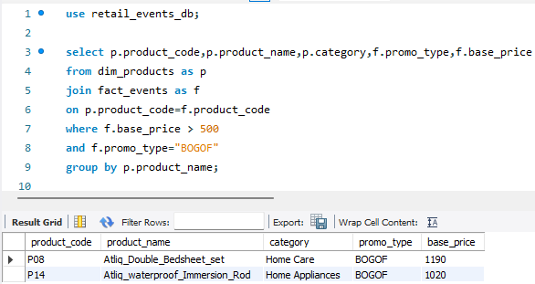
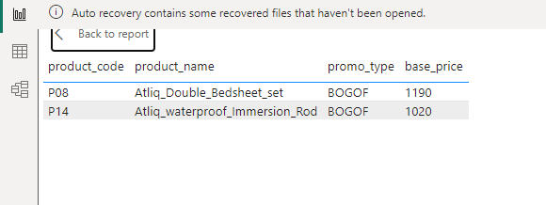
1.Provide a list of products with a base price greater than 500 and that are featured in promo type of 'BOGOF' (Buy One Get One Free). This information will help us identify high-value products that are currently being heavily discounted, which can be useful for evaluating our pricing and promotion strategies1

Slide 7
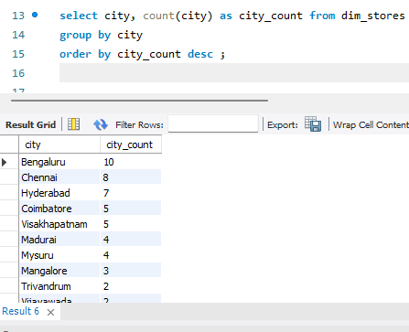
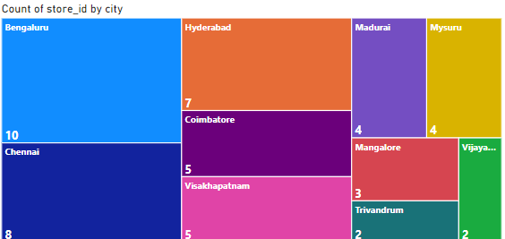
2.Generate a report that provides an overview of the number of stores in each city. The results will be sorted in descending order of store counts, allowing us to identify the cities with the highest store presence.The report includes two essential fields: city and store count, which will assist in optimizing our retail operations.

Slide 8
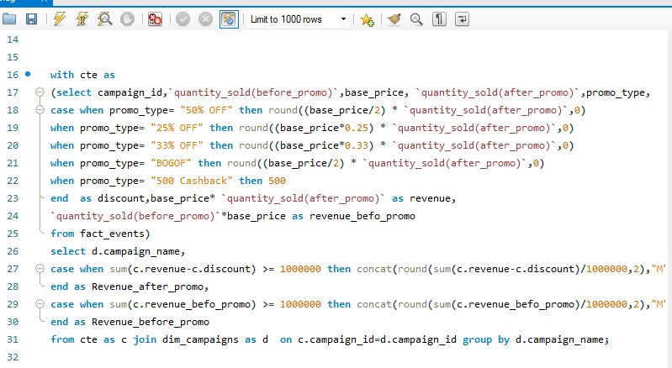
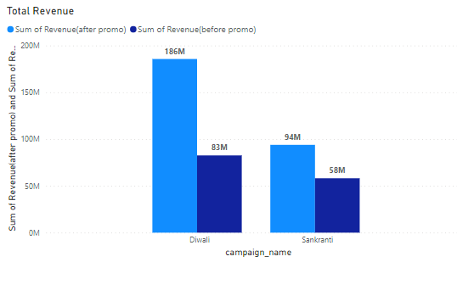

3. Generate a report that displays each campaign along with the total revenue generated before and after the campaign? The report includes three key fields: campaign_name, totaI_revenue(before_promotion), totaI_revenue(after_promotion). This report should help in evaluating the financial impact of our promotional campaigns. (Display the values in millions)

Slide 9
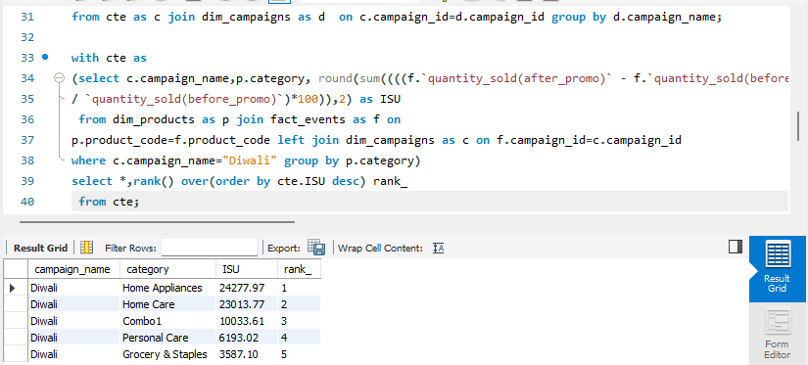
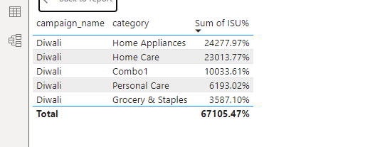
4. Produce a report that calculates the Incremental Sold Quantity (ISU%) for each category during the Diwali campaign. Additionally, provide rankings for the categories based on their ISU%. The report will include three key fields: category, isu%, and rank order. This information will assist in assessing the category-wise success and impact of the Diwali campaign on incremental sales.

Slide 10
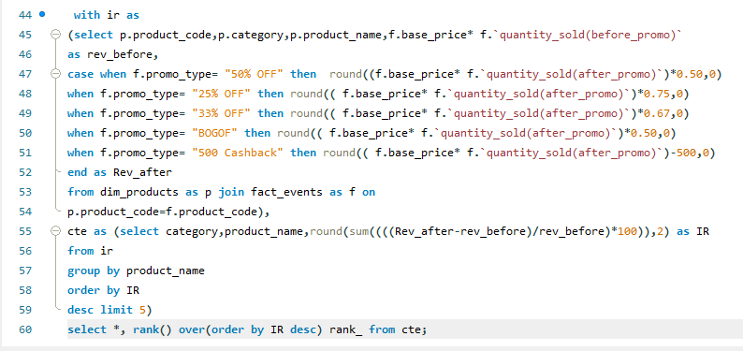
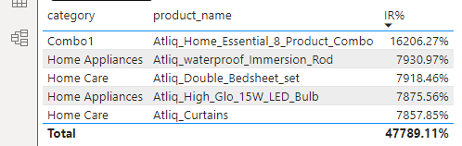
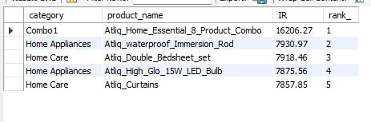
5. Create a report featuring the Top 5 products, ranked by Incremental Revenue Percentage (IR%), across all campaigns. The report will provide essential information including product name, category, and ir%. This analysis helps identify the most successful products in terms of incremental revenue across our campaigns, assisting in product optimization.

Slide 11
Top Insights
City
Bengaluru, Chennai, and Hyderabad represent more stores and witness the highest sales and revenue in
the southern region.
Campaign
The Diwali Campaign is proving to be more effective than the Sankranti Campaign.
Product Type and Category
Atliq_Home_Essential_8_product_combo ,Atliq_waterproff_immersion_rod, Atliq_Double_Bedsheet_Set
are top-generated incremental revenue products.
Home application and Combo 1 categories experienced the highest ISU during the Diwali Campaign.
Promotion Type
500 Cashback and BOGOF Promotion types are showing significant success during both Campaigns.

Slide 12
Bottom Insights
City
Trivandrum, Vijayawada, and Mangalore represent less stores and witness the lowest sales and revenue
in the southern region.
Product Type and Category
Atliq_Fusion_Container_set_of_3 and Atliq_scrub_sponge_for_Dishwasher are less-generated
Incremental Revenue Generated products.
The personal care category experienced the lowest ISU during the Diwali Campaign.
Promotion Type
25% OFF Promotion types are showing less significant success during both Campaigns.

Slide 13
Suggestion
Extend similar promotion to another high-value product to stimulate sales and attract customers, thereby enhancing revenue streams.
The 25% off Promotion is performing poorly so they should use 500 Cashback or BOGOF or
they should use another promotion technique.
Optimize retail operations in well-performing cities to maximize profitability, expand store presence, and provide additional promotional effects in low-performing cities.
To increase the sales of Personal care products it is recommended to implementation by one get a one-get-one-free offer and place a strong emphasis on promoting these deals.

Slide 14
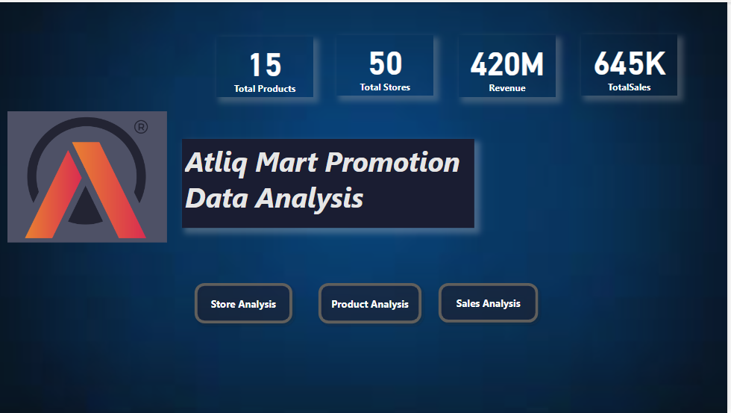
Power BI report Snapshots

Slide 15
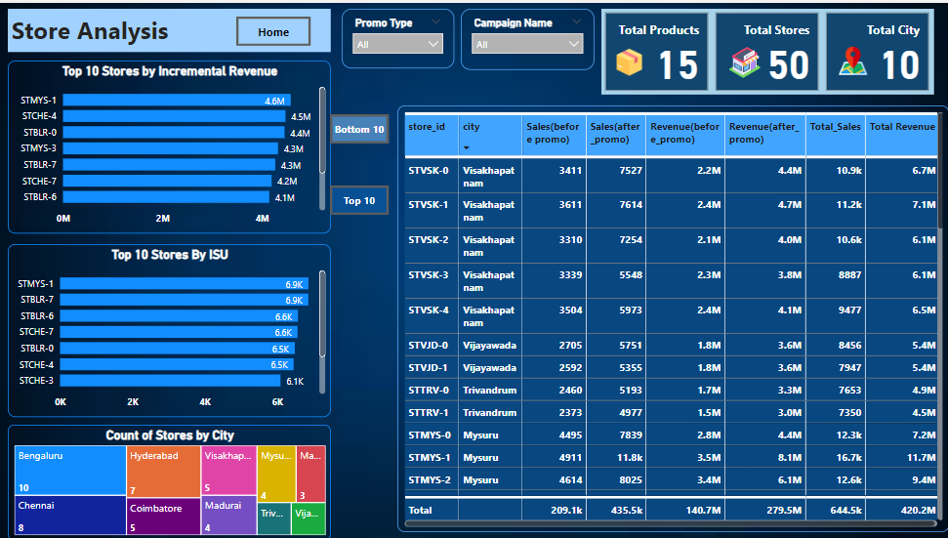

Slide 16
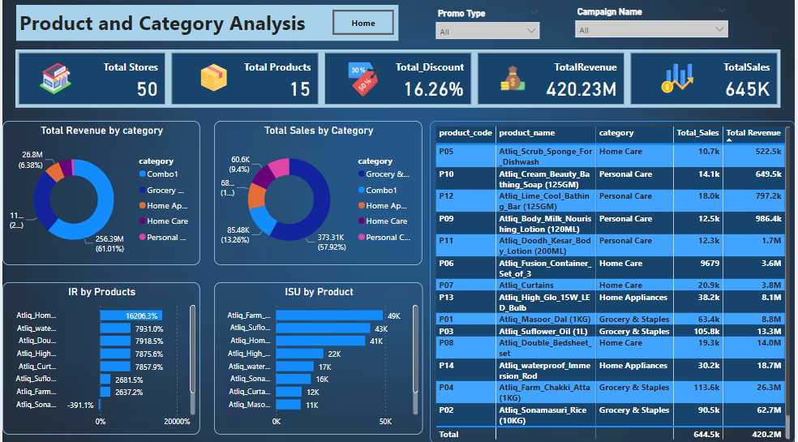

Slide 17
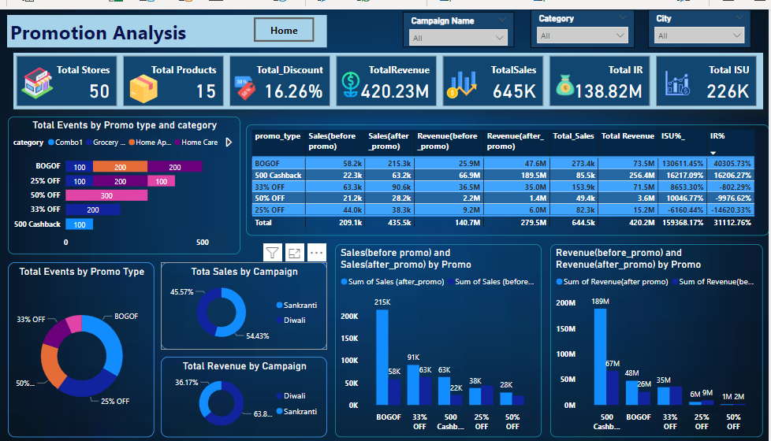

Slide 18


Thank You
For Watching this Presentation
pu231195@gmail.com
https://www.linkedin.com/in/priyanka-ugale-121aa6241/

