Slide 1



HPN
View in Power BI
Last data refresh:
10/8/2023 5:31:54 AM UTC
Downloaded at:
10/8/2023 8:59:30 AM UTC

Slide 2
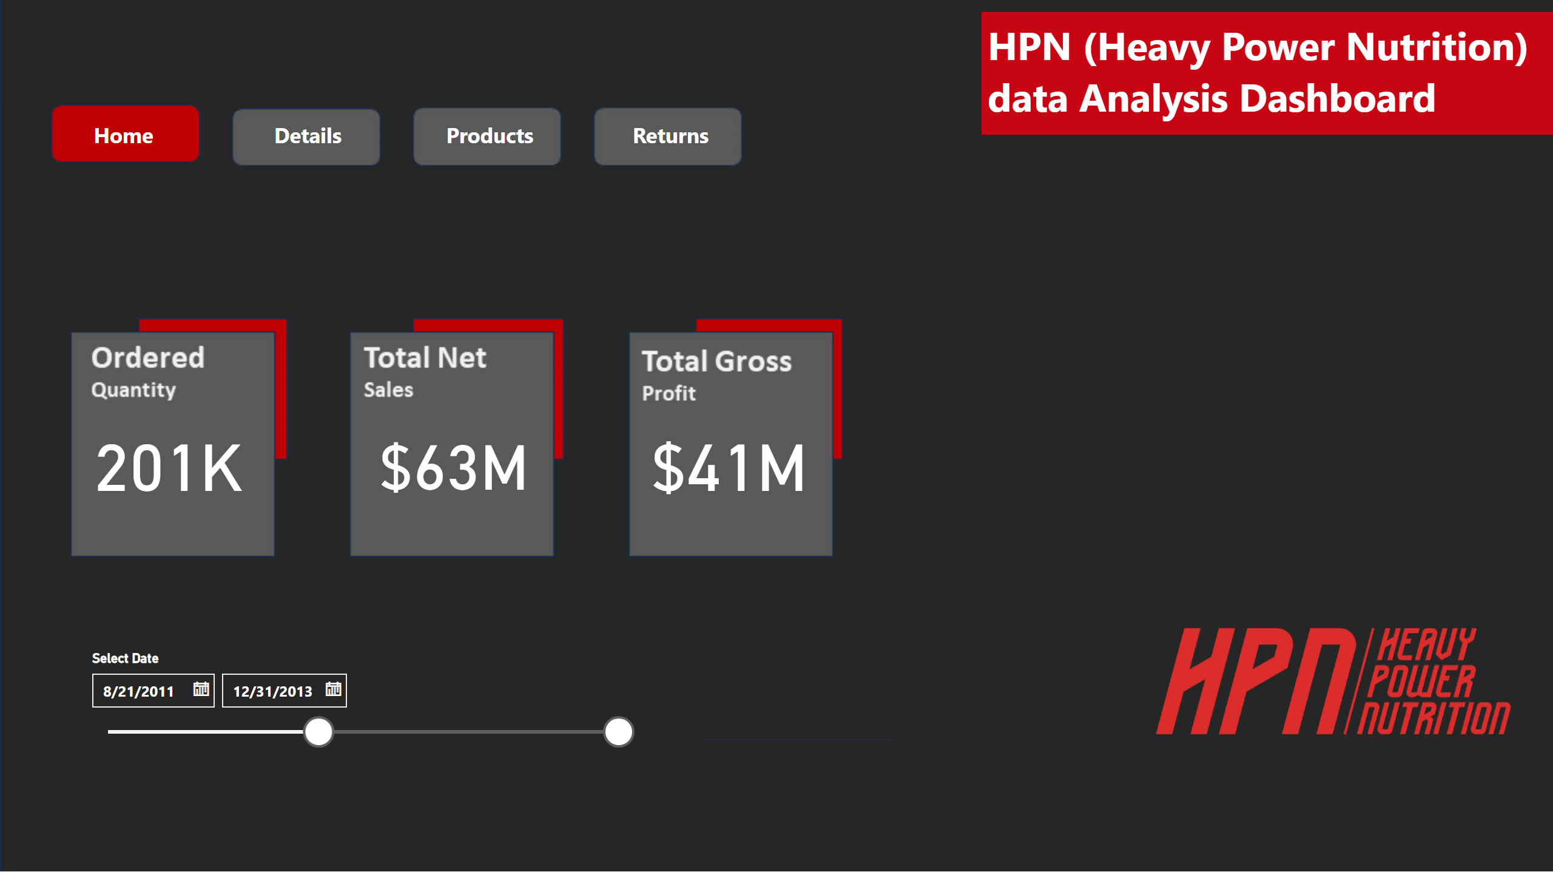
Home Page
Notes:
card
No alt text provided
card
No alt text provided
card
No alt text provided
slicer
No alt text provided
actionButton
No alt text provided
actionButton
No alt text provided
actionButton
No alt text provided
actionButton
No alt text provided
shape
No alt text provided
textbox
No alt text provided
image
No alt text provided

Slide 3
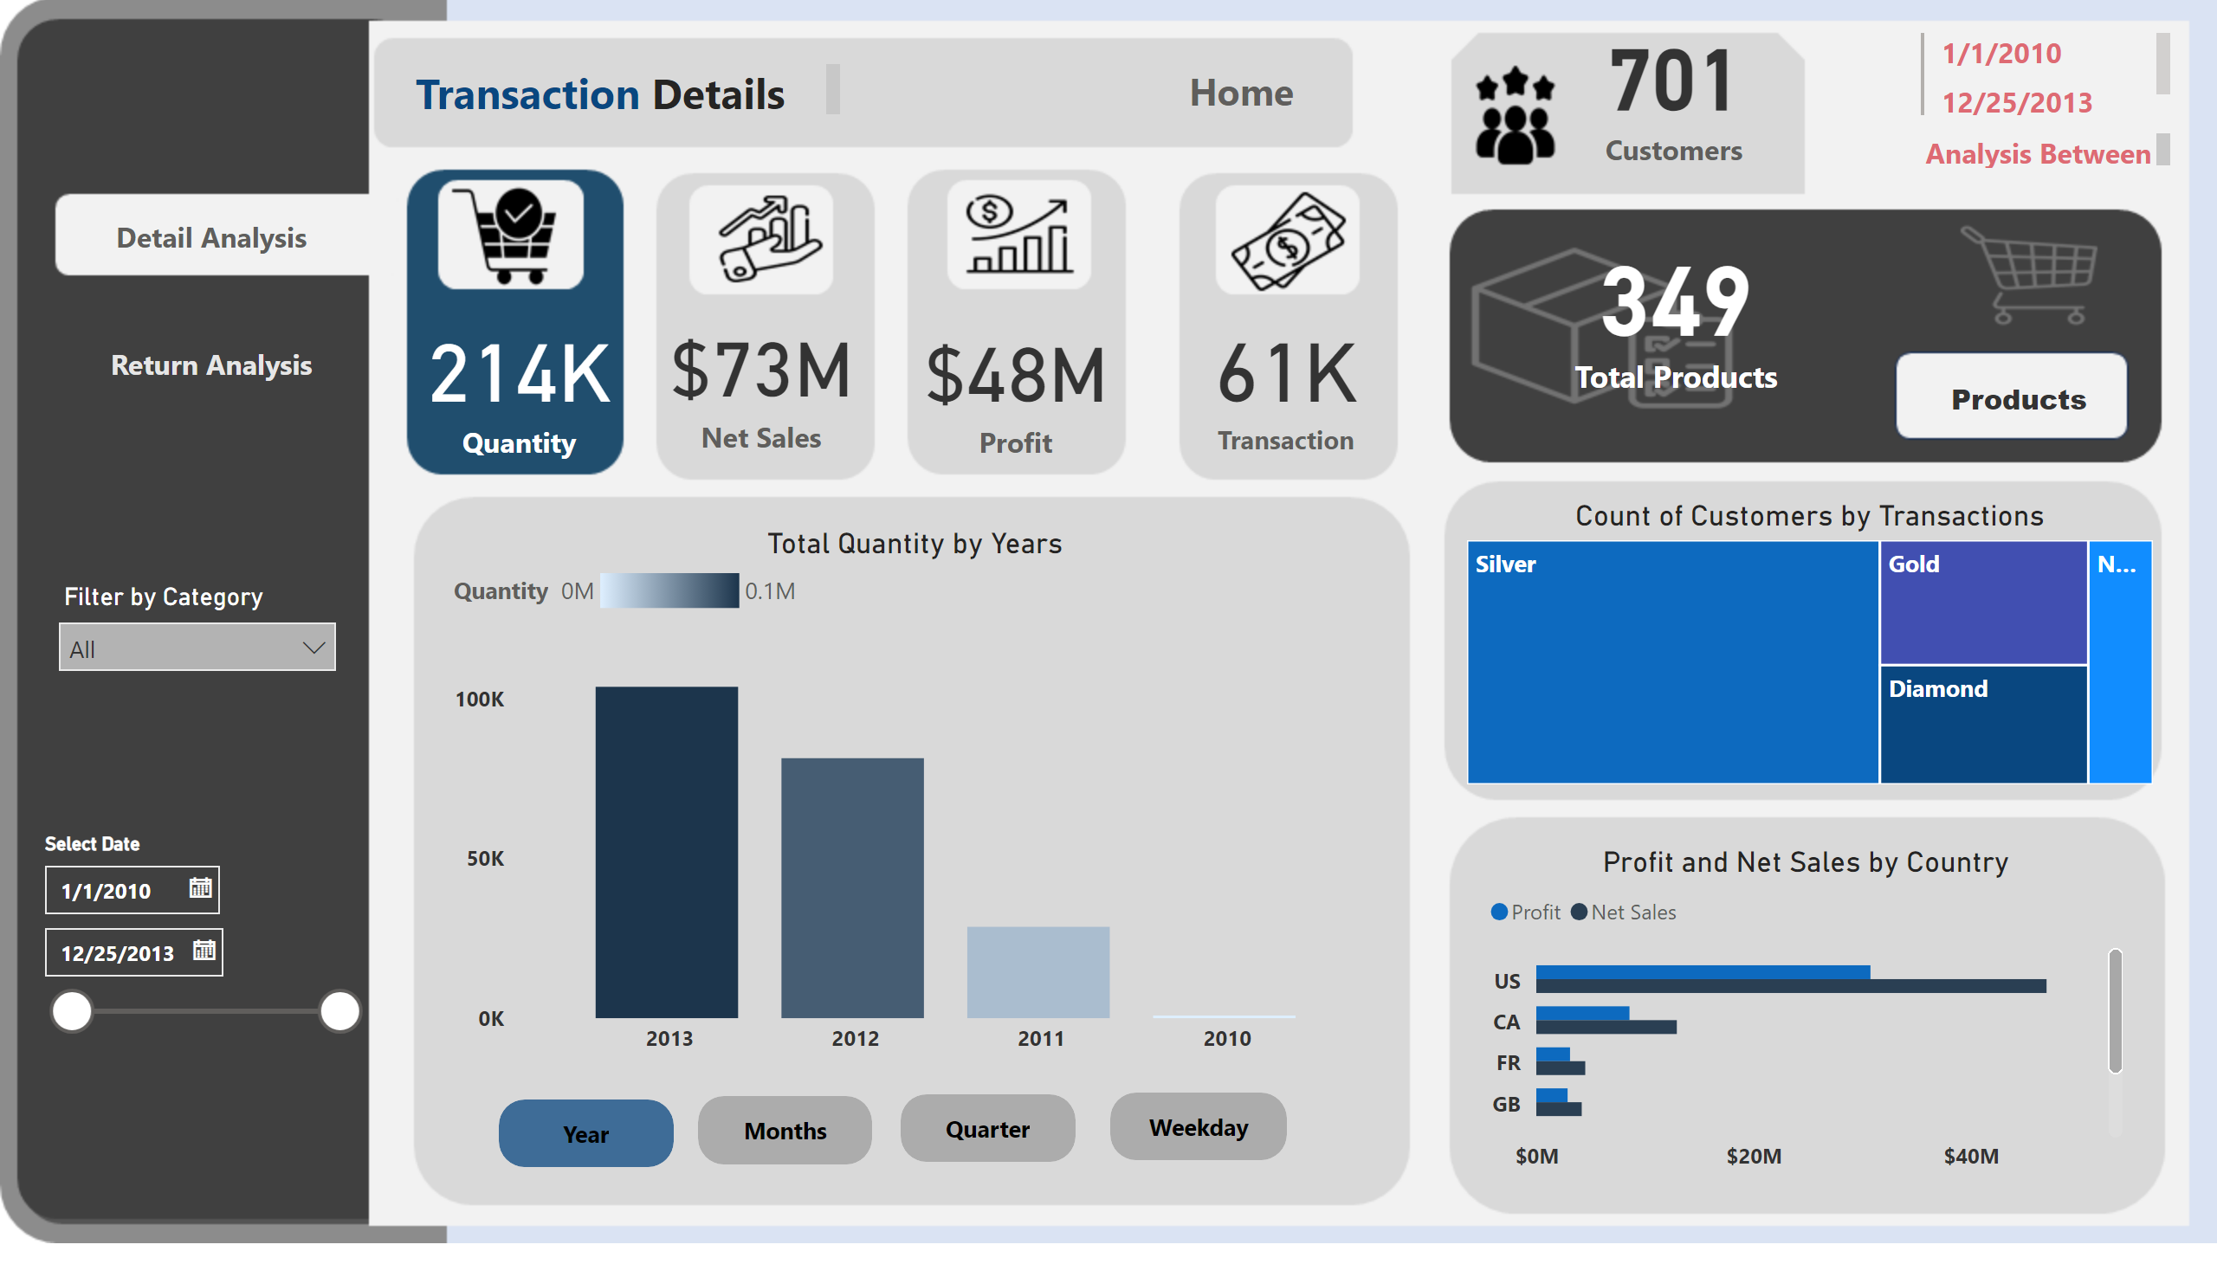
Page 3
Notes:
card
No alt text provided
card
No alt text provided
card
No alt text provided
card
No alt text provided
card
No alt text provided
lineChart
No alt text provided
columnChart
No alt text provided
Total Quantity by Years
No alt text provided
columnChart
No alt text provided
Profit and Net Sales by Country
No alt text provided
Count of Customers by Transactions
No alt text provided
actionButton
No alt text provided
inactive months
No alt text provided
inactive quarter
No alt text provided
actionButton
No alt text provided
actionButton
No alt text provided
active year
No alt text provided
actionButton
No alt text provided
inactive weekday
No alt text provided
actionButton
No alt text provided
card
No alt text provided
actionButton
No alt text provided
actionButton
No alt text provided
multiRowCard
No alt text provided
textbox
No alt text provided
slicer
No alt text provided
slicer
No alt text provided
actionButton
No alt text provided
textbox
No alt text provided
actionButton
No alt text provided
actionButton
No alt text provided
actionButton
No alt text provided

Slide 4
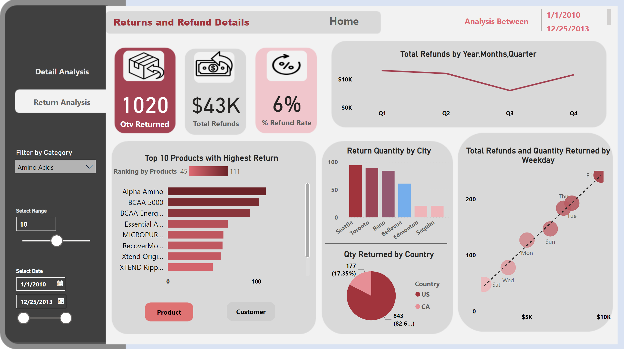
Return
Notes:
Top 10 Products with Highest Return
No alt text provided
slicer
No alt text provided
clusteredBarChart
No alt text provided
active product
No alt text provided
actionButton
No alt text provided
actionButton
No alt text provided
inactive customer
No alt text provided
Total Refunds by Year,Months,Quarter
No alt text provided
Total Refunds and Quantity Returned by Weekday
No alt text provided
card
No alt text provided
card
No alt text provided
card
No alt text provided
textbox
No alt text provided
Return Quantity by City
No alt text provided
multiRowCard
No alt text provided
textbox
No alt text provided
actionButton
No alt text provided
actionButton
No alt text provided
actionButton
No alt text provided
slicer
No alt text provided
slicer
No alt text provided
Qty Returned by Country
No alt text provided
shape
No alt text provided

Slide 5
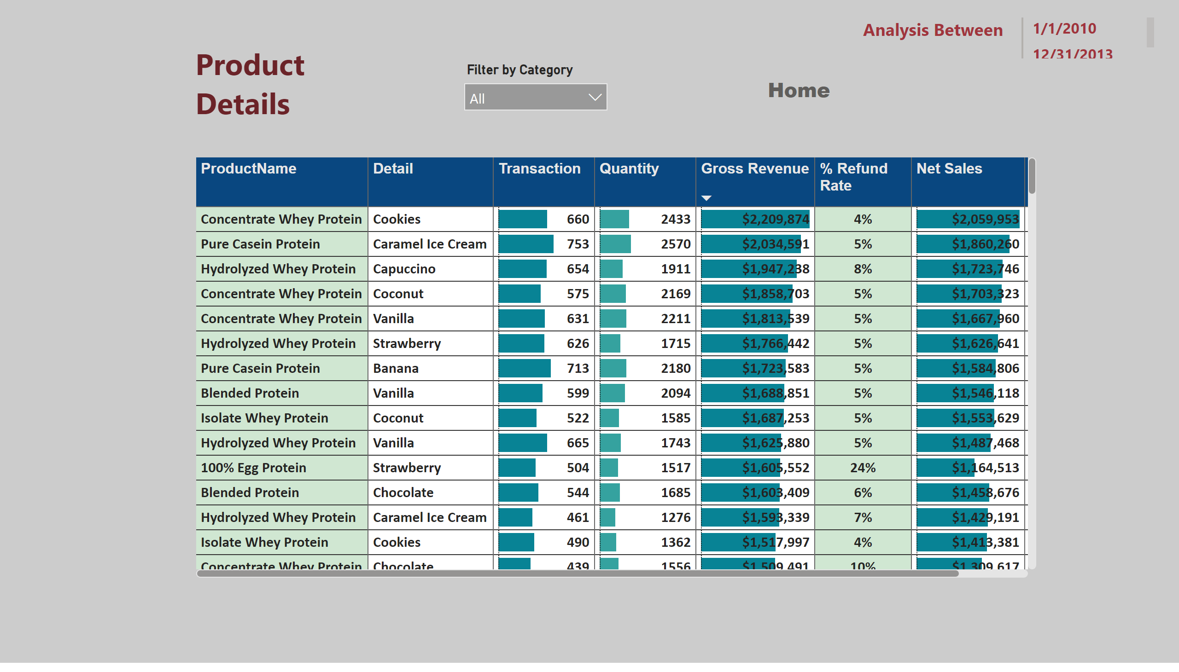
Product
Notes:
tableEx
No alt text provided
multiRowCard
No alt text provided
actionButton
No alt text provided
textbox
No alt text provided
textbox
No alt text provided
slicer
No alt text provided

