Slide 1

Buildtest: HPC Software Stack Testing Framework
Shahzeb Siddiqui (Shahzeb.Siddiqui@3ds.com)
Dassault Systemes
FOSDEM’20
02/02/2020
GitHub: https://github.com/HPC-buildtest/buildtest-framework
Documentation: http://buildtest.rtfd.io

Slide 2
Motivation
Framework Requirements:
The framework is capable of testing of installed software in HPC SW stack
The framework is able to integrate with module system
The framework provides users with a markup language for writing tests
The framework is able to automate test creation and execution
The framework provides contains a test repository that is community driven
Buildtest is not meant to replace tools like make, cmake, or autoconf

Slide 3
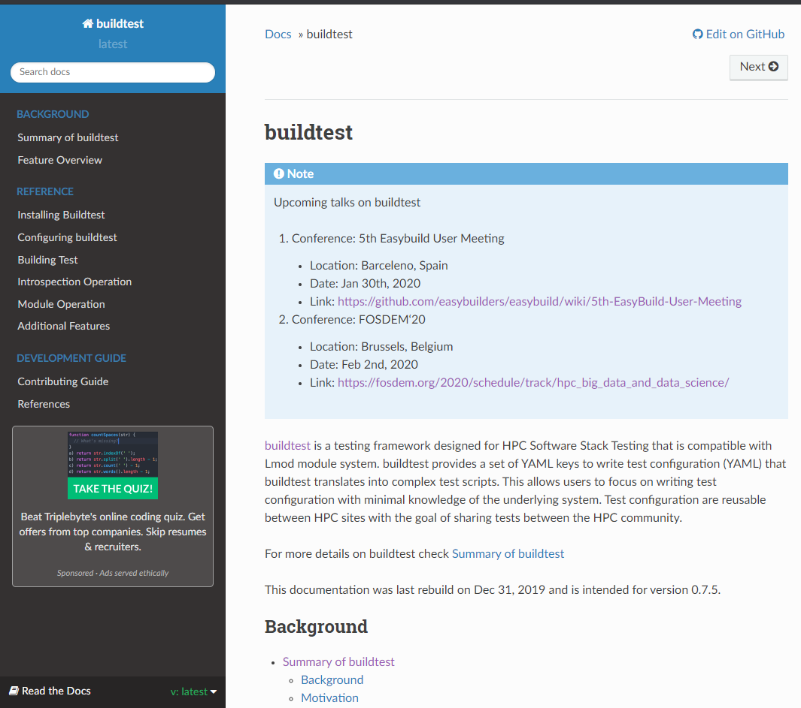
What is buildtest
Buildtest is a framework that:
Automates test script creation
Abstracts test complexity by using test configuration written in YAML
Allows Portable test configurations
Provides many module operations
Buildtest comes with a repository of test configuration and source files

Slide 4
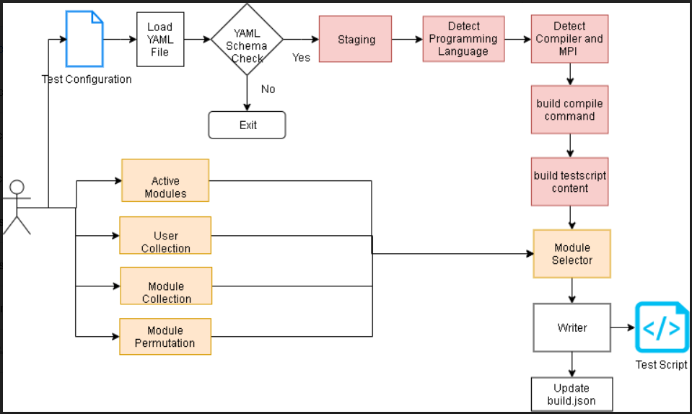
Build Pipeline

Slide 5
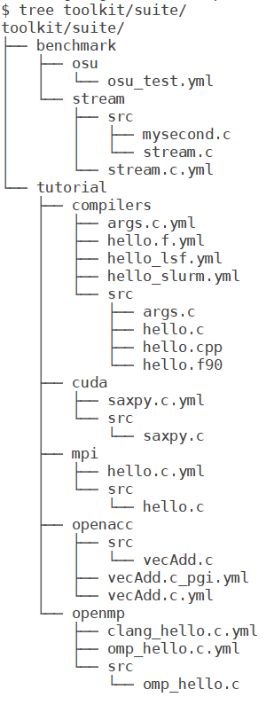
Building a Test
To build a test script just specify a test configuration to buildtest as follows: buildtest build –c <test-configuration>
The test configuration can be found under $BUILDTEST_ROOT/toolkit/suite
Name of test configuration is formulated by replacing file separator (/) by a dot (.) so tutorial/compilers/args.c.yml → tutorial.compilers.args.c.yml
Source code must be under src directory and test configuration must be named with extension .yml

Slide 6
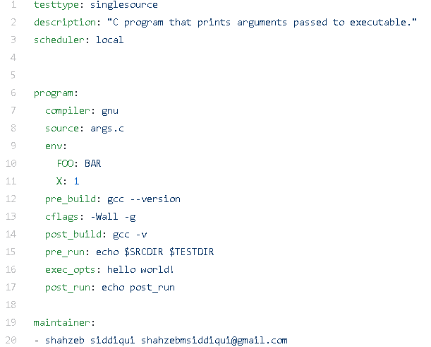
Test Configuration
Informs buildtest this is a Single Source Compilation. Implemented as a Python Class
Description of text. Limited to 80 chars
Run Test Locally
Start of Test Declaration
Specify Compiler Name
Source File to be compiled
Start of Environment Variable Declaration
Commands to run before and after compilation.
Passing flags to C compiler by setting CFLAGS variable
Commands to run before and after execution.
Passing Arguments to the Execution
List of Maintainers

Slide 7
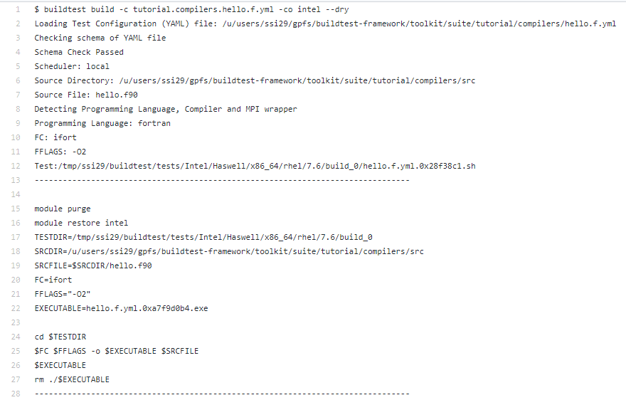
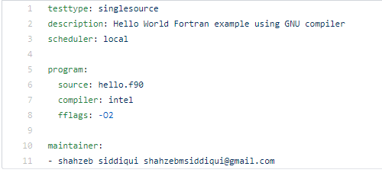
Intel Example

Slide 8
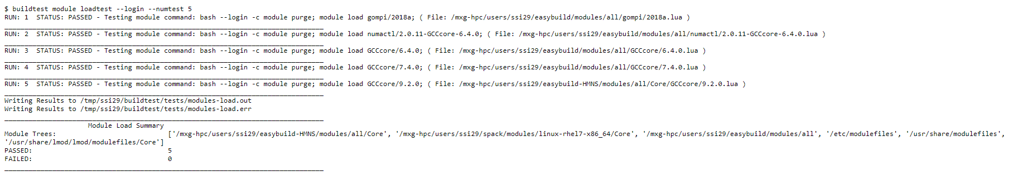
Module Load Testing
Command Executed
Module File Tested

Slide 9
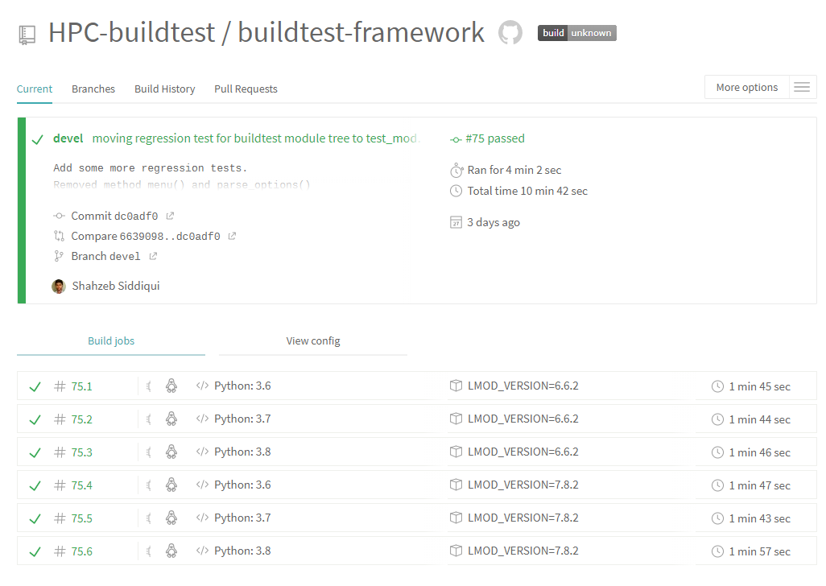
Travis
Since v0.7.4, buildtest can run its regression test in Travis. Several improvement to Travis configuration in v0.7.5
Currently, buildtest contains approximately 30+ regression tests
Some regression tests rely on having a software stack, so buildtest builds a mini stack using easybuild.
Buildtest is tested for Python 3.6, 3.7, 3.8 and Lmod version 6.6.2 and 7.8.2

Slide 10
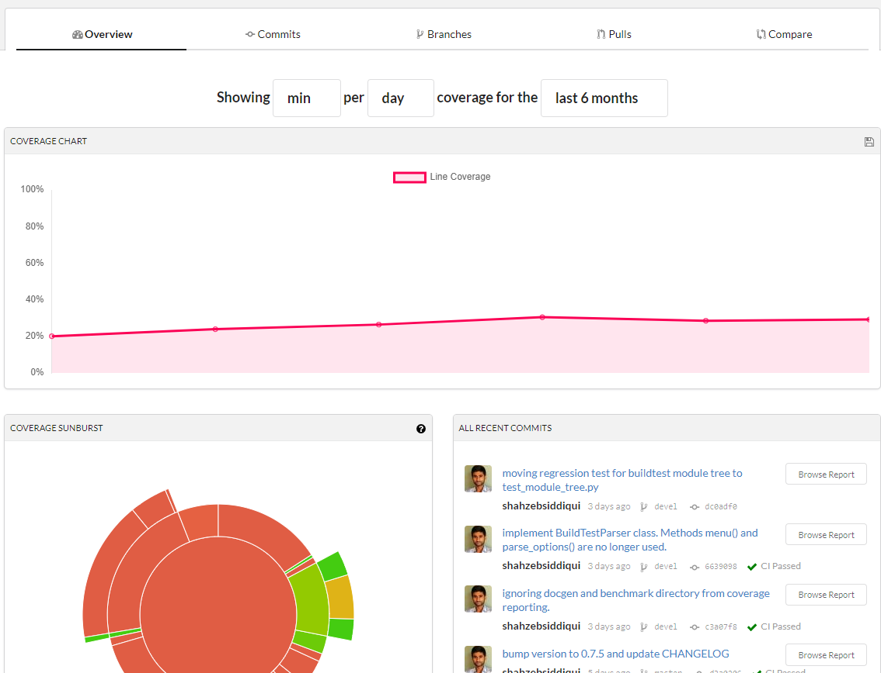
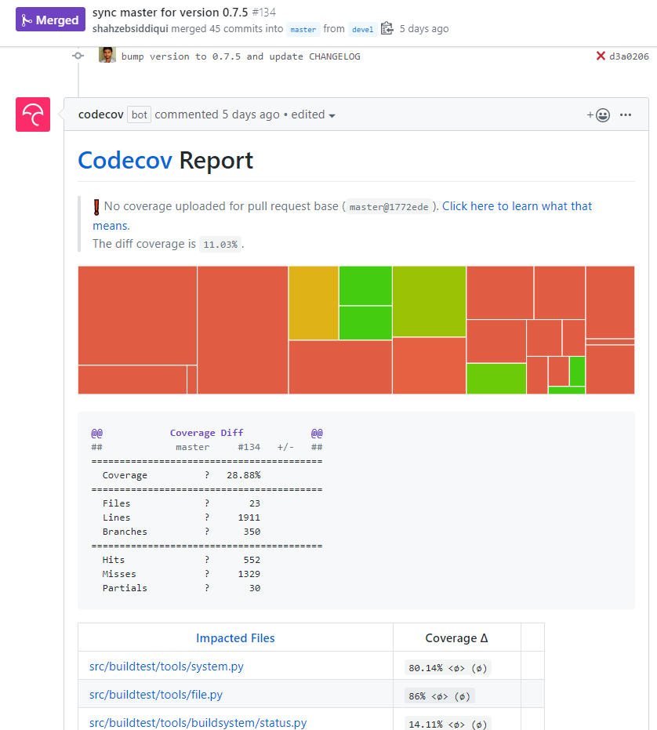
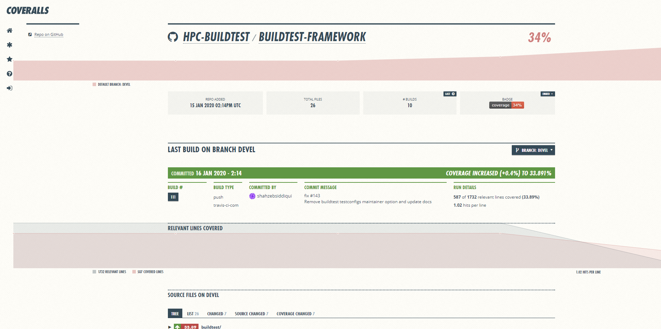
Coverage Report
Since v0.7.5, buildtest can capture coverage report via codecov that is found at https://codecov.io/gh/HPC-buildtest/buildtest-framework
Codecov report is automatically reported by codecov bot on pull requests
Coveralls provides in-depth and more user-friendly coverage report like codecov

Slide 11
GitHub Integration
GitHub Apps Integration
CI: Travis
Code Quality: CodeCov, Coveralls, CodeFactor
Security: Snyk, GuardRails
GitHub Bot Integration
Issue-Label Bot (https://github.com/marketplace/issue-label-bot)
Stale (https://github.com/marketplace/stale)
Trafico (https://github.com/marketplace/trafico-pull-request-labeler)
Pull-Request-Size (https://github.com/marketplace/pull-request-size)
GitHub Action Integration
Black Code Formatter (https://github.com/marketplace/actions/black-code-formatter)
URLs-checker (https://github.com/marketplace/actions/urls-checker)

Slide 12
Future Work
Current YAML schema has some limitation that do not address the following
Declaring variables in tests
Test permutation (compilation flags, multiple runs, environment variables, compilers)
Running test with a range of values (i.e running OpenMP program with range of threads OMP_NUM_THREADS=[1-40] )
Support for multiple source compilation
Increase coverage report for regression tests

Slide 13
Reference
Slack Channel | https://hpcbuildtest.slack.com/
Join Slack via Heroku | https://hpcbuildtest.herokuapp.com/
Documentation | http://buildtest.readthedocs.io/
GitHub | https://github.com/HPC-buildtest/buildtest-framework
ReadTheDocs | https://readthedocs.org/projects/buildtest/
Codecov | https://codecov.io/gh/HPC-buildtest/buildtest-framework
Travis | https://travis-ci.com/HPC-buildtest/buildtest-framework
Coverall | https://coveralls.io/github/HPC-buildtest/buildtest-framework
CodeFactor | https://www.codefactor.io/repository/github/hpc-buildtest/buildtest-framework
Snyk | https://app.snyk.io/org/hpc-buildtest/
GuardRails | https://dashboard.guardrails.io/default/gh/HPC-buildtest

