Slide 1
Untapped Potential: Adopting HPC Carpentry in AU/NZ
Megan Guidry | NeSI Research Communities Advisor
Notes:
Hi everyone, My name is Megan Guidry and I am calling in from Auckland, New Zealand. I work as Research communities advisor for New Zealand eScience Infrastructure as well as Regional coordinator for the carpentries in New Zealand.
The purpose of my talk today is to highlight how tapping into the Carpentries community could help us as we work towards a globally acknowledged and free HPC Certification.
Now, I am new to this conversation so will add a disclaimer that I am not entirely up to speed with any existing relationship between the HPC Certification forum and HPC Carpentry so I am really looking forward to your feedback, comments and questions.

Slide 2
A Quest...
Achieving HPC proficiency is a journey. It takes time, takes support, and requires a learner to overcome obstacles.
Notes:
Now, I love analogies, so for my talk today I am going to suggest we imagine gaining HPC skills is an epic quest. It takes time, dedication, support, and overcoming obstacles.

Slide 3


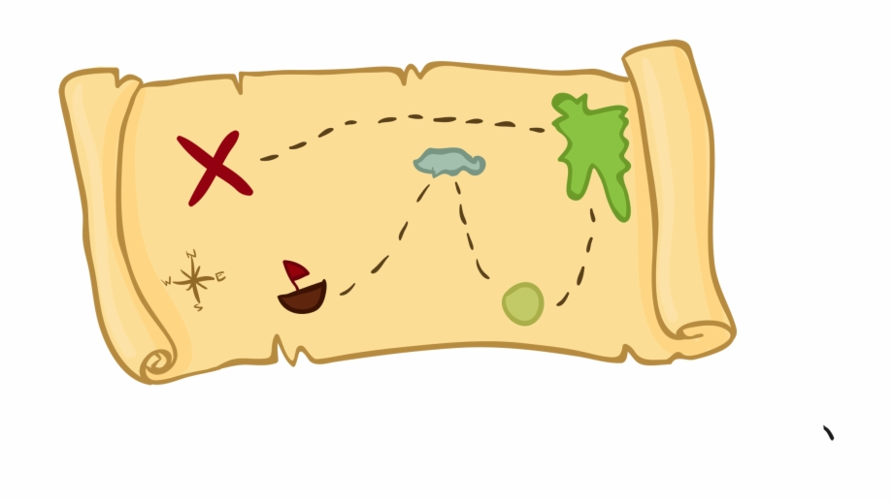
On the researchers’ quest to acquiring HPC skills, the HPC Certification program supplies:
a map, the test, and the seal of approval
Notes:
In this quest analogy, the HPC Certification forum supplies our protagonist - the learner - with three specific things:
The first is competencies defined in a modular and easily expandable skill tree (kind of like a map where potential HPC practitioners can see what their learning journey looks like),
Second, the forum provides an examination process to verify that practitioners possess those skills (this is like the test that our protagonist must overcome to get the glory of HPC certification), and
finally the forum provides the actual certification (this is the recognition that is meaningful and trusted in the broader community)
The development and delivery of the actual training materials lies outside the certification forum…
so the question I’m considering here is how should we go about developing and improving the training materials and delivering workshops? Especially if we want the training to be compatible with a globally acknowledged certification.
The Carpentries is a great ecosystem to look to for some inspiration.

Slide 4

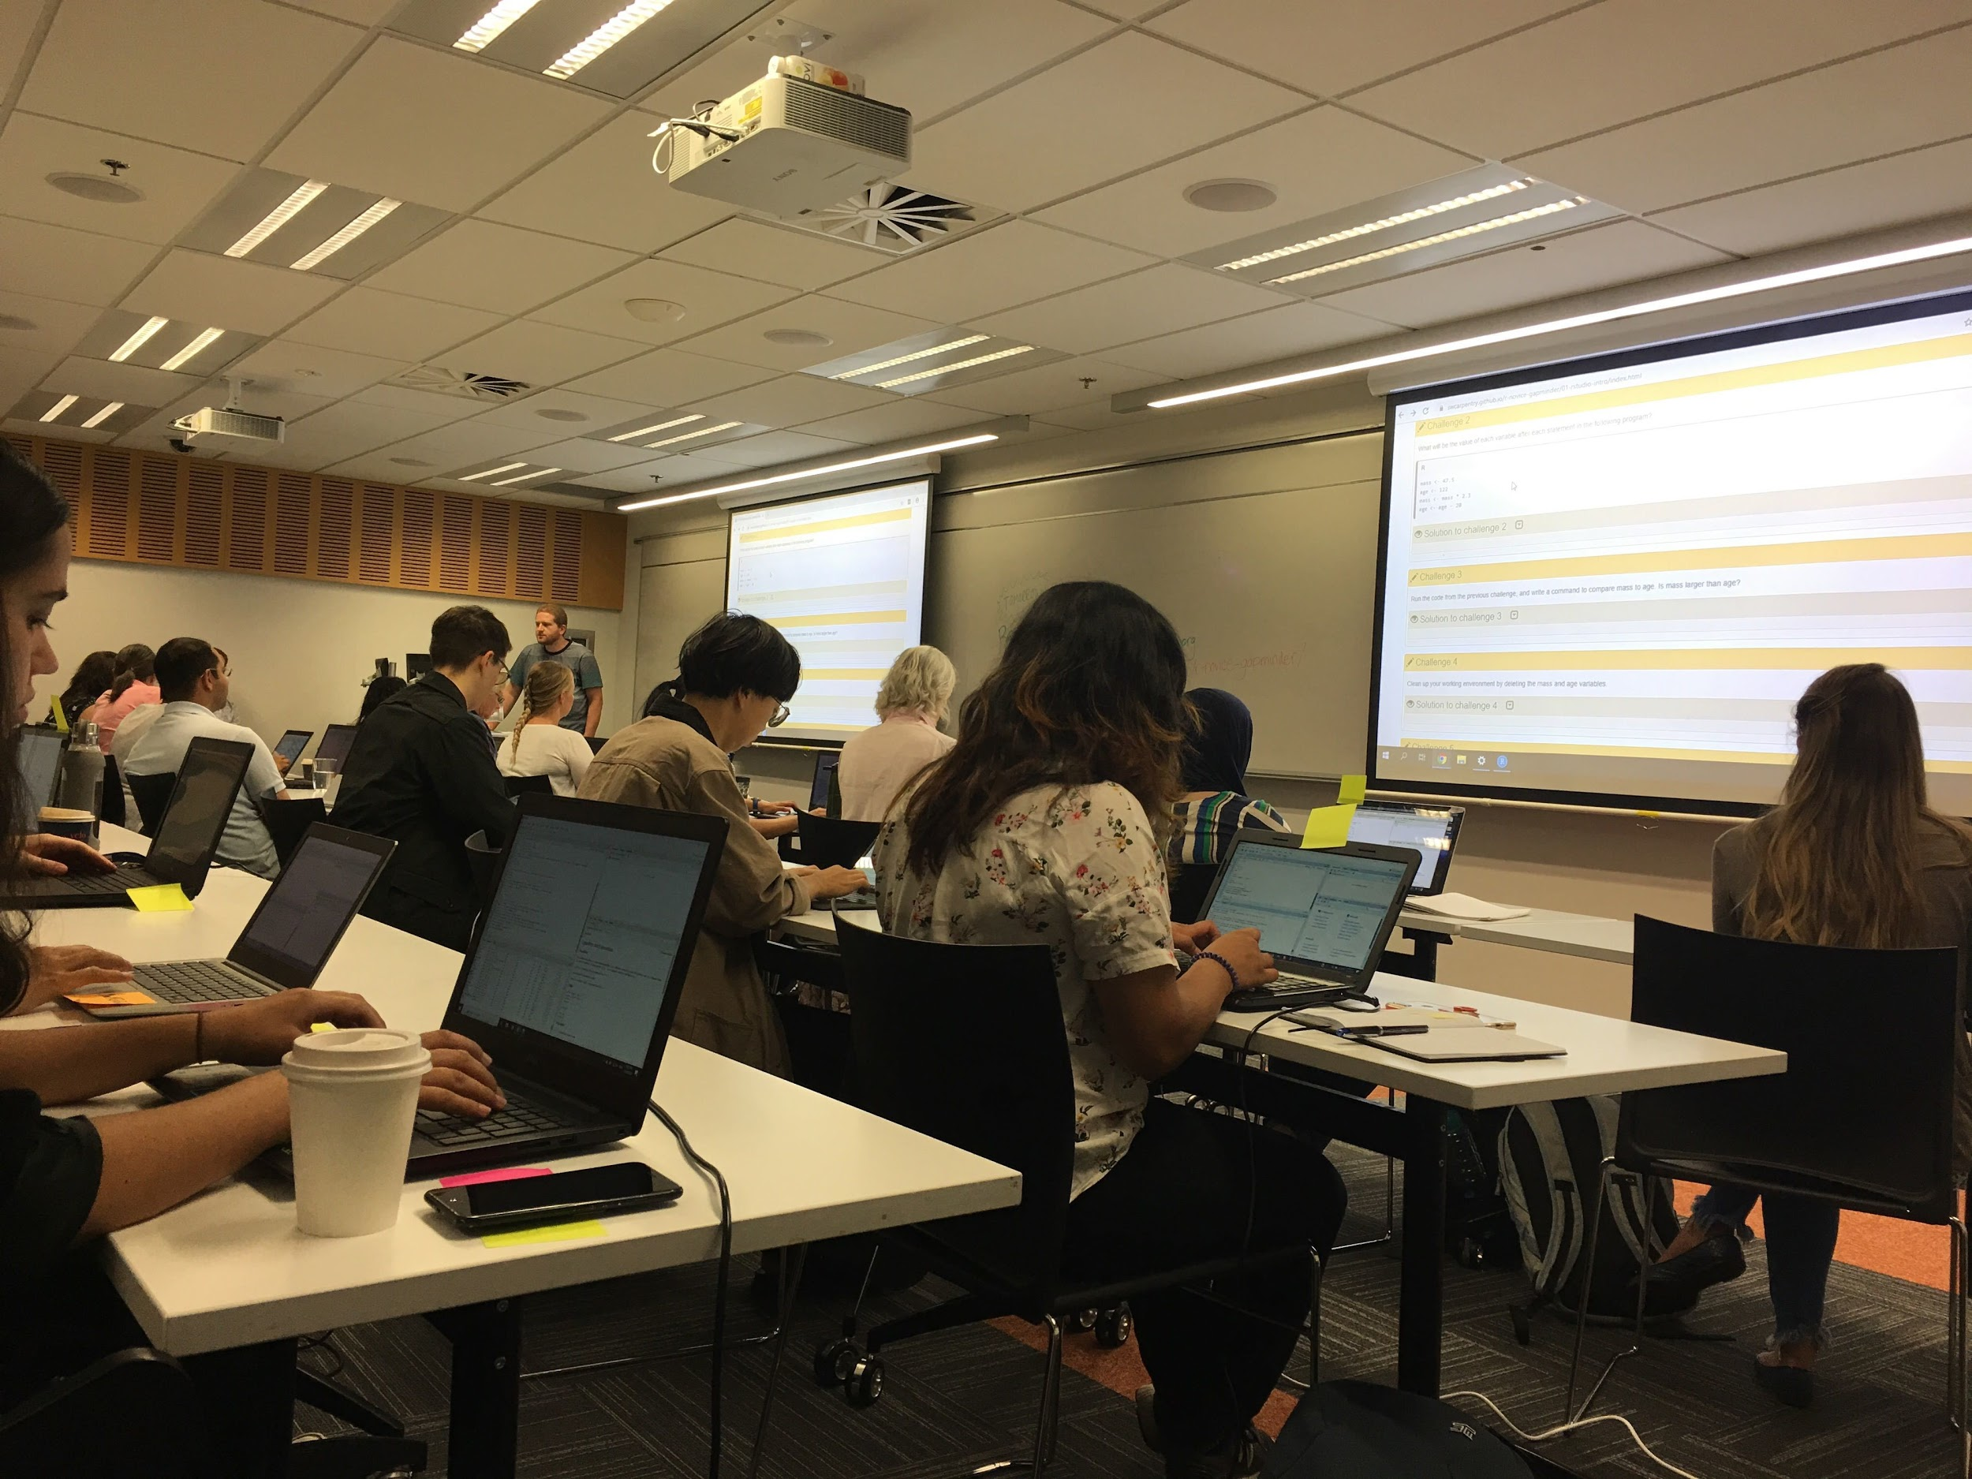
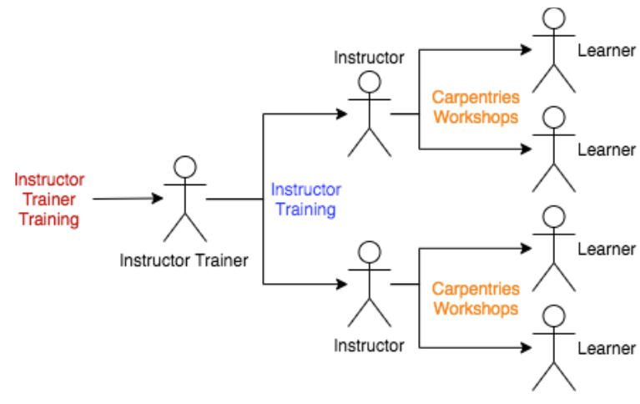
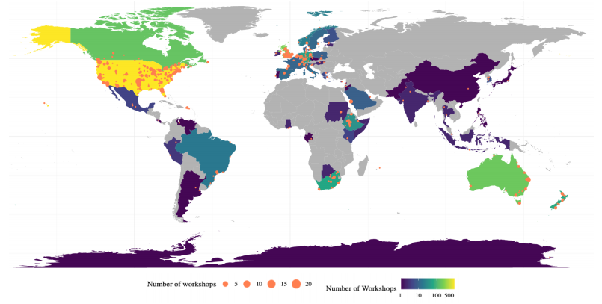
What is The Carpentries?
The Carpentries teaches foundational coding and data science skills to researchers worldwide.
lessons are inclusive and provide a great starting point for beginners
The Carpentries develops quality instructors
The Carpentries has a global presence
Notes:
So what do I mean when I say “the Carpentries”
The Carpentries teaches foundational coding and data management skills to researchers worldwide. It’s a community, its quality lessons, its instructors and maintainers and much more...
But a few things that make the carpentries ecosystem special are
A global presence,
Their focus on inclusivity, and
Their Instructor training mechanism which develops quality teachers simplifies the process of scaling up workshops

Slide 5
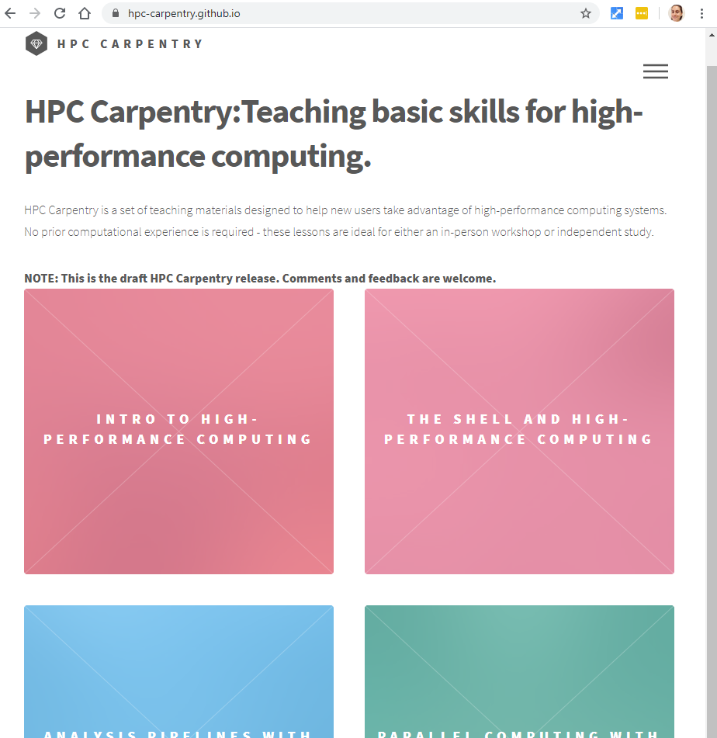
The AU/NZ region has an HPC Carpenries working group aiming to deliver HPC Carpentry in 2020
Check out the lessons at https://github.com/hpc-carpentry/.
Notes:
But, perhaps most relevant to us, is a collection of draft lessons called HPC carpentry.
HPC Carpentry is a set of teaching materials designed to help new users take advantage of high-performance computing systems. While it is not an official Carpentries lesson it is was developed in the Carentries style as an introductory workshop
This lesson is not new and has been delivered a few times in the states (do correct me if I’m wrong though)...
But the reason I am talking about it today is because The Australia/ NZ region has a growing carpentries community that includes HPC practitioners who understand the existing HPC skills gap in the research community; and at a Carpentries connect event in February an HPC Carpentry working group was formed. About 10 people raised their hand to work towards delivering this workshop in the Australia/ NZ region sometime in 2020. Though I will say this was before covid, so the momentum has slowed a bit, but the goal remains.

Slide 6


HPC Certification!
Notes:
So, Going back to our quest analogy, we can think of HPC Carpentry like a guided trek someone takes at the beginning of their journey. It prepares our protagonist for harder challenges to come, which may be intermediate and advanced HPC courses that are platform specific.

Slide 7
What gap does HPC Carpentry fill?
A hands-on introduction to HPC
It’s meant to be accessible and beginner friendly.
Potentially the start of an HPC Certification pipeline
“Topics have been chosen primarily on their ease-of-use and utility (i.e. students should be able to finish the lesson and immediately go out and do something useful with it)”
- HPC Carpentry website
Notes:
Now, In the description for today’s event, it was pointed out that “users struggle to identify the skills required to perform their tasks.”, they struggle to understand if HPC is for them. HPC Carpentry could be used to address this uncertainty and empower researchers since:
Its a hands-on introduction that allows users to experience what it is like to use an HPC.
It’s meant to be accessible and beginner friendly… and may help researchers understand if HPC is right for them.
It could be tweaked to be compatible with a sort of HPC Certification pipeline

Slide 8
What is next?
Thinking through the needs of our users, perhaps through a learner profile exercise: https://carpentries.github.io/instructor-training/15-lesson-study/index.html
Defining a timeline for delivering this first workshop
Understanding how HPC Carpentry fits into the HPC Certification initiative
Notes:
And what’s next for the HPC Carpentry working group? We of course, have the goal of delivering HPC Carpentry but before we can deliver we want to
Thinking through the needs of our users, perhaps though a learner profile exercise (which is an idea I got from Christina Koch who is brilliant),
We also need to determine a timeline for delivering this first workshop, something that helps us keep momentum. It is a big push to do something new, and finally
Understanding how HPC Carpentry fits into the HPC Certification forum so that the workshops we eventually deliver compliments this amazing initiative.

Slide 9
Thank you for your attention! | megan.guidry@nesi.org.nz
www.nesi.org.nz support@nesi.org.nz
@NeSI_NZ
Notes:
Thats all I have for today, So if you have any suggestions, comments or questions I’d love to hear them.

