Slide 1
Engaging Communities to Build HPC Certification: Lessons Learned
Julie Mullen¹, MIT Lincoln Laboratory and David Henty EPCC, University of Edinburgh
Co-Chairs, SIGHPCEducation, Content Committee
Weronika Filinger², EPCC, University of Edinburgh
Chair, SIGHPCEducation, Outreach Committee
1:Presenter EU-US, 2:Presenter EU-Asia-Pacific

Slide 2
SIG HPC Education – The Activities Committees are at work on…
Workshops:
coordinating and managing in-person and virtual events to bring together the community to discuss topics of interest
Computational Science Education:
developing strategies to incorporate and/or enhance computational science education at all levels of education
Education Content:
curating lists of available education and training materials for HPC and computational science skills.
Outreach:
distributing information about the activities of the chapter, including advertising workshops, recruiting webinar speakers and blog entries.
https://sighpceducation.acm.org

Slide 3
SIG HPC Education – The Activities Committees are at work on…
K-12:
Support educators introducing HPC and Data Science in pre-university environments
Systems Professional Committee:
curating, recommending and making available material and resources addressing topics of interest to the HPC systems professionals.
https://sighpceducation.acm.org

Slide 4
Resources on Our Website
YouTube videos of past events:
Undergraduate Computational Science Program Development
HPC Carpentry
Bringing Computer Science to All
Webinars
Links to education and training resources
Blog and discussion forum
Announcements of our workshops and events
Connect to our facebook group
https://sighpceducation.acm.org

Slide 5
Bringing Communities Together
Education Content
HPC Certification
The Education Content committee is focused on informal learning
We reviewed and gathered resources from HPC centers around the global to make resource discovery easier
We were looking to find a way to crowd source the evaluation and usefulness of resources
HPC Certification Forum is focused on finding a way to provide HPC training (Informal Learning)
The HPC Certification Forum created a well-defined set of skills necessary for HPC practitioners
They were looking for a way to crowd source the definition of skills and create assessments

Slide 6
Education Content Committee and HPC Certification Forum
Initial Work (Fall 2019):
Webinar: Julian Kunkel, Introduced the committee to the work of the Certification Forum
November 2019: Meeting at SC19 to discuss ways that the committee could work with the Forum
Recommendation: Select one skill group and build out full process
Define high level skill
Define sub-level skills
Create assessments to test applicants.

Slide 7
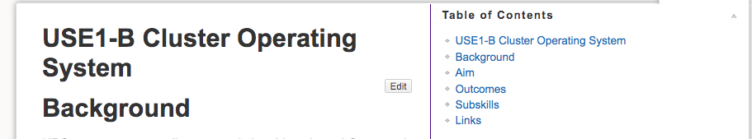
Building a Full Example:
Selected USE1-B and completed the full descriptions of the skills
Next Step – build a library of exam questions
Crowd source
SIGHPC Education Chapter

Slide 8
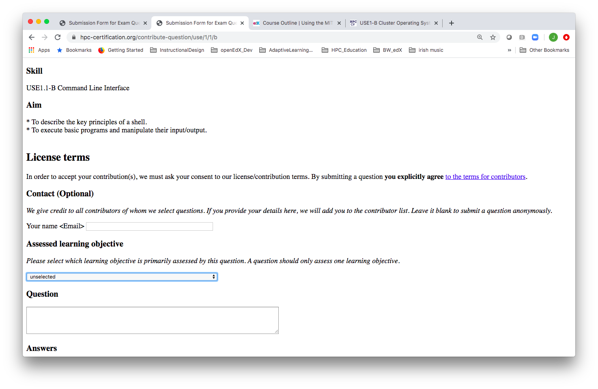

Building a Library of Exam Questions
Our Experience:
We tried it and got at Thank You!
Our concerns
Not clear what questions already exist
Not clear what types of questions can be added
Not clear what the question will look like to the student
It’s really not clear why were are allowed to submit the question

Slide 9
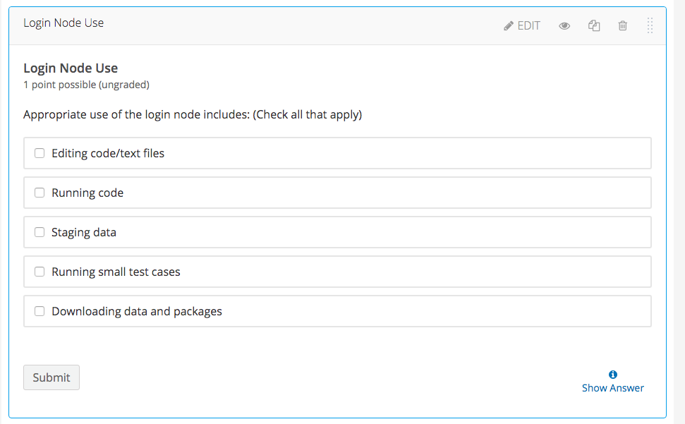

Common Auto-graded Question Formats: Example 1: Open edX
Test Problem Formats
Multiple Choice
True/False
Multiple Answer
Short Answer
Numerical
Process flow
Most online course platforms provide a “solution” and explanation

Slide 10
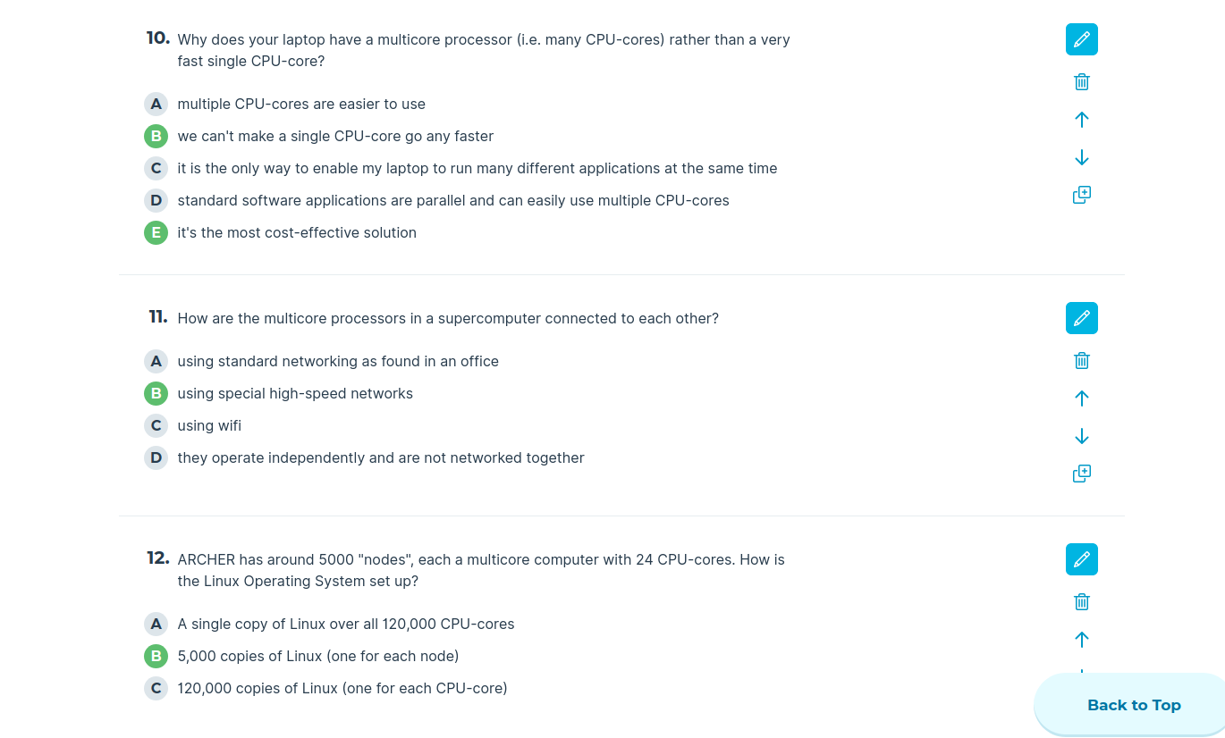

Common Auto-graded Question Formats: Example 2: Socrative.com
Typically used “real-time” at EPCC during a face-to-face or online classroom lesson
Multiple Choice
True/False
Multiple Answer
Free text
Checks key concepts have been understood
promotes discussion

Slide 11
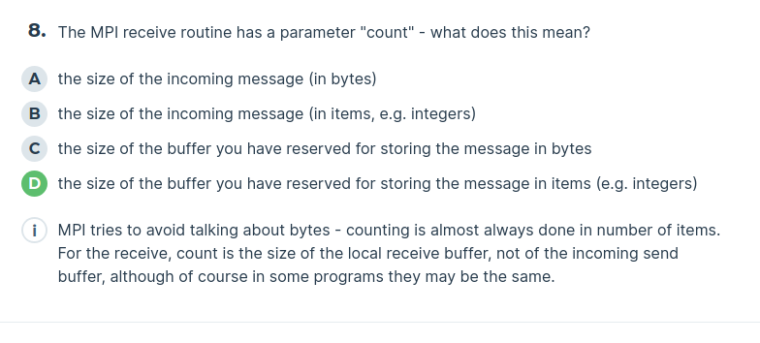
Socrative also provides summary answers
Displayed after the answers have been entered
generic text, not specific to a particular answer

Slide 12
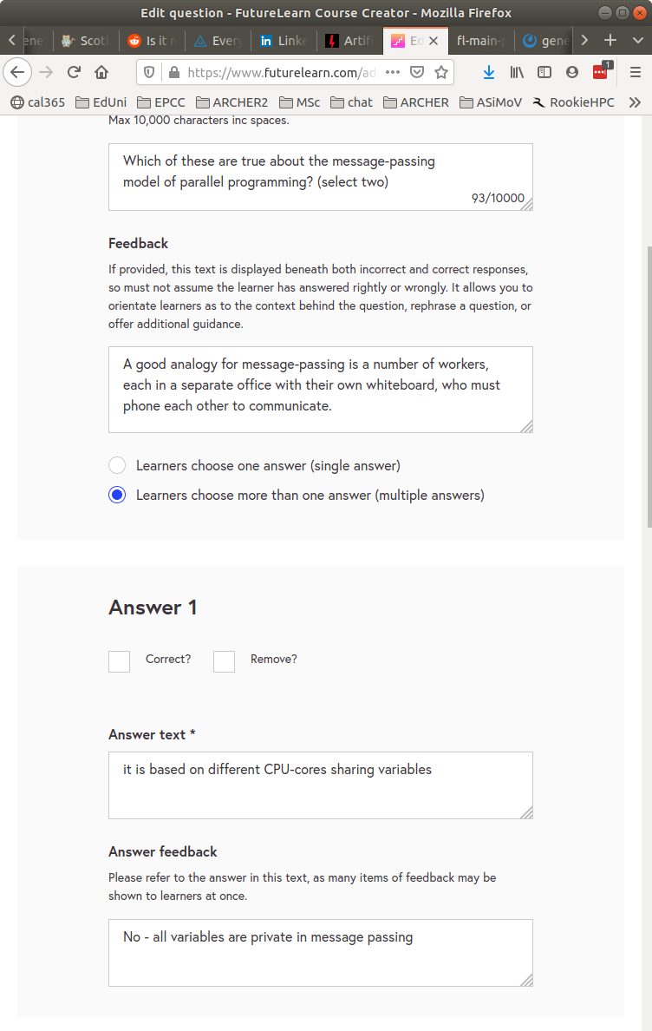

Common Auto-graded Question Formats: Example 3: FutureLearn
futurelearn.com/courses/supercomputing/
Successful completion of “tests” leads to a certificate
material is free but tests cost money
Detailed per-question feedback

Slide 13
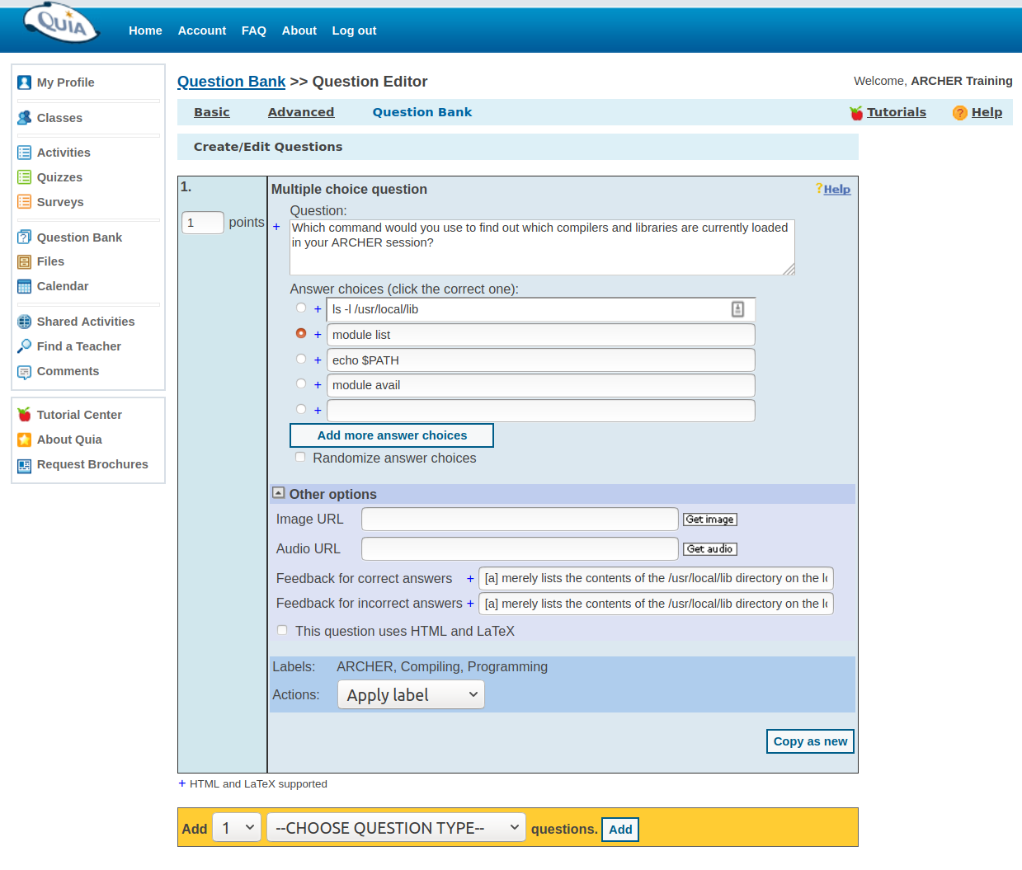

Common Auto-graded Question Formats: Example 4: Quia
Used at EPCC for online “ARCHER Driving test”
success gives new users access to supercomputer
Large bank of questions
classified by area, e.g. Compiling, Filesystem, Data, ...
Each test selects random questions
e.g 30% Compiling, 50% Filesystem, 20% Data

Slide 14
How do we ask the student more detailed questions?
Given: I have a directory with hundreds of files. I need
A single file, files_to_process, that includes all of the file names
N = number of filenames in files_to_process
This is a standard operation that Data Scientists need to do on our system in order to process their data concurrently, taking advantage of the parallel system
One solution is to use egrep and wc, with some piping
How do I craft a problem that accepts and auto-grades an expression?

Slide 15
Discussion
What forms of problems need to be included in order for students to show mastery?
What types of questions are Hiring Managers concerned about?
Where do these questions and problems live?
What is the process for getting permission to submit questions?
How do we find out what questions already exist in the Library?
How do we find out what the final question looks like for a student?
Is there a solution that explains the correct answer?
What is the process for reviewing and testing the Test Library?

Slide 16
Backup

Slide 17
How Can You Get Involved in ACM SIGHPC Education Chapter?
Be a leader
Join one of the committees and share your expertise.
Submit your name for one of the officer positions.
Be a contributor
You have important ideas, techniques, and approaches that need publicity – write a blog post.
You have great training materials - send us the links.
Got an important announcement related to HPC education or training? Send email and the officers will disseminate if approved.
https://sighpceducation.acm.org

Slide 18
Journal of Computational Science Education
Open, online journal
Refereed articles on broad set of computational science education topics
Articles on computational science instructional materials and projects and research on the efficacy of instruction with computational science
Student articles detailing their experiences in computational science internships and research experiences
Become a reviewer! Sign up on our website: www.jocse.org
https://sighpceducation.acm.org

