Slide 1
Training for HPC Virtual Workshop: Toward a Globally Acknowledged and Free HPC Certification, May 18, 2020
Michael Resch, HLRS, Stuttgart, Germany

Slide 2
Roadmap
Short intro to HLRS
Why training & education
Scientific case
Towards industrial training
Summary & Outlook

Slide 3
About HLRS

Slide 4
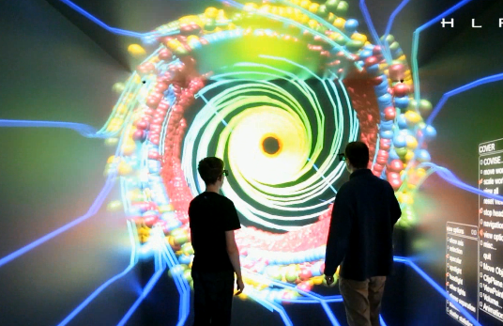

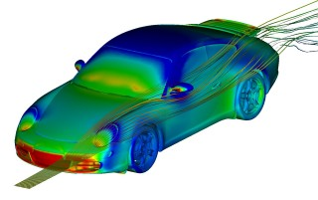



Mission and Vision of HLRS
Research
Industry
Computational
Science & Engineering
since 1996
Engineering
Global Systems Science
Digital Humanities
Politics
Society

Slide 5
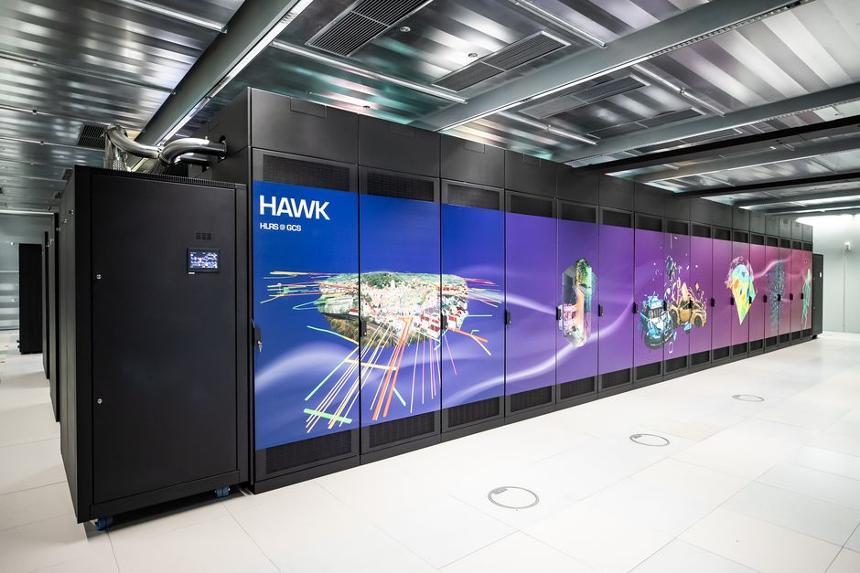
HLRS HPE “Hawk”
HPE Apollo (44M€)
720.896 cores AMD Rome
~26 PetaFlops Peak
>2 PetaFlops Sustained
1,44 PB Main Memory
~26 PetaByte Disk

Slide 6
Why training & Education

Slide 7
Motivation
Have our users get the best from our systems
Make sure our systems are used in the best way
Train people to work for us
Train people to work for our industrial partners

Slide 8
The Science Case

Slide 9
Courses 2019
This year
NEW course
VDI, Baden-Baden
NEW in 2019
wg. Krankheit ausgefallen

Slide 10






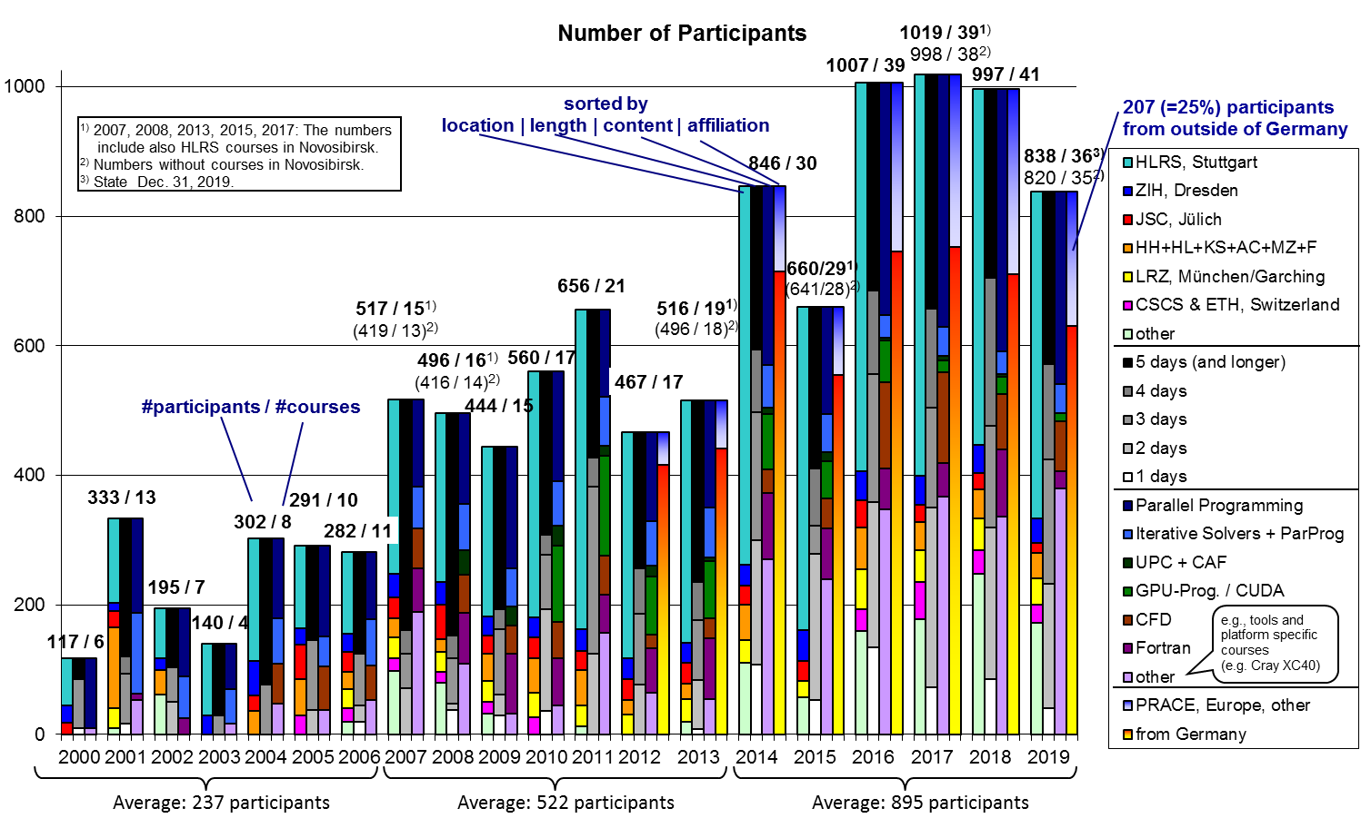


Participants
PATC Courses +
EU-wide
Universität Kassel
51, 75, 131, 105, 260 and 266 foreign participants in 2012–2017
010.gif
by Rolf Rabenseifner
Notes:
10

Slide 11
Towards industrial training

Slide 12

Supercomputing akademie
In-Service Training for aspired HPC-Experts
Prof. Dr. Ing. Hon. Prof. Dr. h.c. Dr. h.c. Michael Resch

Slide 13
What is the Supercomputing-Akademie?
Project: MoeWE
2017-18: Founding of the Supercomputing-Akademie
Goal: In-Service Training for aspired HPC-Experts
Target Audiance: Employed People, Industry
Curriculum: Blended Learning
Form: Modules about 8 different HPC-Subjects
Partner: HLRS, Uni Ulm, Uni Freiburg, Sicos-BW
Funding: ESF, MWK, until Dezember 2020

Slide 14
What do we offer?
8 Modules for In-Service Training
HPC-Developer
HPC-User
HPC-Administrator
Parallel Programmimg
Simulation
HPC-Cluster:
Plan, Build, Run
HPC-Basics
Performance-Optimisation
Visualisation
Economic Efficiency & Sustainability
Big Data & Data Management

Slide 15
What do we offer?
Blended Learning
Presence
Online
Presence
10 - 14 Weeks
weekly virtual seminars
Extent: 120 h
Duration: 10 – 14 Weeks depending on the Module
Distribution: 80% Online, 20% Presence
Weekly Effort: 10 h
Virtual Seminars: 60 Minuten
Presence Days: Stuttgart
Forum: ~ 100 Posts per Module

Slide 16

Which qualifications can be achieved?
After completing a Module
Requirements for a Certificate of Participation
Attendance of the Virtual Seminars
Completion of the Online Courses
Requirements for a Certificate
Certificate of Participation
Passed Exam

Slide 17
What have we achieved so far?
Participants (P) and their Certificates
 | Parallel Programming 1 2018 | ParallelProgramming 2 2018 | Simulation 2019 | HPC-Cluster 2019 | Performance Optimisation 2020 | Economic Efficiency & Sustainability 2020
Number of P | 17 | 9 | 18 | 17 | 17 | 19
Certificate of Participation | 15 | 5 | 9 | 13 | 15
Certificate of Participation | 88 % | 56 % | 50 % | 76 % | 88 %
Certificate | 8 | 5 | 6 | 13 | 13
Certificate | 47 % | 56 % | 33 % | 76 % | 76 %

Slide 18
Summary
Training is a permanent exercise for an HPC center
University training is not sufficient
Training scientists is where we all are good at
Training industry is much more difficult

Slide 19
Questions

