Slide 1
P2Z Comparisons Update
Oct 13 2020

Slide 2
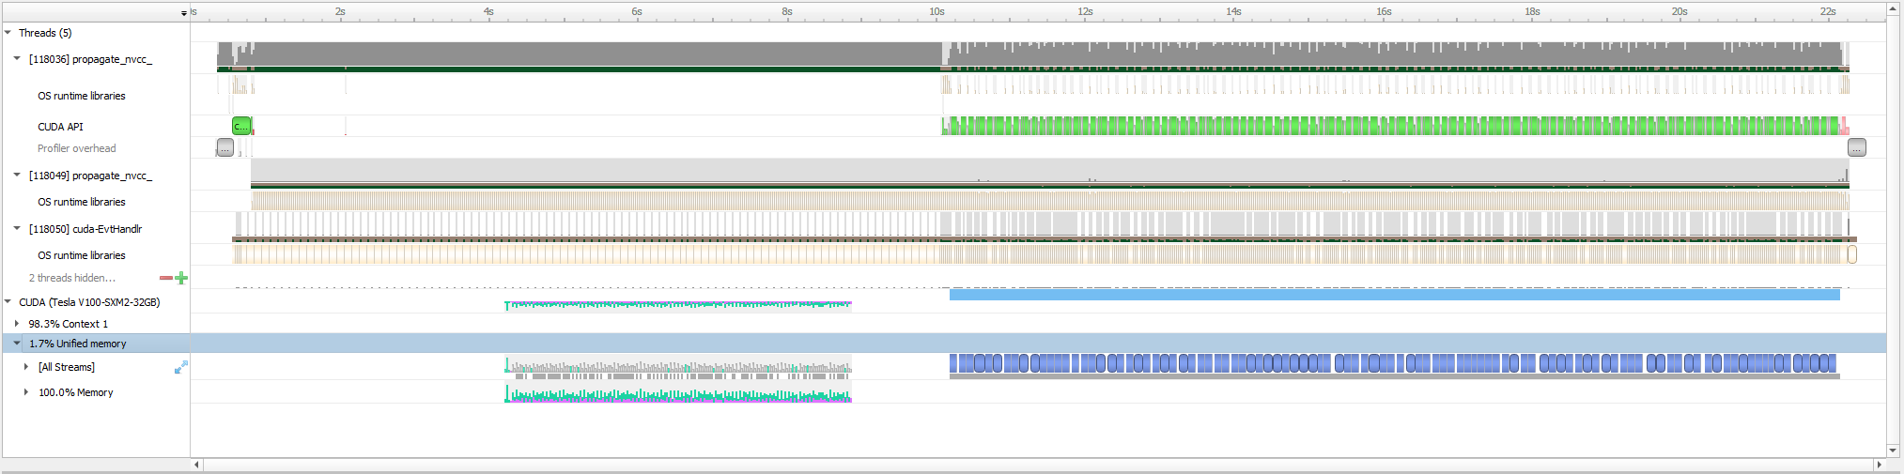
CUDA UVM

Slide 3
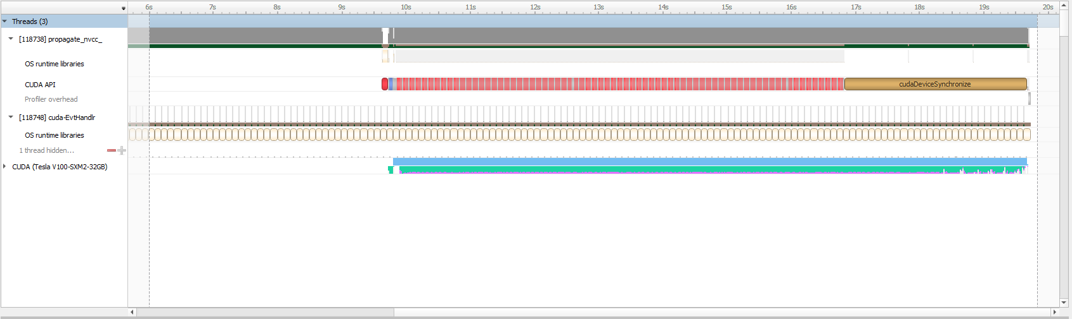
CUDA Manual

Slide 4
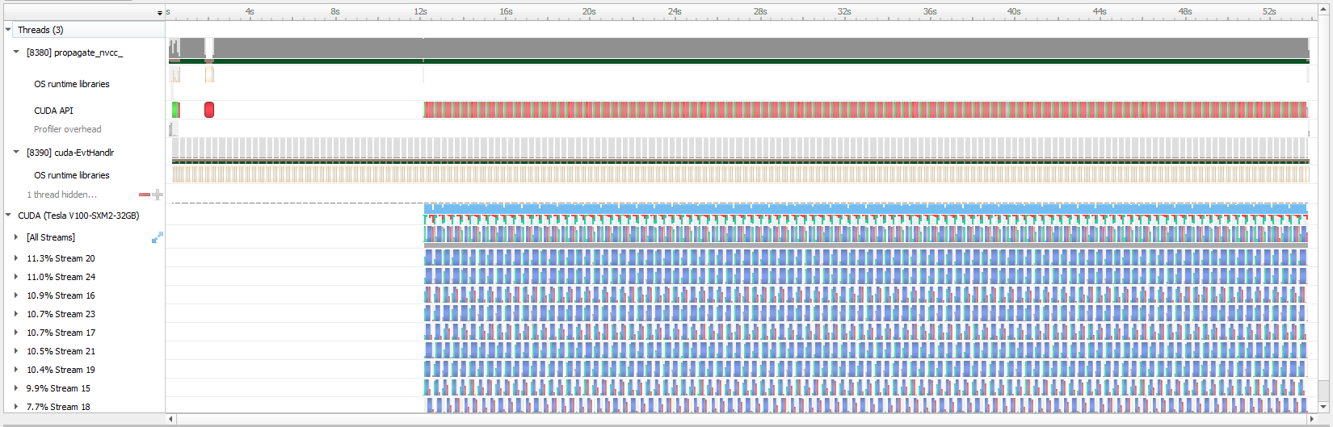
Eigen

Slide 5
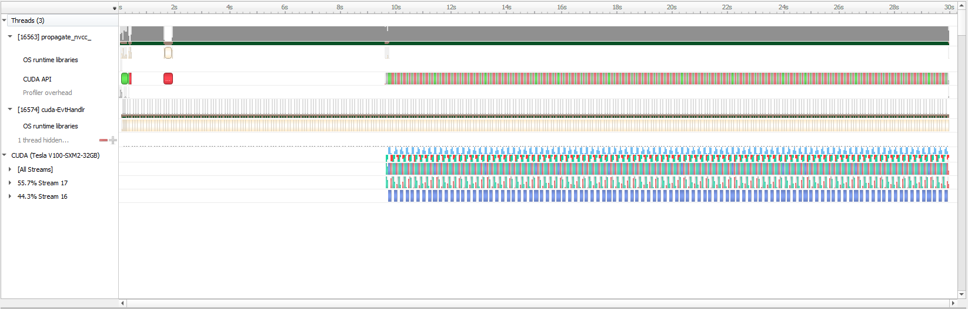
Alpaka

Slide 6
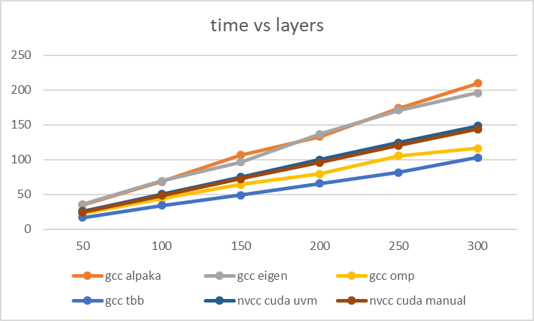
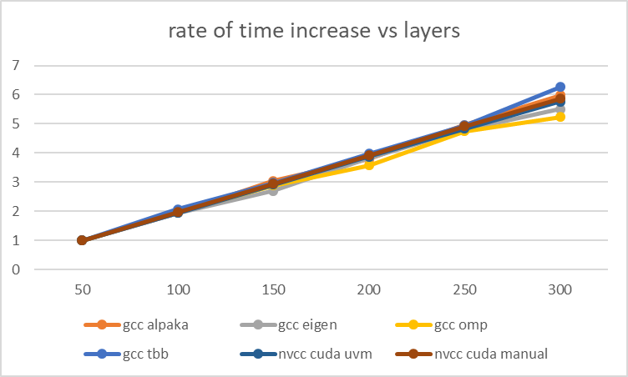
NLAYERS

Slide 7
NLAYERS
layers | gcc alpaka | gcc eigen | gcc omp | gcc tbb | nvcc alpaka | nvcc cuda uvm | nvcc cuda manual | nvcc eigen | icc alpaka | icc eigen | icc omp | icc tbb
50 | 35.048 | 35.581 | 22.211 | 16.457 | 42.393285 | 25.721926 | 24.514969 | 98.173547 | 1139.659 | 141.031 | 6.64 | 5.497
100 | 68.144 | 69.015 | 43.713 | 34.211 | 78.729789 | 50.121344 | 48.384449 | 191.553953 |  | 269.75
150 | 106.594 | 96.382 | 64.273 | 48.845 | 115.289273 | 75.035273 | 72.225625 | 286.575094 |  | 400.412
200 | 132.922 | 136.532 | 79.417 | 65.458 | 150.027813 | 99.796359 | 95.978125 | 381.901406 |  | 523.745
250 | 173.822 | 170.947 | 105.334 | 81.335 | 188.099781 | 124.300258 | 120.507898 | 479.617875 |  | 650.567
300 | 209.519 | 195.868 | 116.242 | 103.048 | 224.724266 | 148.374406 | 143.812484 | 577.353

