Slide 1

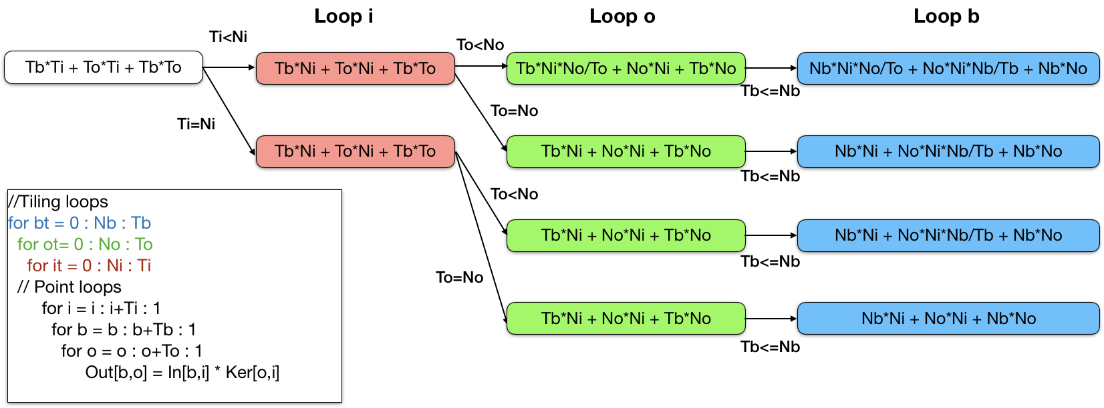
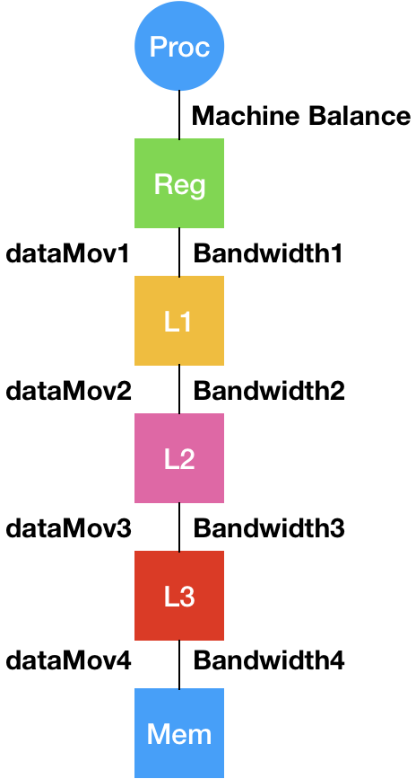
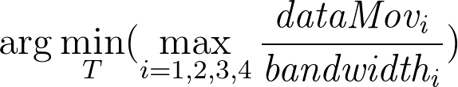
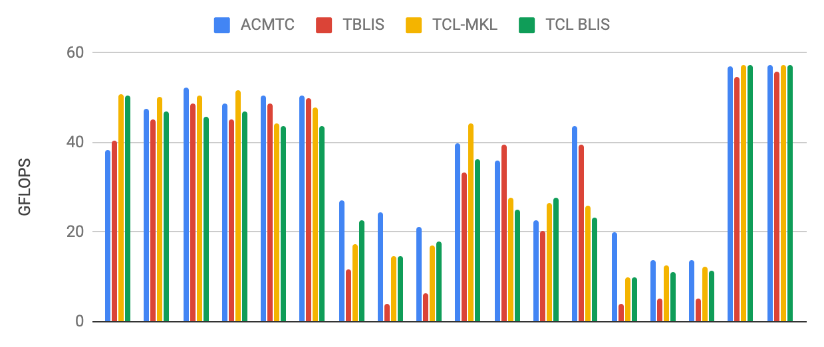
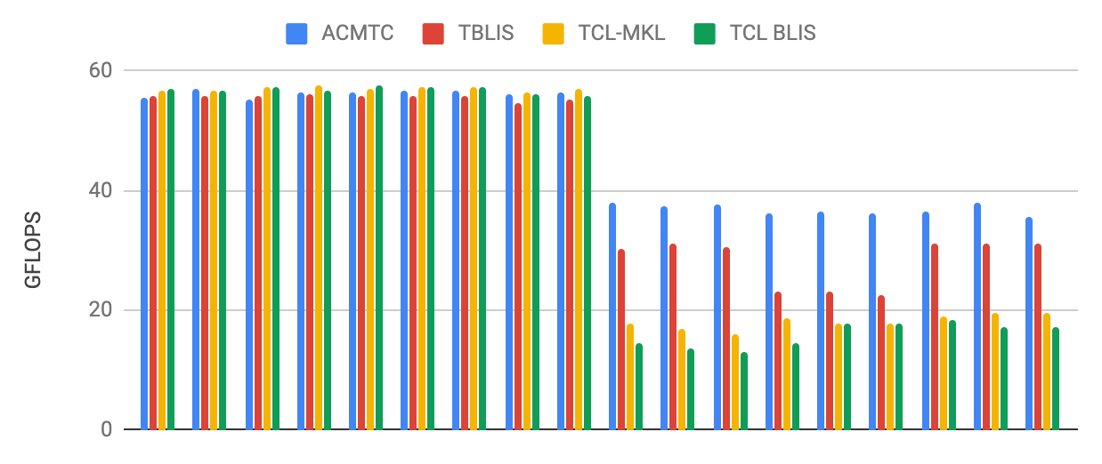



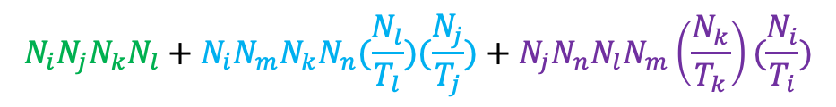
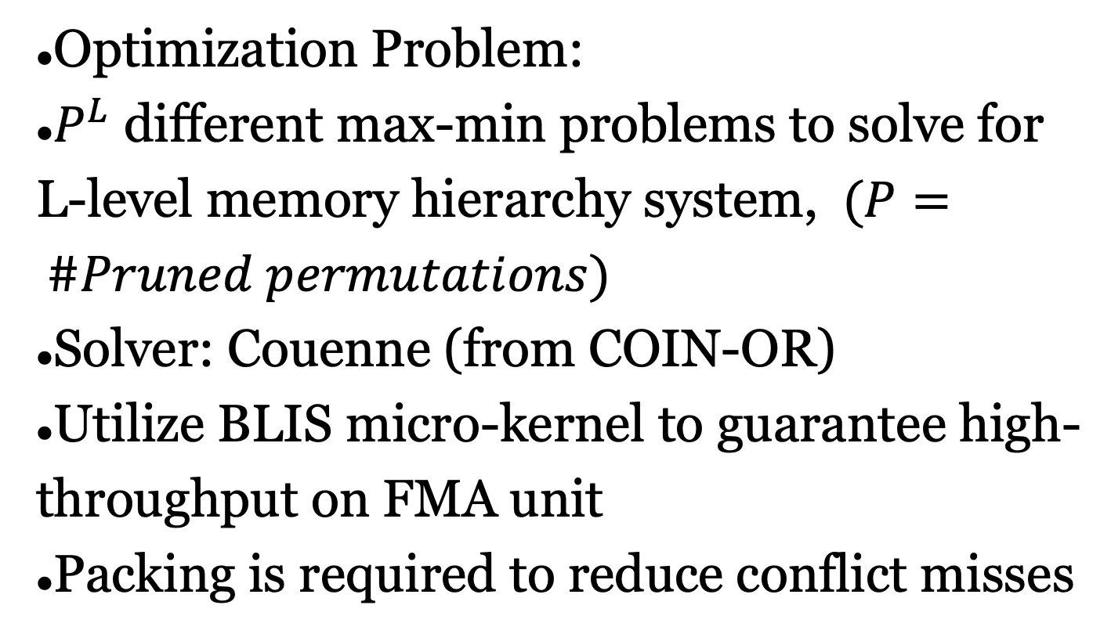





Analytical Cache Modeling and Tile-size Optimization for
Tensor Contractions
Rui Li,. Aravind Sukumaran-Rajam, Richard Veras,
Tze-Meng Low, Fabrice Rastello, Atanas Rountev, P. Sadayappan†
†Utah, WSU, LSU,
CMU, INRIA, OSU
Overview
Automatic Data Movement Calculation
Bottom-up algorithm for each permutation
Prune loop permutations if they have same data movement expression
Goal
High performance tensor contraction on CPU
Challenge
Exponential space of possible code versions when optimizing loop permutation and loop tiling
Solution Approach
Algorithm to automatically compute data movement as a symbolic expression of tile-sizes
Algorithm to automatically compute data movement as a symbolic expression of tile-sizes
Estimation of execution time for multi-level memory hierarchy
Formulation of nonlinear optimization problem for automatic solution
$$N_{i}N_{j}N_{k}N_{l}+N_{i}N_{m}N_{k}N_{n}(\frac{N_{l}}{T_{l}})(\frac{N_{j}}{T_{j}})+N_{j}N_{n}N_{l}N_{m}\left(\frac{N_{k}}{T_{k}}\right)(\frac{N_{i}}{T_{i}})$$
for (ti=0; ti<Ni; ti+=Ti)
for (tj=0; tj<Nj; tj+=Tj)
for (tk=0; tk<Nk; tk+=Tk)
for (tl=0; tl<Nl; tl+=Tl)
for (tm=0; tm<Nm; tm+=Tm)
for (tn=0; tn<Nn; tn+=Tn)
tiles of C_{ijkl}, A_{imkn}, B_{jnlm}
$T_{i}N_{j}N_{k}N_{l}+T_{i}N_{m}N_{k}N_{n}(\frac{N_{l}}{T_{l}})(\frac{N_{j}}{T_{j}})+N_{j}N_{n}N_{l}N_{m}(\frac{N_{k}}{T_{k}})$
$T_{i}T_{j}N_{k}N_{l}+T_{i}N_{m}N_{k}N_{n}(\frac{N_{l}}{T_{l}})+T_{j}N_{n}N_{l}N_{m}(\frac{N_{k}}{T_{k}})$
Time Cost Model on Multi-level Cache
$T_{i}T_{j}T_{k}N_{l}+T_{i}N_{m}T_{k}N_{n}(\frac{N_{l}}{T_{l}})+T_{j}N_{n}N_{l}N_{m}$
Optimization Problem:
$P^{L}$ different max-min problems to solve for L-level memory hierarchy system, $(P= \#Pruned permutations)$
Solver: Couenne (from COIN-OR)
Utilize BLIS micro-kernel to guarantee high-throughput on FMA unit
Packing is required to reduce conflict misses
$T_{i}T_{j}T_{k}T_{l}+T_{i}N_{m}T_{k}N_{n}+T_{j}N_{n}T_{l}N_{m}$
$T_{i}T_{j}T_{k}T_{l}+T_{i}T_{m}T_{k}N_{n}+T_{j}N_{n}T_{l}T_{m}$
$$T_{i}T_{j}T_{k}T_{l}+T_{i}T_{m}T_{k}T_{n}+T_{j}T_{n}T_{l}T_{m}≤C$$
Problem formalization for single level cache
Conditional Optimization problem based on data movement expression and cache capacity constraint
$\underset{all T}{argmin}{N_{i}N_{j}N_{k}N_{l}+N_{i}N_{m}N_{k}N_{n}(\frac{N_{l}}{T_{l}})(\frac{N_{j}}{T_{j}})+N_{j}N_{n}N_{l}N_{m}\left(\frac{N_{k}}{T_{k}}\right)(\frac{N_{i}}{T_{i}})}$
under constraint $T_{i}T_{j}T_{k}T_{l}+T_{i}T_{m}T_{k}T_{n}+T_{j}T_{n}T_{l}T_{m}≤C$
Data Movement Modeling for Tiled Loop Code
Experimental Evaluation
6D Tiled Loop Code
Tiling example for single level cache
6! Permutations brought by 6 tiling loops
Footprints in point loops fit in cache
Permutation of point loops has no effects to data movement
for (ti=0:Ni:Ti)
for (tj=0:Ni:Tj)
for (tk=0:Nk:Tk)
for (tl=0:Nl:Tl)
for (tm=0:Nm:Tm)
for (tn=0:Nn:Tn)
for (i=ti:ti+Ti:1)
for (j=tj:tj+Tj:1)
for (k=tk:tk+Tk:1)
for (l=tl:tl+Tl:1)
for (m=tm:tm+Tm:1)
for (n=tn:tn+tn:1)
C[i][j][k][l]+= A[i][m][k][n]*
B[j][n][l][m];
Evaluation on TTCG benchmark on i7-6700K, single thread, comparing to TBLIS, TCL-BLIS and TCL-MKL
Competitive when all tensors are huge
Outperform when some inputs tensor are large or output tensor is large
Edge Cases Handling: Tile Size equal to Range
If some problem range $N_{x}$can fit in cache, setting $T_{x}$= $N_{x}$changes the cost
$2^{d}$ cases to be traversed for a pruned permutation Must be performed within and across trees
Tree shows all cases for a fixed permutation of Matmul
Each leaf contains a data movement expression
Merging leaves of all trees with same cost expression
Notes:
1

