Slide 1
Analytical Cache Modeling and Tilesize Optimization for Tensor Contractions
Rui Li* (Utah) | Aravind Sukumaran-Rajam (WSU)
Richard Veras (LSU) | Tze-Meng Low (CMU)
Fabrice Rastello (Inria) | Atanas Rountev (OSU)
P. (Saday) Sadayappan (Utah)
Notes:
Hello Everyone, Thanks for attending, My name is Ray, I will present the …
Nxt: The outline of todays presentation..

Slide 2
Outline
Introduction and Motivation
System Overview
Model on Single Level Cache
Model on Multi Level Memory Hierarchy
Prior Work
Experiments
Notes:
Here is outline of today’s presentation
First we will make a short intro to TC and motiviation for optimize TC
Second we provide a overview of the whole system, for people understanding high-lv picture
Then we explain the model in details for single lv cache
And extend to multi-lv mem Hierachy
At last we intro some pre work and show experients

Slide 3
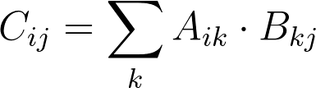
Matrix multiplication
for (i=0; i<Ni; i++)
for (j=0; j<Nj; j++)
for (k=0; k<Nk; k++)
C[i][j]+=A[i][k]*B[k][j];
Notes:
Now to begin with, we look at the simplest example of TC, Matmul
The following code shows
The picture shows what happens
That is, …
If we have a feeling of how to do matmul,
Imagine all of matrix are high-dim tensor, it becomes general TC
The next slides shows the code for a gen TC

Slide 4
Challenge of Optimizing tensor contraction
for (i=0; i<Ni; i++)
for (j=0; j<Nj; j++)
for (k=0; k<Nk; k++)
for (l=0; l<Nl; l++)
for (m=0; m<Nm; m++)
for (n=0; n<Nn; n++)
C[i][j][k][l]+=A[i][m][k][n]*B[j][n][l][m];
Tensor contraction: high-dimension analog of matrix multiplication
Direct implementation as 6D nested loop results in low performance
Key techniques for improving performance
Loop permutation and loop tiling
Challenge: exponential space of possible code versions
State of the art: two-step iterative optimization with polyhedral compilers is insufficient
Find tiled loop structure for assumed tile-sizes
Auto-tune for different tile-size combinations
Notes:
The TC is a high-dim analog of maumul.
PROBLEM: if direct impl as C-loop nests as above, the performance will be not good.
REASONof low perf: it creates massive data mov betwen mem Hierarchy
KEY TECH for reducing DM:change permu, add tiling loops
CHALLENGE #code versions with diff permu and tile sizes is exponential don't know which one pick
STATE OF ART, polyhedral compiler
Not good because permu and tile size are strong corelated,
independtly opt them will not cover the whole

Slide 5
Novel Contributions
Algorithm to automatically compute data movement as a symbolic expression of tile-sizes
Pruning method to reduce number of possible code versions
Estimation of execution time for multi-level memory hierarchy
Formulation of nonlinear optimization problem for automatic solution
Notes:
To solve these problems,
In this paper, we have the following major contributation
First we propose

Slide 6
System overview
Generate loop permutations
Exhaustive search space is huge
Pruning to reduce the space
Formulate cost and constraint for each permutation
Symbolic expression of tile-sizes
Pruning to reduce number of expressions
Solve all optimization problems and find the best solution
Generate Loop Permutations
Cost and Constraint Formalization
Optimization Solver
Notes:
Now we provide a system overview to our model
1st component..
2nd component
In both component, pruning is following the same principle THAT is
if 2 diff config produce same cost expr, we can view them as a same
REASON: opt time <- #opt problem <- cost expr
At the end of 2nd component..

Slide 7
Generate Loop Permutations
for (ti=0; ti<Ni; ti+=Ti)
for (tj=0; tj<Nj; tj+=Tj)
for (tk=0; tk<Nk; tk+=Tk)
for (tl=0; tl<Nl; tl+=Tl)
for (tm=0; tm<Nm; tm+=Tm)
for (tn=0; tn<Nn; tn+=Tn)
for (i=ti; i<ti+Ti; i++)
for (j=tj; j<tj+Tj; j++)
for (k=tk; k<tk+Tk; k++)
for (l=tl; l<tl+Tl; l++)
for (m=tm; m<tm+Tm; m++)
for (n=tn; n<tn+tn; n++)
C[i][j][k][l]+= A[i][m][k][n]*
B[j][n][l][m];
Example for tiling on single-level cache
Data footprint accessed by point loops fits in cache
Permutation of point loops does not change the data movement
6 tiling loops => 6! permutations
Prune permutations with same data movement (cost)
Notes:
Now we give a example of 6 tiling loop, 6 point loop nest for TC on single lv cache
DF for point(blue). PERMU not matter
PERMU for TILe 6!
prune for Same expr
To know whether diff permu have same cost
describe how to count

Slide 8
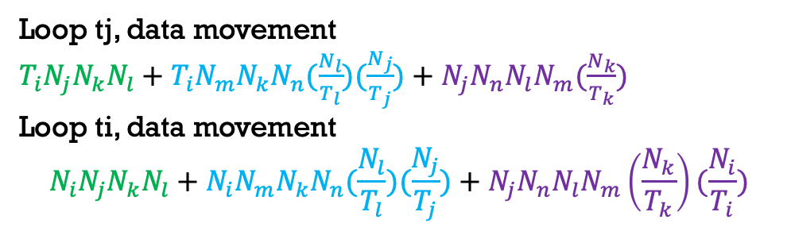
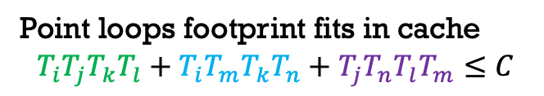
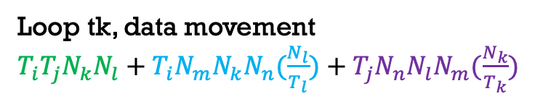
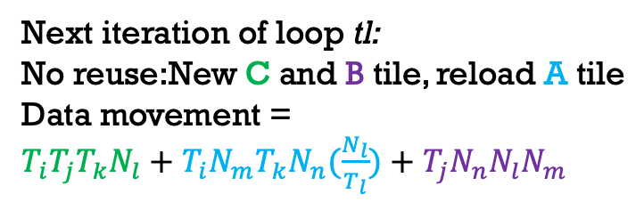
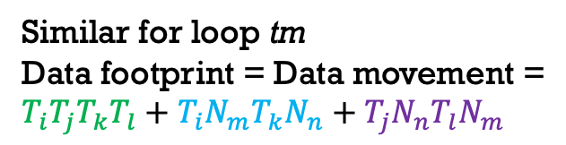
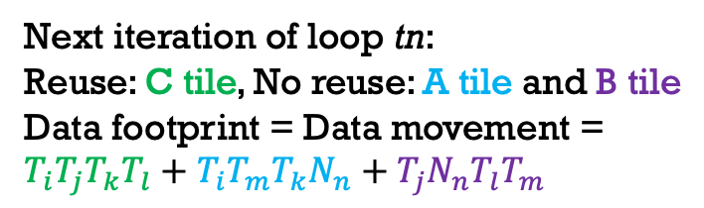
Counting data movement
for (ti=0; ti<Ni; ti+=Ti)
for (tj=0; tj<Nj; tj+=Tj)
for (tk=0; tk<Nk; tk+=Tk)
for (tl=0; tl<Nl; tl+=Tl)
for (tm=0; tm<Nm; tm+=Tm)
for (tn=0; tn<Nn; tn+=Tn)
for (i=ti; i<ti+Ti; i++)
for (j=tj; j<tj+Tj; j++)
for (k=tk; k<tk+Tk; k++)
for (l=tl; l<tl+Tl; l++)
for (m=tm; m<tm+Tm; m++)
for (n=tn; n<tn+tn; n++)
C[i][j][k][l]+= A[i][m][k][n]*
B[j][n][l][m];
Loop tk, data movement
$T_{i}T_{j}N_{k}N_{l}+T_{i}N_{m}N_{k}N_{n}(\frac{N_{l}}{T_{l}})+T_{j}N_{n}N_{l}N_{m}(\frac{N_{k}}{T_{k}})$
Loop tj, data movement
$T_{i}N_{j}N_{k}N_{l}+T_{i}N_{m}N_{k}N_{n}(\frac{N_{l}}{T_{l}})(\frac{N_{j}}{T_{j}})+N_{j}N_{n}N_{l}N_{m}(\frac{N_{k}}{T_{k}})$
Loop ti, data movement
$$N_{i}N_{j}N_{k}N_{l}+N_{i}N_{m}N_{k}N_{n}(\frac{N_{l}}{T_{l}})(\frac{N_{j}}{T_{j}})+N_{j}N_{n}N_{l}N_{m}\left(\frac{N_{k}}{T_{k}}\right)(\frac{N_{i}}{T_{i}})$$
Next iteration of loop tl:
No reuse:New C and B tile, reload A tile
Data movement =
$T_{i}T_{j}T_{k}N_{l}+T_{i}N_{m}T_{k}N_{n}(\frac{N_{l}}{T_{l}})+T_{j}N_{n}N_{l}N_{m}$
Similar for loop tm
Data footprint = Data movement =
$T_{i}T_{j}T_{k}T_{l}+T_{i}N_{m}T_{k}N_{n}+T_{j}N_{n}T_{l}N_{m}$
Next iteration of loop tn:
Reuse: C tile, No reuse: A tile and B tile
Data footprint = Data movement =
$T_{i}T_{j}T_{k}T_{l}+T_{i}T_{m}T_{k}N_{n}+T_{j}N_{n}T_{l}T_{m}$
Point loops footprint fits in cache
$$T_{i}T_{j}T_{k}T_{l}+T_{i}T_{m}T_{k}T_{n}+T_{j}T_{n}T_{l}T_{m}≤C$$
Before, purpose: algorithm automatic creates symbolic expr capture datamov cost
Point to the iteration idx and go tensor expr , why no reuse or reus
Notes:
Counting method starts at point nest, go outside
At point lp lv: DF fits DM=DF
Next loop: LP TN
notice: idx n missing in C, appear in A, B
that means for each new iter for n,
a new portion of A and B are brought to cache, kick the old portion of A and B out.
old portion of C stays. DF? DM?
LOOP TL: new portion of C, B. missing in A, can the old tile of A stay? Not , spill out when iterating inner loop

Slide 9
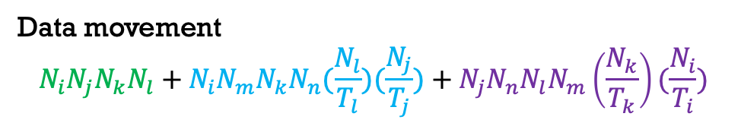
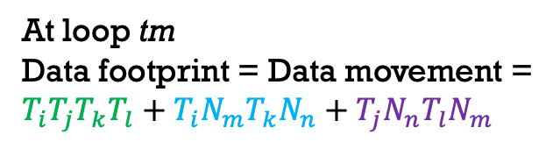
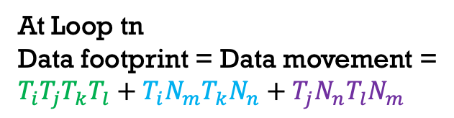

Pruning loop permutations
for (ti=0; ti<Ni; ti+=Ti)
for (tj=0; tj<Nj; tj+=Tj)
for (tk=0; tk<Nk; tk+=Tk)
for (tl=0; tl<Nl; tl+=Tl)
for (tm=0; tm<Nm; tm+=Tm)
for (tn=0; tn<Nn; tn+=Tn)
tiles of C_{ijkl}, A_{imkn}, B_{jnlm}
Data movement
$$N_{i}N_{j}N_{k}N_{l}+N_{i}N_{m}N_{k}N_{n}(\frac{N_{l}}{T_{l}})(\frac{N_{j}}{T_{j}})+N_{j}N_{n}N_{l}N_{m}\left(\frac{N_{k}}{T_{k}}\right)(\frac{N_{i}}{T_{i}})$$
At loop tm
Data footprint = Data movement =
$T_{i}T_{j}T_{k}T_{l}+T_{i}N_{m}T_{k}N_{n}+T_{j}N_{n}T_{l}N_{m}$
for (tj=0; tj<Nj; tj+=Tj)
for (tk=0; tk<Nk; tk+=Tk)
for (tl=0; tl<Nl; tl+=Tl)
for (ti=0; ti<Ni; ti+=Ti)
for (tn=0; tn<Nn; tn+=Tn)
for (tm=0; tn<Nm; tn+=Tm)
tiles of C_{ijkl}, A_{imkn}, B_{jnlm}
Data movement
$$N_{i}N_{j}N_{k}N_{l}+N_{i}N_{m}N_{k}N_{n}(\frac{N_{l}}{T_{l}})(\frac{N_{j}}{T_{j}})+N_{j}N_{n}N_{l}N_{m}\left(\frac{N_{k}}{T_{k}}\right)(\frac{N_{i}}{T_{i}})$$
At Loop tn
Data footprint = Data movement =
$T_{i}T_{j}T_{k}T_{l}+T_{i}N_{m}T_{k}N_{n}+T_{j}N_{n}T_{l}N_{m}$
Notes:
Now we can show that, the two diff permu on slids
Same DM

Slide 10
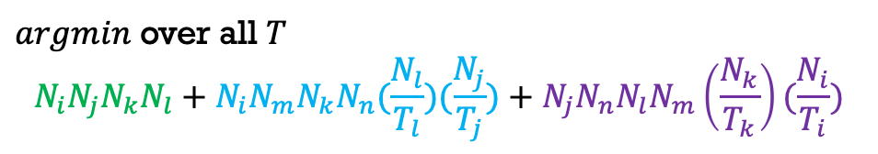
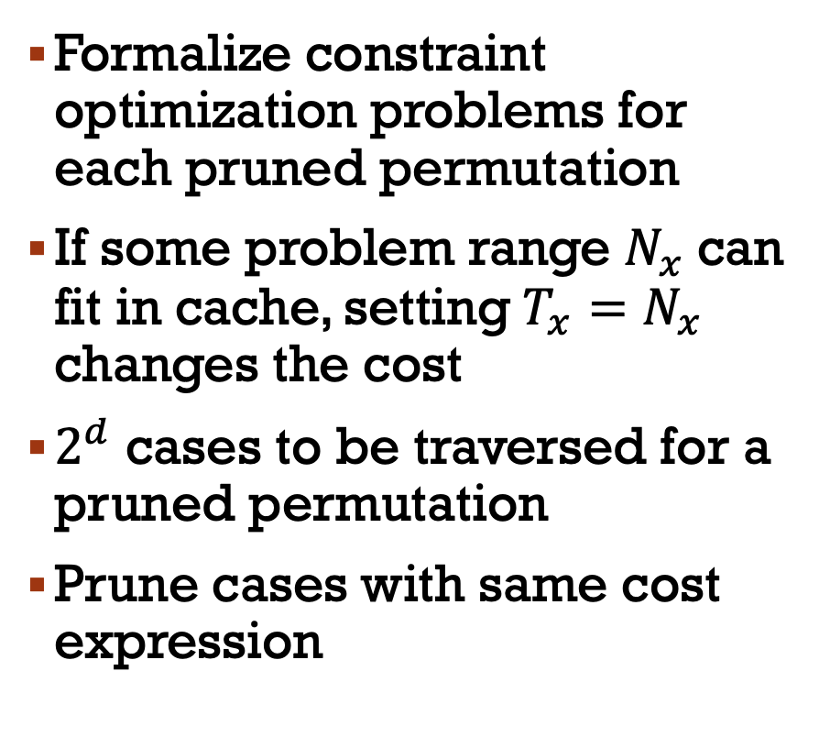
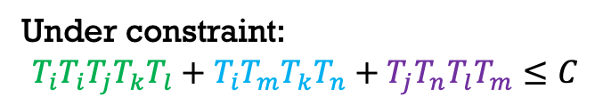
Formalize cost and constraint
for (ti=0; ti<Ni; ti+=Ti)
for (tj=0; tj<Nj; tj+=Tj)
for (tk=0; tk<Nk; tk+=Tk)
for (tl=0; tl<Nl; tl+=Tl)
for (tm=0; tm<Nm; tm+=Tm)
for (tn=0; tn<Nn; tn+=Tn)
tiles of C_{ijkl}, A_{imkn}, B_{jnlm}
Formalize constraint optimization problems for each pruned permutation
If some problem range $N_{x}$can fit in cache, setting$T_{x}=N_{x}$ changes the cost
$2^{d}$ cases to be traversed for a pruned permutation
Prune cases with same cost expression
$argmin$ over all $T$
$$N_{i}N_{j}N_{k}N_{l}+N_{i}N_{m}N_{k}N_{n}(\frac{N_{l}}{T_{l}})(\frac{N_{j}}{T_{j}})+N_{j}N_{n}N_{l}N_{m}\left(\frac{N_{k}}{T_{k}}\right)(\frac{N_{i}}{T_{i}})$$
Under constraint:
$$T_{i}T_{i}T_{j}T_{k}T_{l}+T_{i}T_{m}T_{k}T_{n}+T_{j}T_{n}T_{l}T_{m}≤C$$
Tell Why t=n change the cost
Why 2^d
Notes:
Now we can formalize cost and constraint for each pruned permutation. 2nd component...
Min problem under capa cons
We noticed there are boundary cases:
some prob range fits
d tile size, for each, fits or not probably give new cost
only build opt prob for identical expr

Slide 11
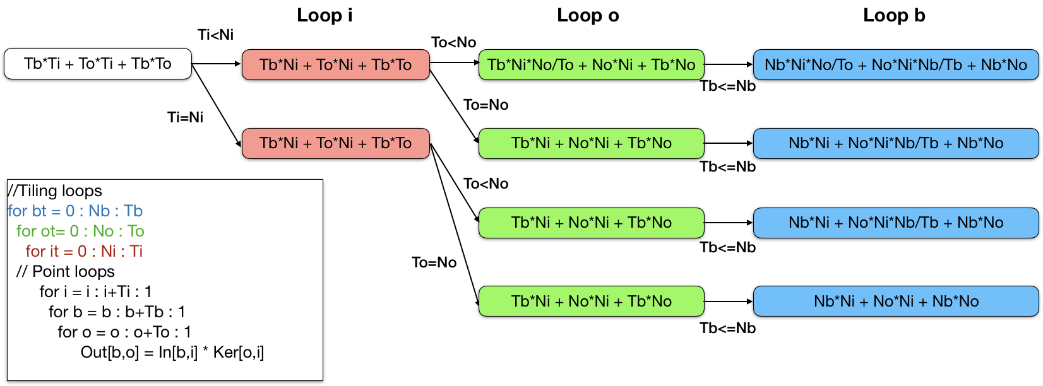
Formalize cost and constraint
Tree shows all cases for a fixed permutation of MatMul
Each leaf contains a data movement expression
Merging leaves of all trees with same cost expression
Notes:
Here we show a full expr tree for a fixed pruned permu for MatMul
Blue leaf is cost expr
As we explained if they are same they can merge
For each pruned permu we have a tree
Collect all leafs, merge all the same
ends up with limited #expr
->#opt prob

Slide 12
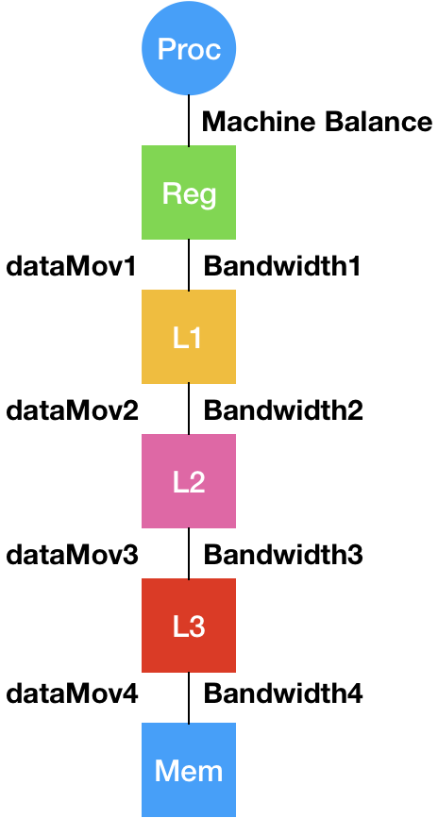
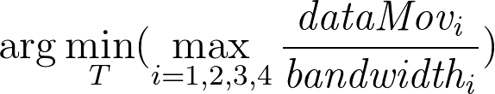
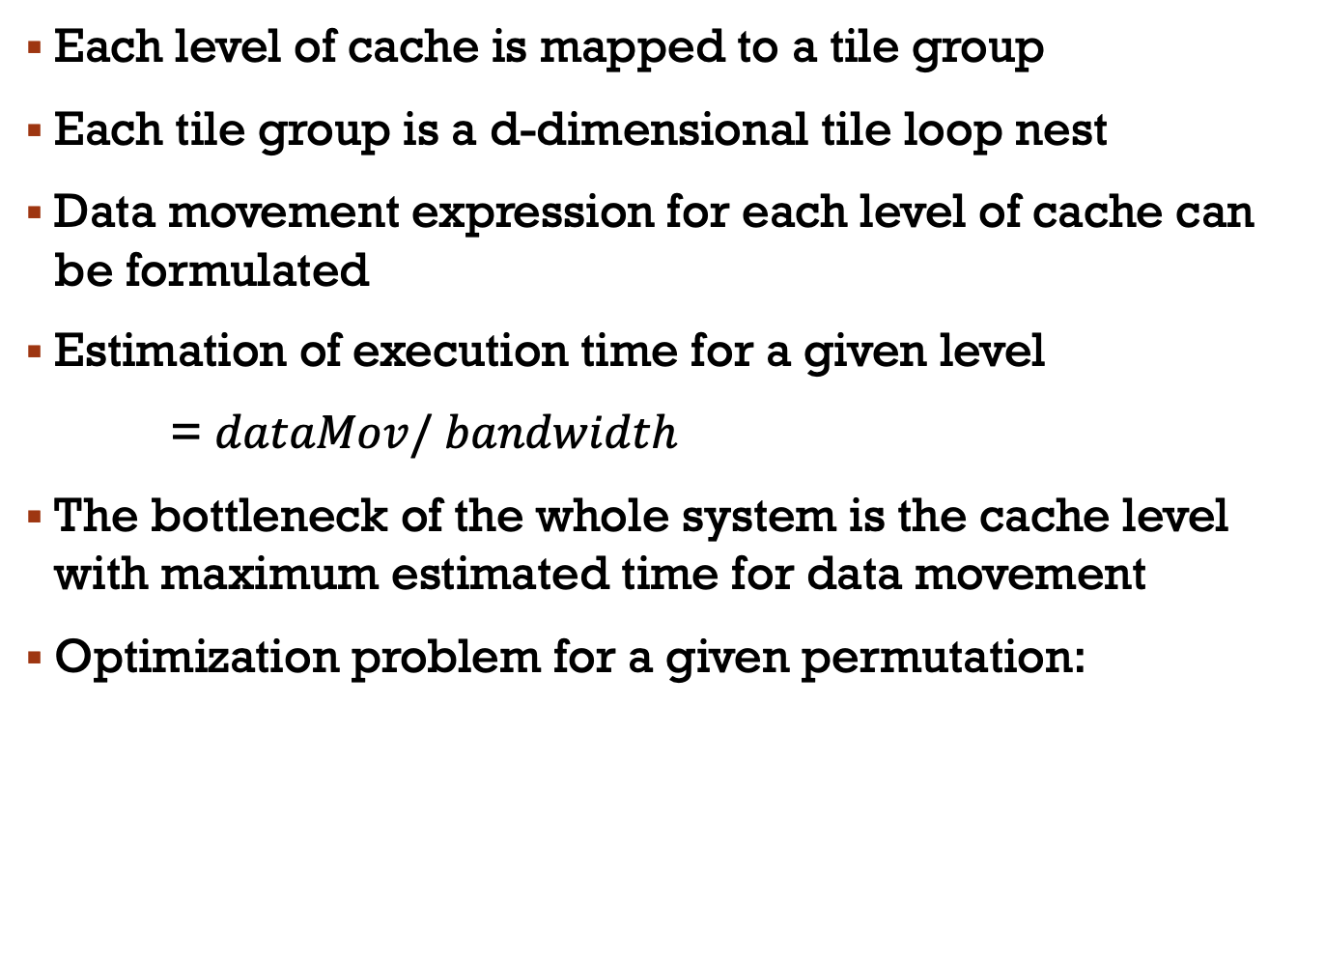
Modeling Time Cost on Multi-level memory hierarchy
Each level of cache is mapped to a tile group
Each tile group is a d-dimensional tile loop nest
Data movement expression for each level of cache can be formulated
Estimation of execution time for a given level
= $dataMov/ bandwidth$
The bottleneck of the whole system is the cache level with maximum estimated time for data movement
Optimization problem for a given permutation:
Notes:
All the previous slides talking about how to apply the model on single-lv cache
extend to multi
processor, many lv fast/slow memory
BW limitation between adj
For each lv cache, build a tile group
Use the previous method formalize cost between adj mem
4 diff cost expr, how model?

Slide 13
Modeling Time Cost on Multi-level Memory hierarchy
Optimization problem:
(#Pruned permutations)^{L} different max-min problems to solve for L-level memory hierarchy system
Solver: Couenne (Convex Over and Under Envelope’s for Nonlinear Estimation)
Avoid machine balance to be the bottleneck
Utilize BLIS micro-kernel to guarantee high-throughput on FMA unit
Optimize tiling loops surrounding micro-kernel
Data-Packing is required to minimize conflict misses
Notes:
The total number of #opt problem is:
By solving, get permu/tile sz
That is the full picture of modeling part
To use this model on implmenting high-perf TC
Two practial disturbance
First: if the max speed of computing unit is not utlized
,Compute bound, no reason to opt data move
UKR: achieve peak throughput of computing unit
Second: cache in reality is set-assoc, confilict misses.
change data layout: ensure data is continous along exe order

Slide 14
Prior work
TTGT
TCL, Implementing tensor contraction using GEMM (Transpose-Transpose-GEMM-Transpose)
Direct Contraction
TBLIS, implementing direct method to avoid explicit copy and transpose in TTGT
For both of methods, permutation & tile-sizes are the same as BLIS
BLIS is a GEMM library optimized for large square matrix multiply.
Hence existing approaches are sub-optimal for other tensor contractions.
Notes:
At last we briefly indro prev work, used for comparison in experiment
...next slides we all show some diff types of TC, not all dim are large

Slide 15

experimentAL Evaluation
Expression | Problem Size
ab-acd-dbc | a:312 b:312 c:312 d:312
ab-cad-dcb | a:312 b:312 c:312 d:312
abc-acd-db | a:312 b:312 c:312 d:312
abc-ad-bdc | a:312 b:312 c:312 d:312
abc-adc-bd | a:312 b:312 c:312 d:312
abc-adc-db | a:312 b:312 c:312 d:312
abc-bda-dc | a:312 b:312 c:24 d:312
abcd-dbea-ec | a:72 b:72 c:72 d:72 e:72
abcd-deca-be | a:72 b:72 c:72 d:72 e:72
abcd-ea-ebcd | a:72 b:72 c:72 d:72 e:72
abcd-eb-aecd | a:72 b:72 c:72 d:72 e:72
abcd-ebad-ce | a:72 b:72 c:24 d:72 e:72
abcd-ec-abed | a:72 b:72 c:72 d:72 e:72
abcde-ecbfa-fd | a:48 b:32 c:32 d:24 e:48 f:48
abcde-efbad-cf | a:48 b:32 c:24 d:32 e:48 f:32
abcde-efcad-bf | a:48 b:24 c:32 d:32 e:48 f:32
abcd-aebf-dfce | a:72 b:72 c:72 d:72 e:72 f:72
abcd-aebf-fdec | a:72 b:72 c:72 d:72 e:72 f:72
Expression | Problem Size
abcd-aecf-bfde | a:72 b:72 c:72 d:72 e:72 f:72
abcd-aecf-fbed | a:72 b:72 c:72 d:72 e:72 f:72
abcd-aedf-bfce | a:72 b:72 c:72 d:72 e:72 f:72
abcd-aedf-fbec | a:72 b:72 c:72 d:72 e:72 f:72
abcd-aefb-fdce | a:72 b:72 c:72 d:72 e:72 f:72
abcd-aefc-fbed | a:72 b:72 c:72 d:72 e:72 f:72
abcd-eafb-fdec | a:72 b:72 c:72 d:72 e:72 f:72
abcd-eafc-bfde | a:72 b:72 c:72 d:72 e:72 f:72
abcd-eafd-fbec | a:72 b:72 c:72 d:72 e:72 f:72
abcdef-dega-gfbc | a:24 b:16 c:16 d:24 e:16 f:16 g:24
abcdef-degb-gfac | a:24 b:16 c:16 d:24 e:16 f:16 g:24
abcdef-degc-gfab | a:24 b:16 c:16 d:24 e:16 f:16 g:24
abcdef-dfga-gebc | a:24 b:16 c:16 d:24 e:16 f:16 g:24
abcdef-dfgb-geac | a:24 b:16 c:16 d:24 e:16 f:16 g:24
abcdef-dfgc-geab | a:24 b:16 c:16 d:24 e:16 f:16 g:24
abcdef-efga-gdbc | a:24 b:16 c:16 d:24 e:16 f:16 g:24
abcdef-efgb-gdac | a:24 b:16 c:16 d:24 e:16 f:16 g:24
abcdef-efgc-gdab | a:24 b:16 c:16 d:24 e:16 f:16 g:24
Springer et.al. "Design of a high-performance gemm-like tensor–tensor multiplication."

Slide 16
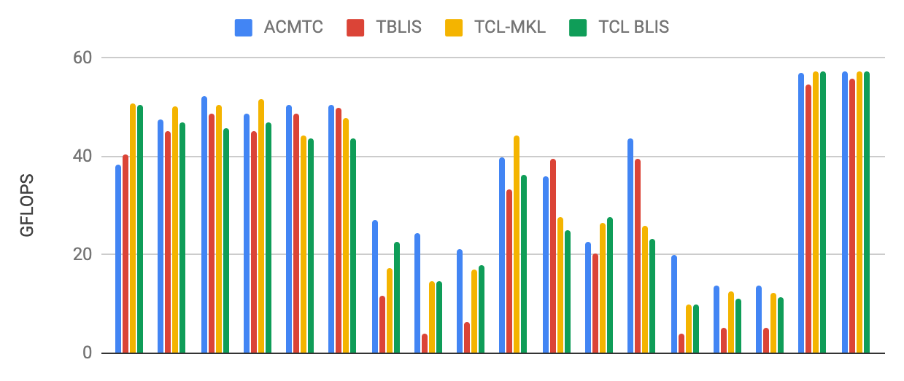
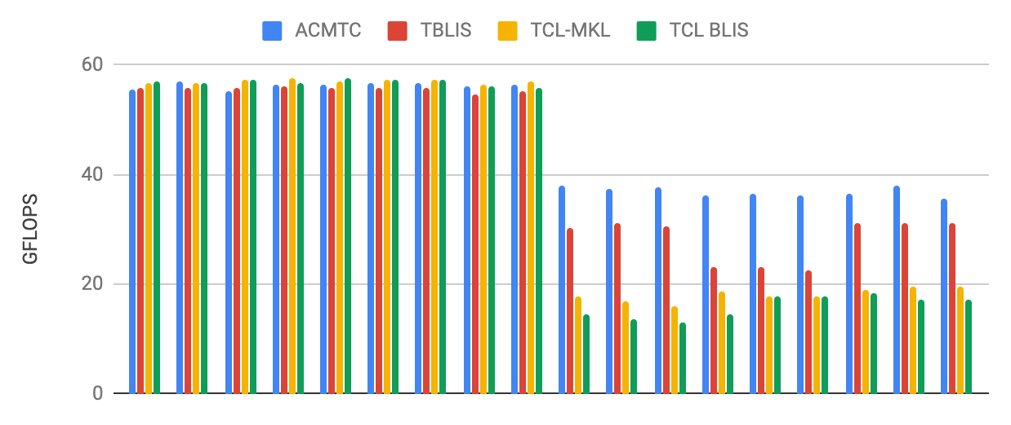
experimentAL Evaluation
Single thread on i7-6700K
Performance in GFLOPS
Competitive when all tensors are huge
Out perform when some inputs tensor are large or output tensor is large
Notes:
speed presented as GFLOPS

Slide 17
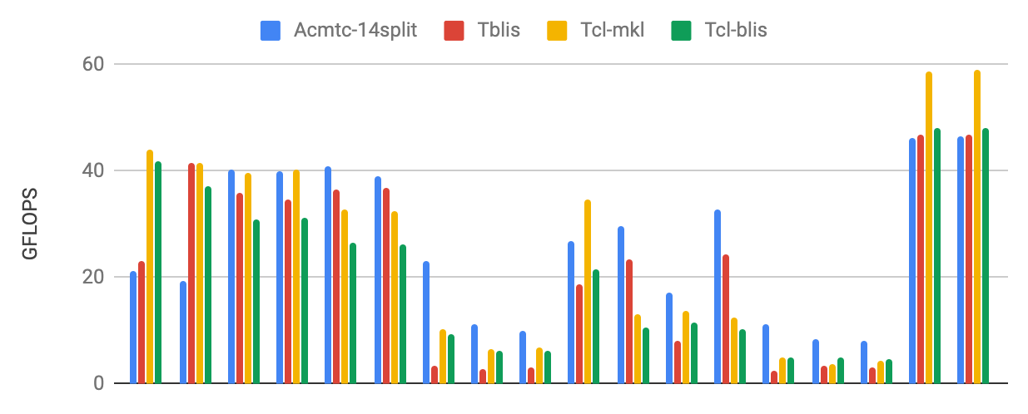
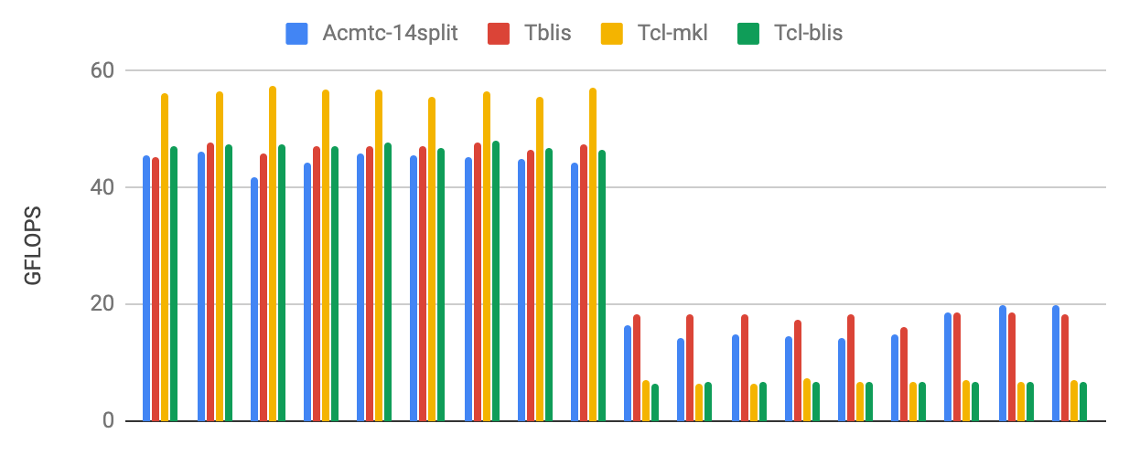
experimentAL Evaluation
Multi thread on i7-6700K
Each thread has its independent data copy
Competitive when output is large
Out perform when some inputs tensor are large

Slide 18
Summary
New approach to model and optimize data movement in memory hierarchy for multi-level tiled tensor contractions
Systematic exploration of huge space of configurations: permutation of tiling loops and tile sizes
Analytical modeling of data movement cost as a function of tile sizes, for a given permutation
Prune away cases that have exactly the same data movement cost
Feasible to solve generated non-linear optimization problem and find optimal permutation and tile sizes
Experimental evaluation demonstrates effectiveness of approach

Slide 19
Thank you

