Slide 1

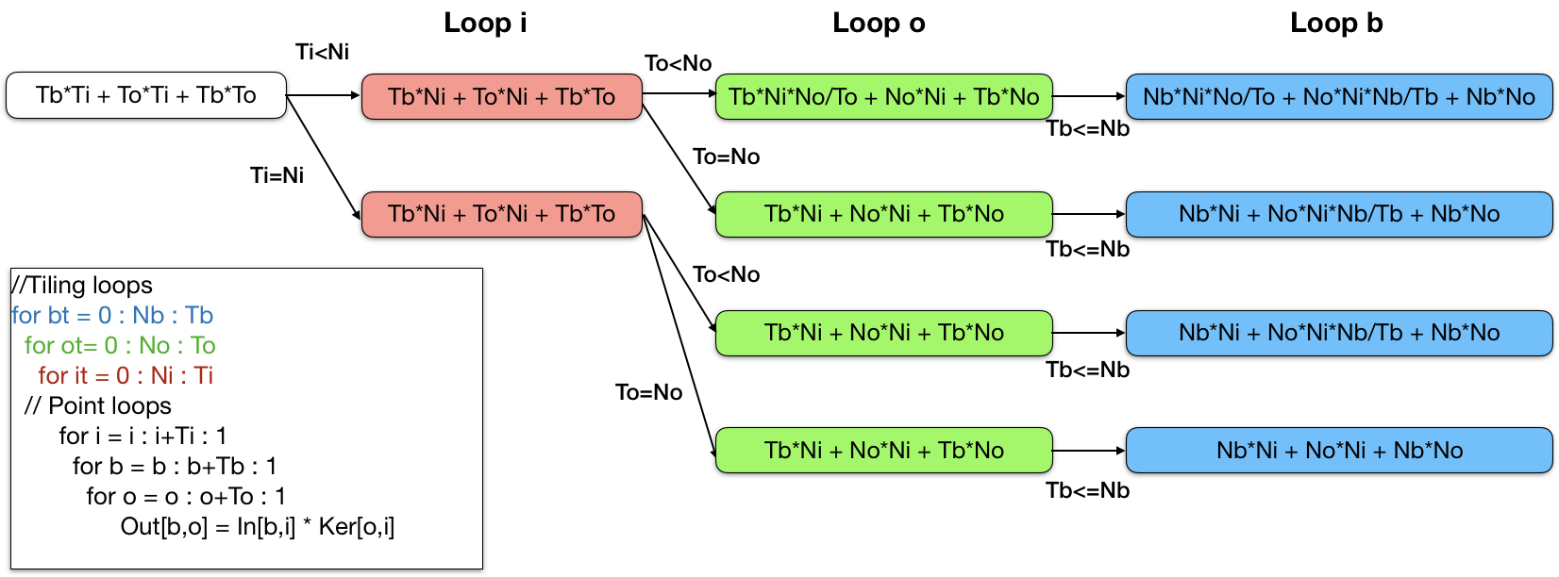
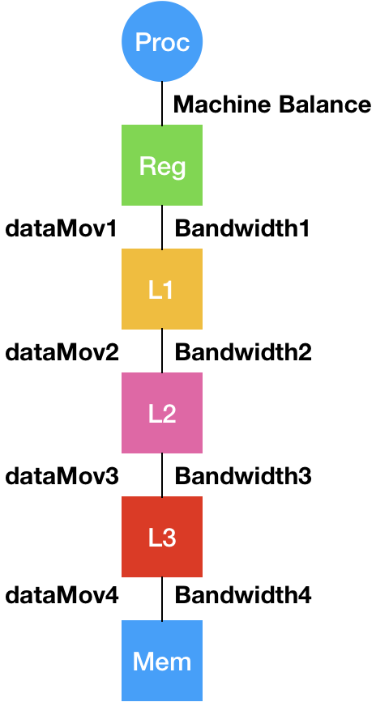
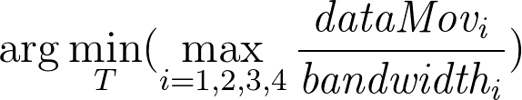
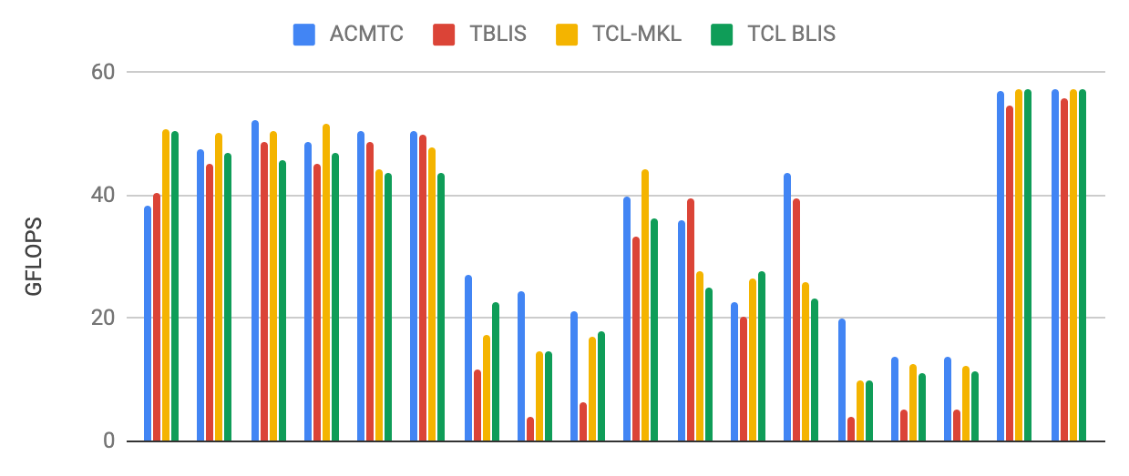
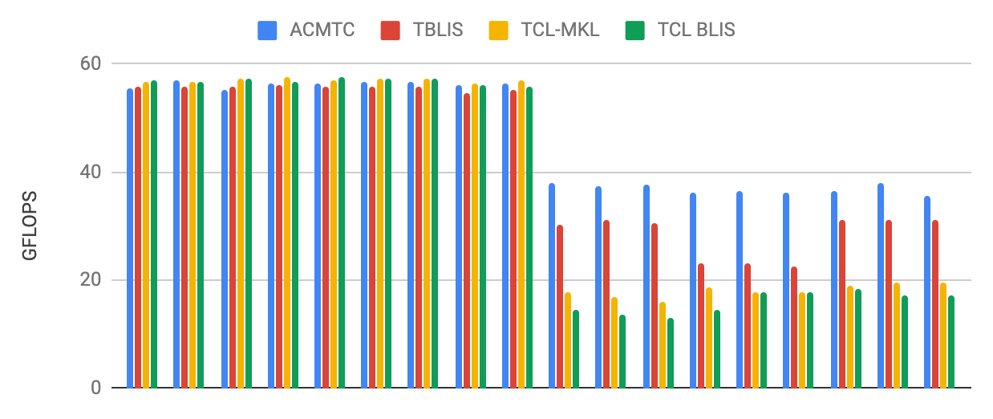



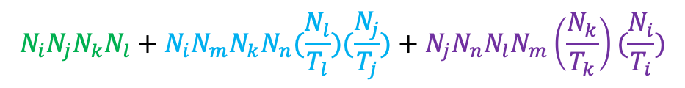
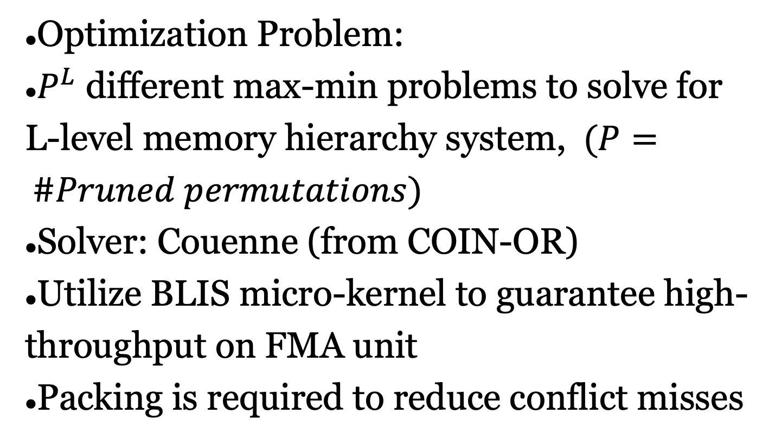





Analytical Cache Modeling and Tile-size Optimization for
Tensor Contractions
Rui Li¹,. Aravind Sukumaran-Rajam², Richard Veras³, Tze-Meng Low⁴, Fabrice Rastello⁵, Atanas Rountev⁶, P. Sadayappan^{1†}
Utah¹, WSU², LSU³, CMU⁴, INRIA⁵, OSU⁶
Overview
Goal
High performance tensor contraction on CPU
Challenge
Exponential space of valid code configurations
How to select the best performing code configuration?
Solution
Data movement is the critical factor affects performance
Develop analytical models to estimate the data movement based on the code configuration
Estimate the time of each code configuration and select the best performing version
Contributions
Modeling data movement of a multi-level memory hierarchy system as a non-linear optimization problem
Estimating the execution time of tensor contractions on a multi-level memory system
Automatic Data Movement Calculation
Bottom-up algorithm for each permutation
Prune loop permutations with same data movement expression
$$N_{i}N_{j}N_{k}N_{l}+N_{i}N_{m}N_{k}N_{n}(\frac{N_{l}}{T_{l}})(\frac{N_{j}}{T_{j}})+N_{j}N_{n}N_{l}N_{m}\left(\frac{N_{k}}{T_{k}}\right)(\frac{N_{i}}{T_{i}})$$
for (ti=0; ti<Ni; ti+=Ti)
for (tj=0; tj<Nj; tj+=Tj)
for (tk=0; tk<Nk; tk+=Tk)
for (tl=0; tl<Nl; tl+=Tl)
for (tm=0; tm<Nm; tm+=Tm)
for (tn=0; tn<Nn; tn+=Tn)
tiles of C_{ijkl}, A_{imkn}, B_{jnlm}
$T_{i}N_{j}N_{k}N_{l}+T_{i}N_{m}N_{k}N_{n}(\frac{N_{l}}{T_{l}})(\frac{N_{j}}{T_{j}})+N_{j}N_{n}N_{l}N_{m}(\frac{N_{k}}{T_{k}})$
Fig.1 Tree for handling all edge cases for Matmul
$T_{i}T_{j}N_{k}N_{l}+T_{i}N_{m}N_{k}N_{n}(\frac{N_{l}}{T_{l}})+T_{j}N_{n}N_{l}N_{m}(\frac{N_{k}}{T_{k}})$
Time Cost Model on Multi-level Cache
$T_{i}T_{j}T_{k}N_{l}+T_{i}N_{m}T_{k}N_{n}(\frac{N_{l}}{T_{l}})+T_{j}N_{n}N_{l}N_{m}$
Optimization Problem:
$P^{L}$ different max-min problems to solve for L-level memory hierarchy system, $(P= \#Pruned permutations)$
Solver: Couenne (from COIN-OR)
Utilize BLIS micro-kernel to guarantee high-throughput on FMA unit
Packing is required to reduce conflict misses
$T_{i}T_{j}T_{k}T_{l}+T_{i}N_{m}T_{k}N_{n}+T_{j}N_{n}T_{l}N_{m}$
$T_{i}T_{j}T_{k}T_{l}+T_{i}T_{m}T_{k}N_{n}+T_{j}N_{n}T_{l}T_{m}$
$$T_{i}T_{j}T_{k}T_{l}+T_{i}T_{m}T_{k}T_{n}+T_{j}T_{n}T_{l}T_{m}≤C$$
Problem Formalization for Single Level Cache
Conditional Optimization problem based on data movement expression and cache capacity constraint
$\underset{all T}{argmin}{N_{i}N_{j}N_{k}N_{l}+N_{i}N_{m}N_{k}N_{n}(\frac{N_{l}}{T_{l}})(\frac{N_{j}}{T_{j}})+N_{j}N_{n}N_{l}N_{m}\left(\frac{N_{k}}{T_{k}}\right)(\frac{N_{i}}{T_{i}})}$
under constraint $T_{i}T_{j}T_{k}T_{l}+T_{i}T_{m}T_{k}T_{n}+T_{j}T_{n}T_{l}T_{m}≤C$
Data Movement Modeling for Tiled Loop Code
Experimental Evaluation
Evaluation on TTCG benchmark on i7-6700K, single thread, comparing to TBLIS, TCL-BLIS and TCL-MKL
Competitive when all tensors are huge
Outperform when some inputs tensor are large or output tensor is large
6D Tiled Loop Code
6! Permutations brought by 6 tiling loops
Footprints in point loops fit in cache
Permutation of point loops has no effects to data movement
for(ti=0:Ni:Ti)
for(tj=0:Ni:Tj)
for(tk=0:Nk:Tk)
for(tl=0:Nl:Tl)
for(tm=0:Nm:Tm)
for(tn=0:Nn:Tn)
for(i=ti:ti+Ti:1)
for(j=tj:tj+Tj:1)
for(k=tk:tk+Tk:1)
for(l=tl:tl+Tl:1)
for(m=tm:tm+Tm:1)
for(n=tn:tn+tn:1)
C[i][j][k][l]+= A[i][m][k][n]*
B[j][n][l][m];
Edge Cases Handling: Tile Size Equal to Range
If some problem range $N_{x}$can fit in cache, setting $T_{x}$= $N_{x}$changes the cost
$2^{d}$ cases to be traversed for a pruned permutation Must be performed within and across trees
Fig.1 shows all cases for a fixed permutation of Matmul
Each leaf contains a data movement expression
Merging leaves of all trees with same cost expression
List.1 Tiled version of tensor contraction (single level cache), Ni, Nj,… , Nn are problem ranges, Ti, Tj,…, Tn are tiles sizes.
Notes:
1

