Slide 1
Brief Announcement: Efficient Distributed Algorithms for Convolutional Neural Networks
Rui Li, Yufan Xu, Aravind Sukumaran-Rajam, Atanas Rountev, P. Sadayappan
Notes:
hi everyone this is Ray from the university of utah. I am in my last year of phd and i am actively looking for full time jobs. if your team is interested in hiring please feel free to contact me. today i'm going to present our asplos paper, the analytical characterization and design space exploration for optimization of convolutional neural networks

Slide 2
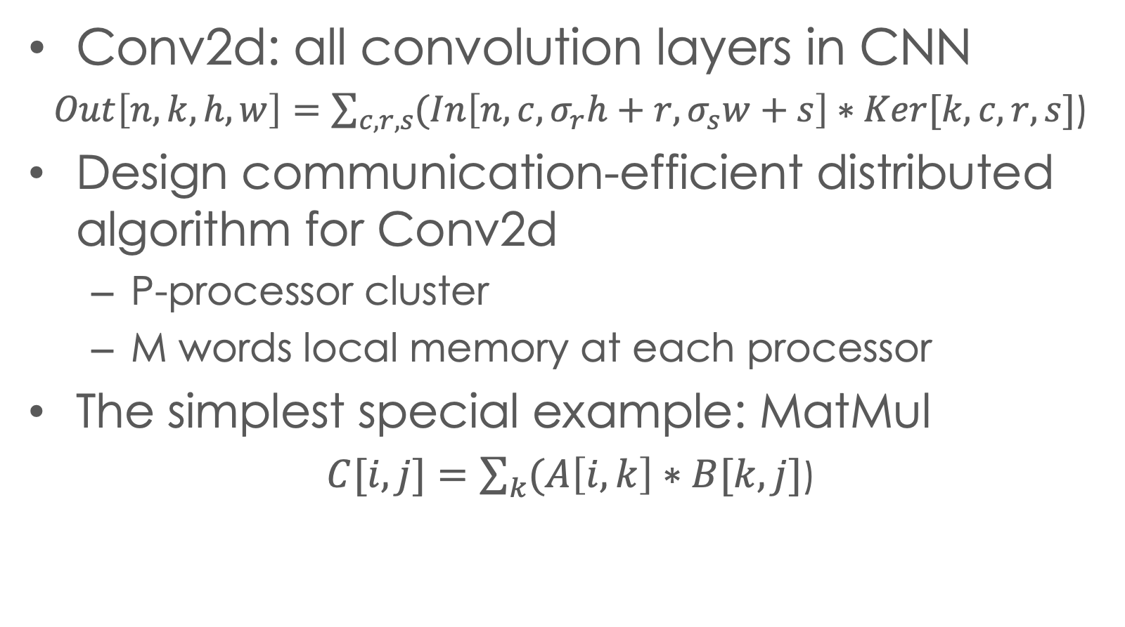
Introduction
Conv2d: all convolution layers in CNN
$Out\left[n,k,h,w\right]=\sum_{c,r,s}{(In\left[n,c,σ_{r}h+r,σ_{s}w+s\right]∗Ker[k,c,r,s}]$)
Design communication-efficient distributed algorithm for Conv2d
P-processor cluster
M words local memory at each processor
The simplest special example: MatMul
$C[i,j]=\sum_{k}{(A\left[i,k\right]∗B[k,j}]$)

Slide 3
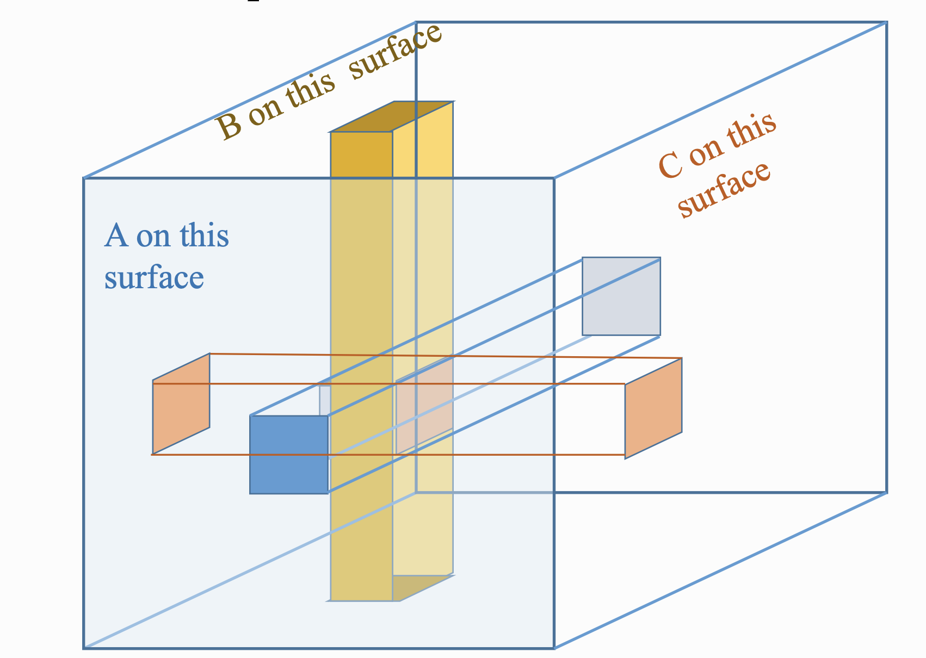
Background: distributed matmul
Existing Matmul algorithm on distributed memory
2D SUMMA (Van de Gejin et. al)
3D (Johnson et. al)
2.5D (Solomonik & Demmels et. al)
All the algorithms are optimal individually for different local memory size
Find a method to automatically derive the proper algorithm based on local memory size
Extend the method to handle distributed CNNs
k
j
B[k,j]
k
*
=
3D algorithm (Figure credit to Rauchwerger, CS484 @ UIUC):
3D processor grid with p^(1/3) processors on each dimension.
Tile size for every dimension is (N/p^(1/3))
Broadcast A, B, processors along k dimension compute partial sums and reduce along k.
i
C[i,j]
A[i,k]
(P/c)^{1/2}
3D algorithm (Figure credit to Demmels, CS267 @ Berkeley):
3D processor grid with c processors along k dimension and sqrt(P/c) processors along i, j
The c processor planes in k dimension perform 2D summa, and reduce the results along k
(P/c)^{1/2}
2D SUMMA algorithm: 2D processor partition & 2D data partition
Broadcast A, B to let each processor computes its C tile
(Figure credit to Demmels, CS 267 lecture @Berkeley)
c
Notes:
our paper is focusing on optimizing the performance of the cnn network. it is the core algorithm of many deep learning applications.
in the figure we are showing the structure of the cnn network. it includes many different types of operators. to optimize the performance of this network. it is important to optimize the performance of the most expensive operator.
that will be the conv2d operator. the conv2d operator can be written as the following math equation,
and we will use this figure to demonstrate how we compute the conv2d. we have three tensors from left to right are input tensor, kernel tensor, and output output tensor. we will project the kernel tensor onto the input sensor. we will use the shadow and the kernel tensor to compute the sum of products and use this value to update a single element in the output. in the next step we will move the shadow to the right, compute another sum of products and update the next element in the output.

Slide 4
Overview
Formulate solve 2-lv opt problem, work partition + data tile
solving the programming problem to opt the vol of global-mem
Translate to dist mem
2-level tiling view of distributed tensor algorithm
Tile size optimization problem construction under global memory assumption
Design distributed memory algorithm from the efficient global-memory solution
Blue: full iteration space (parameter N)
Green: working space of a single processor (variable W)
Orange: tiling iteration space of a single processor. (variable T)
Data footprints of Orange space fit in local memory M
Problem: find W, T to reduce communication cost

Slide 5





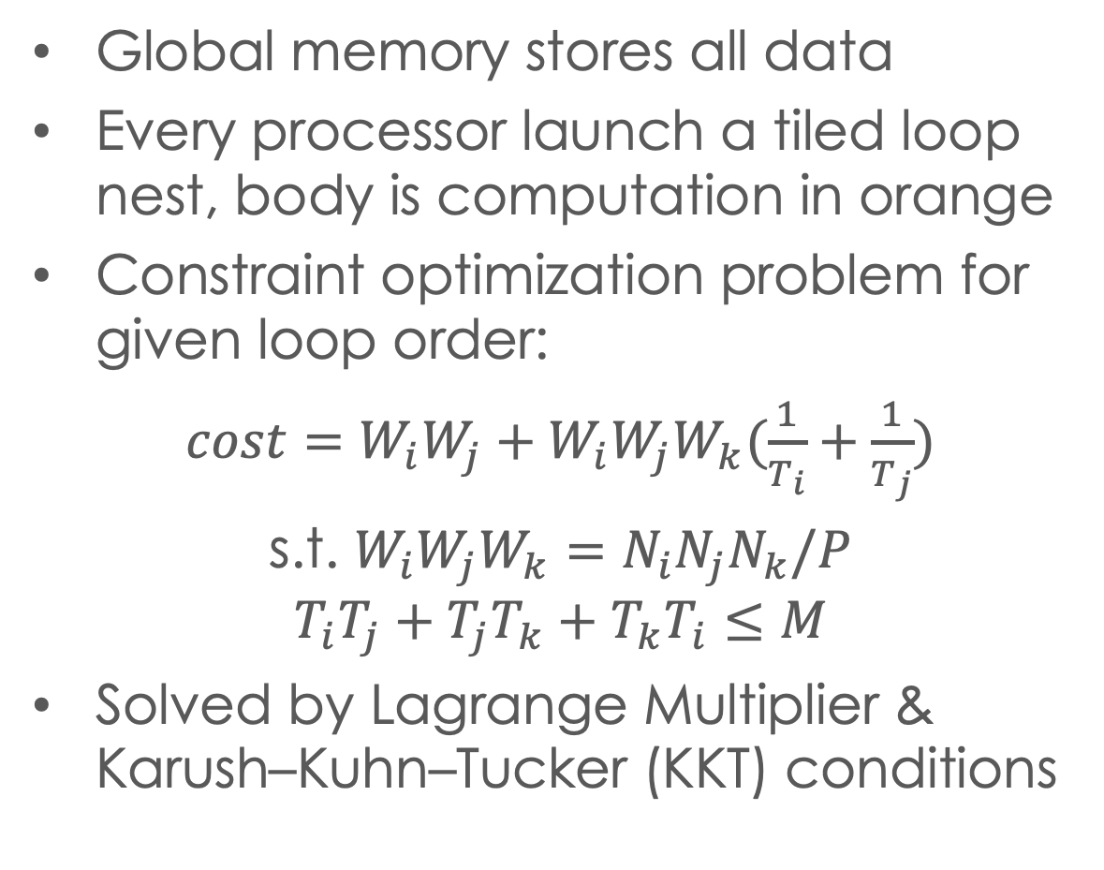

Systematic algorithm construction
Global memory stores all data
Every processor launch a tiled loop nest, body is computation in orange
Constraint optimization problem for given loop order:
$cost=W_{i}W_{j}+W_{i}W_{j}W_{k}(\frac{1}{T_{i}}+\frac{1}{T_{j}})$
s.t. $W_{i}W_{j}W_{k}=N_{i}N_{j}N_{k}/P$
$$T_{i}T_{j}+T_{j}T_{k}+T_{k}T_{i}≤M$$
Solved by Lagrange Multiplier & Karush–Kuhn–Tucker (KKT) conditions
$$T_{k}$$
$$T_{i}$$
$$T_{j}$$
$$W_{k}$$
$$W_{j}$$
$$W_{i}$$
for tile_i..
for tile_j..
for tile_k..
do work in
orange box
Notes:
based on that we can quickly write a simple implementation of conv2d
operator, and we'll demonstrate why it is necessary to optimize this code instead of using it directly.
this simple implementation includes 7d loop nest. this will create a large amount of loop iterations and each loop iteration will have three different data accesses. if we do not optimize this code those data accesses will create a large amount of memory requests and this will slow down the performance of the system.
to optimize this code, an important question is what is the size of the design exploration space of optimizing the conv2d code.
we consider two different techniques the first technique is repermuting the loop order. that will create seven factorial different code versions.
the second technique is the loop tiling. if we tile each loop once we will create a 14 dimensional loop nest. however that is not enough because the loop tiling structure should match to the architecture specification. we will use an example to show the design exploration space of a two-level cache hierarchy

Slide 6
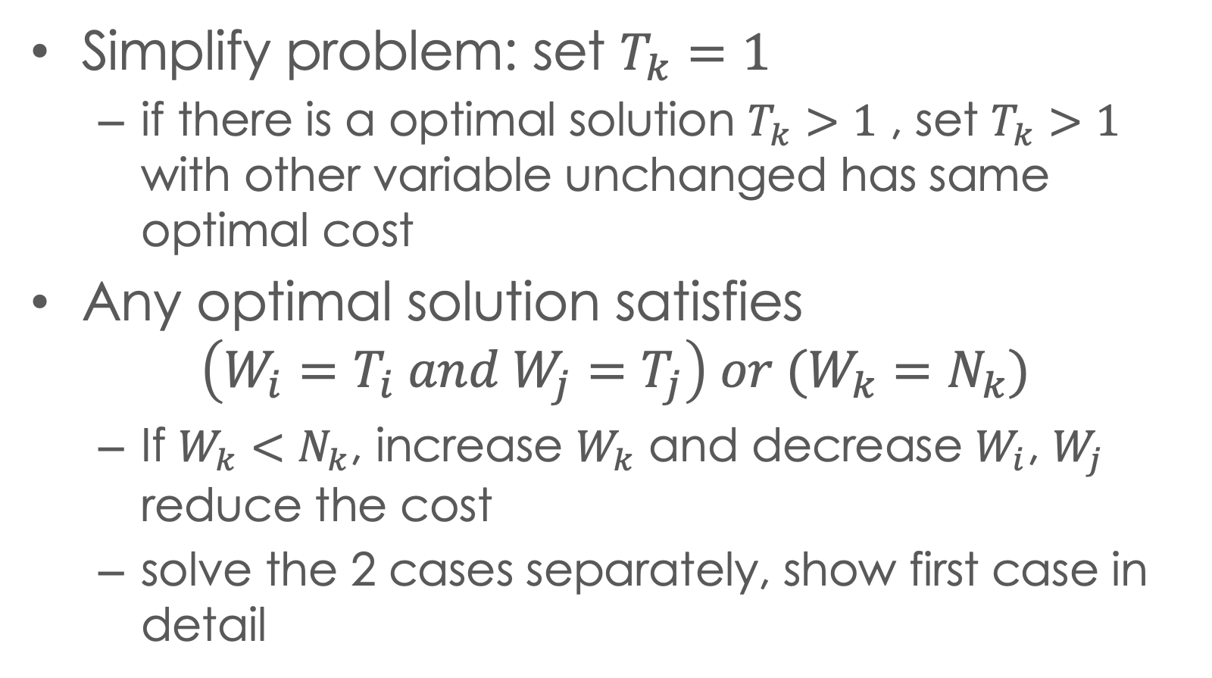
Matmul optimal solution derivation
Simplify problem: set $T_{k}=1$
if there is a optimal solution $T_{k}>1$ , set $T_{k}>1$ with other variable unchanged has same optimal cost
Any optimal solution satisfies
$$\left(W_{i}=T_{i} and W_{j}=T_{j}\right) or (W_{k}=N_{k})$$
If $W_{k}<N_{k}$, increase $W_{k}$ and decrease $W_{i}$, $W_{j}$ reduce the cost
solve the 2 cases separately, show first case in detail

Slide 7
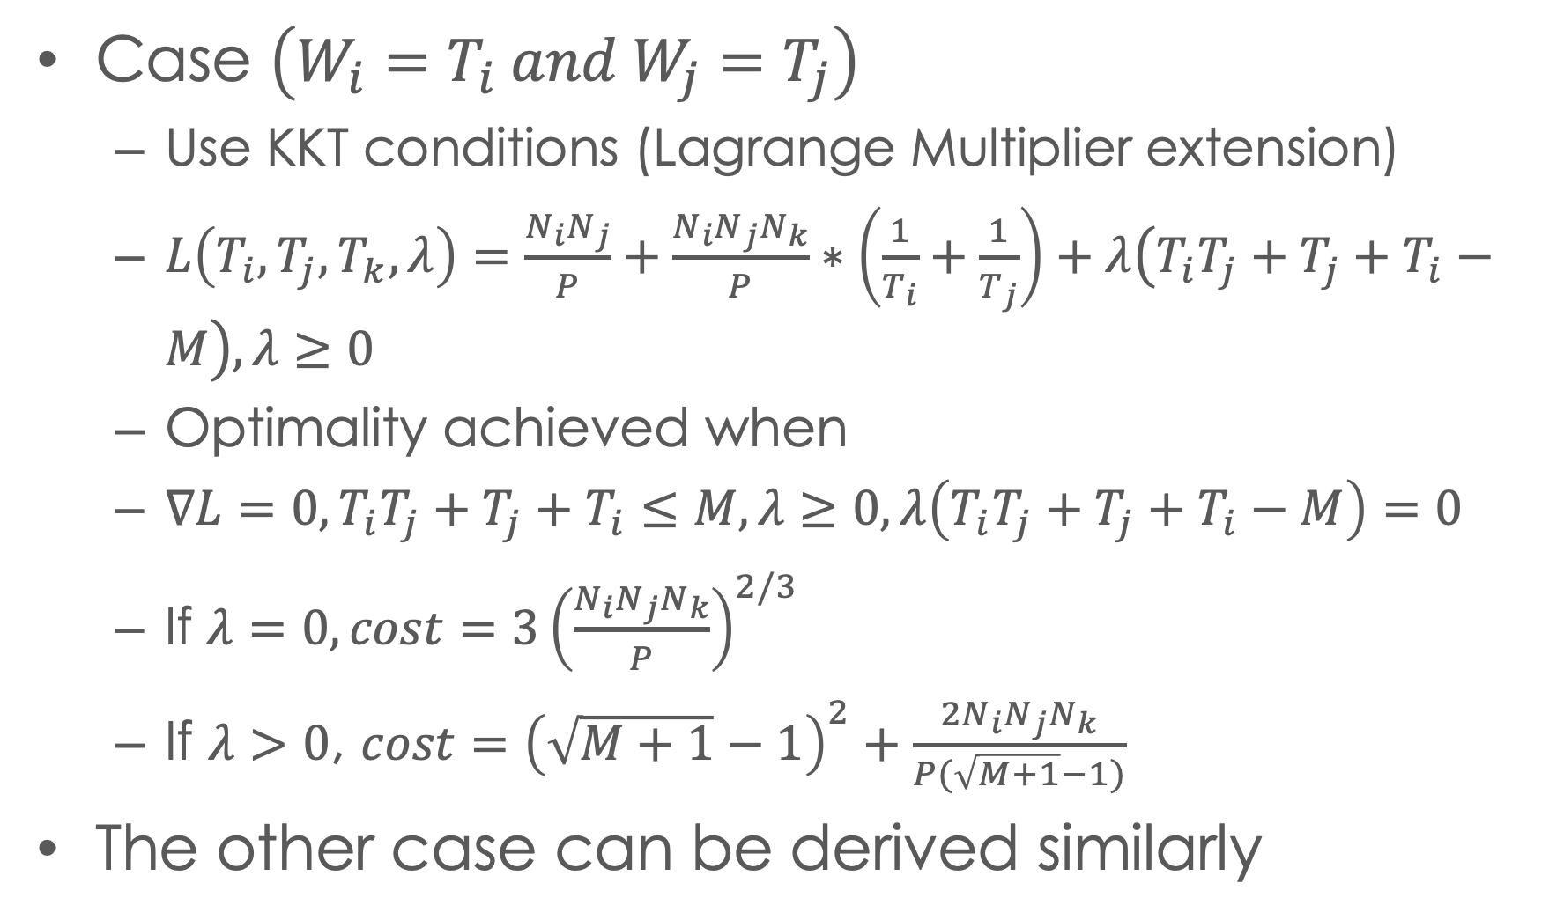
Matmul optimal solution derivation
Case $\left(W_{i}=T_{i} and W_{j}=T_{j}\right)$
Use KKT conditions (Lagrange Multiplier extension)
$L\left(T_{i}, T_{j}, T_{k}, λ\right)=\frac{N_{i}N_{j}}{P}+\frac{N_{i}N_{j}N_{k}}{P}∗\left(\frac{1}{T_{i}}+\frac{1}{T_{j}}\right)+λ\left(T_{i}T_{j}+T_{j}+T_{i}−M\right), λ≥0$
Optimality achieved when
$∇L=0,T_{i}T_{j}+T_{j}+T_{i}≤M,λ≥0,λ\left(T_{i}T_{j}+T_{j}+T_{i}−M\right)=0$
If $λ=0, cost=3{\left(\frac{N_{i}N_{j}N_{k}}{P}\right)}^{2/3}$
If $λ>0$, ${cost=\left(\sqrt{M+1}−1\right)}^{2}+\frac{2N_{i}N_{j}N_{k}}{P(\sqrt{M+1}−1)}$
The other case can be derived similarly

Slide 8
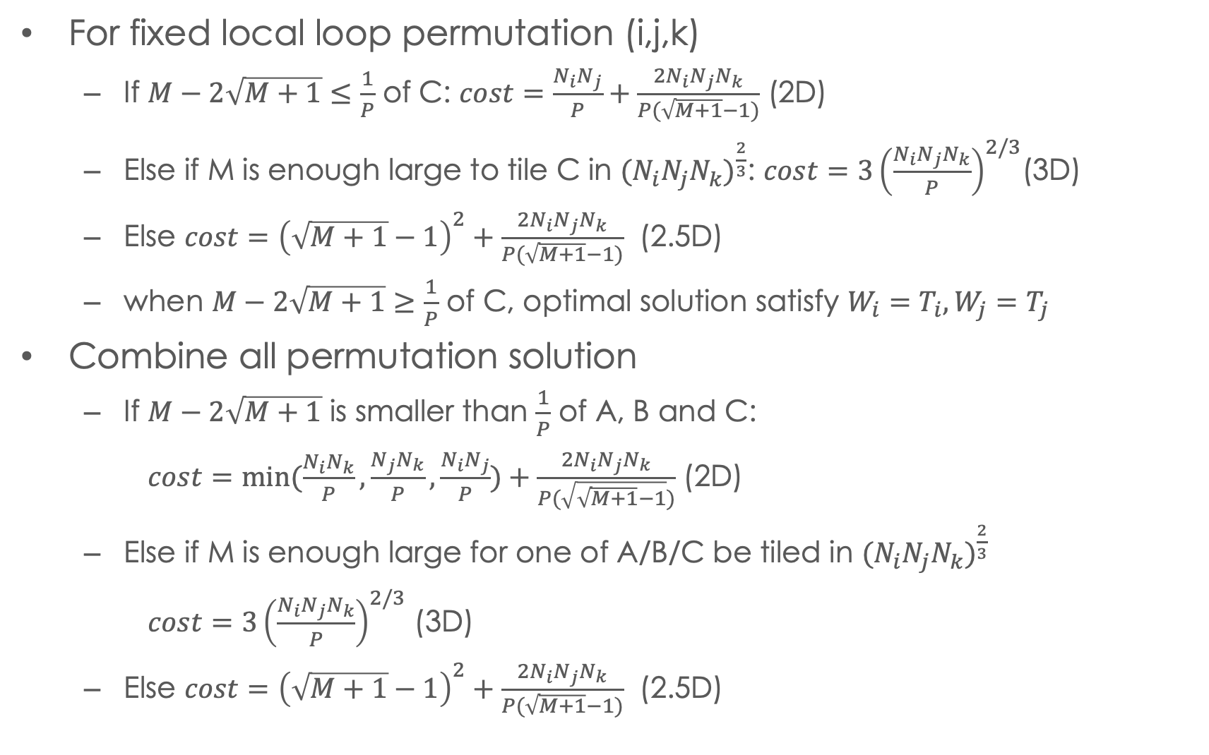
Matmul global solution
For fixed local loop permutation (i,j,k)
If $M−2\sqrt{M+1}$ $≤\frac{1}{P}$ of C: $cost=\frac{N_{i}N_{j}}{P}+\frac{2N_{i}N_{j}N_{k}}{P(\sqrt{M+1}−1)}$ (2D)
Else if M is enough large to tile C in ${(N_{i}N_{j}N_{k})}^{\frac{2}{3}}$: $cost=3{\left(\frac{N_{i}N_{j}N_{k}}{P}\right)}^{2/3}$(3D)
Else $cost={\left(\sqrt{M+1}−1\right)}^{2}+\frac{2N_{i}N_{j}N_{k}}{P(\sqrt{M+1}−1)}$ (2.5D)
when $M−2\sqrt{M+1}$ $≥$ $\frac{1}{P}$ of C, optimal solution satisfy $W_{i}=T_{i}, W_{j}=T_{j}$
Combine all permutation solution
If $M−2\sqrt{M+1}$ is smaller than $\frac{1}{P}$ of A, B and C:
$cost=min⁡(\frac{N_{i}N_{k}}{P},\frac{N_{j}N_{k}}{P},\frac{N_{i}N_{j}}{P})+\frac{2N_{i}N_{j}N_{k}}{P(\sqrt{\sqrt{M+1}−1})}$ (2D)
Else if M is enough large for one of A/B/C be tiled in ${(N_{i}N_{j}N_{k})}^{\frac{2}{3}}$
$cost=3{\left(\frac{N_{i}N_{j}N_{k}}{P}\right)}^{2/3}$ (3D)
Else $cost={\left(\sqrt{M+1}−1\right)}^{2}+\frac{2N_{i}N_{j}N_{k}}{P(\sqrt{M+1}−1)}$ (2.5D)

Slide 9
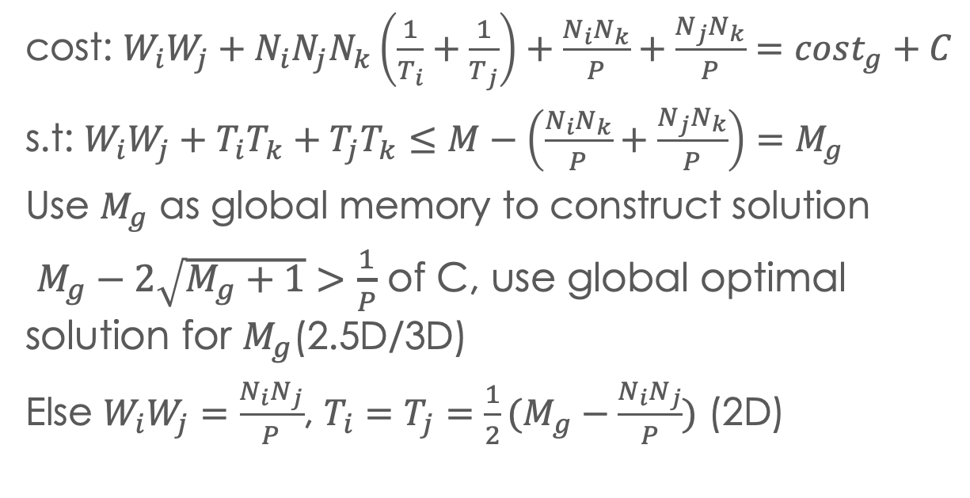
Construct distributed memory algorithm
Initial data distribution
Replicate the tensor reused in local loop
If loop order (i,j,k), replicate C, distribute A,B
replicate
C
cost: $W_{i}W_{j}+N_{i}N_{j}N_{k}\left(\frac{1}{T_{i}}+\frac{1}{T_{j}}\right)+\frac{N_{i}N_{k}}{P}+\frac{N_{j}N_{k}}{P}=cost_{g}+C$
s.t: $W_{i}W_{j}+T_{i}T_{k}+T_{j}T_{k}≤M−\left(\frac{N_{i}N_{k}}{P}+\frac{N_{j}N_{k}}{P}\right)$ $=M_{g}$
Use $M_{g}$ as global memory to construct solution
$M_{g}−2\sqrt{M_{g}+1}$ $>$ $\frac{1}{P}$ of C, use global optimal solution for $M_{g}$(2.5D/3D)
Else $W_{i}W_{j}=\frac{N_{i}N_{j}}{P}$, $T_{i}=T_{j}={\frac{1}{2}(M}_{g}−\frac{N_{i}N_{j}}{P})$ (2D)
k
j
C
A1
B
B1
B2
A2
distributed
i
A

Slide 10
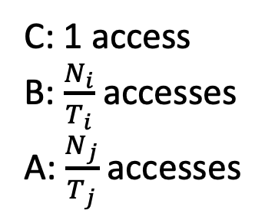
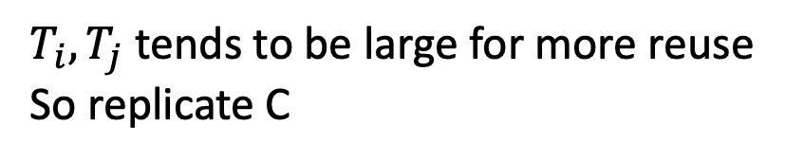
Construct distributed memory algorithm
Local loop schedule:
C: 1 access
B: $\frac{N_{i}}{T_{i}}$ accesses
A: $\frac{N_{j}}{T_{j}}$ accesses
C0
B0
B1
C1
B0
B1
Initial data layout:
A0
A1
replicated
…
A2
A3
C
$T_{i}, T_{j}$ tends to be large for more reuse
So replicate C
B0
B1
A0
A1
C
distributed
Wk
B2
B3
C0
C1
B0
B1
Nj
Wj
A2
A3
C2
C3
B2
B3
Nk
A0
A1
Wi
A2
A3
Ni

Slide 11
Construct distributed memory algorithm
Global memory
Distributed memory
C
C
replicated
C
B0
B1
B0
B1
C
B0
broadcast
A0
Identical, both from
global memory
A0
B1
A1
Nj
Nj
broadcast
A0
A1
Nk
Nk
A1
Ni
Ni

Slide 12
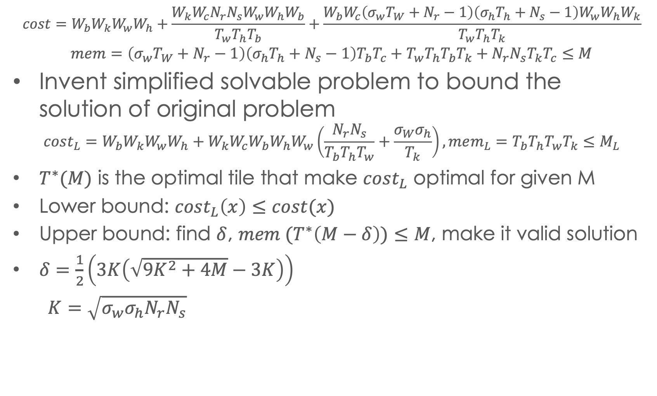

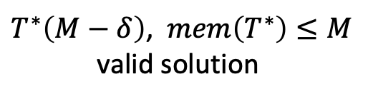

Extend to CNNS
$${cost=W}_{b}W_{k}W_{w}W_{h}+\frac{W_{k}W_{c}N_{r}N_{s}W_{w}W_{h}W_{b}}{T_{w}T_{h}T_{b}}+\frac{W_{b}W_{c}\left(σ_{w}T_{W}+N_{r}−1\right)\left(σ_{h}T_{h}+N_{s}−1\right)W_{w}W_{h}W_{k}}{T_{w}T_{h}T_{k}}$$
$$mem=\left(σ_{w}T_{W}+N_{r}−1\right)\left(σ_{h}T_{h}+N_{s}−1\right)T_{b}T_{c}+T_{w}T_{h}T_{b}T_{k}+N_{r}N_{s}T_{k}T_{c}≤M$$
Invent simplified solvable problem to bound the solution of original problem
$$cost_{L}=W_{b}W_{k}W_{w}W_{h}+W_{k}W_{c}W_{b}W_{h}W_{w}\left(\frac{N_{r}N_{s}}{T_{b}T_{h}T_{w}}+\frac{σ_{W}σ_{h}}{T_{k}}\right),mem_{L}=T_{b}T_{h}T_{w}T_{k}≤M_{L}$$
$T^{∗}(M)$ is the optimal tile that make $cost_{L}$ optimal for given M
Lower bound: $cost_{L}\left(x\right)≤cost(x)$
Upper bound: find $δ$, $mem (T^{∗}\left(M−δ\right))≤M$, make it valid solution
$δ=\frac{1}{2}\left(3K\left(\sqrt{9K^{2}+4M}−3K\right)\right)$
$K=\sqrt{σ_{w}σ_{h}N_{r}N_{s}}$
$T^{∗}\left(M−δ\right)$, $mem\left(T^{∗}\right)≤M$
valid solution
$T^{∗}\left(M\right)$, $mem\left(T^{∗}\right)>M$
Contour line of $mem_{L}$

Slide 13
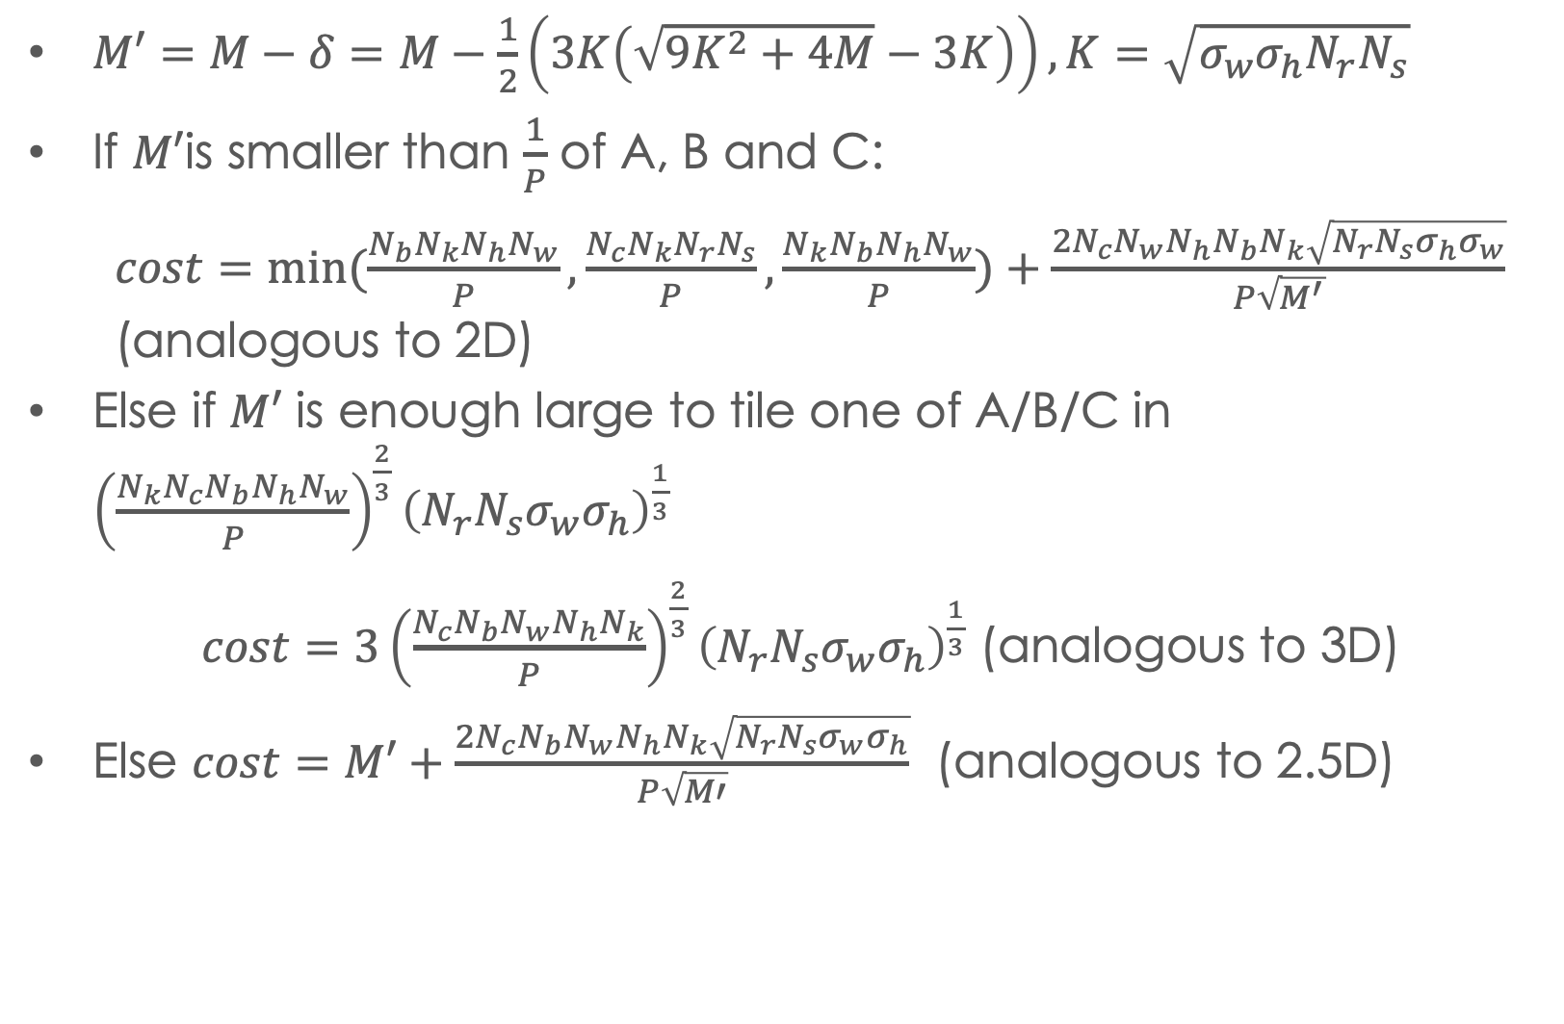
CNNs solution summary
$M′=M−δ=M−\frac{1}{2}\left(3K\left(\sqrt{9K^{2}+4M}−3K\right)\right),K=\sqrt{σ_{w}σ_{h}N_{r}N_{s}}$
If $M′$is smaller than $\frac{1}{P}$ of A, B and C:
$cost=min⁡(\frac{N_{b}N_{k}N_{h}N_{w}}{P},\frac{N_{c}N_{k}N_{r}N_{s}}{P},\frac{N_{k}N_{b}N_{h}N_{w}}{P})+\frac{2N_{c}N_{w}N_{h}N_{b}N_{k}\sqrt{N_{r}N_{s}σ_{h}σ_{w}}}{P\sqrt{M^{′}}}$ (analogous to 2D)
Else if $M′$ is enough large to tile one of A/B/C in ${\left(\frac{N_{k}N_{c}N_{b}N_{h}N_{w}}{P}\right)}^{\frac{2}{3}}{\left(N_{r}N_{s}σ_{w}σ_{h}\right)}^{\frac{1}{3}}$
$cost=3{\left(\frac{N_{c}N_{b}N_{w}N_{h}N_{k}}{P}\right)}^{\frac{2}{3}}{\left(N_{r}N_{s}σ_{w}σ_{h}\right)}^{\frac{1}{3}}$ (analogous to 3D)
Else $cost=M′+\frac{2N_{c}N_{b}N_{w}N_{h}N_{k}\sqrt{N_{r}N_{s}σ_{w}σ_{h}}}{P\sqrt{M′}}$ (analogous to 2.5D)

Slide 14
Thanks for listening
Questions ?

