Slide 1
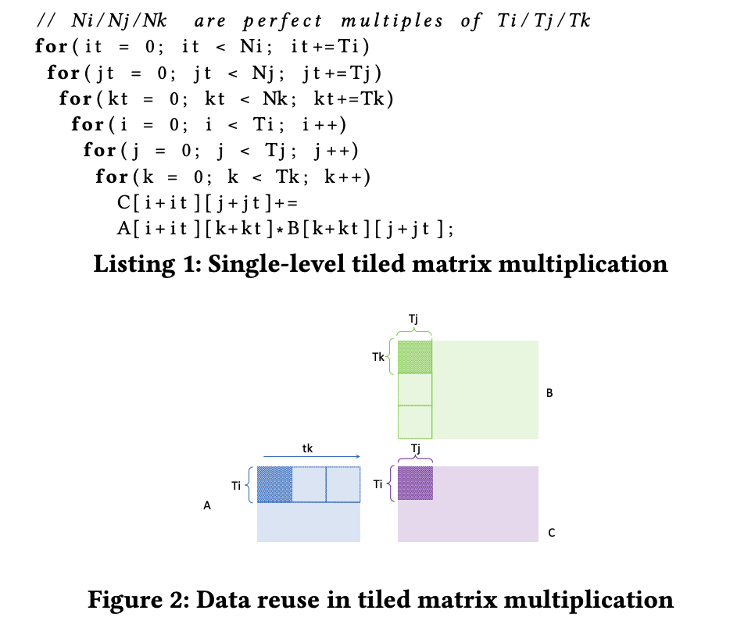
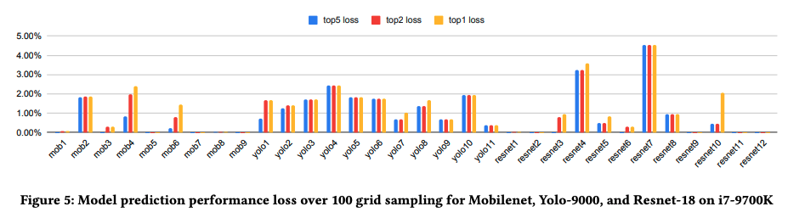
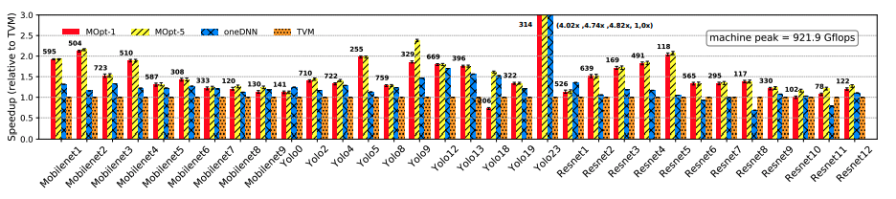
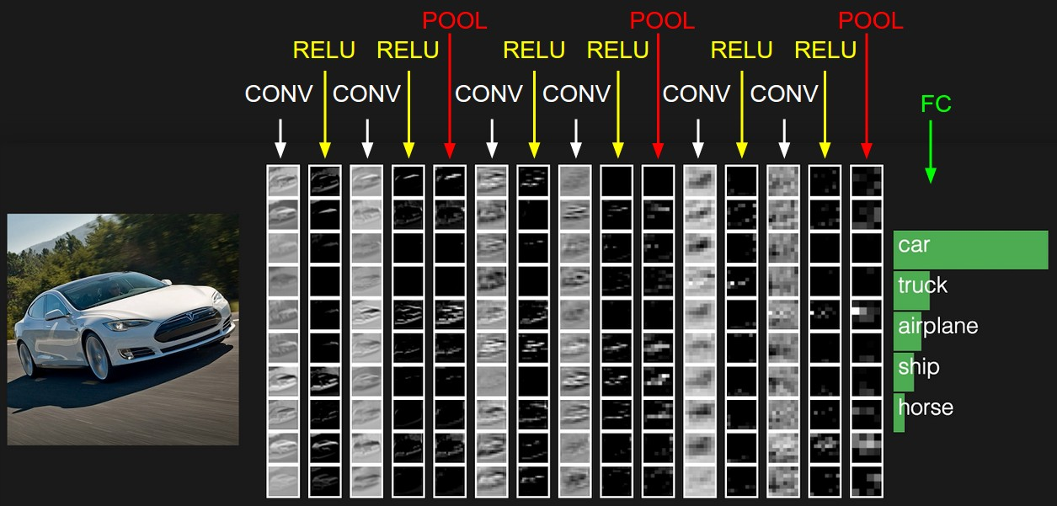
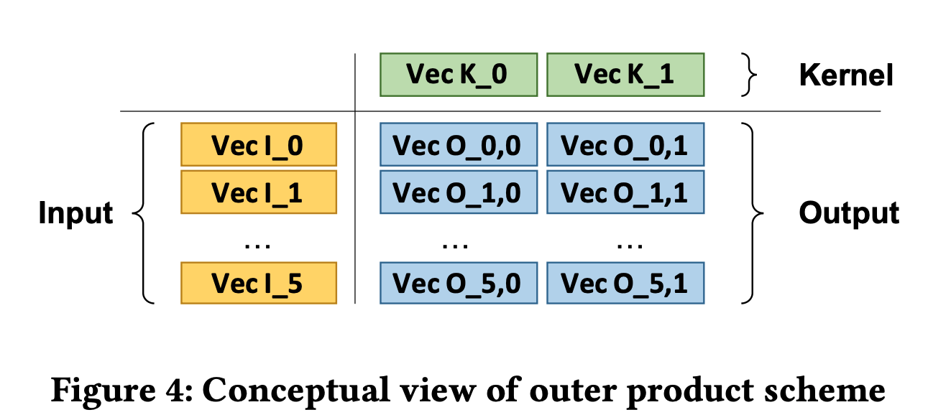
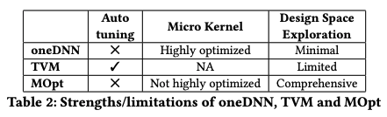
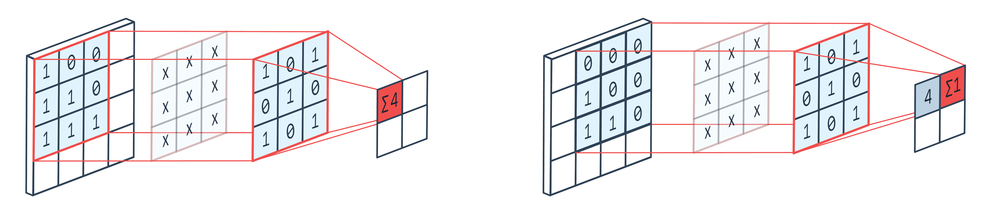
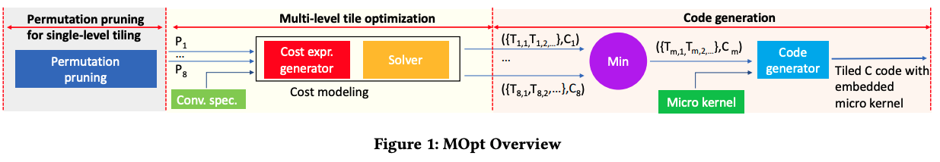
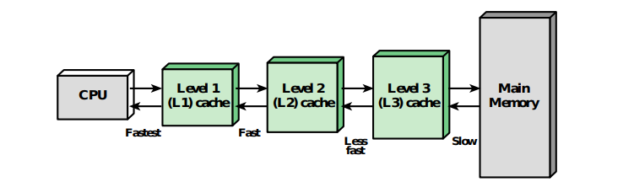
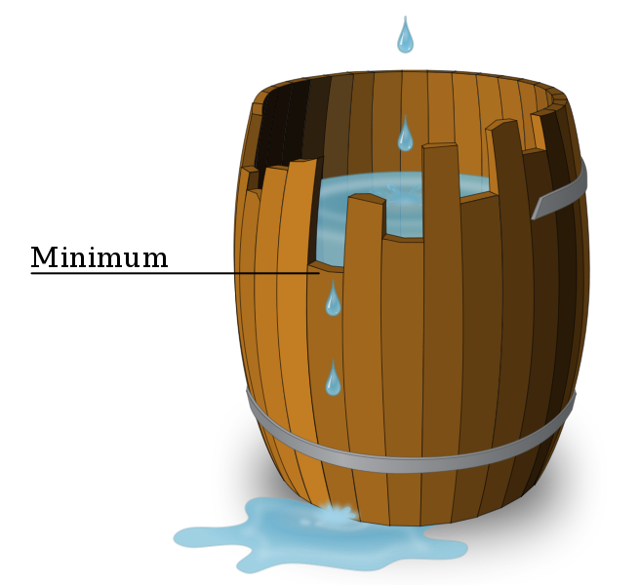

Preparing your poster for printing:
Go to File > Save As. Under Save as type (Windows) or Format (OS X), select PDF.
Open the PDF in Adobe Photoshop. Go to File > Save As. Under Format, select JPEG or TIFF. Choose a location and file name for your file and click Save. Click OK on the default save settings.
DO NOT SAVE TO A JPEG OR TIFF FROM POWERPOINT!
Analytical Characterization and Design Space Exploration for Optimization of CNNs
Rui Li, Yufan Xu, Aravind Sukumaran-Rajam, Atanas Rountev, and P. Sadayappan
University of Utah, Washington State University, Ohio State University
ASPLOS ’21
ABSTRACT
METHODS
RESULTS
Moving data through the memory hierarchy is a fundamental bottleneck that can limit the performance of convolutional neural networks (CNNs). Loop level optimization, including loop tiling and loop permutation, are fundamental transformations to reduce data movement. However, the search space for finding the best loop-level optimization configuration is explosively large. This paper develops an analytical modeling approach for finding the best loop-level optimization configuration for CNNs on multi-core CPUs. Experimental evaluation shows that this approach achieves comparable or better performance than state-of-the-art libraries and auto-tuning based optimizers for CNNs.
Way to improve data movement between caches: Loop Tiling and Loop reordering
Way to improve ALU speed: Micro-kernel that utilize SIMD instruction and Maximum Instruction level parallelism
Put it all together: Systematically model the performance and find the best optimization configuration
Experiments results on i7-9000k, over benchmarks consist of conv2d in ResNet, MobileNet, and Yolo-9000
Validation: How close does the model predicted optimal configuration to the actual best configuration, under a given grid search space?
Comparison: How good performance does the model achieve, comparing to the state of art library (Intel oneDNN) and machine learning compiler (AutoTVM)?
Discussion: Strength/limitations of the state-of-art
INTRODUCTION
Convolutional Neural Networks (CNNs) is widely used in image/video classification and language processing.
Expression: Out[n,k,h,w] += In[n,c,h+r,w+s]*Ker[k,c,r,s]
Multi-level memory hierarchy is common in modern computer systems
Places work in the context of the literature
How fast can modern computers process convolution?
Wooden Barrel: shortest bar decides performance
Bars: ALU speed, data movement between caches
Way to optimize?
CONCLUSIONS
Proposed a new approach to overcome the design-space explosion problem that has thwarted effective compile-time modeling and optimized code generation for CNNs..
Although the space of possible configurations is extremely large, we devise an effective analytical modeling approach to search in this space.
Experimental results demonstrate that achieved performance is superior to code generated by TVM and can be comparable to or better than Intel’s oneDNN.
REFERENCES
Li et. al. Analytical Characterization and Design Space Exploration for Optimization of CNNs. ASPLOS 2021
Chen et. al. TVM: An Automated End-to-End Optimizing Compiler for Deep Learning. OSDI 2018
Intel oneDNN library, Intel Corporation 2020
ACKNOWLEDGEMENTS
This work was supported in part by the U.S. National Science Foundation through awards 1946752, 1919122 and 2018016.
48 inches wide X 36 inches high

