Slide 1
HPC Journey to the Cloud

Slide 2
Introductions
John Finigan
Linux / HPC systems administrator, major interests:
Storage
Virtualization
Security
Datacenter architecture
IT cost management
Research IT since 2011, HPC since 2016
Relative late-comer to cloud: late 2018

Slide 3
Introductions
CU Anschutz Medical Campus in Aurora, CO
But this presentation is only one practitioner’s viewpoint (mine)
Typical user’s profile:
Bioinformatics data – genomics, imaging
Relatively easy IO patterns over large reference data sets (10s of TB)
R and Python, 3rd party bioinformatics tools in C or Java
No MPI
Single program run over many independent data files, usually in parallel
Single threaded code is common
Security-sensitive data

Slide 4
Our HPC deployment in early 2020
Modest-sized on-premises cluster
~800 Intel Haswell cores, Infiniband, RHEL 7, Slurm
Extremely restrictive network environment – default-deny outbound
Spectrum Scale filesystem, one tier storage hierarchy, one namespace
Warranties expire early 2021 – Replace system prior to expiration
To occur concurrently with organizational change
New system owner

Slide 5
Designing a new system
Requirement: new system is cloud based
Organizational / IT strategy reasons
Requirement: deliver a working system quickly
Requirement: bring over users’ code and data from old cluster
Without too much disruption – ideally, unzip old code and submit a job
Want: find opportunities to reduce cost
No cost-naïve design
Want: improve security
High degree of isolation between data sets - Limited “blast radius”

Slide 6
Improving Security
A core strength of cloud is multitenancy
fully virtualized infrastructure
We can use native cloud multitenancy support to isolate data and user groups from each other
Different groups can’t “see” each other at all
Allows more security isolation enforced outside of the cluster OS
Analogy: host-based firewall vs. hardware firewall

Slide 7
Delivering a new system
Long story short, we built a Slurm cluster in the cloud
Given time constraints, too risky to switch to a new compute paradigm
Many Slurm clusters in the cloud!
One cluster per research group / sensitive data set (for security isolation)
Infrastructure deployed with Terraform and Ansible
Ephemeral compute nodes – deleted when idle
Based on cloud node support in recent Slurm (we run 20.02)
https://slurm.schedmd.com/elastic_computing.html
Home-grown Slurm to cloud API glue code
Written in bash – quick hack, but haven’t outgrown it yet

Slide 8
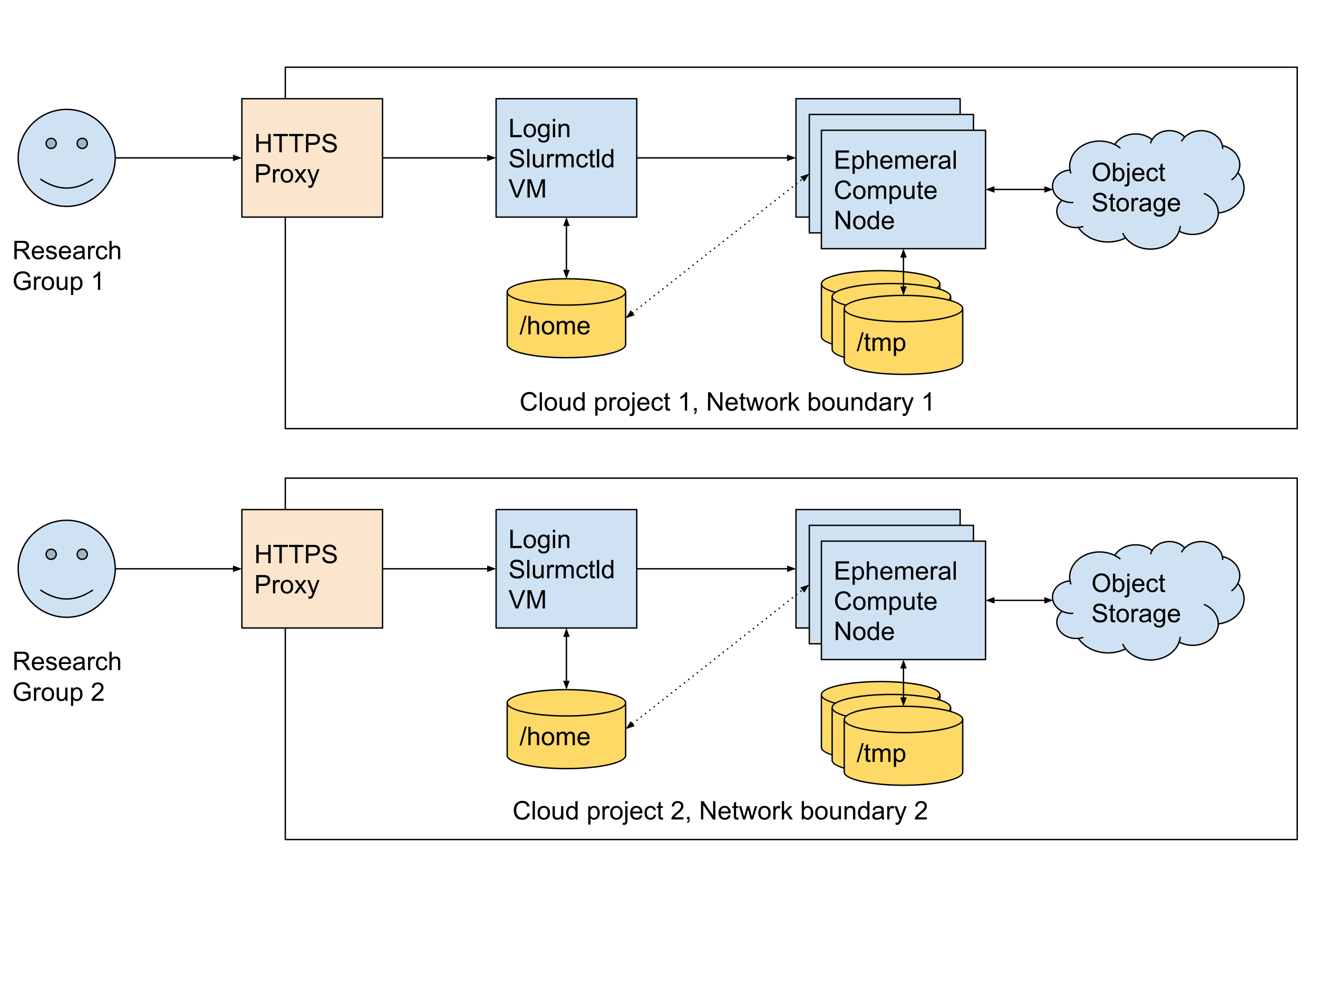
High level diagram

Slide 9
A User’s View
Familiar: Slurm, CLI based Linux system
New: Web based terminal app instead of SSH
New: Different storage hierarchy
Primarily relying on object + node-local scratch, for cost control reasons
NFS /home for code and small data, typically 1 TB or less per cluster
New: Preemptible (spot) nodes
Major cloud providers will sell you a VM at a steep discount, if they’re allowed to kill it whenever they choose
User sees this as a node failure and Slurm requeue

Slide 10
Successes, Improved capabilities
Old HPC decommissioned on schedule
Satisfied with first pass at cost-aware cloud infrastructure design
Better isolation between groups and data sets
Multitenant isolation is fundamental cloud building block
Limited Internet Access using next-gen firewall
Using a CLI app, user can request time-limited access to pre-approved sites
Primarily for CRAN, Bioconductor, PyPi, Anaconda
Orchestrated with cloud-native infrastructure – “serverless” computing
Singularity containerization introduced to many more users
Container-first strategy when users request software build help

Slide 11
What Could Be Better
Storage
Uneasy relationship between users and preemptible (spot) nodes
3x savings on CPU cost, best case. Less in practice.
CentOS 7 getting old, OS future undecided
Application incompatibility just starting to become visible
NIC and disk drivers not optimized for our cloud platform
High network transfer fees complicate designs
December 1, 1996

Slide 12
Storage
Why did we change storage hierarchy?
Object storage is the only cloud storage that comes even close to the price our users are paying on premises
For us, anything above 2.5 cents per GB per month is a regression
Cloud POSIX storage starts at 4 cents / GB / month, for us (raw disk)
Managed NAS or Parallel FS @ 10 to 30+ cents / GB / month
Our new storage hierarchy has decent costs, but users don’t like the added complexity. Currently pondering what’s next.

Slide 13
Future Plans
Keep doing what we’re doing, improve incrementally
Make storage more user friendly
Hybrid on-premises + cloud HPC sounds interesting
Steady state capacity on-premises, burst to cloud
Would use same Slurm cloud node capability
Network egress fees lead to unwanted design complexity

Slide 14
Questions?
john.finigan@cuanschutz.edu

Slide 15
Backup Slide - cost example
One project (one research group, one cluster)
Approx $12k year to date
Approx 450,000 vCPU hours compute
80+ % vCPU hours are preemptible (spot)

