Slide 1
System administration for regulated research data and workflows
Erik Deumens, Senior Director
Information Technology Research Computing, University of Florida
PEARC22 – Boston, MA – July 11, 2022

Slide 2
What we will cover …
High-performance computing (HPC) evolution
Research computing requirements
Regulated research requirements: CUI, PHI, etc.
Cybersecurity frameworks: NIST 800-171 & CMMC v2.0
System administration: UF example

Slide 3
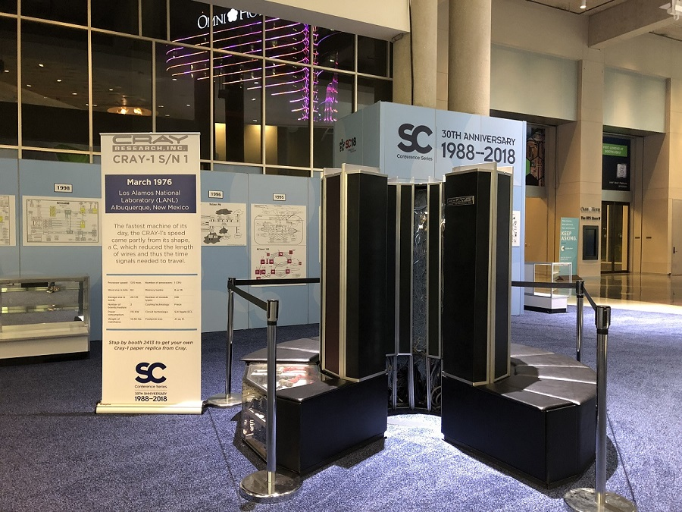
A brief history
1970: HPC systems were primarily about hardware – every new system came with a new OS, an assembler, and a compiler
1990: Hardware became commodity – software and portability were crucial
2000: the era of big data starts …
2010: the era of AI, where ML/DL helps manage big data
Cray-1 on display at SC18 (HPCwire)

Slide 4
HPC priorities shift
1970: expert computer user needs
Special hardware + special software
Hardware architecture changed with every system
Software was code – it was rewritten all the time
2020: domain expert with big data needs
Advanced tools + layers of software + commodity hardware
Hardware architecture must be compatible (constant)
Software APIs must be compatible (constant/slow-changing)

Slide 5
2022 Research computing requirements
Computing capability: CPU and GPU – lots of them – to serve
Many people working
Parameter exploration workflows
Coherent parallel computing
Data storage capability – the era of big data
Fast tier
Cost-effective capacity tier
Low-cost dark archive tier

Slide 6
2022 Research computing requirements (2)
Data transfer capability
Moving large data sets fast
Sharing data and algorithms
Web servers and portals – science gateways
Access with or without authentication
Download as well as upload data
Run workflows

Slide 7
2022 Research computing requirements (3)
Workflow management
Batch job scheduling – SLURM
Light-weight container scheduling – Kubernetes
Interactive sessions – steering, exploring, debugging, visualizing
Confidentiality – work & data isolation – regulations & compliance
Integrity – correctness of processing – authorized changes
Availability – people and automated flows never rest

Slide 8
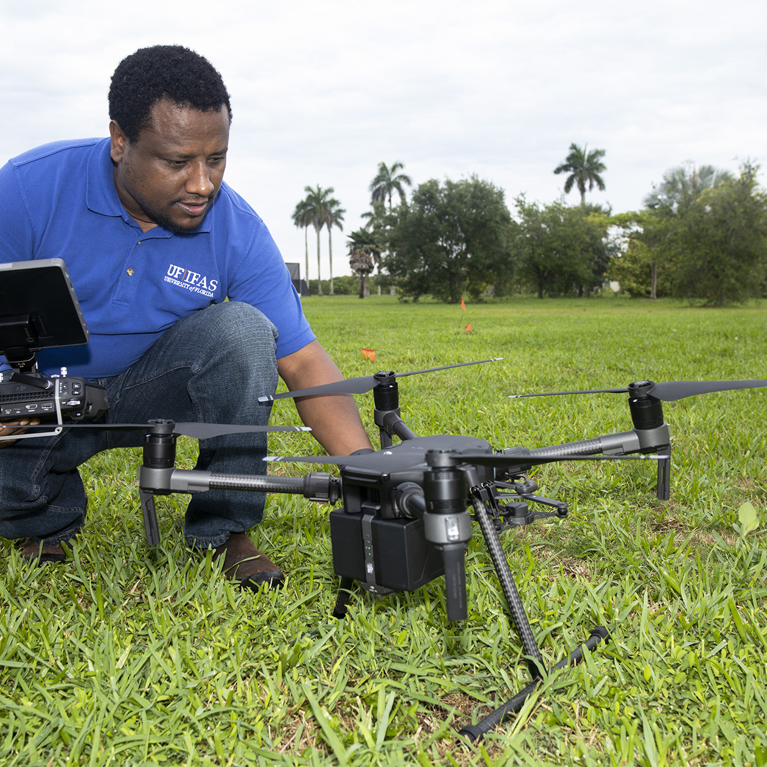

AI needs data
Agriculture applications
Institute for Food and Agricultural Sciences
https://ifas.ufl.edu/artificial-intelligence/expertise-and-research/
Numerous examples
Measuring Crop Evapotranspiration Using Sensors, Drones, and Artificial Intelligence
Detecting Tomato Diseases with 99% Accuracy

Slide 9

Good data may be restricted
Bidirectional Encoder Representations from Transformers
Generative Pre-trained Transformer
Applications in medicine
Health Outcomes & Biomedical Informatics
https://hobi.med.ufl.edu/artificial-intelligence/
GatorTron
Natural language processing (BERT)
On large corpus of medical notes (90 B words)
Training a 3.9B parameter model
In 7 days on HiPerGator
SynGatorTron
Use GPT-3 to generate synthetic text
Validate to be like medical notes
Train BERT again

Slide 10
Regulated research: CUI, PHI, etc.
Consistency across the federal contract space
Executive Order 13556 – Nov 4, 2010
Compliance pending Federal Acquisition Rule (FAR)
Announced Aug 16, 2015 – Continually being postponed
Compliance implemented Defense FAR Supplement
Clause 252.204-7012
Announced Aug 16, 2015 – enforced Dec 31, 2017
Classification National Archive and Registry Administration (NARA)
Implementation NIST 800-171 rev2

Slide 11
Regulated research: CUI, PHI, etc. (2)
Ramsomware and other cyberspace events increased awareness
Executive order 13636 – May 12, 2021
Cybersecurity Maturity Model Certification
2020 – CMMC 1.0 was developed to increase enforcing compliance
5 levels
Nov 2021 – CMMC 2.0 was announced from user feedback
Level 2 – NIST 800-171r2
Level 3 – NIST 800-171

Slide 12
NIST 800-171 controls: diagram
110 controls in 14 families
IT controls 6
Procedures 6
Physical controls 2

Slide 13
NIST 800-171 controls: families
Access control
Awareness and training
Audit and accountability
Configuration management
Identification and authentication
Incident response
Maintenance
Media protection
Personnel security
Physical protection
Risk assessment
Security assessment
System and communications protection
System and information integrity
Physical controls 2
IT controls 6
Procedures 6
These overlap!
NIST 800-171 r1 chapter 3:
110 controls in 14 families
fit on 8 pages

Slide 14
IT compliance process: diagram
Continuous monitoring
Data center
Hardware
Software
Operate
Audit
Access

Slide 15
IT compliance process: training
With standard IT as the baseline:
IT system administrators need extra training
Special steps required for CUI and 800-171
Aware of security boundary of the compliant system
IT security engineers need extra training
Continuous monitoring
Incident response
Logging requirements
Physical access limitations

Slide 16
UF example: Configuration management
Production: Puppet for config management, r10k for replication/sync to puppet masters upon git push, four puppet masters
Foreman for Puppet External Node Classifiers, integrate config mgmt with provisioning
Related – Katello for content management (packages, yum repos, etc.)
Versions
Production (old!) – Foreman 1.15.6 and Puppet 4.10.12
Dev – Foreman 2.5.4 and Puppet 7
Target (summer 2022) – Foreman 3.2 and Puppet 7 – entering dev now
Will drop r10k connected to old gitosis instance in favor of Gitlab CI for sync to masters
Notes:
© Copyright Showeet.com

Slide 17
UF example: What is managed?
What does UFIT Research Computing deploy and maintain from its Foreman/Puppet/Katello infrastructure?
RHEL/CentOS-6/7/8: with Mellanox OFED and without
Citrix XenServer
Debian Buster – switches: ZTP + Cumulus Linux, puppet managed switch configs
Ubuntu 20.04: temporarily for acceptance “DGX-OS 5”
Most important practically as of spring 2022 for UFRC is RHEL-7/8 and Cumulus (Debian)
Config management does all, we rely on it!

Slide 18
UF example: Management architecture
Config management setup and strategy
“Base” set of classes applied to all hosts, virtual or bare-metal
Anything needed to set up in UFRC env including all network interfaces (IB, bonds, bridges, VLAN-tagged, whatever) and operate/maintain HW (if bare metal)
Further specialization according to intended role by associating further classes (hostgroups and config groups) – e.g., HPG SLURM client, edge node, etc
Provisioning time – gets signed cert from puppet CA, and applies same catalog that is enforced on agent runs
SRV domain very helpful for multi-master setup
Our agents run once an hour
Manifest development – git branch and associated environment (Gitlab CI used to make this simple) - once happy/reviewed, merge and remove branch and environment

Slide 19
UF example: Networking
Access from outside through login nodes, web servers and portals
Separate public VLANs with limited ACLs
OSSEC software runs on all edge servers
Compute nodes can access Internet resource via NAT
Backend networks are private – management, storage, InfiniBand
Secure enclave is more protected
Private VLAN
ACLs only for systems management and monitoring

Slide 20
UF example: Authentication
Access from outside requires DUO multi-factor authentication
SSH key or password auth to login nodes
Single-sign on to all web interfaces
SFTP and Globus
Not for SMB (but restricted to campus networks only)
VPN
Federated authentication will leverage COManage and eduVPN
Both services will leverage home institution multi-factor authentication
Secure enclave leverages SSO with DUO
Also requires a special key for access (not SSH key)

Slide 21
UF example: Logging
Centralized logging via rsyslog
rsyslog is configured for Splunk forwarding
Secure enclave nodes are configured to send to SPLUNK directly
Audit logging
Possible, but not enabled
File system audit logs
Linux auditd system logs
Heavy impact to performance

Slide 22
The other controls …
That covers the outline of the 6 families of IT controls
The 2 physical control families and
The 6 procedures families
need to be addressed by involving other people in the organization

Slide 23
Questions?

