Slide 1
A Better Way of Scheduling Jobs on HPC Systems:
Simultaneous Fair-Share
November 22, 2019
HPCSYSPROS 2019 Workshop
Craig P Steffen csteffen@ncsa.illinois.edu
Blue Waters Science and Engineering Applications Support team

Slide 2
Outline
Linear Priority Job Scheduling
Under-served Job Classes on Blue Waters
Queue-stuffing (is NOT a User Problem)
History-based Fair-Share
Simultaneous Fair-Share (SFS)
Scheduler Simulation: Testing SFS
Shortcomings
Future Work
Simultaneous Fair-Share csteffen@ncsa.illinois.edu craigsteffen.net/sfs

Slide 3
terminology
in all cases, users = “users and/or groups of users and/or allocations”
Simultaneous Fair-Share csteffen@ncsa.illinois.edu craigsteffen.net/sfs

Slide 4
Linear Priority Job Scheduling
Jobs are scheduled starting with the highest priority job and thereafter the next highest priority and so on
The priority of a job is a linear sum of terms
P(job) = A * x_a(job) + B*x_b(job) + C*x_c(job)
A,B,C are weight coefficients set by the system administrators
x_a(job) is that job’s “a” characteristic at that time
Typical characteristics are “size of job in nodes”, “total eligible time accumulated”, “requested duration”
Simultaneous Fair-Share csteffen@ncsa.illinois.edu craigsteffen.net/sfs

Slide 5
Why Linear Priority Scheduling Falls Short
Summing the effects of job characteristics together couples the effects of those characteristics to each other
The weighing coefficients must be used to keep the effects in balance so that one job type won’t dominate over another
Shifts in submitter’s aggressiveness and thus instantaneous job mix forces the admins to make changes to keep things flowing reasonably
Simultaneous Fair-Share csteffen@ncsa.illinois.edu craigsteffen.net/sfs

Slide 6
Under-served Job Classes on Blue Waters
Blue Waters has ~22,600 XE CPU nodes
Jobs over 2000 get a reservation and run soon
Jobs under 256 nodes backfill reasonably quickly and run
Jobs between 256 and 2000 nodes, especially from 1000 to 1500, take a long time to gain enough priority to run (called “the valley”)
Chained jobs allow other jobs to get scheduled between them
Chained jobs in the valley are the worst served
Simultaneous Fair-Share csteffen@ncsa.illinois.edu craigsteffen.net/sfs

Slide 7
Queue-Stuffing (is NOT a user problem)
Some users pile large workloads all at once
Some users have long strings of medium-sized sequential simulations
Some users have intermittent groups of tiny short jobs
Some users have to do R&D to get their workload set up, so have very few jobs but like short turnaround
All of these users behave reasonably. The scheduler should be able to treat their workload reasonably.
Linear weighted schedulers tend to favor one job flavor over another, so only one type of work tends to gets done. This is not the user’s fault; it is a fundamental shortcoming of linear scheduling.
Simultaneous Fair-Share csteffen@ncsa.illinois.edu craigsteffen.net/sfs

Slide 8
History-based Fair-Share
Schedulers have fair-share built in based recent history of finished jobs by a user or group
Priority of user’s jobs are lowered when their recent history is above a threshold
Simultaneous Fair-Share csteffen@ncsa.illinois.edu craigsteffen.net/sfs

Slide 9
Problems with History-Based Fair-Share
History-based fair-share engages when completed jobs are registered, accounted for, and enter fairshare window
Heavy use incurs drastic priority lowering, causing surging in use
  heavy use for one cycle, no priority lowering, priority unchanged
  a second cycle gets scheduled and launches before the first block has been registered in the fair-share algorithm
  By the time the third cycle is being considered, that group’s jobs have been heavily reduced in priority, as a result, no jobs by that group get scheduled
  Lots of other jobs get to run in the vacuum
  That group’s jobs reurge in priority after the fair-share period, and they get scheduled again
  the cycle repeats
Even when it’s not swamped by surging, fair-share is competing with the other priority weights for effectiveness, so it must be part of the give-and-take of adjusting priorities
Simultaneous Fair-Share csteffen@ncsa.illinois.edu craigsteffen.net/sfs

Slide 10
What SHOULD a scheduler do?
prioritize jobs according to priority weight policy
deliver cycles to users who are ready to use them
  (don’t let users be left out)
Simultaneous Fair-Share csteffen@ncsa.illinois.edu craigsteffen.net/sfs

Slide 11
Simultaneous Fair-Share Algorithm setup
The Simultaneous Fair-Share algorithm makes scheduling decisions based on the current, instantaneous resources a user or group is using (their resource throughput)
User’s ideal throughput: size of allocation / calendar time of allocation
Example: Dr. Gajibe has 1,000,000 node hours for one year on Blue Waters Her ideal throughput is 1M nd*hr / 1 yr ≈ 114 nd*hr per hr or 114 nodes
User’s target throughput: ideal throughput * some factor (say, 2)
Dr. Gajibe’s target throughput (used in SFS calculations) is 114 x 2 = 228 nodes
User’s target throughput is STATIC in time; it does not change with time or as you use up your allocation
Simultaneous Fair-Share csteffen@ncsa.illinois.edu craigsteffen.net/sfs

Slide 12
Simultaneous Fair-Share Algorithm procedure
For any time slice there are TWO scheduling passes
Scheduling pass ONE schedules for all users who for that time slice are not above their target throughput
  occupancies are updated on the fly for that time slice. When scheduling a job for that time slice makes a user exceed their target throughput they are removed from the pass-one list job list
  pass one ends when the pass one job list is empty or the machine is full
Scheduling pass TWO uses the same job list but no consideration for target throughput
Simultaneous Fair-Share csteffen@ncsa.illinois.edu craigsteffen.net/sfs

Slide 13
Simultaneous fairshare description: simple example: pass one.
Jobs ordered within pass one by numerical priority value.
Green line represents the present time, the time slice we
Are scheduling for.
Target occupancies
coded by color
Jobs in the queue. Height is priority.
Jobs ordered by priority left to right.
Simultaneous Fair-Share csteffen@ncsa.illinois.edu craigsteffen.net/sfs

Slide 14
Simultaneous fairshare description: simple example; in pass one.
One job scheduled. Red and blue still in pass one list.
Simultaneous Fair-Share csteffen@ncsa.illinois.edu craigsteffen.net/sfs

Slide 15
Simultaneous fairshare description: simple example; pass one, two jobs scheduled.
Blue now exceeds target occupancy; blue now removed from pass one list.
Simultaneous Fair-Share csteffen@ncsa.illinois.edu craigsteffen.net/sfs

Slide 16
Simultaneous fairshare description: simple example. Pass one.
Three jobs scheduled; red still eligible.
Simultaneous Fair-Share csteffen@ncsa.illinois.edu craigsteffen.net/sfs

Slide 17
Simultaneous fairshare description: simple example, pass one.
Four jobs scheduled, red still eligible.
Simultaneous Fair-Share csteffen@ncsa.illinois.edu craigsteffen.net/sfs

Slide 18
Simultaneous fairshare description: simple example. Red jobs now exceed red target; red jobs out of pass one list. Pass one list empty, pass one complete.
Simultaneous Fair-Share csteffen@ncsa.illinois.edu craigsteffen.net/sfs

Slide 19
Simultaneous fairshare description: simple example: pass two. No eligibility removal. Jobs ordered by numerical priority
Simultaneous Fair-Share csteffen@ncsa.illinois.edu craigsteffen.net/sfs

Slide 20
Simultaneous fairshare description: simple example: pass two. One additional blue job scheduled. No more jobs fit. Pass two done
Simultaneous Fair-Share csteffen@ncsa.illinois.edu craigsteffen.net/sfs

Slide 21
How Simultaneous Fair-Share Addresses The
Problems with Linear Priority and History-Based Fair-Share
SFS moves fair-share considerations to a different layer of scheduling than priority based on job characteristics
  (It separates the who from the what)
No fair-share oscillations because SFS applies separately to each instantaneous time slice
Simultaneous Fair-Share csteffen@ncsa.illinois.edu craigsteffen.net/sfs

Slide 22
Testing SFS: Scheduler Simulation
proof-of-concept, based on perl, writes state information to disk (ended up slower than expected)
static set of timed user job submissions
scheduler walks forward 5 minutes per iteration
no topology-awareness
Simultaneous Fair-Share csteffen@ncsa.illinois.edu craigsteffen.net/sfs

Slide 23
Testing SFS: Four Scheduler Setups
1) linear priority scheduling. Priority roughly equally weighted between node-count and time-eligible (approximate 2019 Blue Waters stock scheduler priority weights).
2) linear priority scheduling. Node-count weight significantly increased from Blue Waters stock.
3) Simultaneous Fairshare scheduling. Priorities Blue Waters stock.
4) Simultaneous Fairshare scheduling. Node-count weight increased from Blue Waters stock.
Simultaneous Fair-Share csteffen@ncsa.illinois.edu craigsteffen.net/sfs

Slide 24
Testing SFS: Artificial Job Mix (applied to each config)
Alice (blue jobs): on day 1,2,3,4,5,6,7: each day submits several 4000-node jobs
Bob(red jobs): on day 1,2,3,4,5,6,7: each day submits several 500-node jobs
Chris(yellow job): on day 7 submits one 14,000-node job
Simulation runs until the all jobs finish
Alice’s jobs start immediately and have steady throughput
Look for:
how soon Bob’s and Chris’s jobs start from when they’re submitted
how much throughput Bob’s jobs get early on
Simultaneous Fair-Share csteffen@ncsa.illinois.edu craigsteffen.net/sfs

Slide 25
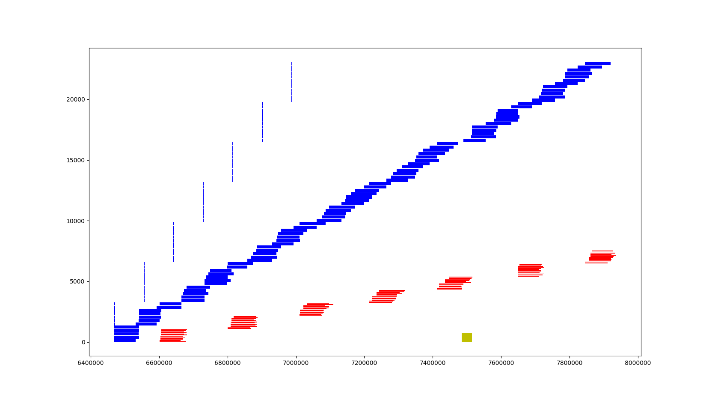
Testing Simultaneous Fair-share Results:
Linear Priority Scheduling, Blue Waters stock priorities
Chris’s latency ~7 days
day 3
day 5
day 7
Bob’s latency:
~1.5 days
no steady throughput
day 1
Bob
Chris
TIME
Simultaneous Fair-Share csteffen@ncsa.illinois.edu craigsteffen.net/sfs

Slide 26
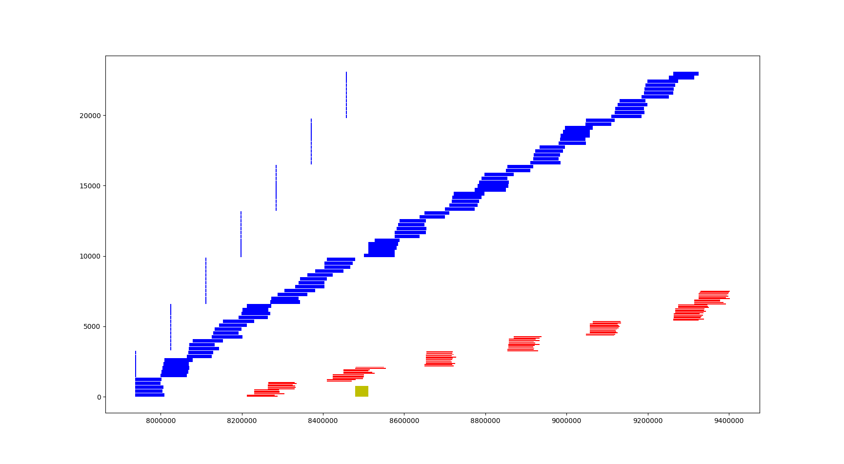
Testing Simultaneous Fair-share Results:
Linear Priority Scheduling, Nodecount-Biased over stock
Chris’s latency ~0 days
day 7
day 3
day 5
Bob’s latency:
~3 days
no steady throughput
day 1
Bob
Simultaneous Fair-Share csteffen@ncsa.illinois.edu craigsteffen.net/sfs

Slide 27
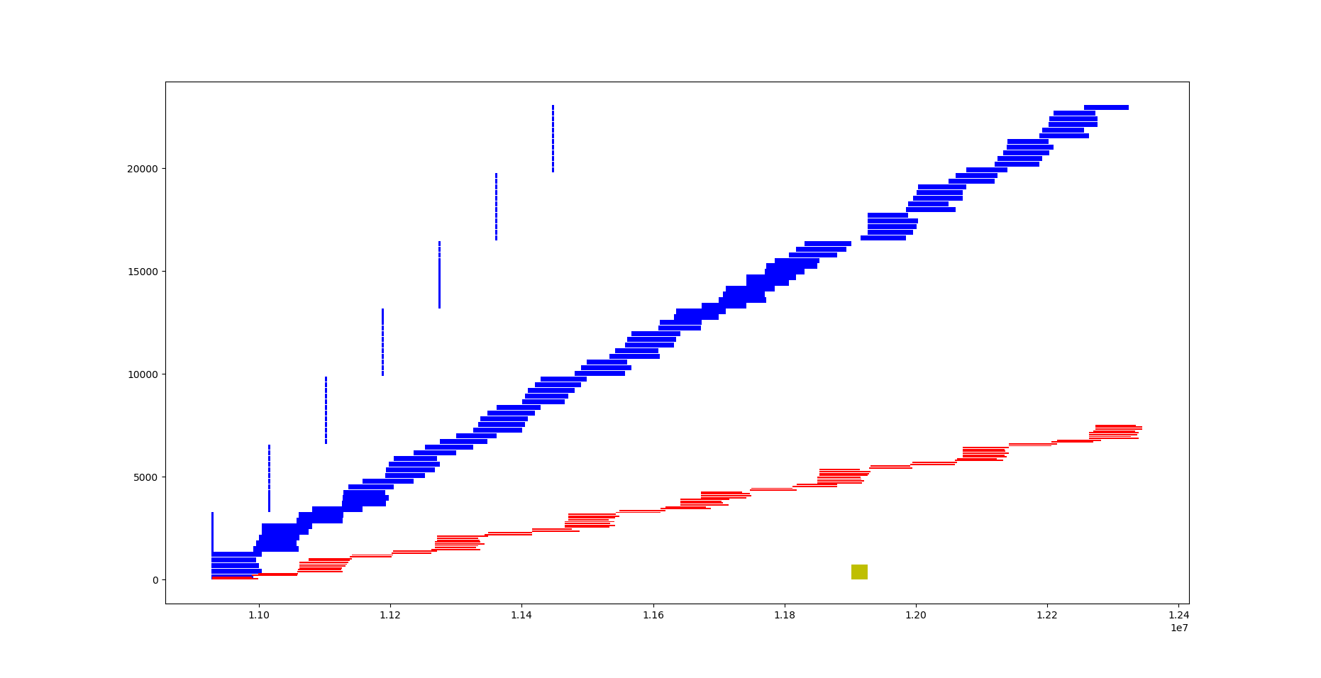
Testing Simultaneous Fair-Share Results:
SFS Scheduling, Blue Waters stock
Chris’s latency ~7 days
day 7
day 3
day 5
Bob’s latency:
~0 days,
steady throughput
day 1
Chris
Simultaneous Fair-Share csteffen@ncsa.illinois.edu craigsteffen.net/sfs

Slide 28
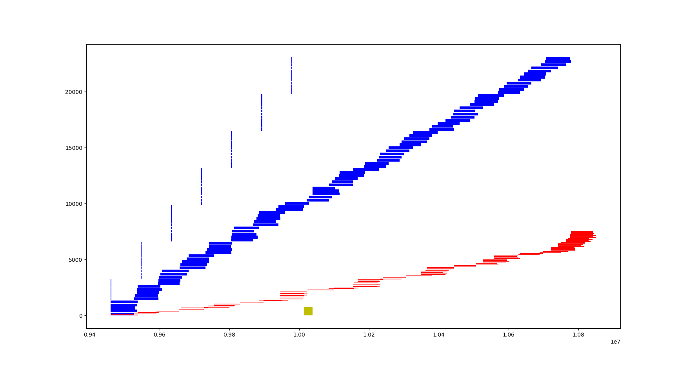
Testing Simultaneous Fair-Share Results:
SFS Scheduling, Nodecount-Biased over stock
Chris’s latency ~.25 days
day 7
day 5
day 3
Bob’s latency:
~0 days
steady throughput
day 1
Simultaneous Fair-Share csteffen@ncsa.illinois.edu craigsteffen.net/sfs

Slide 29
What Simultaneous Fair-share Buys us
Fair-share no longer has to be baked into job priority mix
  naturally combats or eliminates underserved valley
SFS naturally supports chained sequential jobs
Users starting out (initial testing) have a natural mechanism to get jobs running quickly
Simultaneous Fair-Share csteffen@ncsa.illinois.edu craigsteffen.net/sfs

Slide 30
How does SFS deal with TAS vs. backfill
How to implement SFS as a full scheduler with topology awareness?
Walk forward in time until there’s space for top job in that time slice’s pass one list
(Testing this will require a more fully-featured scheduler simulator with topology-awareness)
Simultaneous Fair-Share csteffen@ncsa.illinois.edu craigsteffen.net/sfs

Slide 31
What the Scheduler Simulator Does Not Do (yet)
No topology awareness
Not fast enough to cope with a real job throughput
Simultaneous Fair-Share csteffen@ncsa.illinois.edu craigsteffen.net/sfs

Slide 32
What knobs do sysadmins have in SFS?
Adjust overall ideal → target throughput multiplier
If necessary to promote a user, adjust their individual ideal→target throughput multiplier
Simultaneous Fair-Share csteffen@ncsa.illinois.edu craigsteffen.net/sfs

Slide 33
Weaknesses of Simultaneous Fair-Share
Still subject to gaming by putting in ONE big job all the time
  (possibly blunted by not having the incentive to do this?)
Unfamiliarity
Simultaneous Fair-Share csteffen@ncsa.illinois.edu craigsteffen.net/sfs

Slide 34
Future Work
update the simulation to use databases to make it faster
set up a month’s worth of real Blue Waters job submissions as a baseline test set
use the test set multiple times to quantitatively investigate how different scheduler configurations (both linear and SFS schedulers) treat types of jobs
Understand how to user SFS with topology-awareness
Implement SFS as a Slurm plugin
Simultaneous Fair-Share csteffen@ncsa.illinois.edu craigsteffen.net/sfs

Slide 35
Acknowledgements
SFS work is part of the Blue Waters sustained-petascale computing project. Thank you to the National Science Foundation (awards OCI-0725070 and ACI-1238993) and the State of Illinois. Blue Waters is a joint effort of the University of Illinois at Urbana-Champaign and its National Center for Supercomputing Applications.
Thank you to the Blue Waters Project Office and my boss, Greg Bauer for allowing me the time to work on this.
Simultaneous Fair-Share csteffen@ncsa.illinois.edu craigsteffen.net/sfs

