Slide 1

NIST SP800-TBD & CMMC v2.0 Update
Dr. Erik Deumens – University of Florida
ACM SIGHPC SYSPROS22 Workshop @SC22, Dallas, TX Nov 14, 2022

Slide 2
Two topics
Update on DFRS, CMMC, and certification (the second “C”)
Report on a NIST 800 publication focused on HPC
SC22 workshop on this work
First International Workshop on Cyber Security in High Performance Computing (S-HPC 2022) in C141-143-145
Friday morning Nov 18 11:09 – 11:59 am CST
Upcoming in-person workshop
in Gaithersburg, MD
March Wed-Thu 15-16, 2023

Slide 3
A brief history of CMMC
2015: Draft Federal Acquisition Rules includes CUI protection
DoD adopts this in DFARS
2017: DFARS NIST 800-171 compliance for CUI takes effect
2010-2020: DoD assesses compliance with DFARS for CUI
Contracts with Johns-Hopkins to developed a certification program
Cybersecurity Maturity Model Certification
Adds controls and processes to NIST 800-171
Nov 2020: Interim DFARS rule – put 800-171r2 score in SPRS
2021: CMMC v2.0 simplifies back to NIST 800-171 but r3
2022: lots of discussion – NIST 800-171r2 is the rule of the land

Slide 4
The full history of CMMC
For the full story with the background, watch the talk
By Jacob Horne
“The fascinating History of CMMC”
https://www.youtube.com/watch?v=jbY2irZ1ePg

Slide 5
CMMC v2.0
CMMC v1.0
L1 – FAR “safeguarding”
L2 – intermediate level
L3 – SP800-171r2 + 17 extras + processes
L4 – intermediate level
L5 – SP800-172 + processes
CMMC v2.0
L1 – Same
N/A
L2 – SP800-171r3 + processes
N/A
L3 – SP800-172 + processes
SP800-172 – handle advanced persistent threat, needs a SOC

Slide 6
CMMC in 2022
What is happening now?
People and organizations are finally taking the DFARS 2017 seriously.
Assessors are being trained, C3PAOs are being certified
First reports on the training:
Scoping rules are different from the NIST 171A assessment guide
This is relevant to academic institutions, where scoping is crucial
Compared to DIB (DoD Industrial Base) companies small and large
See the Oct 12 webinar for RRCoP
Regulated Research Community of Practice
https://regulatedresearch.org

Slide 7
Proving Compliance
How do you show a contractor that you meet requirements?
Whether legal, regulatory, or contractual
Somebody must check, i.e. audit or assess
NOTE: No conflict of interest with the service owner and operator
Who is a credible auditor and/or assessor?
At universities: Office of Internal Audit (OIA) has status of independence
External auditor with credentials on the type of assessment
Some contracts allow self-assessment
That “self” means the organization signing the contract, e.g. UF
Not the service owner, e.g. UFIT Research Computing at UF
E.g. Information Security Office at UF may provide self-assessment

Slide 8
External Assessment Process
Get auditor company
Look for an existing contract with a university for the same work and use that
UF evaluated three auditors and selected Sera-Brynn
Formal ITN (Invitation To Negotiate) process to select F&D out of 23 companies – 4-month process in first half of 2022
Assessment overview
Initial workshop – What does assessment entail? What are deliverables? What does UF have to provide? What is the timeline? Who is responsible for what action/deliverable?
One point of contact at each organization – many people contribute
Weekly meetings of core teams to avoid getting stuck
Get final report

Slide 9
Working with NIST
In 2018, NIST started an effort to address security of HPC systems
The approach in RMF with the NIST SP 800-53 catalog did not address HPC
Often controls are not relevant or impact performance
That puts the HPC mission at risk!
2022, under leadership of Dr. Yang Guo at NIST,
A team has been meeting throughout 2022
Many also took part in 2018
Writing a draft of a Special Publication 800 addressing HPC
“NIST Interagency Report”
There are special considerations for HPC

Slide 10
DRAFT: HPC system concepts
Introduce “zones” to describe and discuss security of HPC systems
There are four zones with different security posture
Access zone
Connected to the outside
All access goes through here
High Performance Computing zone
Isolated compute nodes
Data storage zone
High-performance storage systems for user data
Management zone
Infrastructure to manage and operate the system
Scheduler, software storage, configuration management, DHCP, DNS, etc.

Slide 11
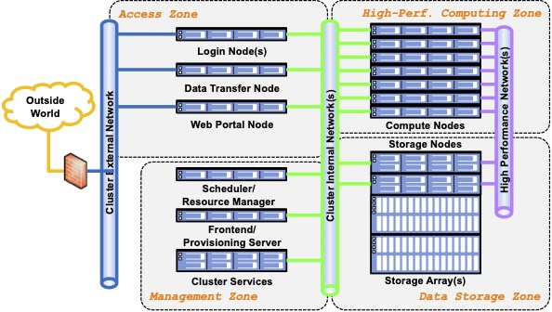
DRAFT: HPC system “zones”

Slide 12
DRAFT: Contents
The draft discusses
HPC conecpts
Software
Containers
Architecture variants
Risk assessment
Threats to the various zones
Security posture
Challenges

Slide 13
Challenges
Root of trust
Lack of tools
Non-applicable RMF controls
Supply chain
Diversity and evolution of hardware and software
Performance degradation caused by security controls

Slide 14
Questions?

Slide 15
NIST 800-171 controls: diagram
110 controls in 14 families
IT controls 6
Procedures 6
Physical controls 2

Slide 16
NIST 800-171 controls: families
Access control
Awareness and training
Audit and accountability
Configuration management
Identification and authentication
Incident response
Maintenance
Media protection
Personnel security
Physical protection
Risk assessment
Security assessment
System and communications protection
System and information integrity
Physical controls 2
IT controls 6
Procedures 6
These overlap!
NIST 800-171 r1 chapter 3:
110 controls in 14 families
fit on 8 pages

