Slide 1
Democratizing Remote HPC Storage Access at Penn State
Adam Focht
Institute for Computational and Data Sciences
Penn State University
Notes:
Adam Focht
Senior Engineer at Penn State Institute for Computational and Data Sciences
Talk about how we’re working to make HPC and other storage more accessible at PSU

Slide 2
ICDS Resources
Standard Environment
25,000 cores, 100 GPUs
16PB Shared VAST NFS Filesystems
Restricted Environment
24,000 cores, TBD GPUs
8PB Shared GPFS Filesystems
Notes:
Provide HPC resources to Penn State community
Number of resources, our largest are highlighted here
All are backed with POSIX filesystem, primarily serving the Linux compute cluster

Slide 3
Remote HPC Storage Access
SSH-based
SCP, Filezilla, WinSCP, etc.
SSHFS
Use existing SSH services
Not native on Windows
NFS
Firewall/security headache
Not native on Windows
CIFS
Windows native
Security concerns/firewall headache
Notes:
Worked with the standard mounting or file management protocols
SSH or NFS
Don’t always play nicely with Windows
CIFS
Doesn’t always play nicely with Linux
Can only open to workstations on trusted networks

Slide 4
Simple HPC Storage Access
“There’s a better way” – Amit Amritkar
Cross-platform
Familiar Behavior
Similar to OneDrive, Dropbox
Minimal user interaction
File sharing interface
Role-based Access Control
Integration with Existing Infrastructure
Account data (SSO)
Remote shared filesystems
Notes:
Our technical director worked on a similar project at his previous position, and pitched this idea
Seek to provide a familiar solution for our users
Multiple platforms
Familiar behavior
Good access control
Works with existing accounts and UID/GID space

Slide 5
Unifying Storage Access
HPC Storage
NFS, SMB, or SSH-based access
Multiple targets/systems
University Shared Storage
Box – contract ended
OneDrive – contract ending
SMB mounted local storage
Notes:
Could this be something that would serve our broader community (beyond HPC)?
Researchers have gone through Box, OneDrive, local storage, etc.
Like the interface
Like the “free” and unlimited transport (compared to S3)
Working toward worry-free storage access
Multiple filesystems, disparate access
Unified interface makes life easier for everyone
NOT a replacement for Globus

Slide 6
Storage Cloud Implementation
We used Nextcloud Files
Meets requirements above
Integrates well with many providers
Open source, with paid option
Focus on security
Running on Kubernetes
Deployed via Helm
Integrated with Penn State central AD services
Available outside of Penn State (no VPN required)
Notes:
Looking at options available
Nextcloud
Owncloud
Etc.
Chose Nextcloud primarily due to focus on security
Meets requirements
Integrates with what we have
Open source, with paid support
Runs on Kubernetes
Simple deployment with Helm
Works with PSU auth services
Uses standard protocols (simpler firewall rules)

Slide 7
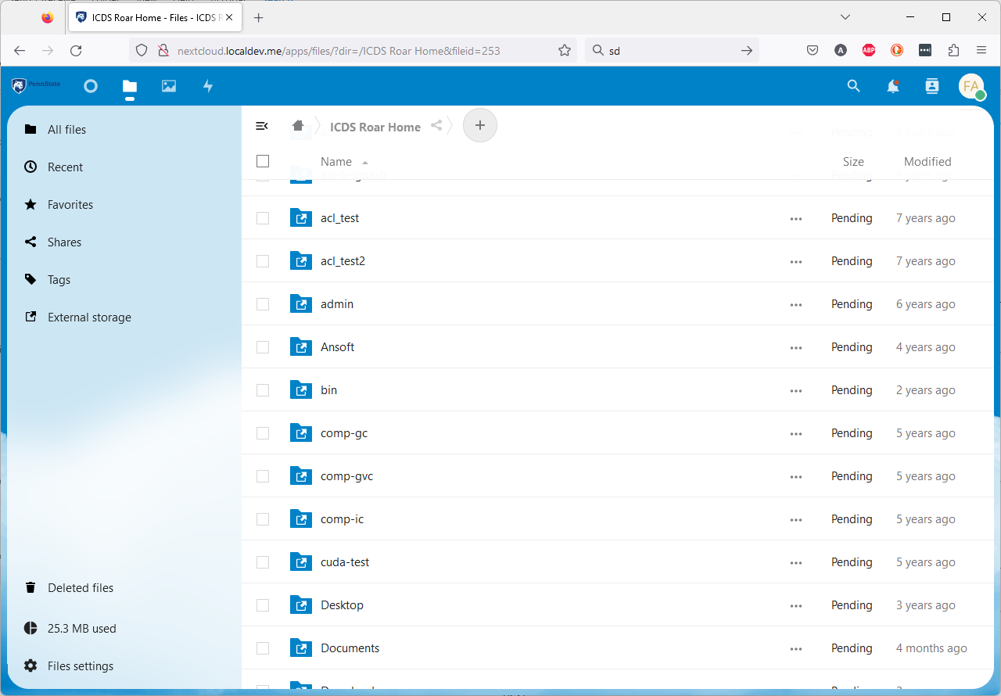
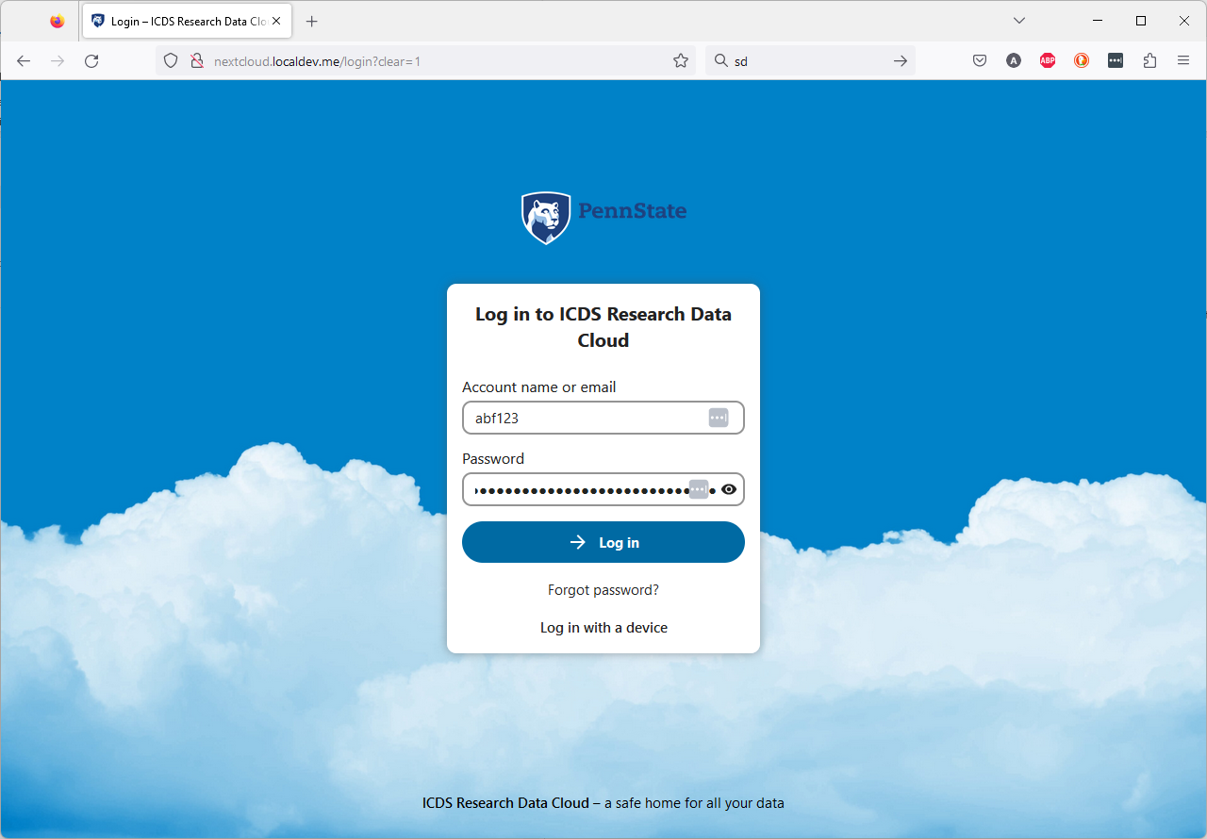
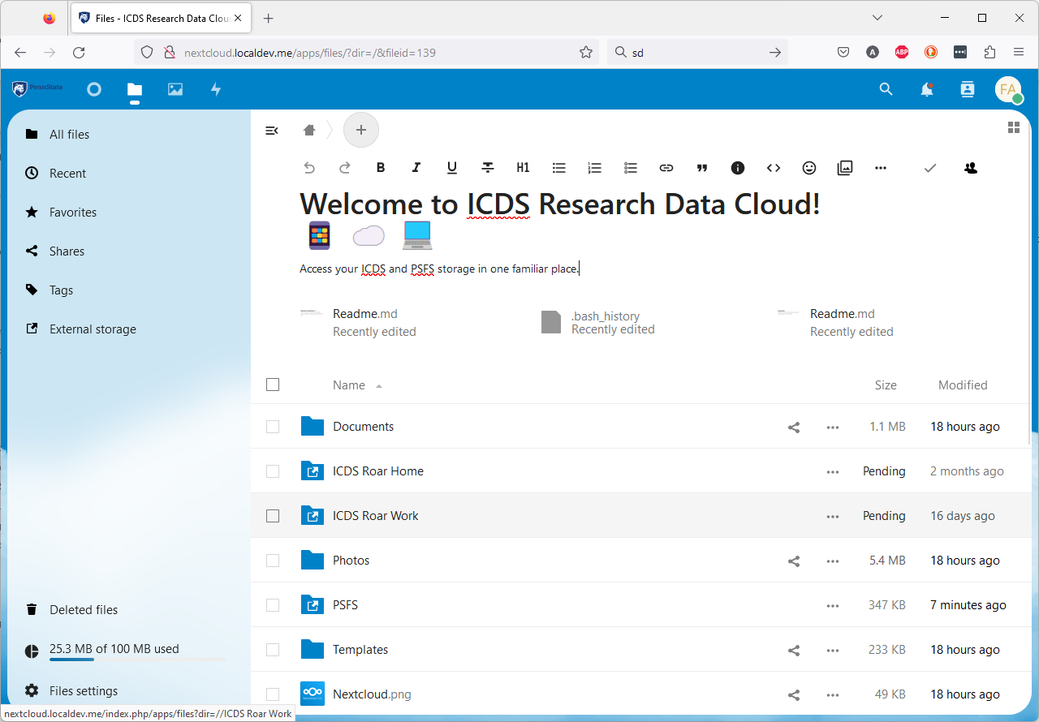
Web Client
Remote Cluster Home
Login with University Credentials
Nextcloud Base Directory

Slide 8
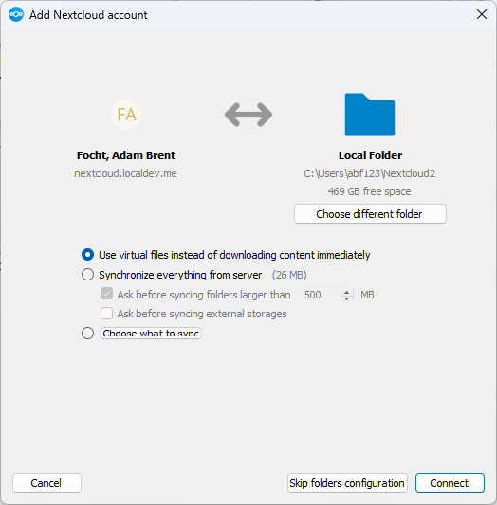
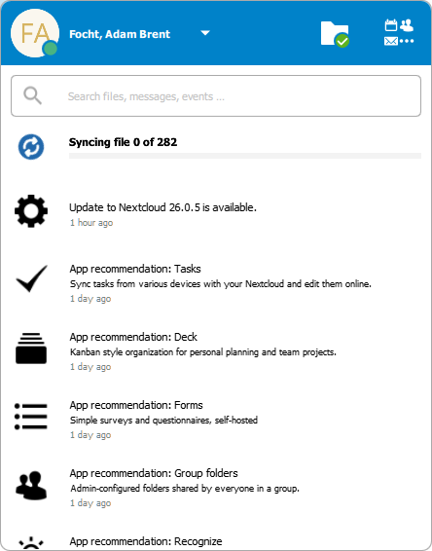
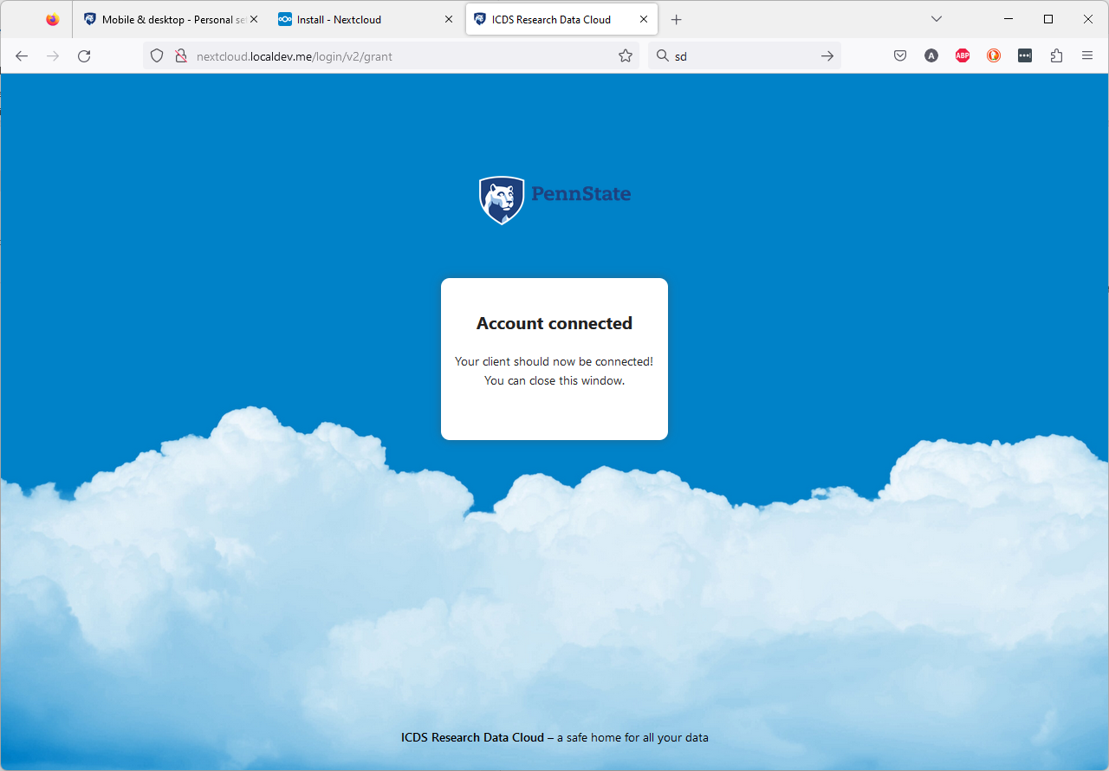

Desktop Client
Initial Client Setup
Client Status Pop-up
Authentication via Web Browser
Taskbar Status
Notes:
Also iOS and Android mobile clients

Slide 9
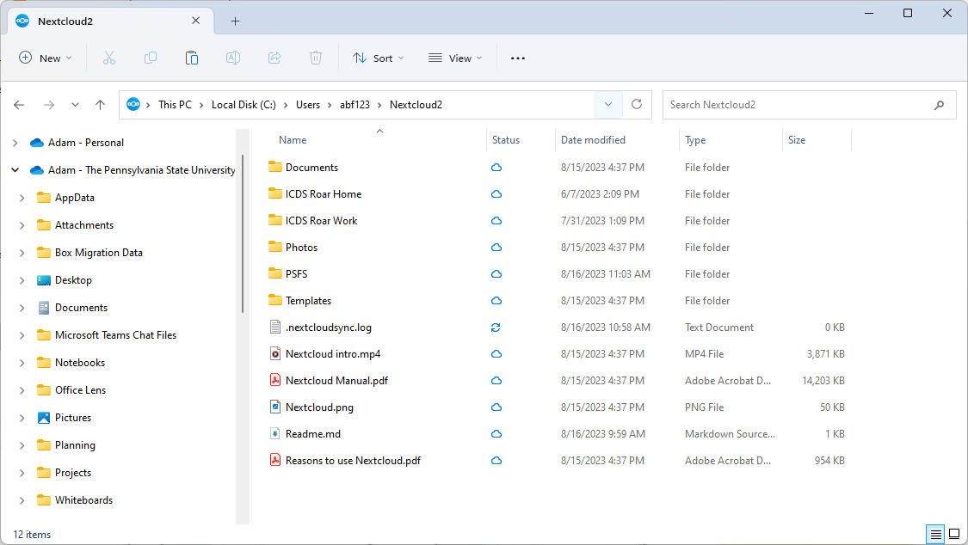
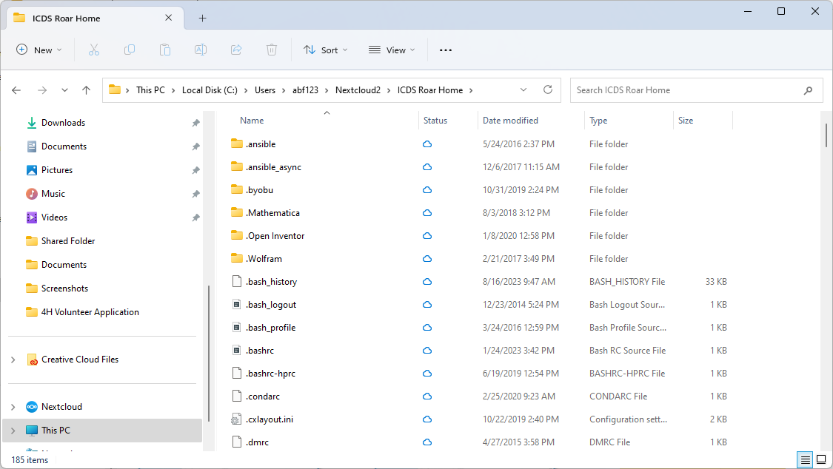
Desktop File Explorer Integration
Local Nextcloud Directory
Local Cluster Home Synced Directory
Notes:
Work locally with similar tools to stage
MATLAB
Mathematica
Etc.

Slide 10
Storage Cloud Lessons Learned
Large (LDAP/AD) Directories Significantly Affect Performance
Backing Database Impact on Performance
Multi-Factor Auth Can Be Incredibly Annoying
Opens multiple SSH sessions for multi-threaded interface
MFA prompt per session if no MFA caching
Internal SSH w/o MFA using Web SSO w/ MFA
Kubernetes Persistent Storage Multi-access Challenges
Helm Ease-of-Deployment
Notes:
Tying into PSU directory, which is very large
Found we need to target a small subset in lookups
Sensitive to backing database performance
Needed to consider how to minimize MFA prompts, Nextcloud very noisy
Using Kubernetes (OpenShift/OKD) presents challenges in persistent storage multi-access
Helm is great!

Slide 11
Need for Further Testing
Large File Transfers
Timeouts
Performance
General Performance of SSH-based Filesystems
File Locking Across Access Vectors
Redis Caching Effect on Performance
Horizontal Pod Auto-Scaling (Kubernetes)
Notes:
We don’t intend to replace Globus, but expect users to try to use beyond our expectations
Test file transfers
Real-world testing
SFTP-based mount to HPC
Performance
File-locking across native, desktop, mobile, etc.
Impact of Redis caching
Tuning HPA

Slide 12
Enabling HIPAA-Aligned Workflow
… or any managed restricted data store …
Data Manager Role
Transition data through lifecycle
Verify access needs
Restrict Access via (Auto-)Tagging
Enable download, view, etc. via well-formed names or attributes
… or work with SELinux MLS? …
Notes:
We’re also planning to look at utilizing this to provide a managed restricted data store

