Slide 1


Report on Adaptable Open-Source Disaster Recovery Solution for Multi-Petabyte Storage Systems
Honwai Leong
November 2023
Notes:
Good morning, all!
My topic today is report on adaptable open-source disaster recovery solution for multi-petabyte storage systems.
This is a work implemented at The University of Sydney with professional services provided by DDN.

Slide 2
Outline
Overview of Research Data Store
High level architecture
Data replication workflow for disaster recovery
Improvements to data replication workflow
Performance Analysis
Conclusion
Notes:
Here’s the outline for my presentation today:
First, we will have a look at the overview of research data store at Sydney University, I will talk about its high-level design, and a custom data replication workflow that is implemented for disaster recovery purpose.
Next, I will walk through some of the improvements that have been made to the data replication workflow to improve its efficiency.
Then, we will have a deep dive analysis into the performance of the replication workflow
And finally, a conclusion to this presentation.

Slide 3
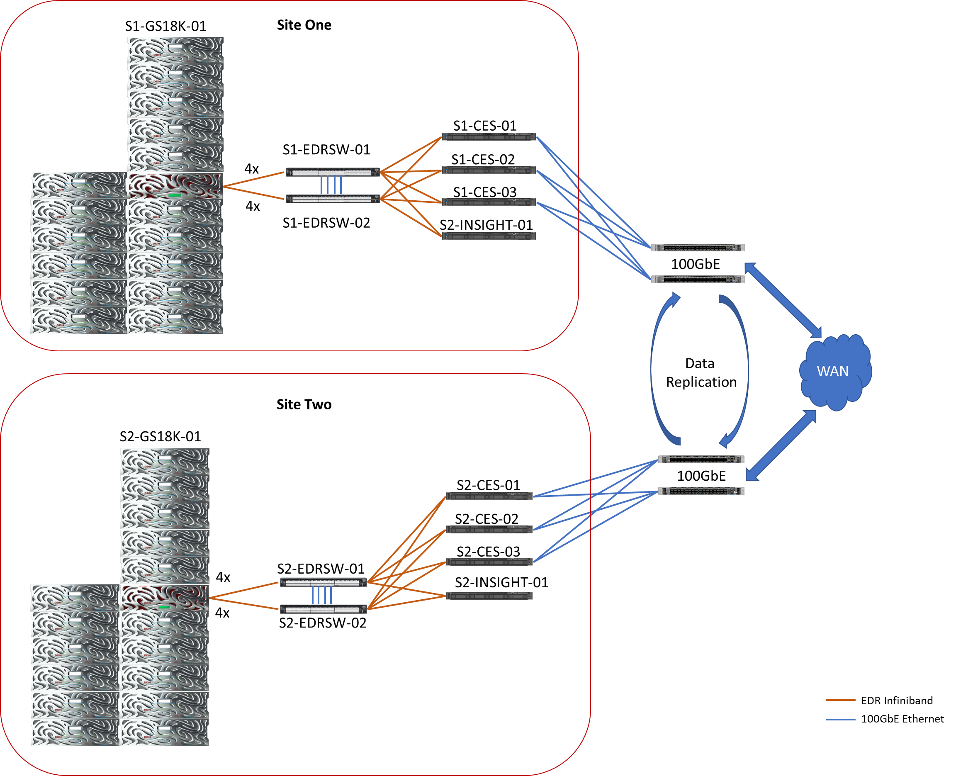
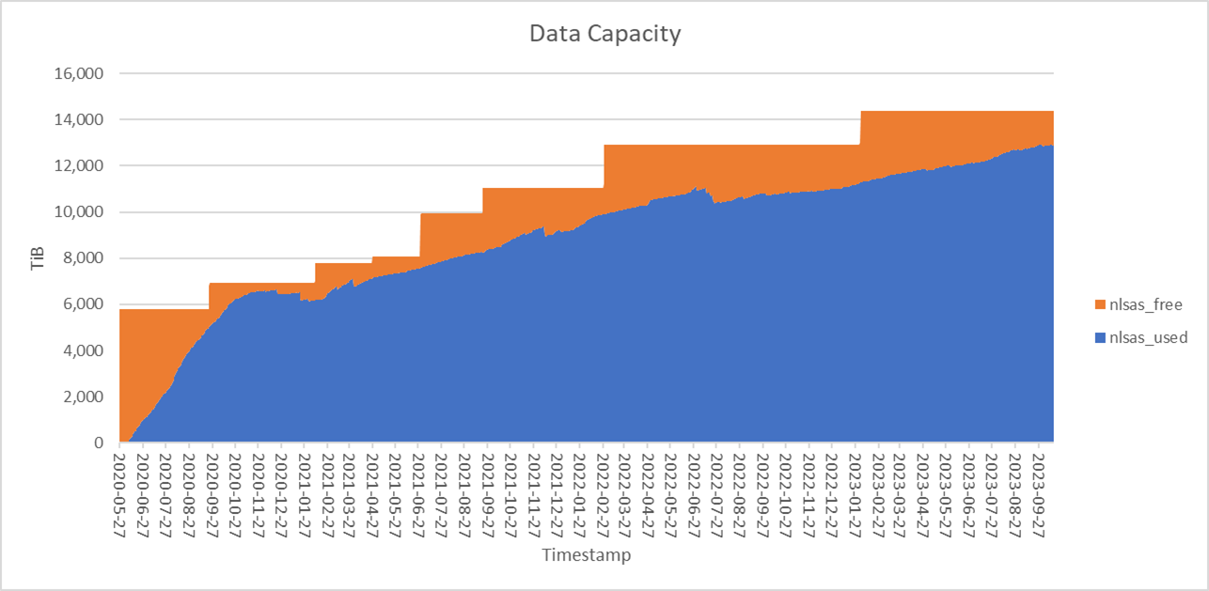
Architecture of Research Data Store (RDS) @ The University of Sydney
Active-active storage systems
DR sites for each other
Notes:
So, this is the high-level design of research data store (in short form RDS) at Sydney University that was put into production in year 2020. It is used to store and serve research data to end users via SMB and NFS protocols.
We have two sites, in two different data centers, separated by about 40km (25 miles) away, each site has about 13PB capacity, increased from 8 PB from three years ago. The graph in the right-hand side here shows how much the data has grown in the last three years. These storages are designed to be active-active, and serve as DR for each other. That means half of the data at each site is production data, half is DR data from the other site.
In order to meet an SLA of four hours RPO for the DR copy, given the large amount data transactions in and out of RDS, we implemented a custom data replication workflow between the sites, which is adaptable and utilizes open-source tools.

Slide 4
Data Replication Workflow
At each site, run an Information Lifecycle Management (ILM) policy to compare file system snapshots to generate a list of new and changed files/directories that need to be replicated to other site.
Candidate files/directories are replicated across site using rsync (non-recursive). Concurrent rsync of multiple files is achieved using GNU Parallel.
Run mpiFileUtils’ dsync to perform a complete data synchronization of changed directories between sites, including deletion of files at destination which have been deleted at source.
H. Leong, A. Janke, S. Kolmann and D. Richards, “Parallelized Data Replication of Muti-Petabyte Storage Systems", in SC (SC20) ACM SIGHPC SYSPROS Workshop 2020, Atlanta, 2020. 10.5281/zenodo.4737878
Notes:
This is a brief description of our data replication workflow.
At each site, we run an information lifecycle management (ILM) policy, a feature of IBM scale file system, to compare file system snapshots to generate a list of new and changed files/directories that need to be replicated to other site.
Then the candidate files/directories are replicated across site using rsync, in a non-recursive manner. We use GNU parallel to achieve concurrent rsync of multiple files to maximize the transfer bandwidth.
Finally, we run MPI dsync to perform a complete data synchronization of changed directories between sites. This step removes files at destination which have been deleted at source, as well as recopy files to destination under directory that has been renamed at source.
We run this workflow every hour, with a target to have the workflow completes within four hours time.
The full implementation was presented in the 2020 edition of this workshop, you are encouraged to read the paper to find out more about this implementation.

Slide 5
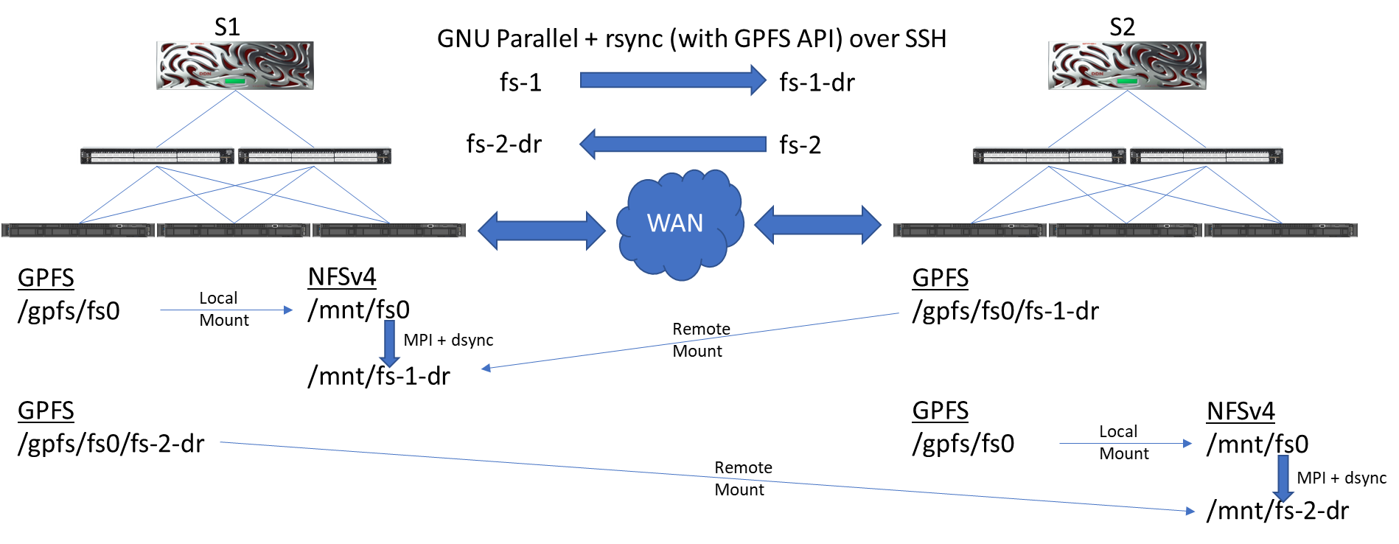
Architecture of Cross-Sites Data Replication
rsync Transfer bandwidth > 4.5 GB/s
dsync Transfer bandwidth > 550 MB/s
rsync : A. Tridgell and W. Davison, “The rsync algorithm“, The Australian National University, Canberra, 1996.
GNU Parallel : O. Tange, GNU Parallel 2018, 2018. 10.5281/zenodo.1146014
dsync : D. Sikich, G. D. Natale, M. LeGendre and A. Moody, "mpiFileUtils: A Parallel and Distributed Toolset for Managing Large Datasets“, in 2nd Joint International Workshop on Parallel Data Storage & Data Intensive Scalable Computing Systems, Denver, 2017
Notes:
This diagram here shows the architecture of cross-sites data replication between the two sites.
The reason why we use parallel rsync and MPI dsync is due to performance reason. For parallel rsync over SSH, we are able to achieve an aggregate bandwidth up to 4.5 GB/s. But as each rsync thread could only work on one file at a time, it becomes a bottleneck when copying a very large file. So, we leave the large file to be copied over using MPI dsync, which could decompose the large file and copied over by multiple MPI processes. We also leverage mpi dsync to do the complete sync between sites, to deal with deleted files and renamed directories at source. We could do away with this replication workflow by just using dsync, but as dsync could only give us about 550MB/s transfer bandwidth over NFS, we can’t forgo the luxurious transfer bandwidth that we can get with rsync.

Slide 6
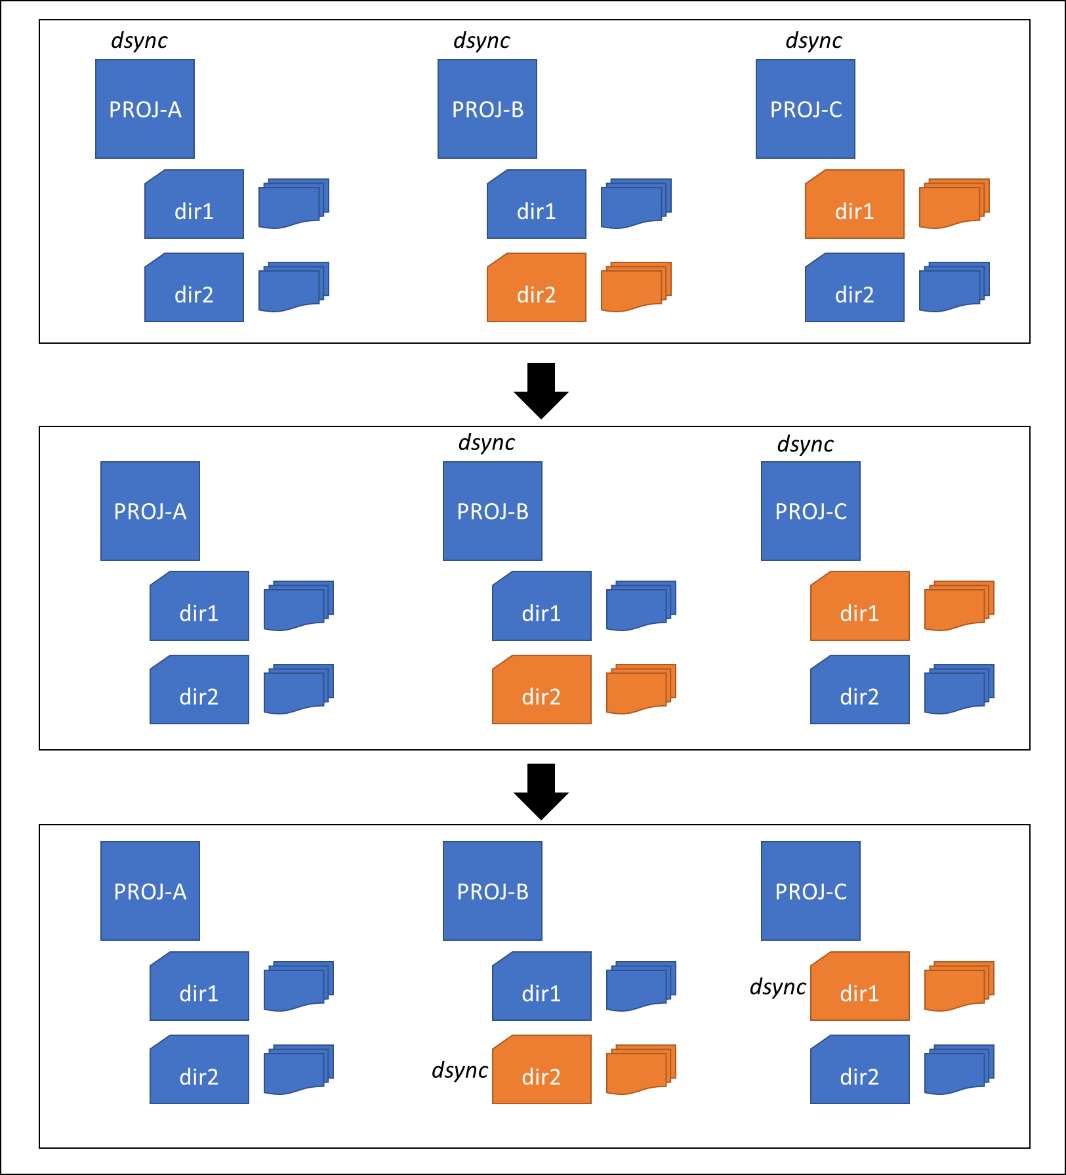
1. Optimization of dsync Phase
Revision 1: Execute dsync on every project directory.
Revision 2: Execute dsync only on project directories with changes.
Revision 3: Execute dsync only on sub-directories with changes.
Notes:
Over the last three years, we have made a few changes to the replication workflow, particularly the dsync phase in order to meet the ever growing complexity of RDS.
The file system hierarchy of RDS is structured into project directories, for example we have PROJ-A, PROJ-B, PROJ-C which belongs to different research projects.
As mentioned in previous slide, we designed this replication workflow from scratch. At first, it started in a simple way. We just dsync everything from top down, on every project directory. This approach is proven not sustainable as the file system grows into thousands of project directories.
So, rather than doing dsync on every directory, we changed our approach to just run dsync on project directories that have changes. Given some project directories are really huge, dsync has to scan through the metadata of the source and destination every time they walk through the project directory tree, which is a very time consuming process, just to find and sync a small subdirectory that has changes. This approach again become not efficient as some project directory grows into millions of files.
So, in our subsequent iteration of the workflow, we further narrow down dsync to start only from subdirectories of project directories that have changes, bypassing their parent directories.

Slide 7
2. Exception Treatment to extreme large project directories
Running dsync on some large project directories may last few hours.
Move dsync to run on large project directories only during the weekend.
if [[ $currentdir = "PRJ-bigproj1" || $currentdir = "PRJ-bigproj2" ]]
then
echo Skipping $currentdir
touch ${currentdir}.pending
continue
fi
if [ $(date -d today +%A) == "Saturday" ]
then
for PROJECT in PRJ-bigproj1 PRJ-bigproj2
do
if [[ -f ${PROJECT}.pending && ! -f ${PROJECT}.done ]]
then
echo It is Saturday, Syncing $PROJECT
<...MPI dsync...>
touch ${PROJECT}.done
rm -f ${PROJECT}.pending
fi
done
else
for PROJECT in PRJ-bigproj1 bigproj2
do
[[ -f $PROJECT.done ]] && rm -f $PROJECT.pending
done
fi
Notes:
Even with the last iteration that we made in the previous slide, there will be inevitable situation where the top directory of the project itself has changes, which will trigger dsync to walk through the whole directory tree. We had identified a few very large project directories that we want to avoid having dsync running over them in every replication cycle. So, we moved dysnc to run on these large project directories only during the weekend. This helps us to reduce the average cycle time of the workflow to below four hours during normal day, and only have a long one running during the weekend.

Slide 8
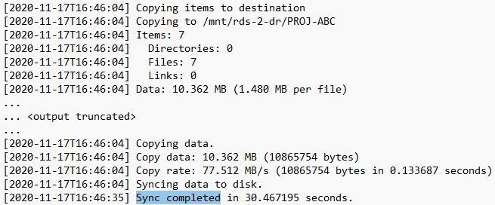
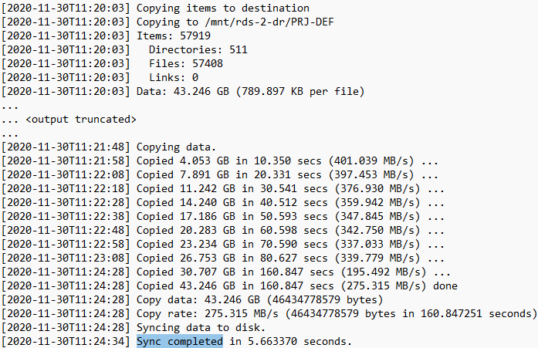
3. Effect of Cached/Buffered Memory
sync; echo 3 > /proc/sys/vm/drop_caches
Notes:
One thing that we observed with dsync is that, it called out the sync function at the end which sometimes take a very long time even with only few files copied in the directory tree, and sometimes it took only few seconds for larger dataset copy.
We noted the sync duration has a direct relation to the amount of buffer/cached memory built up on the nodes doing the dsync. The more buffer kept in the memory, the longer it took to complete the sync. So, to workaround this, we changed our workflow to check for available free memory on the nodes in between each dsync run, if the free memory falls below a threshold, we will clean up the cache before continuing. We also do a cache cleaning at the end of each workflow cycle to return the data mover nodes to a clean slate before starting the next cycle.

Slide 9
Performance Analysis
Cycle Time | S1 ⇨ S2 |  | S2 ⇨ S1
 | # of Cycles | % | # of Cycles | %
<= 1 hour | 11,893 | 73.975 | 6,605 | 57.515
<= 2 hours | 14,354 | 89.283 | 8,925 | 77.717
<= 4 hours | 15,503 | 96.430 | 10,435 | 90.866
<= 8 hours | 15,916 | 98.999 | 11,152 | 97.109
<= 12 hours | 15,991 | 99.465 | 11,327 | 98.633
<= 24 hours | 16,041 | 99.776 | 11,434 | 99.565
> 24 hours | 36 | 0.224 | 50 | 0.435
TOTAL | 16,077 |  | 11,484
From June 2020 to June 2023
Notes:
Now, let’s look at some statistics on the performance of our data replication workflow.
We use a cron job to start the workflow every hour, with the target completion time within four hours. We put in a safety check so that no overlapping runs occur if the current cycle still progressing after an hour.
Over the last three years, we completed 16 thousands cycles doing DR copy from Site 1 to Site 2; and 11 thousands something cycles from site 2 to site 1. As S2 is mounted on the HPC cluster of the University, more production data flows into S2, thus the average runtime of replication cycle from S2 to S1 is generally longer than from S1 to S2.
As we can see here, we achieved 96.430% of the time completing the replications from S1 to S2 within four hours, and 90.866% of the time from S2 to S1. We are happy to see that in fact about 74% of the cycles completed within one hour from S1 to S2, and over 57% completed within one hour from S2 to S1.
Overall, >99% of cycles completed within a day at both sites.

Slide 10
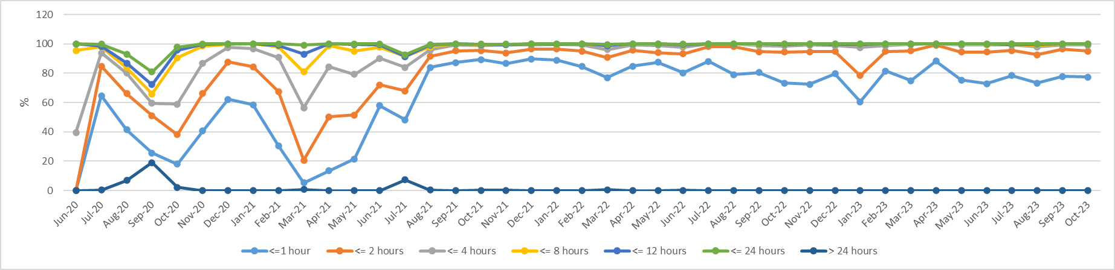
Performance Analysis - S1 to S2
$$\% of cycles completed in X hour\left(s\right)in each month =\frac{Number of cycles completed in X hour(s) in each month}{Total number of cycles completed in each month}$$
1. Rev. 1
1. Rev. 2
2.
1. Rev. 3
Notes:
In this graph, we analyze the efficiency of our replication workflow in the last three years, along with the changes that we made.
We measure this by calculating the percentage of cycles completed within X hours in each month as number of cycles completed in X hours in each month divided by total number of cycles completed in each month.
As you can see here, at the beginning when RDS first went into production, with new projects ramping up, and data migrations from old storage, we had a pretty bad performance. That was when our workflow ran dsync on every project directory in every cycle, as indicated as 1. Rev. 1 here.
As explained earlier, we made changes to the workflow so that we run dsync only on project directories with changes, that’s indicated here as 1. Rev. 2. That change gave us a boost the following month, but it started to slump again in the next few months when the project directories grow larger and larger.
So, we identified a few extremely large project directories that have more than 50 millions of files in them, where we skip doing dsync on them in every cycle, and defer to run them only once on the weekend. That’s something we started to implement in Oct 2020.
We gained back some performance after the change, but the performance again slumped in March 2021, where we realized it is no longer sustainable to do dsync from top down on every project directory that has changes.
Thus, we changed our workflow again to only do dsync starting from the particular subdirectory that has changes within a project directory, bypassing all its unchanged parent directories.
We slowly see the efficiency getting better after this change, backlogs clearing up, and have been happy with the overall performance since then.

Slide 11
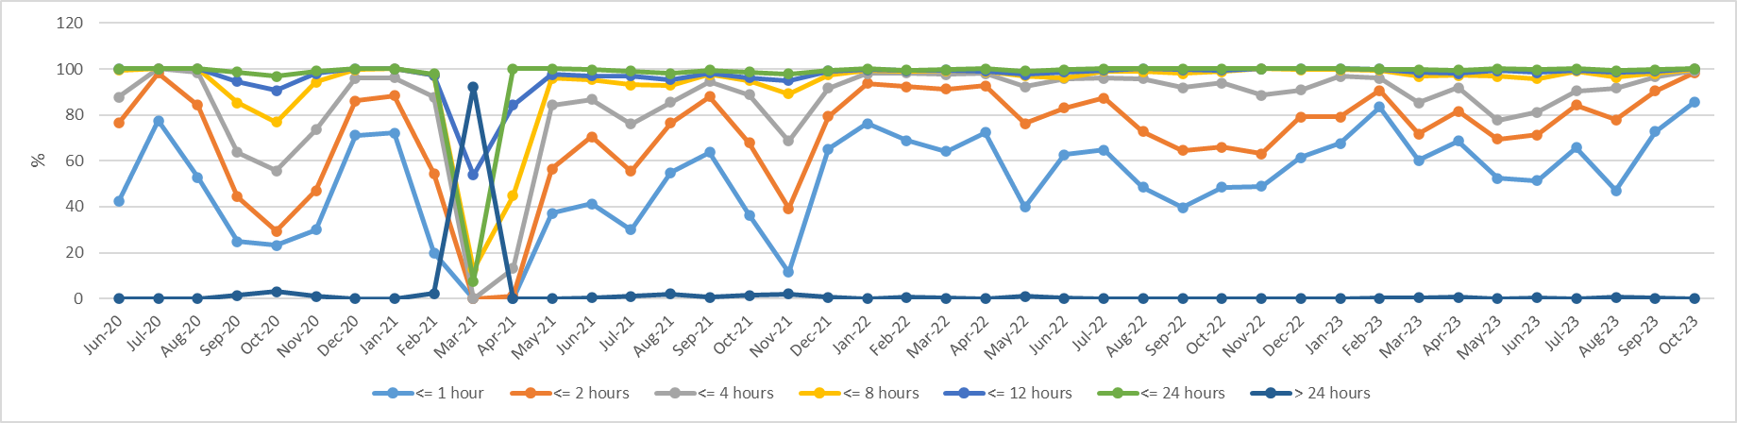
Performance Analysis - S2 to S1
$$\% of cycles completed in X hour\left(s\right)in each month =\frac{Number of cycles completed in X hour(s) in each month}{Total number of cycles completed in each month}$$
1. Rev. 1
1. Rev. 2
2.
1. Rev. 3
Notes:
Similar trend of performance is observed for replication from site 2 to site 1. We applied the same changes that we made to Site 1. Overall Replication from Site 2 to site 1 is harder given the loading on site 2 is higher than site 1. but as you can see at the end of this graph, we are getting better performance, after we moved one extreme large project directory to have the dsync run on a weekend rather than in every cycle during weekdays. This again shows that our workflow is an adaptable one to meet the changing workload of RDS.

Slide 12
Dealing with anomaly activities
The adaptability of our replication workflow allows us to quickly deal with anomaly activities in the file system that affected the workflow performance.
Alerts were sent out when the workflow exceeded four hours to trigger the admins to investigate.
Depending on the severity of the issue, a project directory can be excluded from the replication workflow either from rsync or dsync phase, or both until the problem is rectified by end users.
Notes:
Most of the time, the workflow exceeded four hours due to recopy of renamed directories at the source. In some rare cases, it is due to unintentional activities from the end users, for example a bad script which created infinite loops of subdirectories down the project directory tree.
Excluded project directory can be reinstated into the workflow easily, a one-time dsync is run on the project directory on weekend to resync it to DR site.

Slide 13
Conclusion
Two 13-PB data storage systems are kept in sync using open-source solution.
The adaptable nature of the solution allows for fine tunings to improve efficiency.
Removal and recopy of renamed directory from source to destination remains a bottleneck.
Greater and dedicated resource availability will improve efficiency further.
Notes:
Finally, conclusion to my presentation.
We have two 13-PB data storage systems where we keep in sync using home-brewed data replication workflow.
The adaptable nature of our solution allows for easy fine tunings to improve efficiency.
We are happy with this solution except for the part when doing dsync on renamed directories, it has to remove all the files at the destination and recopy them. We still haven’t found a way to get around this, and this has been the main bottleneck of this workflow.
We believe that with greater and dedicated resource availability, we should be able to further improve the efficiency of our workflow.

Slide 14
Thank you!
Q & A
Contact : Honwai Leong,
E-mail : honwai.leong@sydney.edu.au
hleong@ddn.com

