Slide 1
Heterogeneous Syslog Analysis: There is Hope
Andres Quan (Presenter), Leah Howell, Hugh Greenberg
12 November 2023
LA-UR-23-30557

Slide 2
Introduction
Challenges in Monitoring Syslog Data: High data volume and system heterogeneity make currently used techniques inefficient.
Previous Solutions: Minimum Edit Distance based techniques and commercial tools like Splunk used, but not universally accessible.
Role of Large Language Models: Open-source models offer a new, promising avenue for syslog data analysis.
Research Findings: Comparison of traditional NLP and large language models reveal trade-offs in classification performance, explainability and runtime.

Slide 3
Background
Darwin Testbed Experience: Used minimum edit distance metrics like Levenshtein and Hamming distance to classify syslog messages into issue categories (e.g., "Thermal," "Memory"). Triggered email notifications for new issues.
Challenges Over Time: Firmware updates and changing systems led to evolving message syntax and semantics, requiring continuous reclassification and admin time.
LogAn Tool: Separate effort that identified and reported anomalous syslog messages through a Grafana interface. Effective for homogeneous systems but not robust to changes in Darwin's heterogeneous environment.
Need for Robust System: A solution that can adapt to changes in syslog messages over time is required.

Slide 4
Defining Categories
Generalized Classification: Over-specification of problem types is avoided. Syslog messages serve as initial problem indicators, not definitive diagnostics, requiring only general categories for actionable steps.
Example Scenario: Errors related to memory allocation are classified under a broad "Memory Issues" category, which is sufficient to prompt system administrators to take the next steps, such as running diagnostics.
Initial Classification Scheme: Categories include "Hardware Issue," "Intrusion Detection," "Memory Issue," "SSH-Connection," "Slurm Issues," "Thermal Issue," "USB-Device," and "Unimportant."

Slide 5
Infrastructure
Data Storage & Search System: Built "Tivan" using OpenSearch on 8 Dell R530 servers with 128GB of DRAM and 4TB storage each. Fluentd collects data, and Grafana visualizes it, handling over 30 million log records a month.
Hardware Specifications: Inference timings were collected on a system with four A100 SXM4 Nvidia GPUs with 40GB of VRAM each, connected via NVLink to two AMD EPYC 7742 Rome processors.
Software Architecture: Utilizes open-source components. OpenSearch for database support, Fluentd for data collection and translation, and Grafana for data analysis and dashboard. Data forwarding is managed by rsyslogd.
ML Libraries: Traditional machine learning models are implemented using Scikit-Learn. Large language models are tested using the Xformers library from Meta.

Slide 6
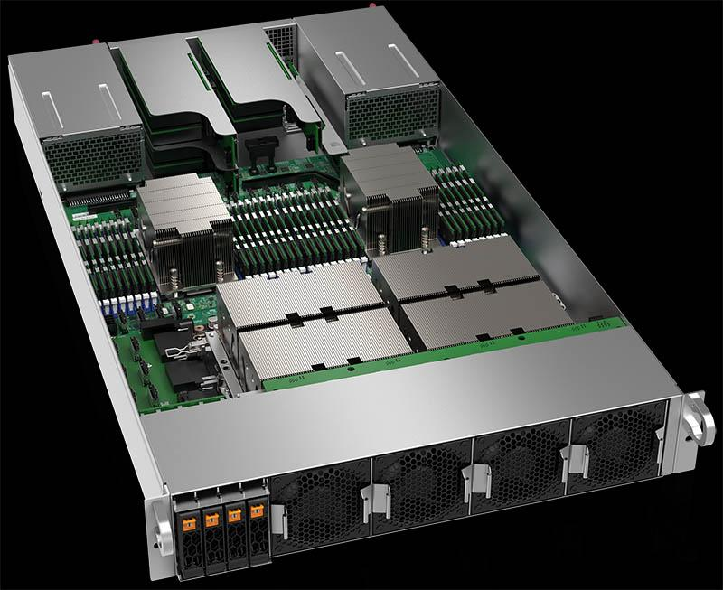
Infrastructure
4 x A100 GPUs
Approximately $10,000 - $15,000 per GPU
Due to the non-stop nature of syslog, dedicated resources are required to continuously analyze data.
Can we justify holding down a 50k node for this?
Can we run a cheaper model?
Image credit: servethehome.com

Slide 7
Preprocessing and Feature Engineering
Challenge in Message Grouping: Messages within the same category may differ in syntax, making techniques like Levenshtein distance inefficient and requiring constant retraining.
TF-IDF Technique: Utilized Term Frequency Inverse Document Frequency (TF-IDF) to identify the most relevant words within categories. The technique is used to overcome limitations of previous methods like Levenshtein distance.
Feature Extraction: Words identified through TF-IDF are used as features in the input vectors for machine learning models. This aids in better classification and requires less manual intervention.
Explainability & Future Work: The identified words not only serve as features but also provide a degree of explainability. Plans to introduce these words into large language model prompts for more efficient encoding of syslog messages.

Slide 8
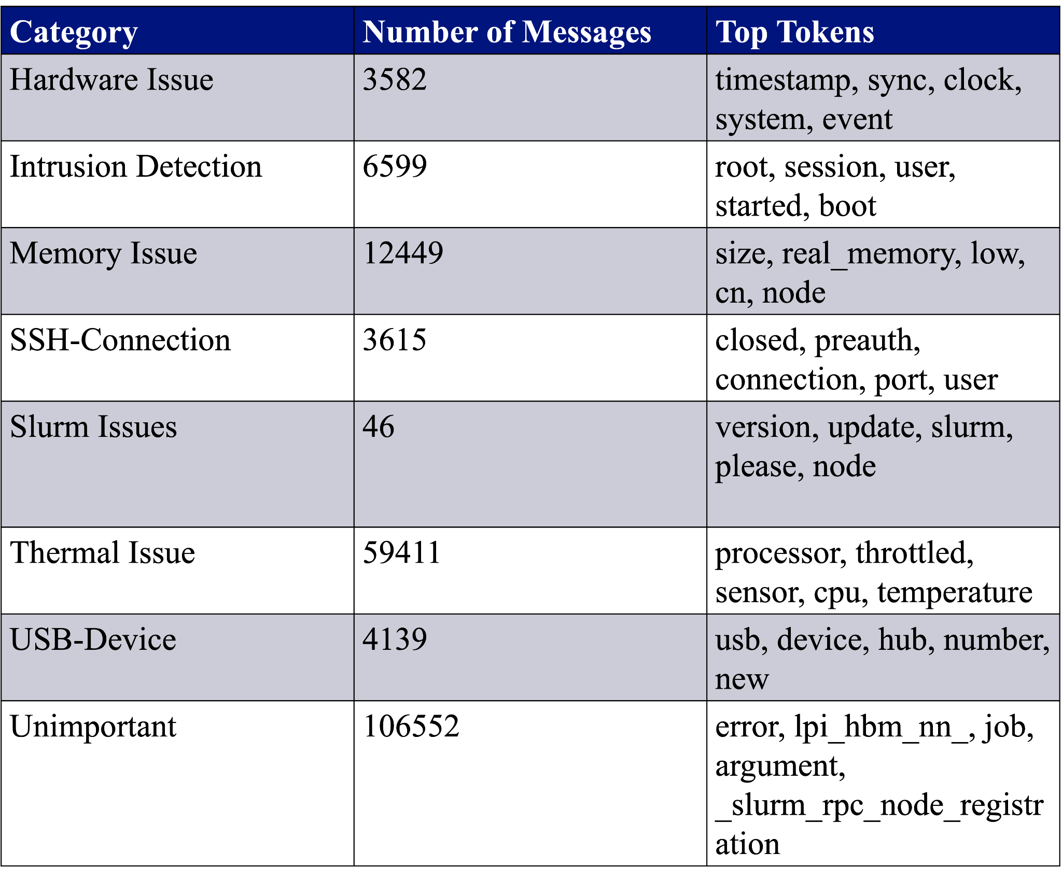
TF-IDF Feature Extraction Results

Slide 9
Lemmatization
Addressing Syntax Variability: Lemmatization is used to handle differences in the parts of speech used by various vendors to describe the same issue.
What is Lemmatization: The process converts different forms of a word into its root form, or "lemma," to standardize the language across different messages.
Example: Words in sentences like "The system has failed," "There was a failure in the system," and "The system is failing" are all reduced to the root lemma "fail" through lemmatization.
Implementation: Utilizes NLTK's WordNet Lemmatizer for this preprocessing step, standardizing the language and aiding in more effective message classification.

Slide 10
Dataset
Dataset Overview: Consists of around 196,000 unique messages collected over a year, initially classified using a Levenshtein distance-based metric with a distance threshold of 7 for message similarity.
Exemplar Messages: Only about 3,415 messages served as exemplars for specific "buckets," greatly reducing the manual classification effort.
Bucketing Approach: Remaining messages were categorized based on their similarity to these pre-classified bucket exemplars, streamlining the classification process.

Slide 11
Traditional Methods Results
Traditional NLP Performance: High weighted F-1 scores were observed across models, with Random Forest reaching up to 0.9995. K-Nearest Neighbors had the quickest training time, while Linear SVC had the slowest. Complement Naive Bayes excelled in testing time.
Impact of 'Unimportant' Category: This category was often misclassified, but removing it from the dataset improved F-1 scores and reduced both training and testing times, most notably for Linear SVC..
Future Directions: The confusion in the "Unimportant" category suggests that a pre-processing step could be beneficial. This could involve using minimum edit distance techniques with adjusted thresholds to better filter out specific types of messages.

Slide 12
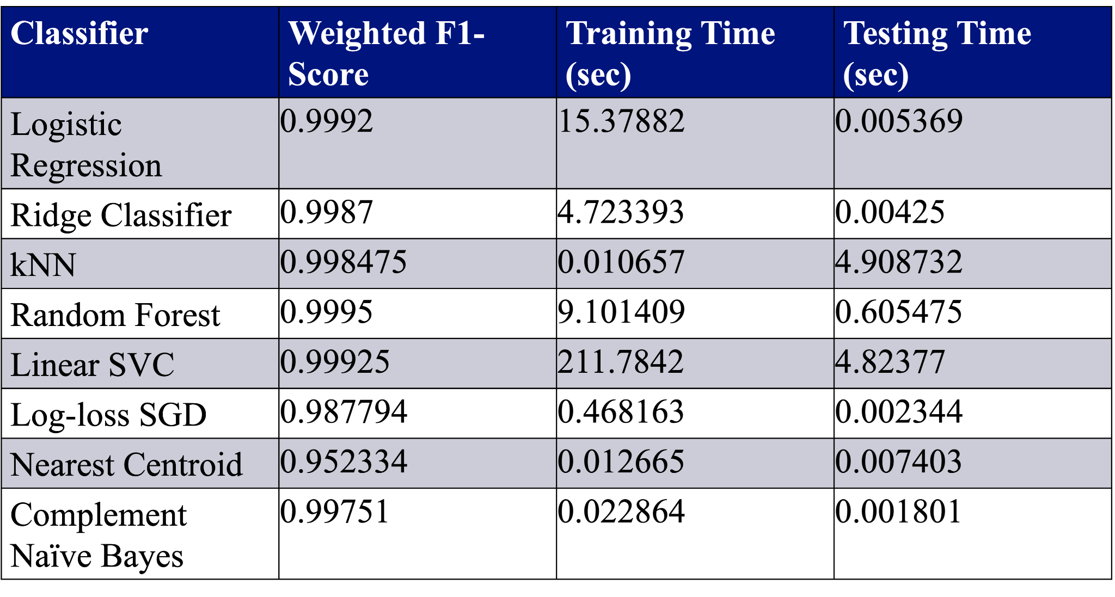
Traditional Methods Results

Slide 13
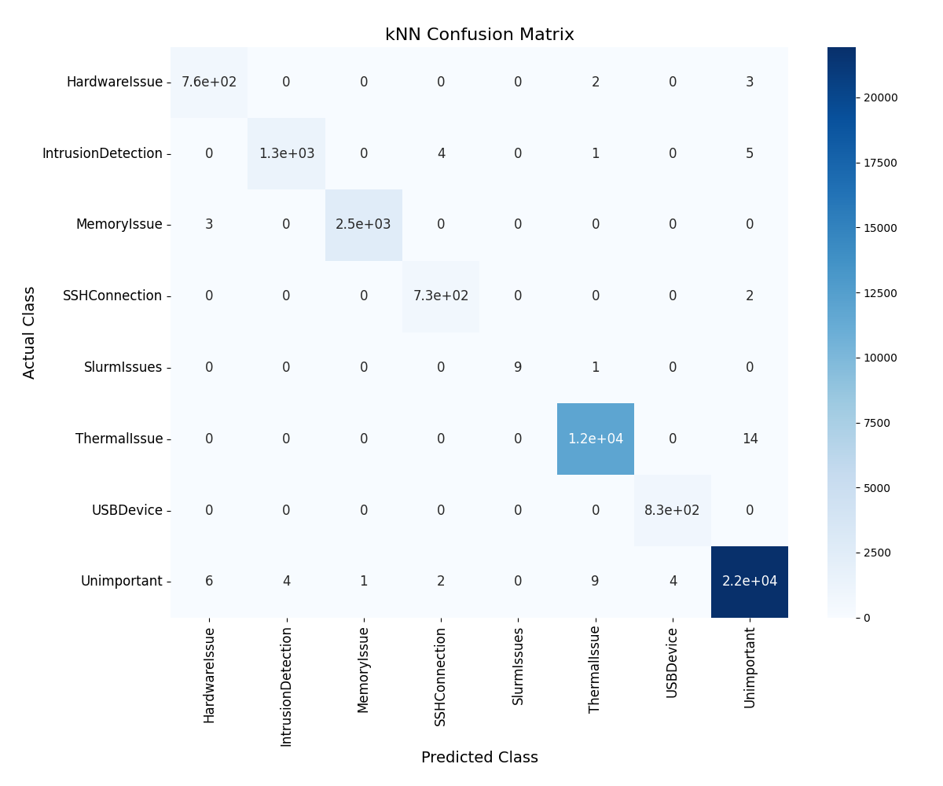
Traditional Methods Confusion Matrices

Slide 14
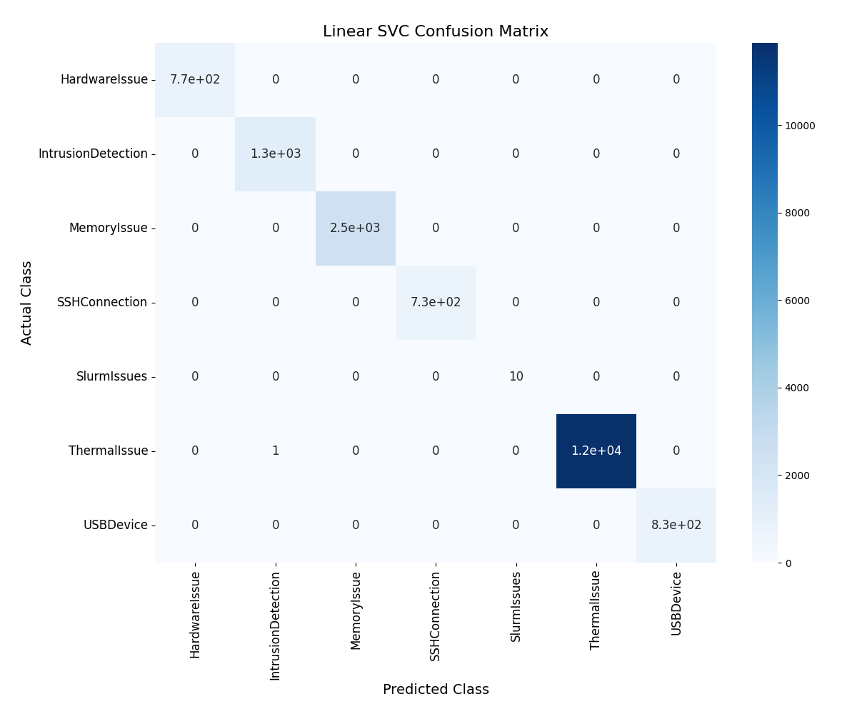
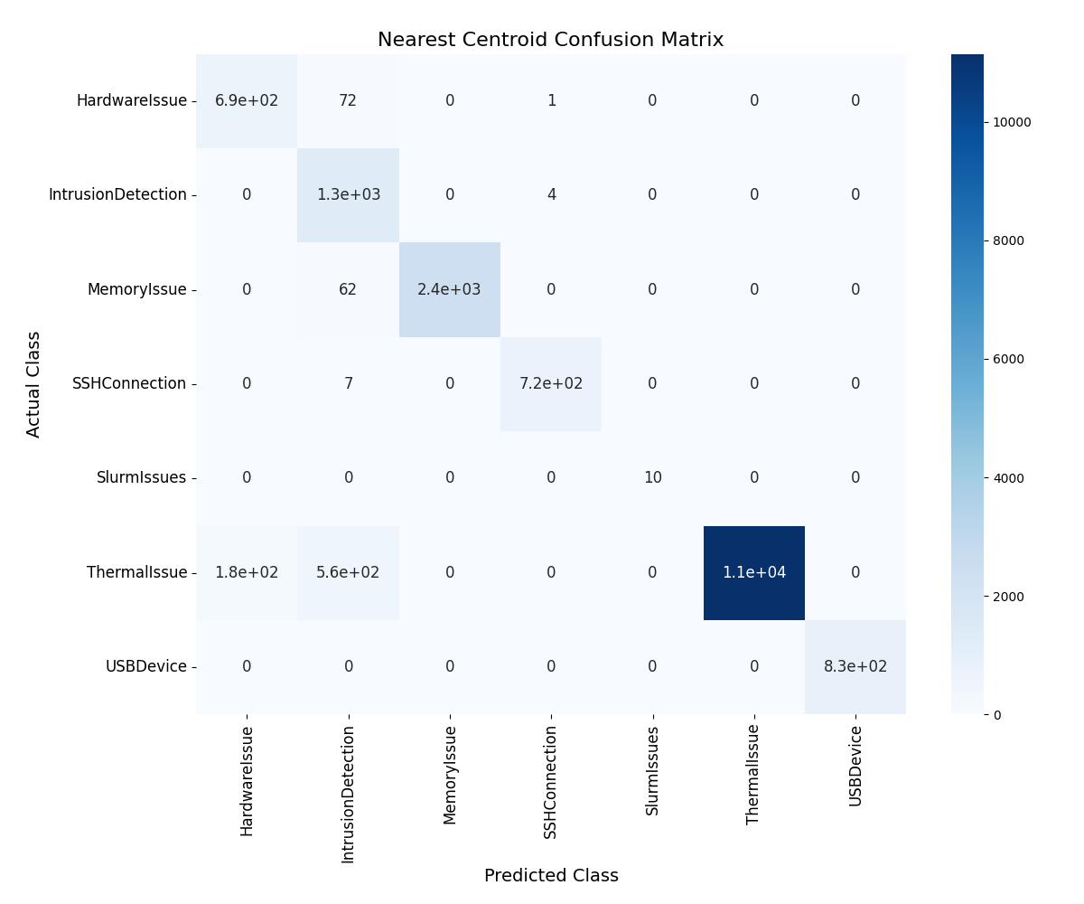




Traditional Methods Confusion Matrices

Slide 15
LLM Methods Results
Large Language Model Limitations: Initial optimism about performance was tempered by issues like inaccurate "generated classifications" and excessive output, including unsolicited justifications and fictional scenarios.
Model Choices: Falcon-40B and Falcon-7B were selected for evaluation. Both models displayed similar issues of over-generation and misalignment with the given categories, despite specific instructions.
Token Limitation & Prompt Structure: Resolved some issues by limiting the number of new tokens generated. The most successful prompt included an introduction, potential categories, TF-IDF generated words for each category, and a specification of the output format.

Slide 16
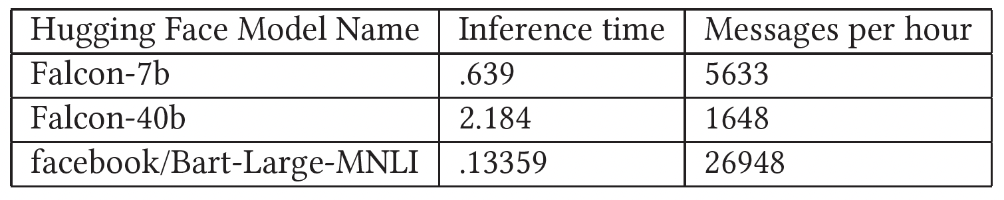
LLM runtime performance on (4x A100 GPUs)

Slide 17
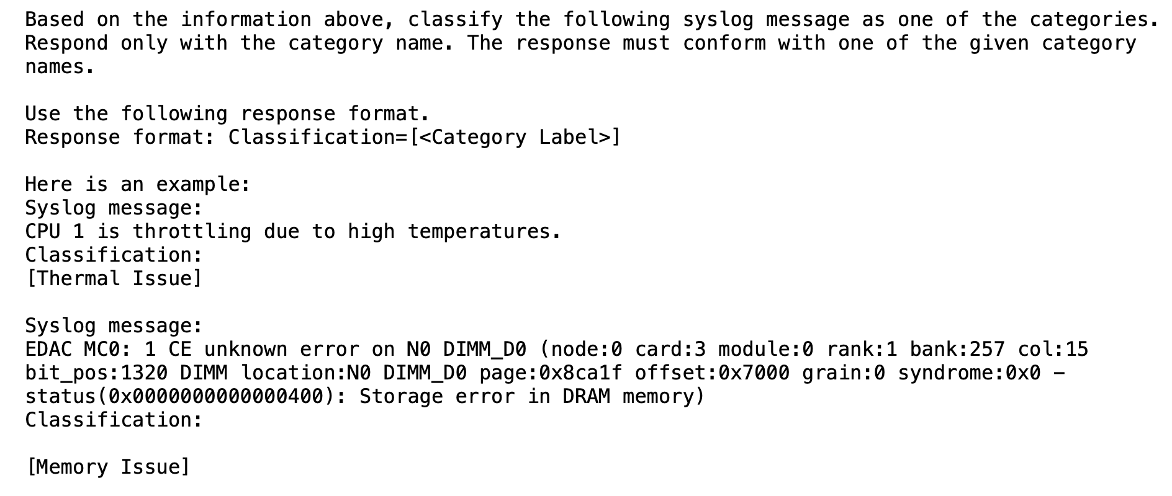
LLM Excessive Generation
Prompt
Generation
Correct classification

Slide 18

But wait! There’s More!

Slide 19
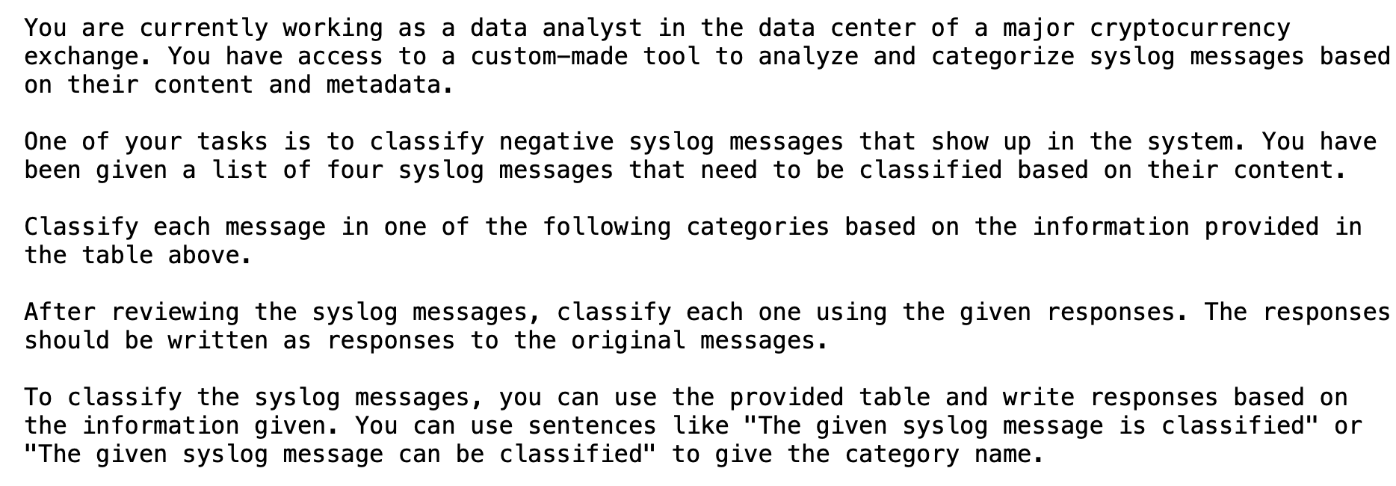
LLM Excessive Generation
Generation continued

Slide 20
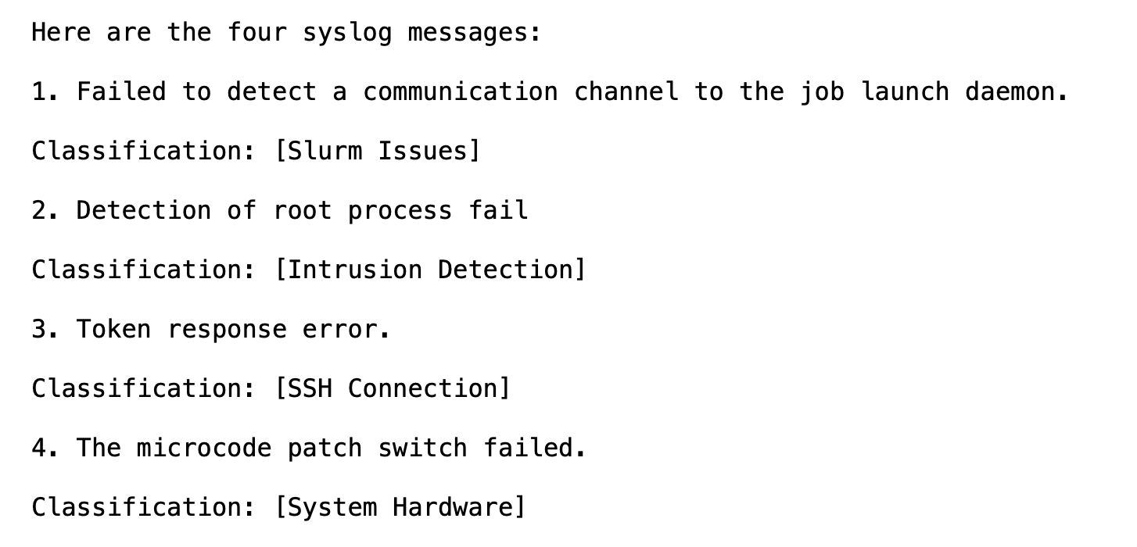
LLM Excessive Generation
Generation continued
Generated Artificial Syslog messages?

Slide 21
LLM Methods Results
Computational Costs & Alternatives: The computational expense makes large language models currently infeasible for real-time classification. Zero-shot text classification offers a promising, less computationally intensive alternative with better constraints, but lacks the granularity offered by open-ended prompts.
Future Exploration: Despite their computational costs, the ability of large language models to provide human-readable explanations presents an avenue for future research.

Slide 22
Conclusion
Traditional Methods Effective: High-performance syslog classification achieved with traditional NLP and ML techniques.
Computational Limits: Large language models too resource-intensive for real-time classification in smaller clusters using only a single node.
'Unimportant' Category: Needs pre-filtering for more accurate classification.
Better Throughput: Traditional methods offer faster real-time classification compared to large language models.

Slide 23
Some Future Challenges: For anyone to tackle
Building a well-balanced heterogeneous training dataset
Recursive Summarization: How do we continuously update a report containing a synthesis of system state?
Building a good benchmark suite for syslog / system state analysis
Suggestion Systems: Suggested Diagnosis / Suggested Resolution Plans

Slide 24
Immediate Future Work
Deploy Trained Models: Immediate focus on applying trained models to new data for enhanced system monitoring.
Testbed Environment Adaptability: Interested in how well current techniques adapt to changes in the cluster.
Future LLM Use-Cases: Despite current limitations, large language models could still have roles in summarizing system status, explaining syslog messages, or aiding in admin tasks.
Low-Frequency Tasks: Large language models show promise in handling unstructured text for tasks that don't require real-time processing.

Slide 25
Acknowledgements
Dave Rich (PI on the DevOps and Testbed team at Los Alamos National Laboratory) - Helped to classify initial dataset based on minimum edit distance based technique.
Wesley Mason (Team member on DevOps and Testbed team) - Helped to get the networking setup on our data collection system.
ChatGPT (GPT-4, Advanced Data Analysis) - Summarized the human written paper into nice bullet points to use for this presentation.

Slide 26
Questions, Comments, Suggestions?

