Slide 1
Disease cluster and mapping with R
By Huibo

Slide 2
Content
Disease cluster
Methods (Disease cluster)
Disease mapping
Demo

Slide 3
Disease Cluster
Input data
longitude, latitude
Case, population
Method, alpha
Output data
Cluster information
lat, lon, cluster, pvalue, statistic

Slide 4
Disease Cluster
Package: Dcluster, rpy2(linux)
Language
R
Python

Slide 5
Method
Three methods
Openshaw’s GAM method (Opgam)
Besag & Newell method (BN)
Kulldorﬀ & Nagarwalla method (KN)

Slide 6
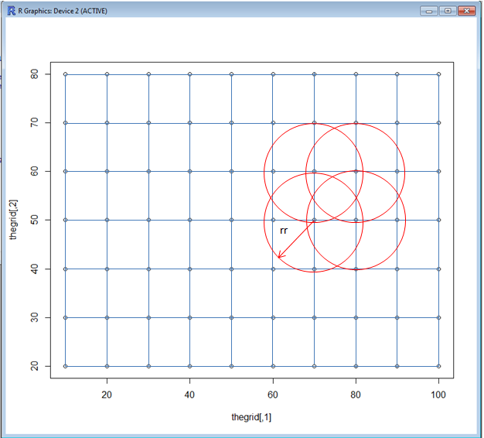
Openshaw’s GAM(Opgam)
Arguments:
The step of the grid.
radius
Disadvantage:
1.Circles of the same size can refer to different-sized population
2. It does not account for multiple testing

Slide 7
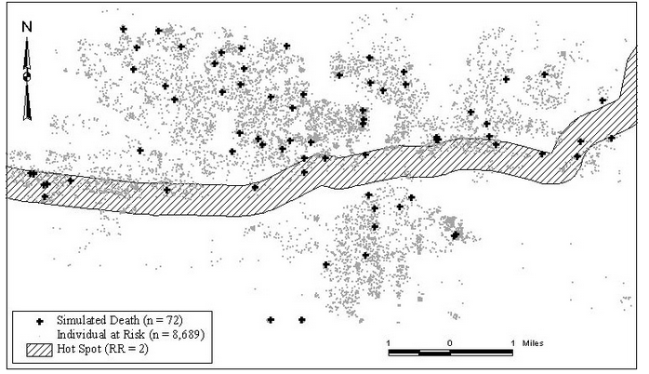
Besag & Newell(BN)
K cases in each clusters
Arguments:
Size of the cluster
Disadvantage:
The a priori
choice of cluster size

Slide 8
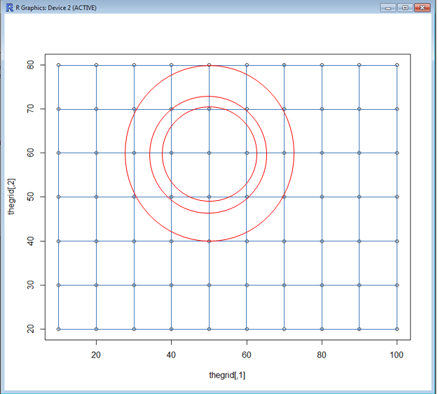
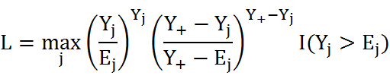
Kulldorﬀ & Nagarwalla(KN)
Arguments:
Maximum fraction of the total population used when creating the balls.

Slide 9
Disease mapping
Input data
longitude, latitude
Case, population
Output data
Lon,lat,RR,Rrmed,SMR
R package SpatialEpi

Slide 10
Disease mapping
SMR: Observed/Expected
RR: Smooth results(empirical Bayes estimates)
RRmed: Smooth results(gamma model)

Slide 11
DEMO

